Slide 1
Monitoring & Observability Setup for JA
Cost Optimization Through Open-Source Tooling
Prometheus • Grafana • Loki • Tempo • ArgoCD Siddhartha Sanapala | 22 July 2026

Slide 2
Agenda
Objective & motto
Architecture overview & technology stack
GitOps delivery via ArgoCD
Namespace strategy
Core components — what & why
How metrics, logs, and traces each flow
Configuration: data sources, querying, retention
What we actually observe (beyond CPU)
Real-world validation
Production readiness & next steps

Slide 3
Objective & Motto
Motto: “Setup of monitoring & observability for JA — cost optimization using open-source tools”
100% open-source / CNCF stack — zero licensing cost
One unified platform for metrics + logs + traces, instead of three separate paid tools
Self-hosted = full control over retention, cost, and data residency
Built with enterprise practices from day one: GitOps, RBAC, network segmentation

Slide 4
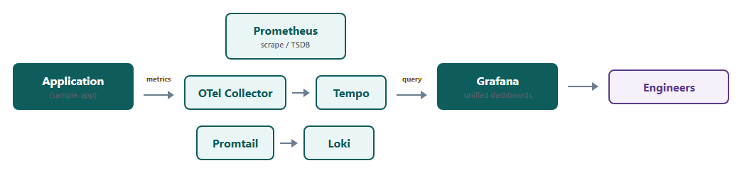
High-Level Architecture
Every arrow is real, in-cluster traffic — nothing manually wired
Grafana is the single pane of glass across all three pillars

Slide 5
Technology Stack Overview
Component | Purpose
Prometheus | Metrics collection & storage
Alertmanager | Alert routing & notification
Grafana | Visualization — unified dashboarding
Loki | Log aggregation
Promtail | Log shipping agent
Tempo | Distributed trace storage
OTel Collector | Vendor-neutral trace ingestion
node-exporter | Host-level infrastructure metrics
kube-state-metrics | Kubernetes object-state metrics
ArgoCD | GitOps delivery & manifest history

Slide 6
GitOps & ArgoCD — Why & How
Every manifest lives in Git — Git IS the change history
ArgoCD continuously reconciles cluster state to match Git (no drift)
“Self-heal”: any manual kubectl edit not committed to Git is auto-reverted
App-of-Apps pattern — one root Application manages 14 child Applications
Rollback = git revert, not tribal knowledge of past commands
Full audit trail — who changed what, when, reviewed via pull request

Slide 7
Namespace Strategy — Overview
7 namespaces total, split into Platform vs Tenant
Platform: argocd, cert-manager, kube-system
Tenant: observability, logging, tracing, demo-app
Every tenant namespace has its own ResourceQuota, LimitRange, NetworkPolicy, and restricted Pod Security Standard

Slide 8
Platform Namespaces vs Tenant Namespaces
Platform namespaces — infrastructure/control-plane concerns, not tied to one workload
– argocd: the GitOps controller itself
– cert-manager: certificate lifecycle
– kube-system: core Kubernetes services + host-access DaemonSets
Tenant namespaces — simulate isolated teams/services, each with its own quota & security boundary
– observability, logging, tracing, demo-app

Slide 9
Namespace-by-Namespace Purpose
Namespace | Hosts | Why
argocd | ArgoCD components | GitOps control plane
cert-manager | cert-manager + issuer | Certificate lifecycle
observability | Prometheus, Alertmanager, Grafana, kube-state-metrics | Metrics + dashboards + alerting
logging | Loki | Log storage
tracing | Tempo, OTel Collector | Trace storage + ingestion
demo-app | Reference application | Proves the pipeline end-to-end
kube-system | node-exporter, Promtail | Need host access — incompatible with restricted namespaces

Slide 10
Prometheus + Alertmanager — Metrics & Alerting Core
Prometheus pulls (scrapes) metrics from targets on an interval — 2 replicas for HA
Chart: prometheus-community/kube-prometheus-stack, pinned version
Targets discovered automatically via ServiceMonitor CRDs — no manual scrape config
Alertmanager evaluates PrometheusRule alerts and routes notifications — 3 replicas (odd number, real gossip quorum)
Both backed by persistent storage — survive pod restarts

Slide 11
Grafana — Visualization Core
Single pane of glass across metrics (Prometheus), logs (Loki), and traces (Tempo)
Deployed as part of the same Helm release as Prometheus
Dashboards & data sources provisioned as code — not manual UI clicks
PVC-backed — dashboards and users persist across restarts
Free & open-source — no per-seat licensing

Slide 12
Loki + Promtail — Logging Pipeline
Loki: log aggregation backend, indexes by label rather than full text — cost-efficient at scale
Deployed in SingleBinary mode — right-sized for this scale, avoids unneeded complexity
Promtail: DaemonSet, one pod per node, tails every container’s stdout
Runs in kube-system — needs hostPath access, incompatible with restricted namespaces
Pushes logs to Loki — cluster-wide visibility by default

Slide 13
Tempo + OTel Collector — Tracing Pipeline
Tempo stores distributed traces, single-binary mode
OTel Collector sits in front of Tempo rather than apps talking to Tempo directly
Why: vendor-neutral ingestion — the app depends on the OTLP standard, not Tempo specifically
Backend can be swapped later without touching any application code
Both are PVC-backed for trace persistence

Slide 14
node-exporter + kube-state-metrics — Infrastructure Metrics
node-exporter: host-level metrics — CPU, memory, disk, network, per node
DaemonSet, needs hostNetwork/hostPID — runs in kube-system
kube-state-metrics: Kubernetes OBJECT state — pod status, deployment replica counts, resource requests/limits
Different data: node-exporter = machine health, kube-state-metrics = cluster/object health
Both scraped by Prometheus like any other target

Slide 15
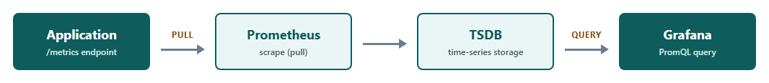
Metrics Flow
Pull-based — Prometheus initiates every scrape
Target discovery is fully automatic via ServiceMonitor

Slide 16
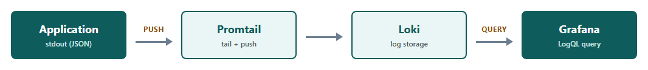
Logs Flow
Push-based — Promtail sends logs to Loki
Every namespace tailed by default — cluster-wide coverage

Slide 17
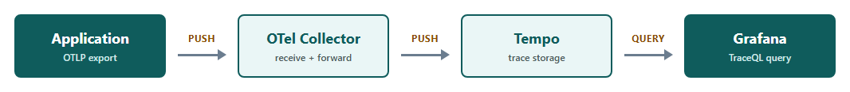
Traces Flow
Push-based — the application exports spans over OTLP
The Collector decouples the app from the specific trace backend

Slide 18
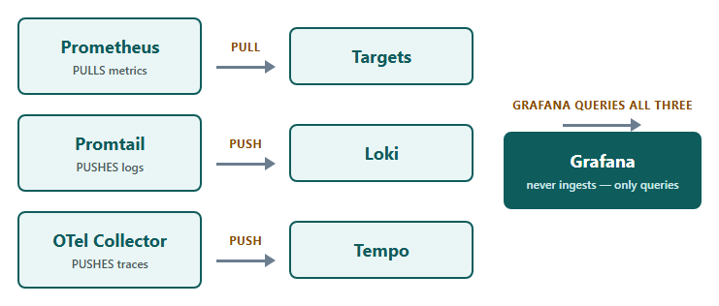
How Grafana Binds It All — Pull vs Push
Grafana never ingests data — it only queries the three backends
Data is physically stored in each backend’s own persistent volume, never inside Grafana

Slide 19
Data Source Configuration
Configured as code in the kube-prometheus-stack Helm values (grafana.additionalDataSources)
Prometheus is wired automatically by the chart itself
Loki & Tempo added explicitly, using in-cluster Service DNS URLs
Zero manual “Add data source” clicks — fully reproducible from Git
Identical configuration redeploys the same way on any cluster

Slide 20
Core Setup Building Blocks
Every component installed via pinned, versioned Helm charts — not raw, hand-maintained YAML
prometheus-community/kube-prometheus-stack, grafana/loki, grafana/promtail, grafana/tempo, open-telemetry/opentelemetry-collector
Each chart pulls specific open-source container images: Prometheus, Alertmanager, Grafana, Loki, Promtail, Tempo, otelcol-contrib
Every version pinned — no floating “latest” tags anywhere
Zero proprietary software anywhere in the stack

Slide 21
Querying & Selective Data Retention
Metrics — PromQL, scoped by label selectors; only relevant series returned
Logs — LogQL, filtered by label + text search, e.g. one namespace or one app
Traces — TraceQL / trace-ID lookup; pull exactly one request’s trace
Metrics ingestion is already selective — Prometheus only scrapes declared ServiceMonitor targets
Logs are ingested cluster-wide by design for full visibility; can be scoped at the Promtail pipeline stage if volume/cost becomes a concern
Retention windows bound how long data is kept, controlling storage growth

Slide 22
What Metrics Do We Actually Collect?
Not just CPU / memory — two full categories are captured
Infrastructure: node CPU/mem/disk (node-exporter), pod/deployment state (kube-state-metrics)
Application: HTTP request rate & latency per endpoint, error rate, custom business counters
Captured via OpenTelemetry auto-instrumentation plus custom application metrics
Yes — real endpoint-level hits and user-driven request patterns are captured, not just host resource usage

Slide 23
Reference Application — Proving the Pipeline
Purpose-built instrumented application (ASP.NET Core) — not synthetic load
Sends all three pillars simultaneously:
– Metrics: scraped directly from its /metrics endpoint
– Traces: OTLP export to the OTel Collector
– Logs: structured JSON to stdout, tailed by Promtail like every other pod
One real request produces a genuine multi-span trace — not a single isolated span

Slide 24
Cross-Pillar Correlation — Proof It Works
Every log line is enriched with the active Trace ID
The same Trace ID appears in the trace (Tempo) and the log line (Loki) for one request
The corresponding Prometheus counter increments for that same request
One click-through path: dashboard panel → exact trace → exact log lines
Validated with real traffic, not assumed from configuration alone

Slide 25
Dashboards & Alerts as Code
Dashboard JSON stored in Git, wrapped as a ConfigMap — Grafana’s sidecar auto-loads it
No manual dashboard building through the UI
Alert rules (PrometheusRule) version-controlled: node health, pod crash-loops, application SLO error-rate
Changing a dashboard or alert is a commit + push — ArgoCD does the rest

Slide 26
Real Incident Caught — Validating the Alerting Pipeline
Yes — a real CrashLoopBackOff was encountered in this implementation (Tempo, OOMKilled)
The PodCrashLooping alert fired correctly and caught it
Root cause: a memory/values misconfiguration — diagnosed and fixed via a Git commit
Proof the alerting pipeline detects genuine problems, not just lab conditions

Slide 27
Workload Types — Why Each One
StatefulSets — Prometheus, Alertmanager, Loki, Tempo: need stable identity + per-replica persistent storage
Deployments — Grafana, OTel Collector, the sample app: stateless, interchangeable replicas, trivial rolling updates
DaemonSets — node-exporter, Promtail: need exactly one pod per node for host-level collection
Workload type is chosen by data/identity needs, not convention

Slide 28
Current Environment — Minikube
The entire implementation was built and validated hands-on on Minikube
Proves the Kubernetes-native design — the 90% that matters — before any cloud spend
Same manifests, same Helm charts — portable by design
An honest starting point for the production conversation, not a hidden detail

Slide 29
Production Bottlenecks of the Current Setup
Single-node cluster — no real multi-node / multi-AZ high availability
Local hostPath storage — not durable, tied to one node, cannot survive node loss
No real cloud IAM — identity federation is designed for, but not wired to, a real provider
No real Ingress / TLS / DNS — accessed via port-forward during development
No node autoscaling — fixed local resource ceiling shared with the whole machine

Slide 30
Overcoming Them — The Cloud-Native Path
Move to a managed multi-AZ cluster (GKE or EKS) — real node & control-plane high availability
Cloud block storage (Persistent Disk / EBS gp3) — durable and zone-aware
Workload Identity / IRSA — keyless AWS/GCP API access, no stored credentials
Managed load balancer + ACM / Google-managed certificates for real external access
Cluster Autoscaler — node capacity scales with demand
Already documented and Helm-packaged for both clouds — zero redesign needed

Slide 31
Prometheus Storage in Production
Short/medium retention: a larger cloud-backed PVC (gp3 / premium-rwo), same self-managed Prometheus
Long-term/historical retention: remote_write to Thanos, Cortex, or Mimir — object-storage backed (S3/GCS)
Fully managed alternative: Amazon Managed Service for Prometheus / Google Cloud Managed Service for Prometheus
Choice depends on retention needs vs. operational effort — both paths already evaluated

Slide 32
Cost Optimization Summary
$0 licensing across the entire stack — 100% open-source / CNCF projects
One platform instead of separate paid tools for metrics, logs, and traces
Retention & storage tuned to actual need, not a vendor’s fixed pricing tier
Self-hosted — pay only for the compute/storage actually consumed
GitOps reduces operational toil — fewer manual-intervention incidents

Slide 33
Key Achievements
Full 3-pillar observability stack, GitOps-managed end to end
26/26 automated validation checks passing
Enterprise security baseline: RBAC, NetworkPolicy, Pod Security Standards
A real incident was caught and resolved using the platform itself
Cloud-ready — GKE and EKS packaging already built and validated

Slide 34
Thank You
Questions & Discussion
Siddhartha Sanapala | siddhartha.sanapala@sailssoftware.com

