Slide 1

Note: The data and information in this document is reflective of a hypothetical situation and client. This document is to be used for KPMG Virtual Internship purposes only.
Sprocket Central Pty Ltd
Data analytics approach
Siddharth Badal

Slide 2
Note: The data and information in this document is reflective of a hypothetical situation and client. This document is to be used for KPMG Virtual Internship purposes only.
Agenda
Introduction
Data Exploration
Model Development
Interpretation

Slide 3
Note: The data and information in this document is reflective of a hypothetical situation and client. This document is to be used for KPMG Virtual Internship purposes only.
Introduction
Identifying and Recommending High Value Customers
Problem Statement
Sporocket is a company that deal in high quality bikes and accessories.
The motive is to boost the bike sales
Finding the 1000 new value customers that would lead to higher value in business.
Analyzing data on demographic, gender, jobs and industry level to find the new customers from the 3 datasets available.
Data Analysis Approach
Bikes and cars related purchase for last few years
Industry, gender distributions
Wealth segment analysis by Age groups
Cars owned by states and age groups
Customers segmentations
Profit segmentations
New and ole customers analysis
RFM analysis for customer classifications

Slide 4
Note: The data and information in this document is reflective of a hypothetical situation and client. This document is to be used for KPMG Virtual Internship purposes only.
Agenda
Data Quality Assessment
- Key data quality issues and amendment
 | Accuracy | Completeness | Consistency | Currency | Relevancy | Validity
Customers Demographics | Age: Missing DOB: Inaccurate data type | Job Title: blanks | Gender: Inconsistency | Deceased customers filtered out | Column with irrelevant information removed
Transaction | Profit: missing Transaction month: missing | Brands: blank Online Order: blank | Price and date format: incorrect |  | Order_status: cancelled filtered out | Sold_date: format Price: format
Customer Address |  |  | States: inconsistence

Slide 5
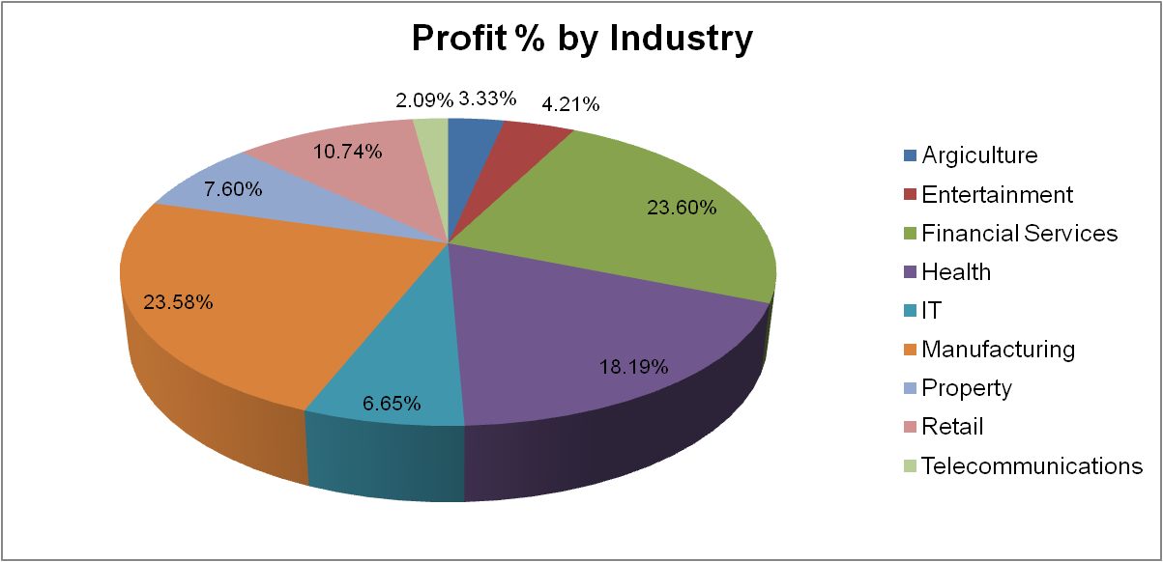
Note: The data and information in this document is reflective of a hypothetical situation and client. This document is to be used for KPMG Virtual Internship purposes only.
Introduction
Profit Contribution by Job Industries
- Four industry contributes more than 10% of total profit.
Manufacturing
Financial Services
Health
Retail
- One reason of choosing bikes by these industry professional could be the distance. These offices might be on a reasonable distance from homes.

Slide 6
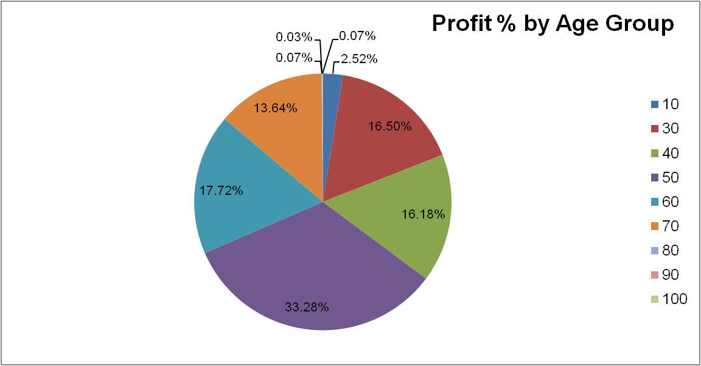
Note: The data and information in this document is reflective of a hypothetical situation and client. This document is to be used for KPMG Virtual Internship purposes only.
Data Exploration
Profit % by Age Group
40-49 Age group has shared most profit for the business.
Followed by 50-60 age group of people.
Mass customer segment is between 20-60. offering more than 75% of contributions.

Slide 7
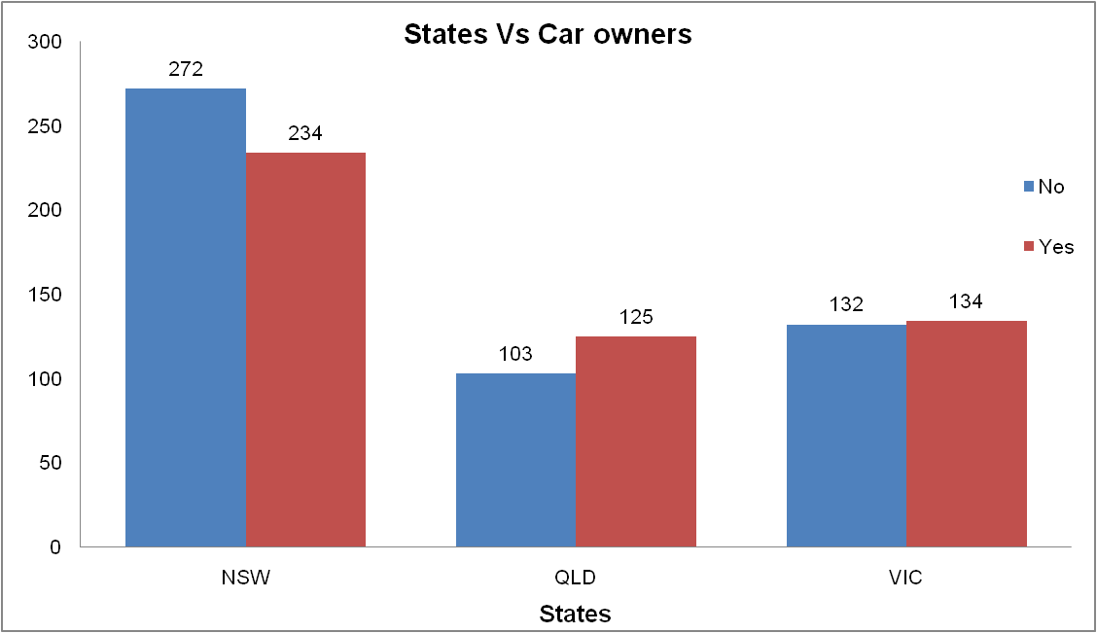
Note: The data and information in this document is reflective of a hypothetical situation and client. This document is to be used for KPMG Virtual Internship purposes only.
Data Exploration
Number of cars owned in each state.

Slide 8
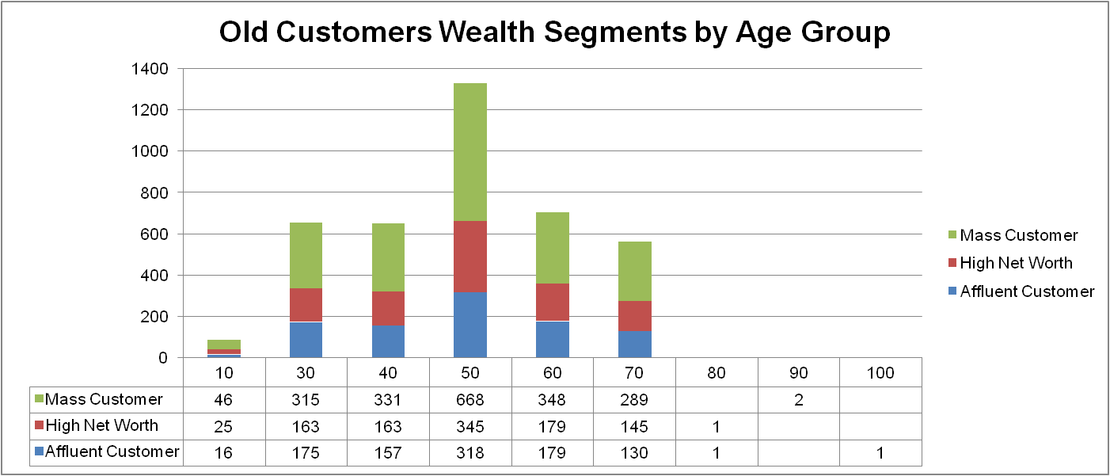
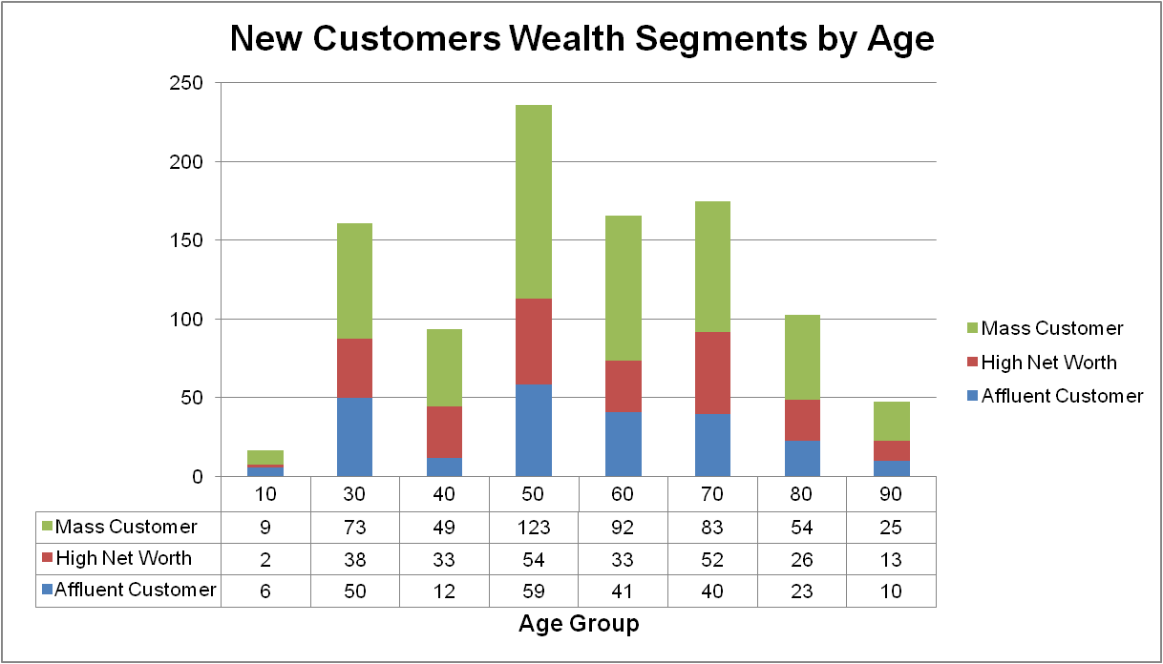
Note: The data and information in this document is reflective of a hypothetical situation and client. This document is to be used for KPMG Virtual Internship purposes only.
Data Exploration

Slide 9
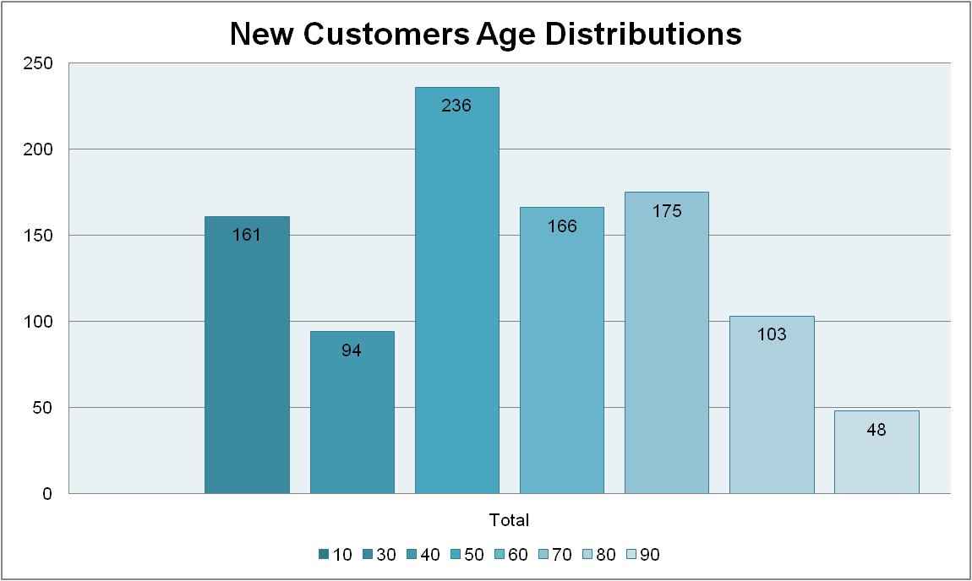
Note: The data and information in this document is reflective of a hypothetical situation and client. This document is to be used for KPMG Virtual Internship purposes only.
Data Exploration

Slide 10
Note: The data and information in this document is reflective of a hypothetical situation and client. This document is to be used for KPMG Virtual Internship purposes only.
Data Exploration
New And Old Customers Age Distribution
Most customers 40-49 age group in both new and old customers
lowest age groups are 20 and 80+
20-29 age group in new customers is also on growth.
in both the customers 30-39 age group shows a decline.
In old customers there is no contribution after age of 70
In old customers, except 40-49 age group, rest all groups have same contribution.
while in new customers, there is a small segment of 70+ age group.

Slide 11
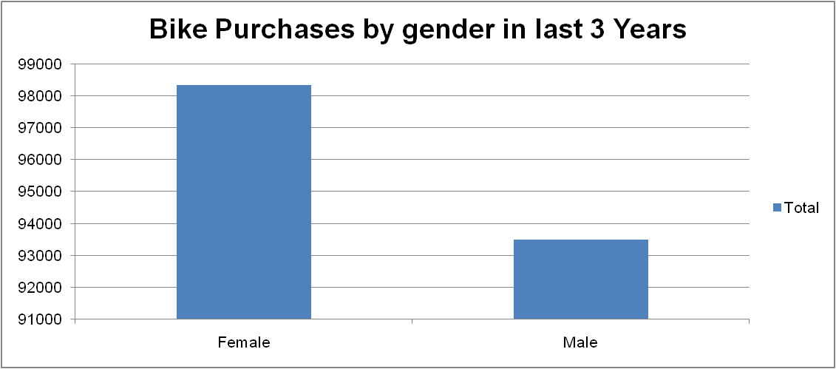
Note: The data and information in this document is reflective of a hypothetical situation and client. This document is to be used for KPMG Virtual Internship purposes only.
Data Exploration
Females have made more bike related purchases in last there years.

Slide 12
Note: The data and information in this document is reflective of a hypothetical situation and client. This document is to be used for KPMG Virtual Internship purposes only.
Data Exploration

Slide 13
Note: The data and information in this document is reflective of a hypothetical situation and client. This document is to be used for KPMG Virtual Internship purposes only.
Data Exploration

Slide 14
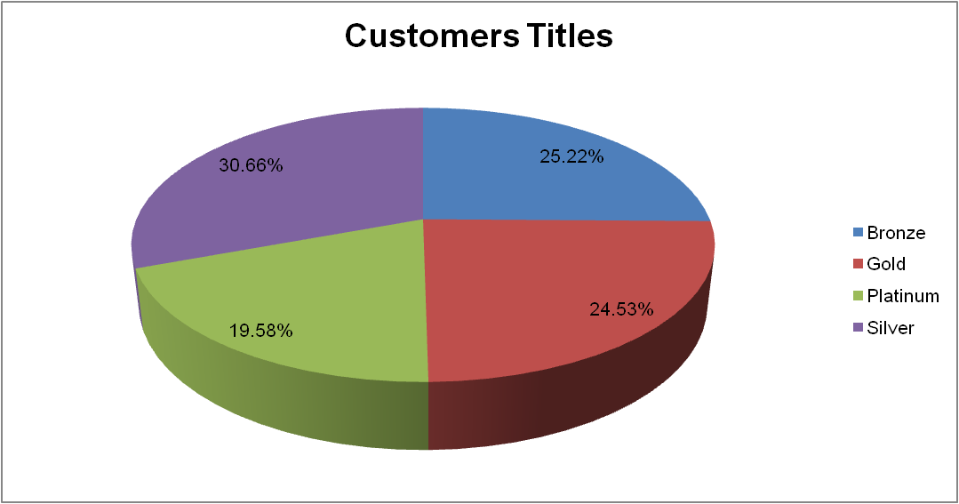
Note: The data and information in this document is reflective of a hypothetical situation and client. This document is to be used for KPMG Virtual Internship purposes only.
Data Exploration

Slide 15
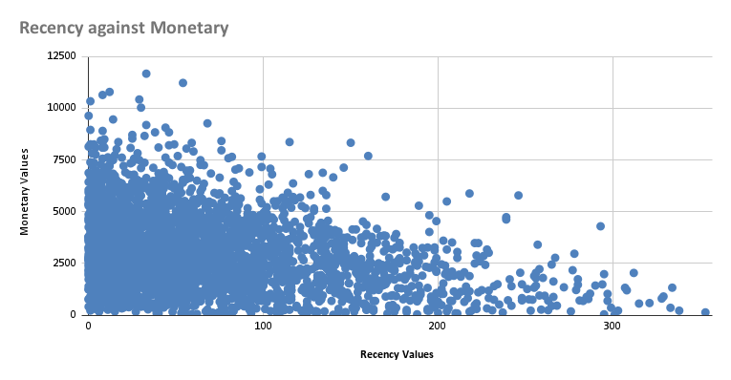
Note: The data and information in this document is reflective of a hypothetical situation and client. This document is to be used for KPMG Virtual Internship purposes only.
Model Development
Scatter Plot of RFM Values
Customers from recent past 0-100
Days show to generate a moderate
Amount of business.
Customers who visit after 200 days
Generate low revenue.
very recent customers helps
generating greater revenue.

Slide 16
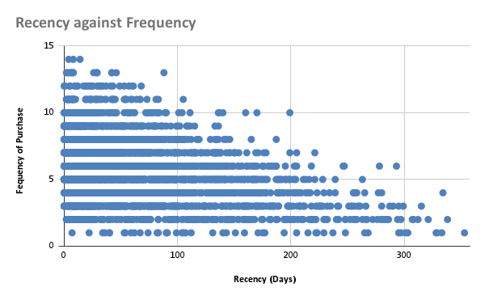
Note: The data and information in this document is reflective of a hypothetical situation and client. This document is to be used for KPMG Virtual Internship purposes only.
Model Development
Scatter Plot for RFM Values
Low frequency 0-2 relate to high
recency values. More than 250 days.
Recent visits 0-50 days lead to more
visit in future.
Higher frequency has a negative
relation with recency values.

Slide 17
Note: The data and information in this document is reflective of a hypothetical situation and client. This document is to be used for KPMG Virtual Internship purposes only.
Model Development
Customer Classification
Most high value customers come from financial, health or manufacturing industry
Best age group is 31-49. while 41-49 remains the most valued age group in both old ad new customers
New South Wales can offer better value than other
Although female is more aggressive buyers, man are not far behind. Age wise division shows
both are high vales.
Mass customer in wealth segment offer greater value
Customers who visited recently should be focused as they will again visit in near future.

Slide 18
Note: The data and information in this document is reflective of a hypothetical situation and client. This document is to be used for KPMG Virtual Internship purposes only.
Interpretation
Summary Table for few High Value Customers
first_name | last_name | past_3_years_bike_related_purchases | age | Industry | Wealth segment | owns_car | state
Hasheem | Groucock | 98 | 48 | Manufacturing | High Net Worth | Yes | NSW
Theresa | Cowper | 99 | 46 | Manufacturing | Mass Customer | No | NSW
Pace | Clemonts | 99 | 32 | Retail | High Net Worth | No | VIC
Sammy | Borsi | 99 | 50 | Financial Services | Mass Customer | No | NSW
Leticia | Hovenden | 98 | 25 | Retail | Mass Customer | Yes | VIC
Selle | Casper | 98 | 44 | Health | Mass Customer | Yes | NSW
Calhoun | Mussington | 98 | 29 | Health | Mass Customer | No | NSW
Kizzee | Agget | 98 | 46 | Manufacturing | Affluent Customer | No | NSW

Slide 19
Note: The data and information in this document is reflective of a hypothetical situation and client. This document is to be used for KPMG Virtual Internship purposes only.
THANK YOU

