Slide 1

Full Stack Web-Development
By-Siddharth gautam
2300290100251
Sem-3

Slide 2
Project-1 Create a simple personal web page
Description-
Include a Profile picture
Brief bio
Links to social media accounts
Tech Stack Used-
Basic Html(Hyper Text Markup Language)
IDE’S Used-
Visual Studio code

Slide 3
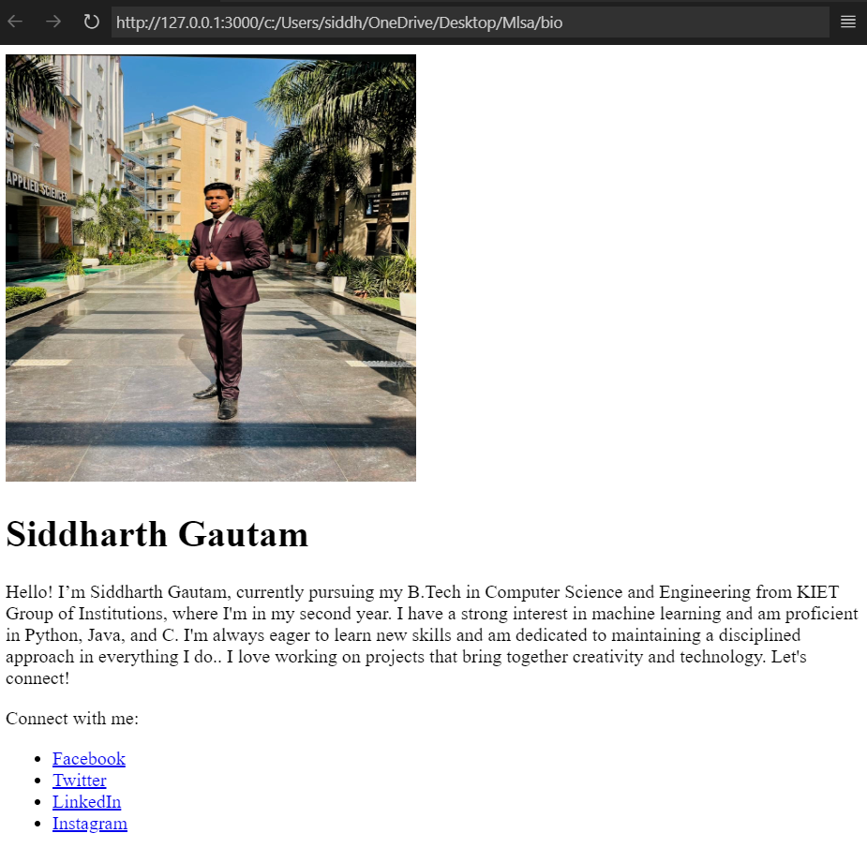

Slide 4
Outcome of Project-1
The personal webpage project successfully resulted in a visually simple yet functional profile page, showcasing my background, interests, and social media links. This project enhanced my understanding of HTML structure, web page organization, and basic responsive design principles. Through this project, I gained valuable skills in creating a digital presence, paving the way for future additions like a portfolio section or interactive features (e.g., a calculator). This experience has provided a solid foundation in front-end development and personal branding.

Slide 5
Project-2 Create a Simple Calculator
Description-
Develop a calculator application that performs basic arithmetic operations using JavaScript.
Skills-
Java Script decision making.
Tech stack used-
HTML, CSS JAVA SCRPIT
IDE Used-
Visual Studio code

Slide 6
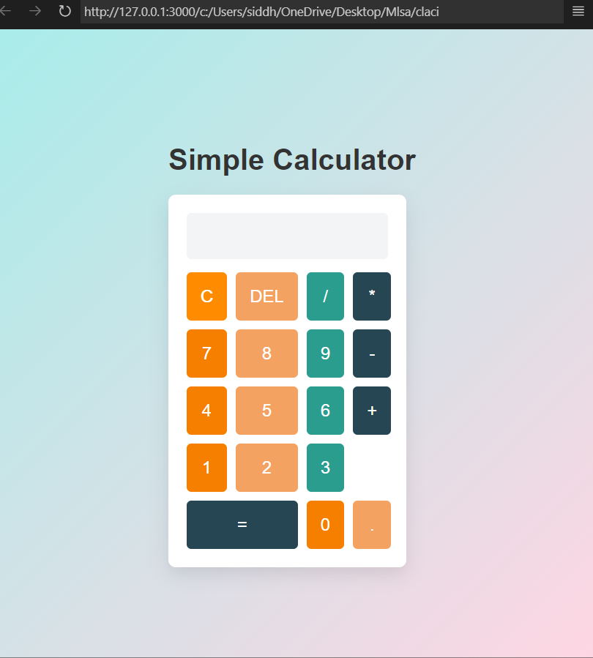

Slide 7
Outcome of Project-2
This project created a simple yet interactive calculator with a clean, user-friendly interface. Built with HTML, CSS, and JavaScript, the calculator allows users to perform basic arithmetic operations (addition, subtraction, multiplication, and division) and features buttons for clearing, deleting, and evaluating expressions. Through this project, I developed skills in designing responsive layouts, applying JavaScript for interactivity, and ensuring a seamless user experience with intuitive functionality.

Slide 8
Acknowledgement
I would like to express my heartfelt gratitude to Microsoft Learn Student Ambassadors (MLSA) for providing me with this valuable internship opportunity, which has been instrumental in enhancing my skills in web development. I am deeply thankful to Mr. Vineet Sharma, Dean of the CSE Department, for his constant encouragement and support.
I would also like to extend my sincere appreciation to my seniors and friends who guided and motivated me throughout this project. Their insights and support have been invaluable in successfully completing this work. This experience has not only enriched my technical skills but has also strengthened my passion for continuous learning and collaboration. Thank you all for your contributions to this journey.

