Slide 1







Stack overflow survey
IBM Capstone Project
Siddharth K
09-08-2021

Slide 2



OUTLINE
Executive Summary
Introduction
Methodology
Results
Visualization – Charts
Dashboard
Discussion
Findings & Implications
Conclusion
Appendix

Slide 3

EXECUTIVE SUMMARY
A modified subset of Stack Overflow data was analysed to identify the present and future data technologies trends across the world.
Dashboard containing the tabs - current data technologies, future data technologies and demographics of respondent wascreated. IBM Watson studio and IBM Cognos Dashboard platforms were used to analyse and visualize the results.
From the Current technologies dash board it was clearly visible that
Java Script and MySQL were most popular languages and Database respectively.
Windows and jQuery were preferred platform and webframe to work with.
From the future trend technologies dashboard it was clearly visible that
HTML/CSS and Elasticsearch languages and Database respectively were most popularly desired to be worked for the next upcoming year.
Linux and react.js were preferred platform and webframe to be worked for the next upcoming year.
Lastly, Demographics analysis was done in the third tab and it showed that:
93.7% respondent were male with majority of them being from USA and India in the age group of 21 to 43.
Also majority of the male population had a masters or bachelor's degree while completing this survey. From different visualization it was clear that data technologies field are preferred by students pursuing bachelors and master’s degree. Seeing the popularity among youths
Also, we may observe various MNC’s may start to diversify themselves into this field to stay competitive and entice the youth toward them.

Slide 4

INTRODUCTION
To Visualize the data, dashboards were created to emphasis on the present and future trends of data technologies.
From such a clustered survey data, we need to analyse the present data technologies and future data trends considering the various different demographics of the respondents.
Through creating dashboards using IBM Cognos Dashboard, we would be able to visualize our data based on top 10 present and future data technology trends based on respondent gender, formal education, age and countries.

Slide 5

METHODOLOGY
A modified subset of Stack Overflow data consisting of data sets based on the demographics and data technologies were used to visualize the present and future data trends.
As these data sets were subsets of data sets and therefore they did not require a lot of cleaning. Hence no particular methodology was used to visualize the data. Only filtering option was used to ignore the nulls values from data.
IBM Cognos dashboard was used to create different Dashboards.

Slide 6
RESULTS
The data was collected from stack overflow blog under ODbl: Open Database License. It was further modified and use for the analysis purpose.
It consisted of two data sets :
Survey data technology normalized consisted of approximately 75K respondents querying them about the present and future data technologies interest. Then using visualization tools such as bar, columns graphs along with tree maps and hierarchy trees were used to analysis the top trending present and future technologies trends.
Survey data demographics was more clustered data set a which involved around 11K respondents answering about various demographics questions such as country, age, education level, ethnicity, gender etc. The results of these finding were visualized in form of bar, line charts along with maps.
In next few slides we will be discussing the crucial findings from the data sets for present and future technologies trends

Slide 7
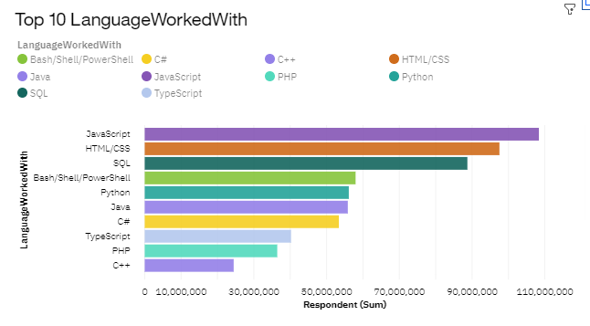
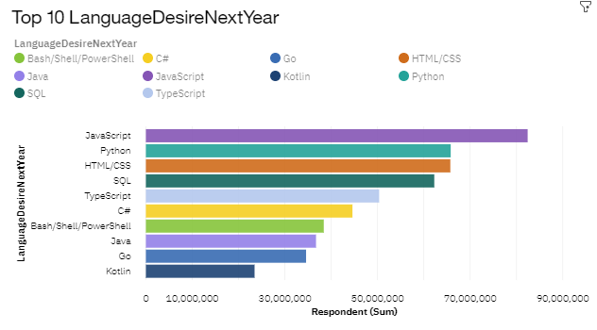
PROGRAMMING LANGUAGE TRENDS
Current Year
Next Year
<Bar chart of top 5 programming languages for the current year goes here.> Languages, Databases, Web frame & platform
< Bar chart of top 5 programming languages for the next year goes here.>

Slide 8
PROGRAMMING LANGUAGE TRENDS - FINDINGS & IMPLICATIONS
Findings
JavaScript and HTML were the languages that were preferred and will continue to dominate in future too.
•They were further followed by SQL, Bash, and Python for current trends but they may not be the next go to languages in future.
Implications
The job market would see a higher influx of JavaScript and HTML engineer.
•This may decrease the present high demand of such developer and we may see a saturation point in coming years.

Slide 9
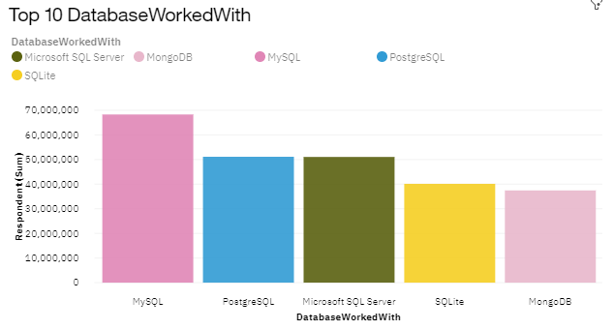
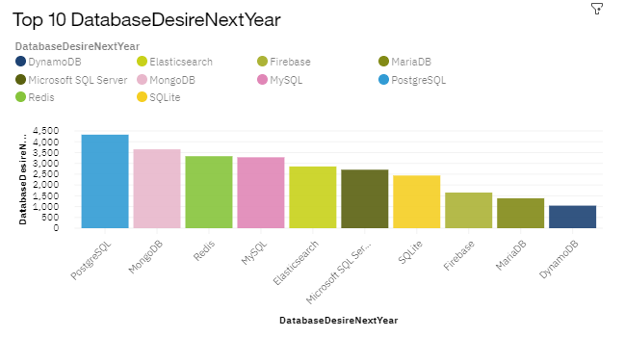
DATABASE TRENDS
Current Year
Next Year
< Bar chart of top 5 databases for the current year goes here >
< Bar chart of top 5 databases for the next year goes here.>

Slide 10
DATABASE TRENDS - FINDINGS & IMPLICATIONS
Findings
My SQL dominates the Database platform preferred by developers but in next few years we may see a steep decline in its preferences.
•PostgreSQL was the next database platform preferred by developer and see a steep increase in its preference to be worked on in future too.
•MongoDB would be the database platform which would be most preferred Database
Implications
We may see more organization preferring to work with MongoDB and PostgreSQL, as the popularity of them may increase in coming years
We may see MongoDB and PostgreSQL as the next essential databases skills to have in resume
MySQL may reach a saturation point and wouldn’t be sufficient enough to give you an edge over others in term of skills.

Slide 11

DASHBOARD
Dashboard link

Slide 12
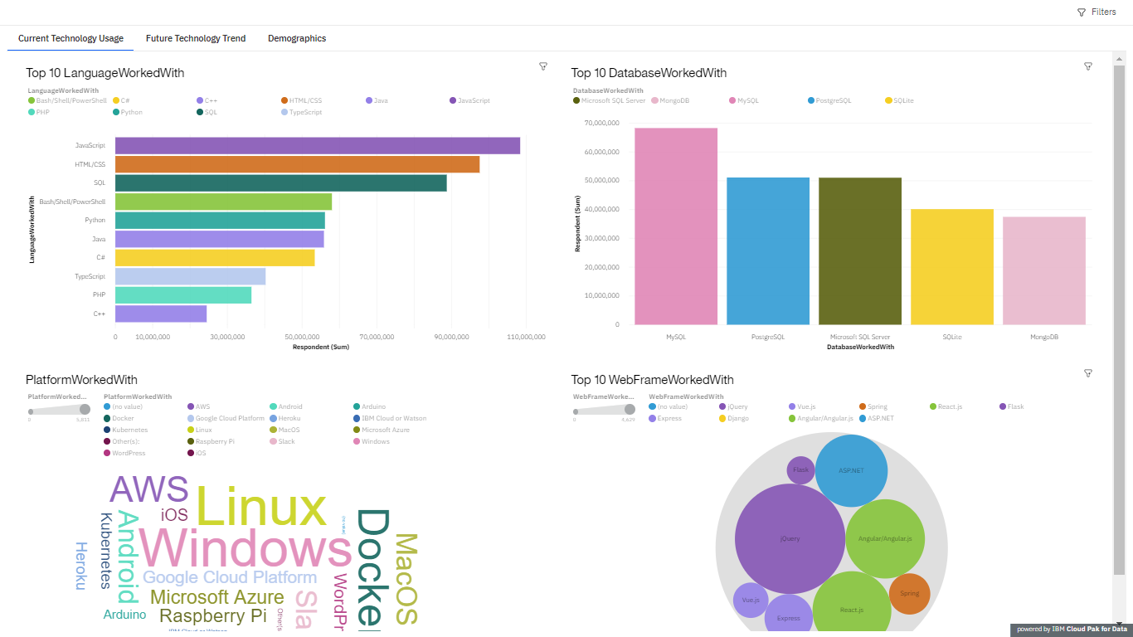
DASHBOARD TAB 1
Screenshot of dashboard tab 1 goes here

Slide 13
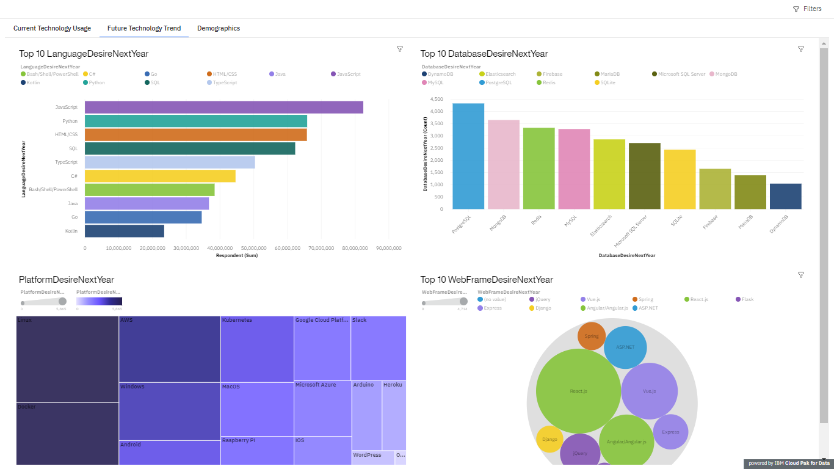
DASHBOARD TAB 2
Screenshot of dashboard tab 2 goes here

Slide 14
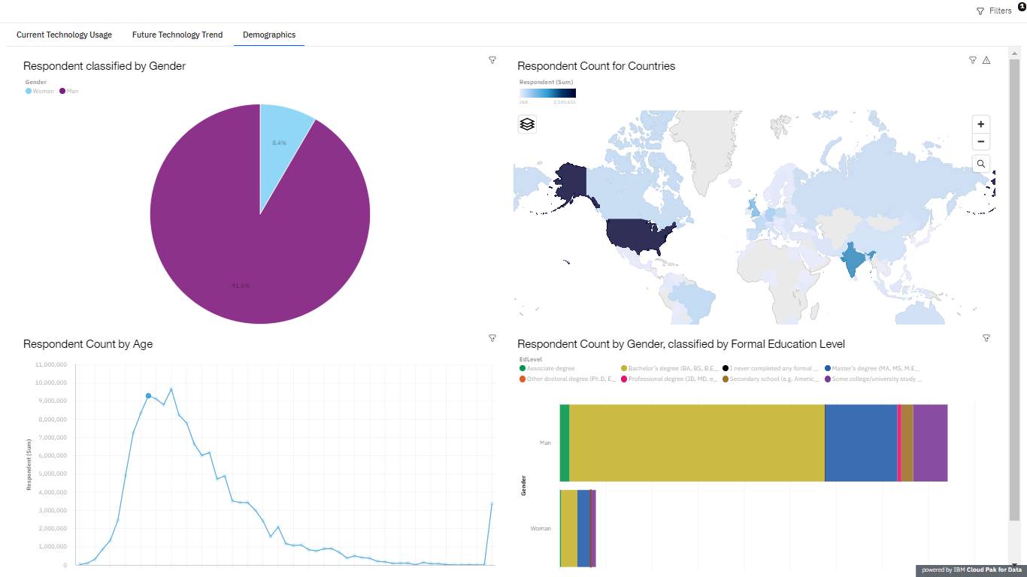
DASHBOARD TAB 3
Screenshot of dashboard tab 3 goes here

Slide 15
DISCUSSION
Languages:
Will SQL and Python tend to loose it dominance in upcoming years?
Will other languages such as Go, C# would be the new emerging languages of future?
Database:
Would MongoBDand PostgreSQL would be the new MYSQL in emerging times
Why is the popularity of MySQL declining so drastically?

Slide 16
OVERALL FINDINGS & IMPLICATIONS
Findings
The database technologies surveys results are dominated by male population, majority of them being USA respondents.
Bachelor's and Master’s students highly prefer doing specialization in data technology.
Implications
Seeing the popularity amongst youths, we may see more bootstrap camps being set up to enhance their skillsets.
The popularity trends may be similar in other countries too and we may see various MNC’s diversifying into this sector.

Slide 17

CONCLUSION
We wanted to analyze the dataset for the preferred current and future trends in data technology while also considering the demographics of the respondent.
From the data visualization it is clearly visible that the data technologies trends are preferred by population b/w 21 to 36 years
It has a wider acceptance among male as compared to women.
Among the languages, HTML and Javascript will remain the most preferred languages to be worked with.
Among the Database, we may see the popularity of SQL decreasing and which may be replaced by MongoDB and PostgreSQL.
We may see an increase in number of bootcamps for enhancing skills and may come across many MNC’s diversifying into data technology to keep up the pace. Further analysis on same can be done next to validate this.

Slide 18

APPENDIX
Resources used:
Database taken from: Stack overflow blog under Odbl(Open Database License).
IBM Cognos dashboard were used for creating Dashboards.
Acknowledgement:
Coursera for allowing the access to this course

