Slide 1

Orbit Observers
Satellites that stay serviceable, even on their worst day
The minimum client-side preparation that keeps a satellite serviceable when it is healthy, degraded or tumbling. Not another docking port.
Business / Technical / Serviceability
Notes:
0:00. We are Orbit Observers. We make satellites serviceable on their worst day. (The 10 second video plays here.)

Slide 2
Most satellites were never designed to be grabbed
Legacy clients
The last 12 metres
The GEO shift
Often non-cooperative. No standard capture or service interface. Safe-mode behaviour can fight a servicer.
A tumbling client, a noisy camera and an unknown spin rate. The servicer carries all the risk and cost.
Chemical to hybrid to all-electric removes the accidental nozzle and ring features servicers used. Future satellites need a deliberate interface.
Notes:
0:15. Most GEO satellites were never designed to be grabbed. When one tumbles the servicer carries all the risk in the last twelve metres, and electric platforms remove the accidental features servicers used. We ask: what is the minimum a client must carry to stay serviceable?

Slide 3
Three client states, five layers of preparation
C3
Nominal
C2
Degraded
C1
Tumbling
Healthy, controlled, talking
Partial computer, power or comms
No control, no comms
IOS mode: control handed to the servicer
Independent Service Beacon: rate, ID, health
Markers and a known capture point
OSAN service zone for high-value platforms: capture and load transfer, power and data, optional fluid transfer, POD attachment. Concept only; no loads or layout yet.
Notes:
0:50. Three states: healthy, degraded, tumbling. Five layers: markers, a capture point, an independent beacon, an IOS handover mode, and a service zone. Each keeps the satellite serviceable one step further.

Slide 4
Preparation matters where an unprepared client starts to fail
+51 pp
at 3 deg/s: unprepared 41% to markers 92%
+8 pp
rate data in the beacon: 92% to 100% (p = 0.008)
5 deg/s
only a cooperating client passes (C3 assumes self-damping)
Notes:
1:30. At three degrees per second an unprepared client reaches the terminal window 41 percent of the time, with markers 92, with a rate beacon 100. An identity-only radio adds nothing; rate information does. Above five degrees only a cooperating client works. v4.1, 100 seeds per cell; v4.0 gave 41.6, 91.8, 100 with 500 seeds.

Slide 5
One system from ground approval to client handover
Ground
Servicer
Client
Dashboard and AI agents
Policy and human approval
Hash-chained audit
Monte Carlo feasibility
Estimator on estimates only
Hold point, braking approach
Abort gates and retreat
On-board log and downlink
Markers and capture point
Independent beacon
IOS state machine
Fuel gauge: book-keeping + PVT
Rules built in: flight logic never sees truth. Humans approve every high-risk step. IOS handover needs a human-approved gate and aborts from any state.
Notes:
2:15. One system: a ground platform with human approval, a servicer and a prepared client. Flight logic never sees truth. The IOS handover is gated by human approval and aborts from any state.

Slide 6
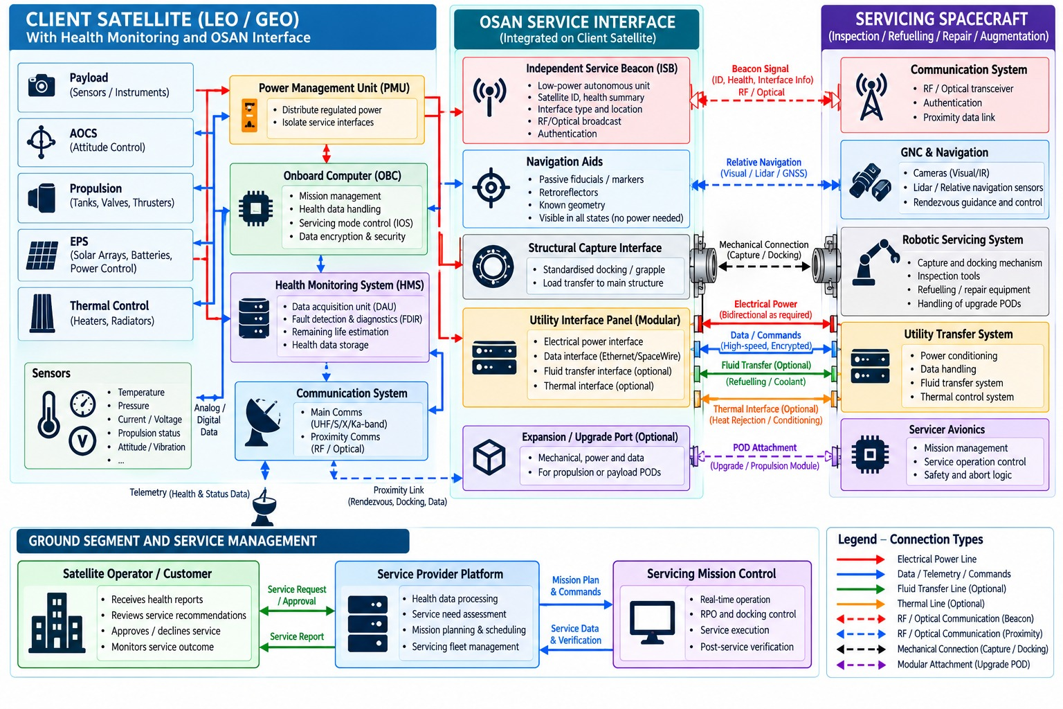
Reference architecture: what we cover and what comes next
Covered
Navigation aids, servicer GNC and abort logic, ground platform and approvals
Partial
Service Beacon (no interface or health fields yet), IOS mode, health monitoring (fuel and logs only), capture geometry without loads
Not modelled
Utility and fluid transfer, upgrade port, robotic servicing, power and thermal lines
Notes:
Reference diagram from the team. It confirms our three layers and adds a client health monitoring system, power management, a utility interface panel and an upgrade port. We cover navigation aids, servicer GNC and abort logic, and the ground platform; the beacon, IOS and health monitoring are partial; utility and fluid transfer, the upgrade port and robotic servicing are next. Full table: docs/PRESENTATION_PACK.md section 10.

Slide 7
Built, tested, and honest about its limits
74
41,240
0 / 6,140
1.2 kg
automated tests pass
simulated approaches (35,100 + 6,140)
keep-out violations (a count, not a bound)
fuel gauge error from 800 kg
Verified
Not yet
Paired seeds, intervals, exact tests, replayable runs
IOS coupled to the approach: approval gate, rate envelope, abort
Beacon bench plan B1 to B7 with model-derived limits
Leak and sensor faults flagged in 100 of 100 runs
No contact or capture model: 'window met' is not a grab
Retreat passive safety not established
No hardware data; costs and noise are assumptions
Authentication is a simulation token
Notes:
2:45. 74 tests, reproducible campaigns on HPC, zero keep-out violations in 6,140 runs. This is a model: no contact physics, no hardware yet, and we say so on every slide.

Slide 8
A tiered kit that makers add at build time
Tier 1
Tier 2
Tier 3
Tier 4
EOL-ready
Service-ready
Life-extension-ready
Augmentation-ready
Capture fixture + markers
+ IOS mode + beacon
+ refuelling port
+ power, data, POD (OSAN)
EUR 0.36 M
EUR 1.46 M
EUR 2.18 M
EUR 6.68 M
enables: Removal
enables: Attached propulsion
enables: Refuel and release
enables: Upgrade POD
Buyers (hypotheses): satellite makers and operators for the kit; servicers for more successful visits per vehicle; insurers and regulators for reproducible evidence. Costs per unit are assumptions: unit price, mass, launch and shared development.
Notes:
3:15. Buyers are satellite makers and operators who add a tier at build time, and servicers who get more successful visits per vehicle. All costs here are assumptions.

Slide 9
Markers repay almost at once; the beacon and IOS need more
At 3 deg/s | Success within 3 tries | Add-on cost per client | Break-even P(needs rescue) | Servicer break-even price per success
C0 unprepared | 64% | EUR 0 | n/a | EUR 32.0 M
C1 markers | 98% | EUR 45 k | 0.6% vs C0 | EUR 20.0 M
C2 + rate beacon | 100% | EUR 0.40 M | 75% vs C1 | EUR 19.6 M
C3 IOS mode | 100% | EUR 1.15 M | 14.5% vs C0 | EUR 19.6 M
Assumed inputs
What to test first
Rescue worth EUR 20.8 M net (EUR 40 M a year, 60% margin, 5 years, 8% discount, EUR 75 M price). Every price and probability is ours, not a customer's.
How often a client degrades enough to need rescue. It drives every break-even. The beacon is likely undervalued: identity, interface and health data carry no value in the simulator.
Notes:
With our assumed inputs, markers repay their cost if even 0.6 percent of clients ever need rescue. The beacon and IOS mode pay off where tumble is high or where data beyond approach matters. Source: docs/ECONOMICS_MODEL.md.

Slide 10
Others fix the servicer; we specify the client
Existing offers [to verify]
Rules that shape the design [to verify]
Northrop Grumman MEV and MRV: life extension of unprepared GEO clients
Astroscale: removal, inspection, docking plate on client
Starfish Space: autonomous docking and inspection
ClearSpace: capture of defunct objects
Orbit Fab, MDA, Airbus, Thales Alenia, OHB: refuel ports, arms, interfaces
ISO 24330 for rendezvous and servicing practice
ISO 24113 and IADC for debris and end of life
ECSS series for GNC, verification and interfaces
NASA-STD-7009 for model credibility
ITU and national licensing for the beacon
Owner consent and national authorisation; EU Space Act evolving
Notes:
Competitor and standards lists are from background knowledge and must be sourced before submission. A patent search is still open.

Slide 11
Next: a ground demonstration with agreed criteria
now
next
later
after
Study
Ground demo
IOD
Product family
Envelopes, beacon and IOS concept, tier trade
Bench B1 to B7, contact model, HIL rig
Prepared client and servicer in orbit
Tiers 1 to 4 as catalogue items
EUR 770 k
40
Use of funds: about 42% people, 45% bench and rig hardware, 13% contingency. Six work packages: systems, RPO and GNC, HPC and analysis, beacon bench, IOS and OSAN, business and regulatory.
draft ground-demo budget (assumed)
person-months at EUR 8 k assumed
Notes:
3:50. Next is a ground demonstration: bench-test the beacon, validate a contact model, run the HIL rig. A draft budget is about 770 thousand euros, assumptions we want ClearSpace to challenge. Budget table: docs/PRESENTATION_PACK.md section 5.2.

Slide 12
Three asks and the risks we are watching
What we need
Risks
Confirm the reference client and the degraded failure cases
Point us to failure statistics so we can test how often rescue is needed
Agree the success criteria for the ground demo
Value rests on an assumed failure rate and price
Buyers may prefer servicer-side fixes
Contact-model fidelity and hardware lead time
Standards fragmentation and licensing timing
Novelty not yet checked against patents
Notes:
4:30. Three asks: confirm the reference client and failure cases, point us to failure statistics, agree the ground-demo success criteria.

Slide 13
Minimum preparation. Safe when degraded. A scalable roadmap.
Notes:
4:50. Minimum preparation. Safe when degraded. A scalable roadmap.

Slide 14
Appendix: what is evidence and what is assumed
Item | Status | Source
Pass rates, paired effects, aborts | Model result | results/v4_1_validation, results/v4_0
Beacon power, mass, link margin | Engineering model, assumed derating | rpo_project/ios.py, docs/BEACON_BENCH_PLAN.md
Prices, revenue, probabilities, budget | Assumed | docs/ECONOMICS_MODEL.md, docs/PRESENTATION_PACK.md
Competitors and standards | From background knowledge, unsourced | docs/EXPERT_CHECKPOINT_SESSION1.md
Fuel gauge, downlink, platform demo data | Simulated | tools/export_fuel_demo.py, export_downlink_demo.py
TRL statement: simulation and concept today (our judgement, about TRL 2 to 3); proposed target for the ground demo about TRL 4 to 5. Not an assessed rating.

