Slide 1
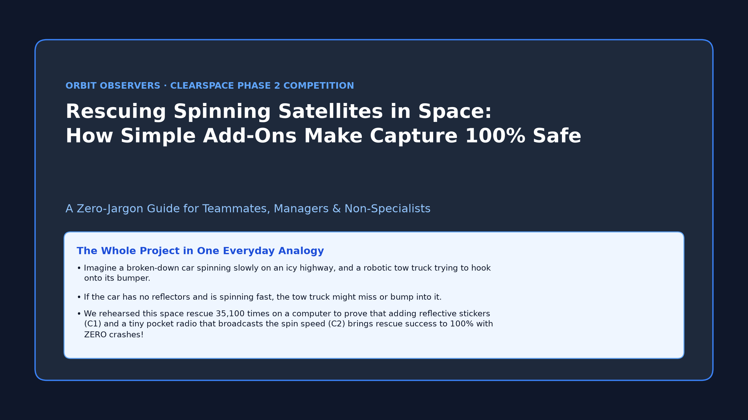
Notes:
Welcome! This deck explains our entire space project in plain, everyday English—no space or engineering background needed. Use the analogy of a tow truck rescuing a spinning car on ice.

Slide 2
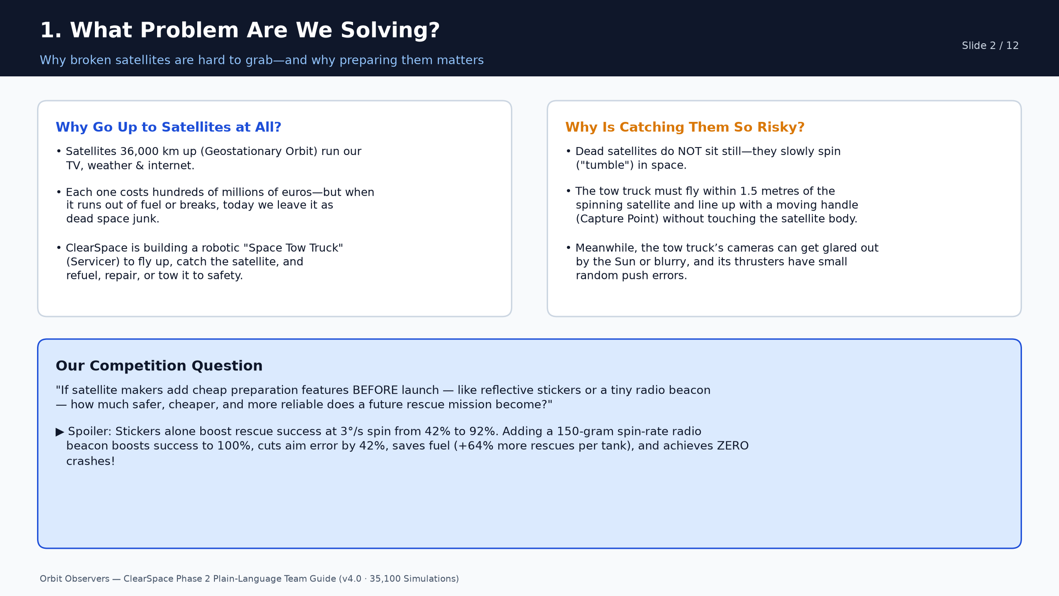
Notes:
Slide 2 explains the real-world problem: expensive satellites die and spin in space. ClearSpace wants to send a robotic tow truck to grab them, and we are proving which cheap add-ons make that rescue safe.

Slide 3
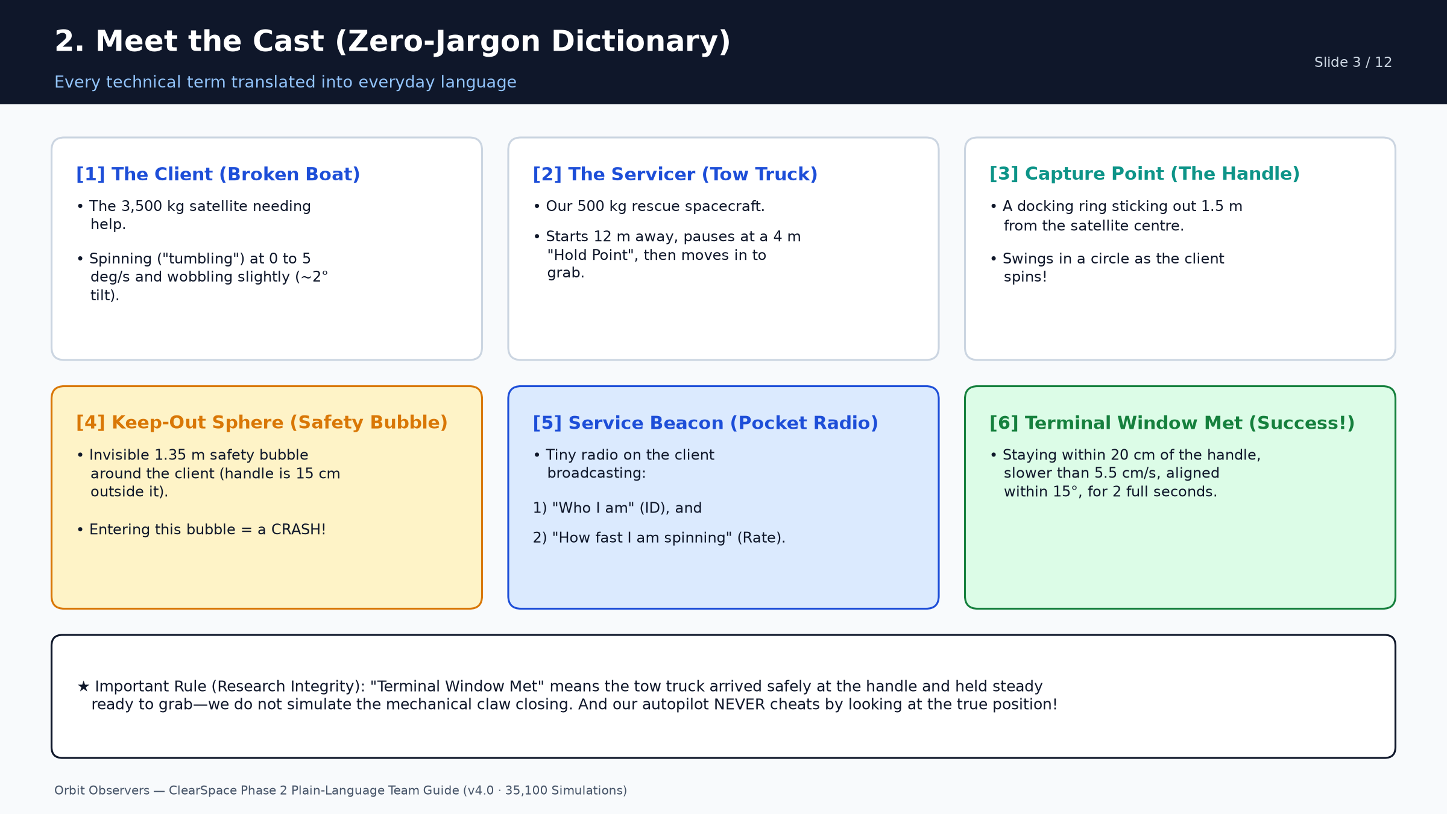
Notes:
Slide 3 translates all 6 space terms into everyday objects: the Client is the drifting boat, the Servicer is the tow truck, the Capture Point is the handle, and the Keep-Out Sphere is the 1.35m no-touch safety bubble.

Slide 4
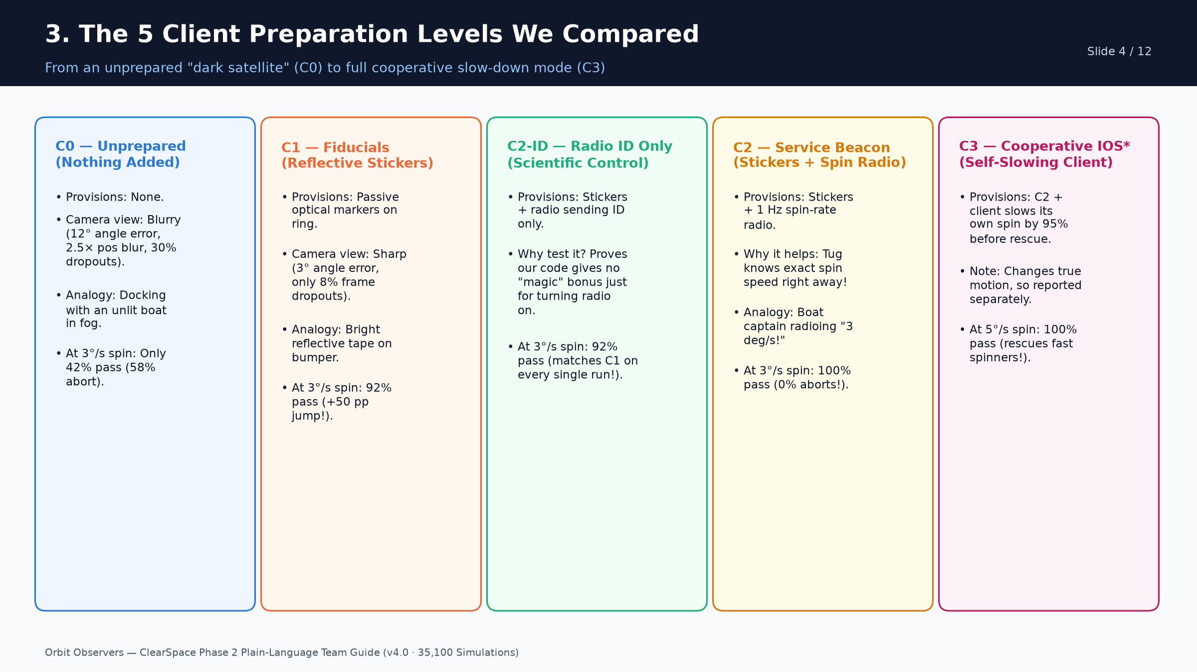
Notes:
Slide 4 shows the 5 tiers. Emphasize why C2-ID is included: judges love scientific controls! C2-ID proves that an ID-only radio gives 0% navigation improvement over C1, whereas adding spin rate in C2 jumps success to 100%.

Slide 5
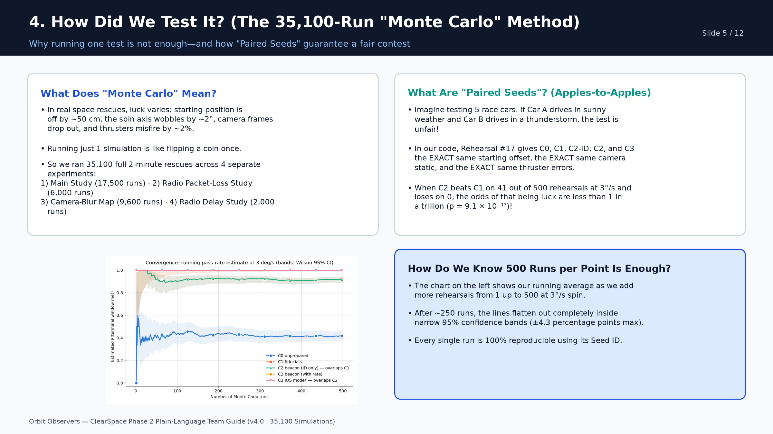
Notes:
Slide 5 explains Monte Carlo and Paired Seeds without math. Use the race car in identical weather analogy: because every tier faces the exact same random bad luck on each seed, we know for sure the improvements are real.

Slide 6
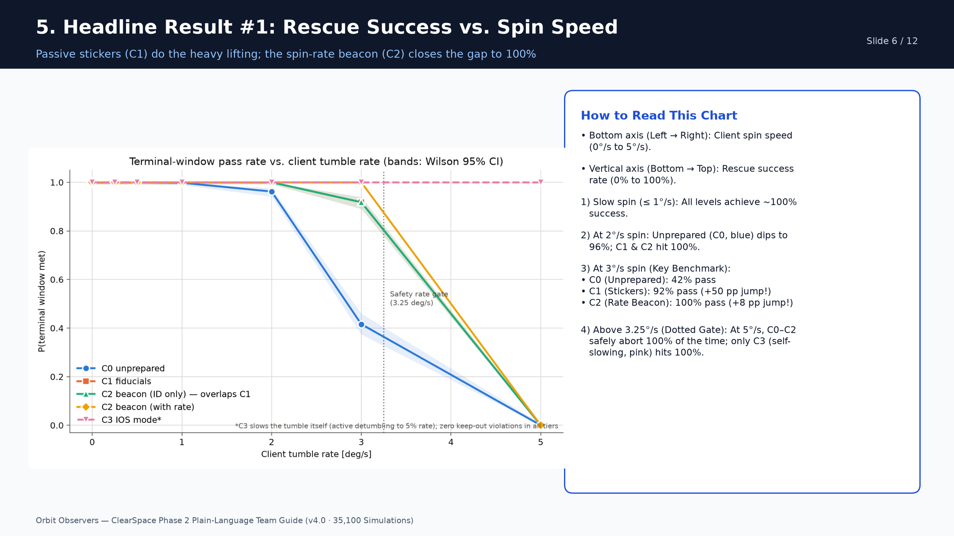
Notes:
Slide 6 is our most important graph (Plot 1). Point to 3 deg/s: Unprepared is 42%, Stickers jump to 92%, and the Rate Beacon hits 100%. Then point to 5 deg/s: non-cooperative tiers safely abort, while C3 hits 100%.

Slide 7
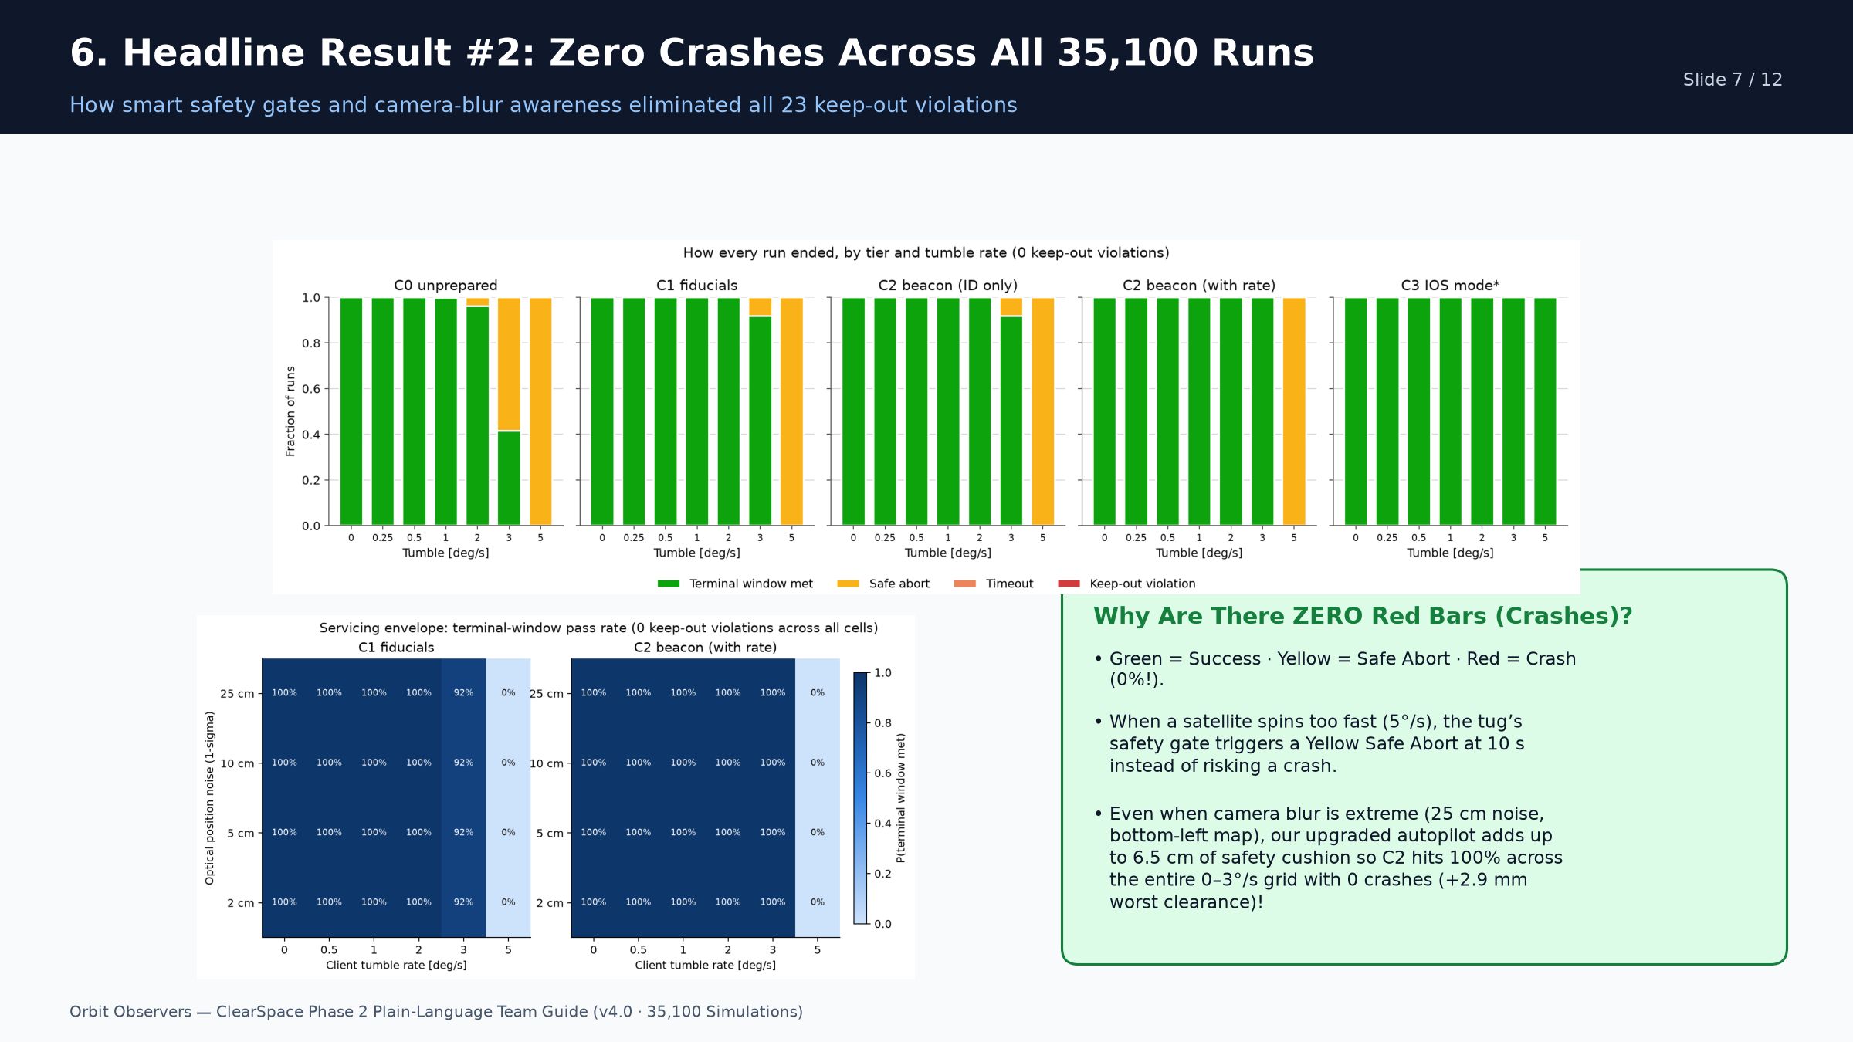
Notes:
Slide 7 shows Plot 6 (top) and Plot 3 (bottom left). Point out that there is ZERO red anywhere: when conditions are unsafe at 5 deg/s, the tug turns yellow (Safe Abort) instead of red (Crash). And in the blue heatmap, C2 gets 100% in every single square up to 3 deg/s!

Slide 8
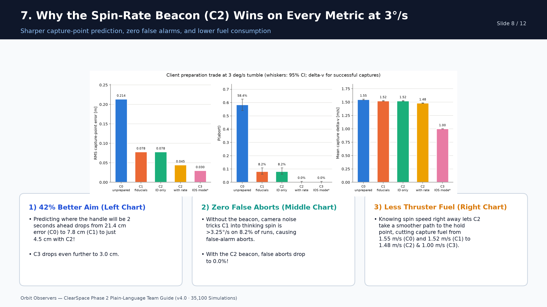
Notes:
Slide 8 shows Plot 4: the 3-panel bar chart at 3 deg/s. Every bar steps down cleanly from left to right: lower prediction error, lower abort rate, and lower fuel burned per capture.

Slide 9
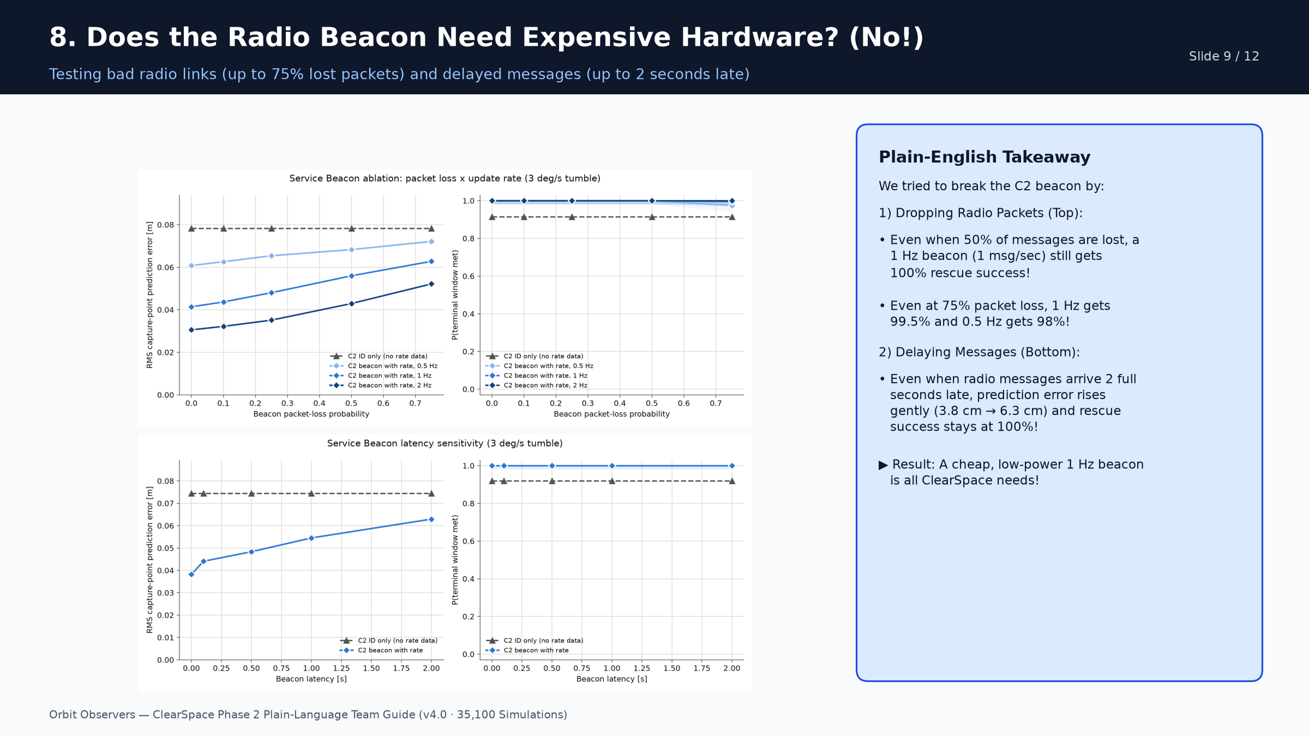
Notes:
Slide 9 shows Plots 2 and 5. Judges will ask: what if the radio signal is weak or delayed? These two charts prove that even 50% packet loss or 2 seconds of delay still gives 100% capture success at 1 Hz.

Slide 10
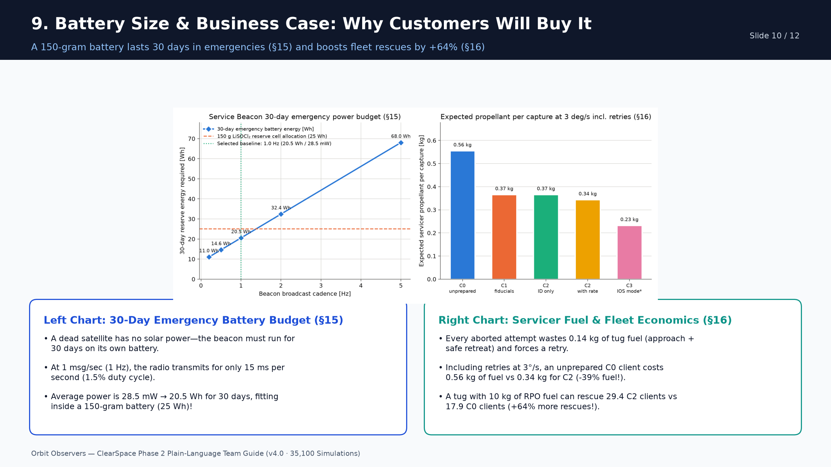
Notes:
Slide 10 covers the business and hardware trade (Plot 8). Left: 1 Hz needs only 20.5 Wh for 30 days (a 150g battery, weight of an apple). Right: eliminating aborts cuts total fuel per rescued client from 0.56 kg to 0.34 kg (+64% more clients rescued per tank).

Slide 11
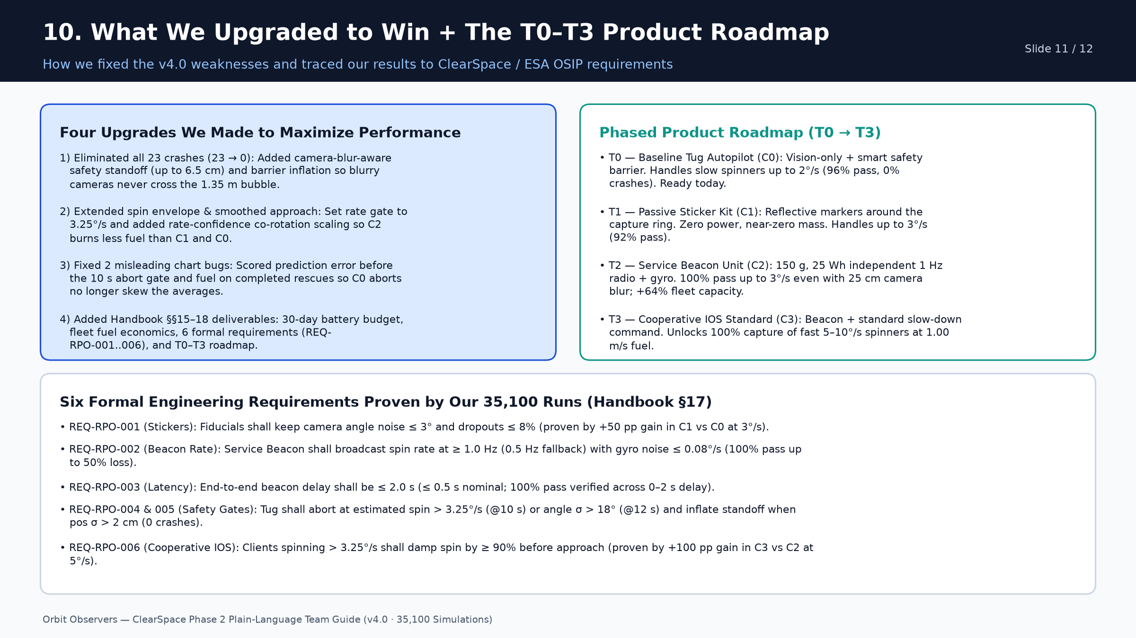
Notes:
Slide 11 summarizes for teammates exactly what we upgraded in the project and shows the T0-T3 product roadmap and 6 formal engineering requirements required by the competition guide.

Slide 12
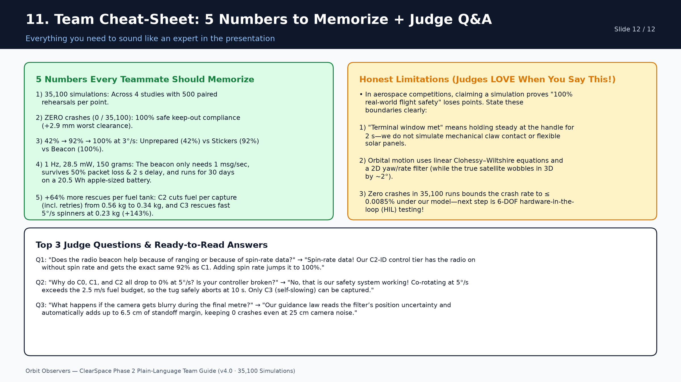
Notes:
Slide 12 is your 60-second Q&A cheat sheet. Memorize the 5 numbers on the left, state the honest model boundaries on the right, and use the 3 ready-made judge answers at the bottom!

