Slide 1
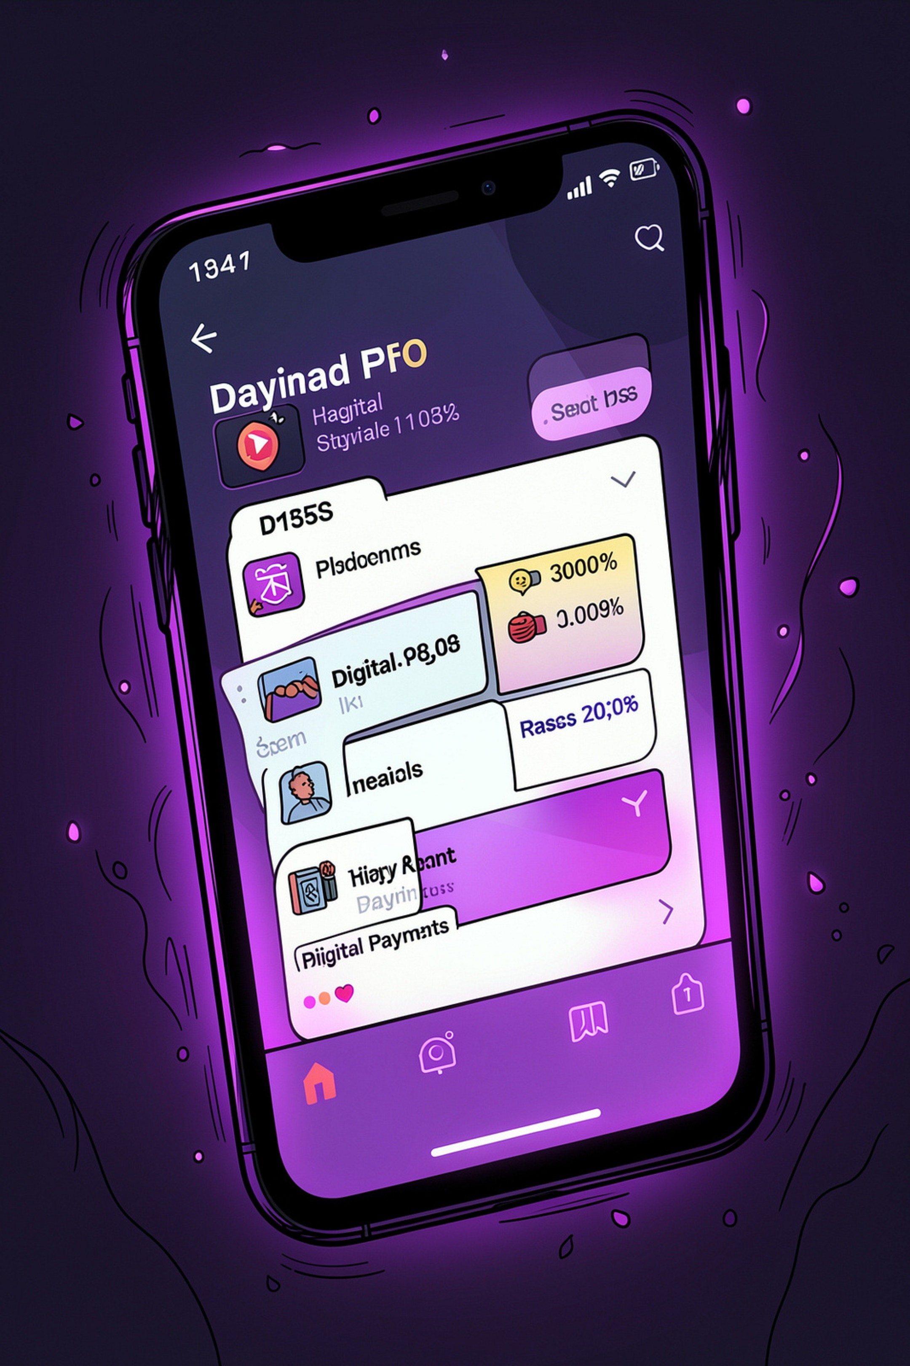
PhonePe Transaction Analysis: A Power BI Dashboard Project
Analyzing digital payment trends, user behavior, and transaction performance

Slide 2

Project Objective
1
Uncover Transaction Trends
Analyze transaction volume and value across all PhonePe services to surface meaningful patterns.
2
Analyze User Behavior
Segment user demographics and evaluate payment success rates to understand engagement drivers.
3
Drive Business Decisions
Deliver actionable insights that empower data-driven strategy across product and operations teams.

Slide 3
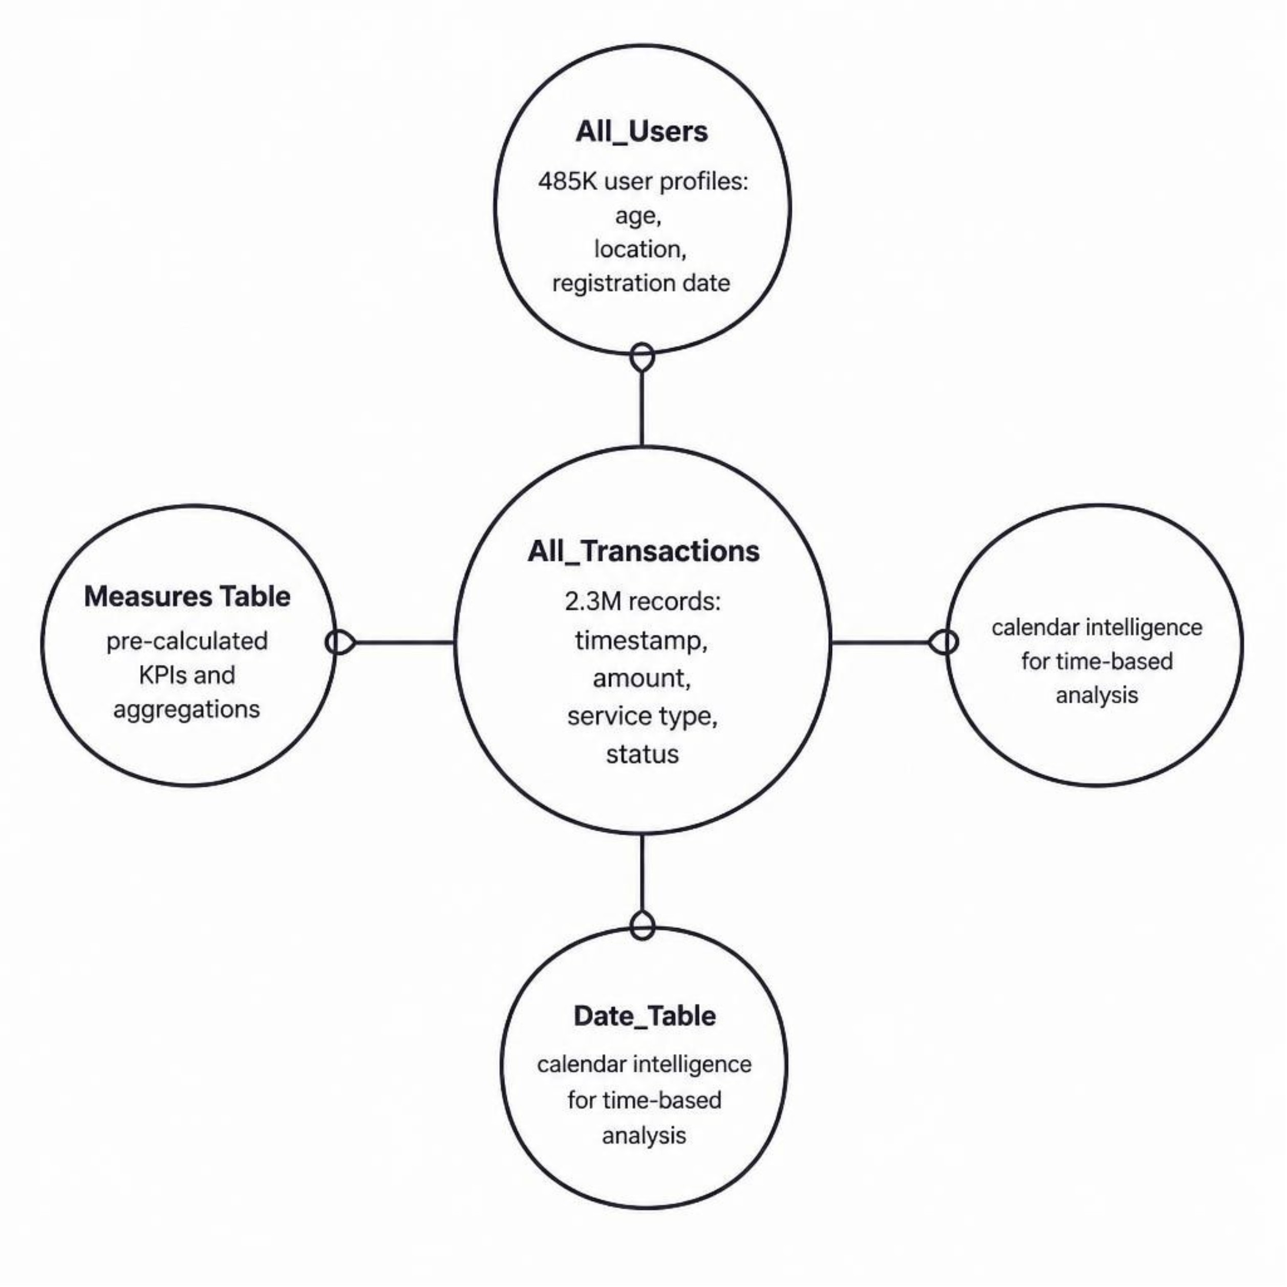

Data Model Architecture
Core Data Tables
All_Transactions
All_Users
2.3M records — timestamp, amount, service type, status
485K profiles — age, location, registration date
Date_Table
Measures Table
Calendar intelligence for time-based analysis
Pre-calculated KPIs and aggregations

Slide 4
Key Performance Indicators
₹4.2B
2.3M
Transaction Value
Total Transactions
Total value processed across all services
Individual payment events recorded
485K
94.2%
Total Users
Success Rate
Active user profiles in the dataset
Transactions completed without failure
+18.5%
+22.3%
MoM Volume Growth
MoM Value Growth
Month-over-month transaction count increase
Month-over-month transaction value increase

Slide 5
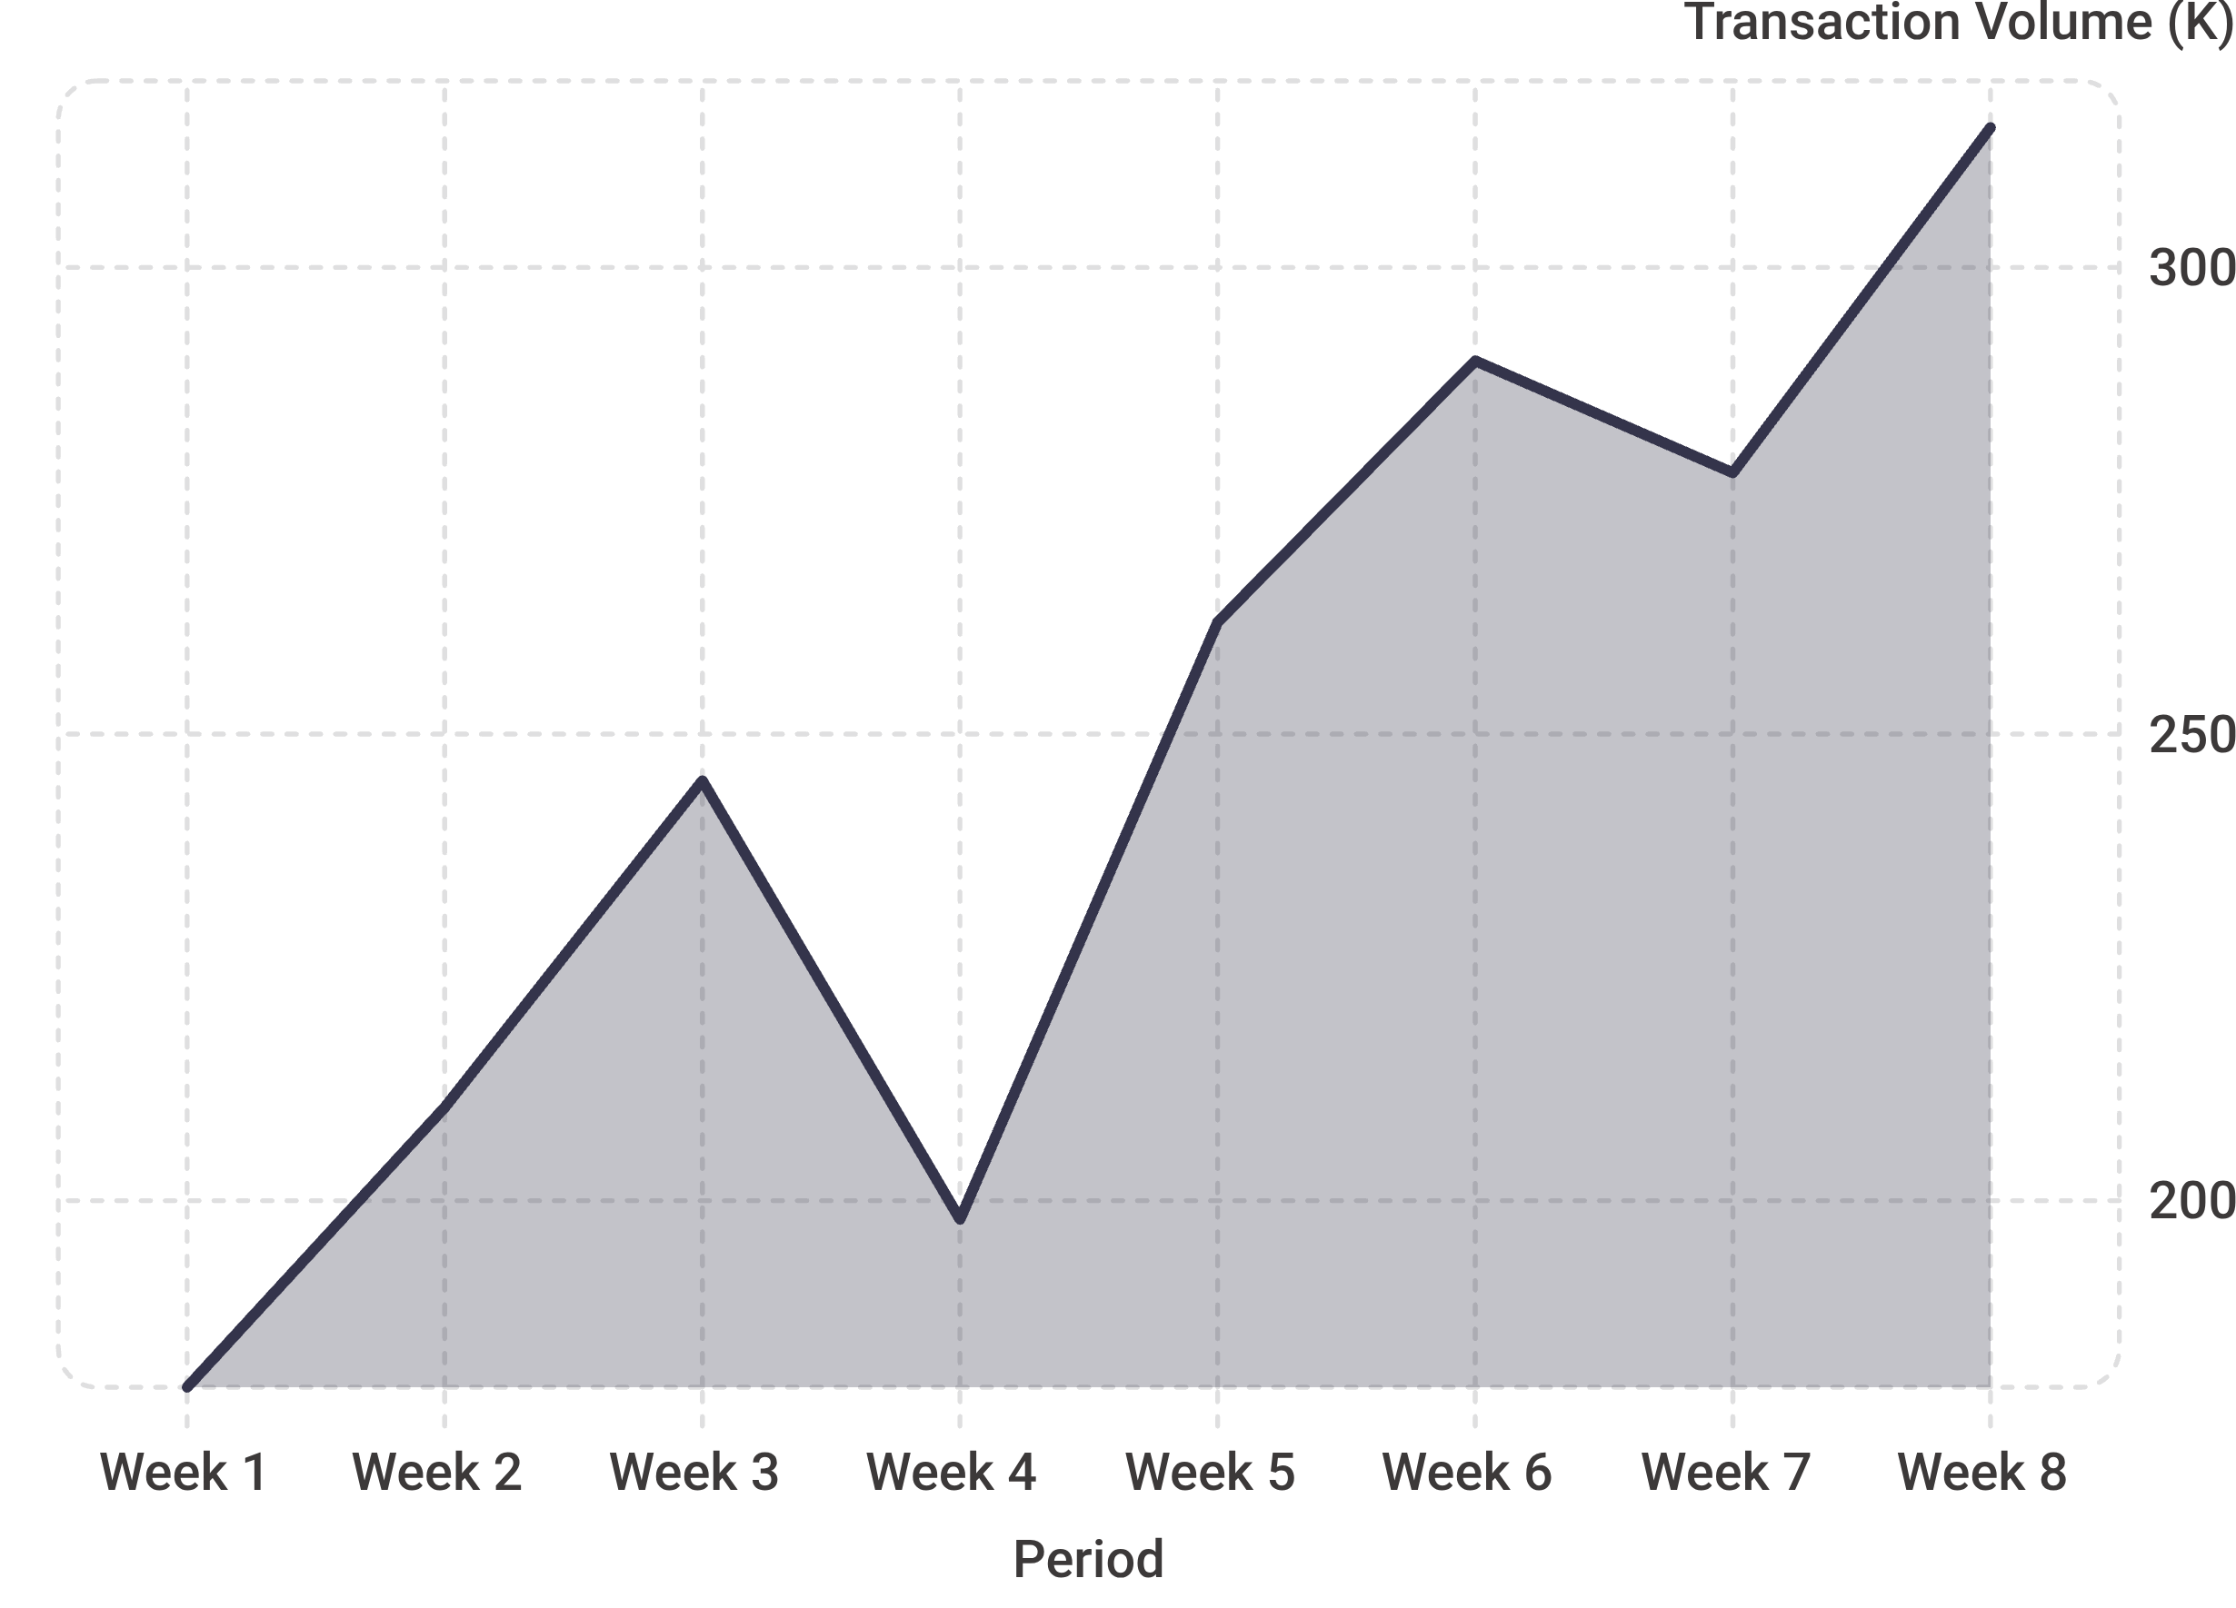
Transaction Trend Over Time
Trend Highlights
Mid-Month Peak
Weekend Spikes
Daily transaction volume averages ₹145M at its mid-month peak.
Consistent weekend uplift visible across all weeks in the dataset.
Upward Momentum
12% MoM growth in transaction count — a clear indicator of platform adoption acceleration.

Slide 6
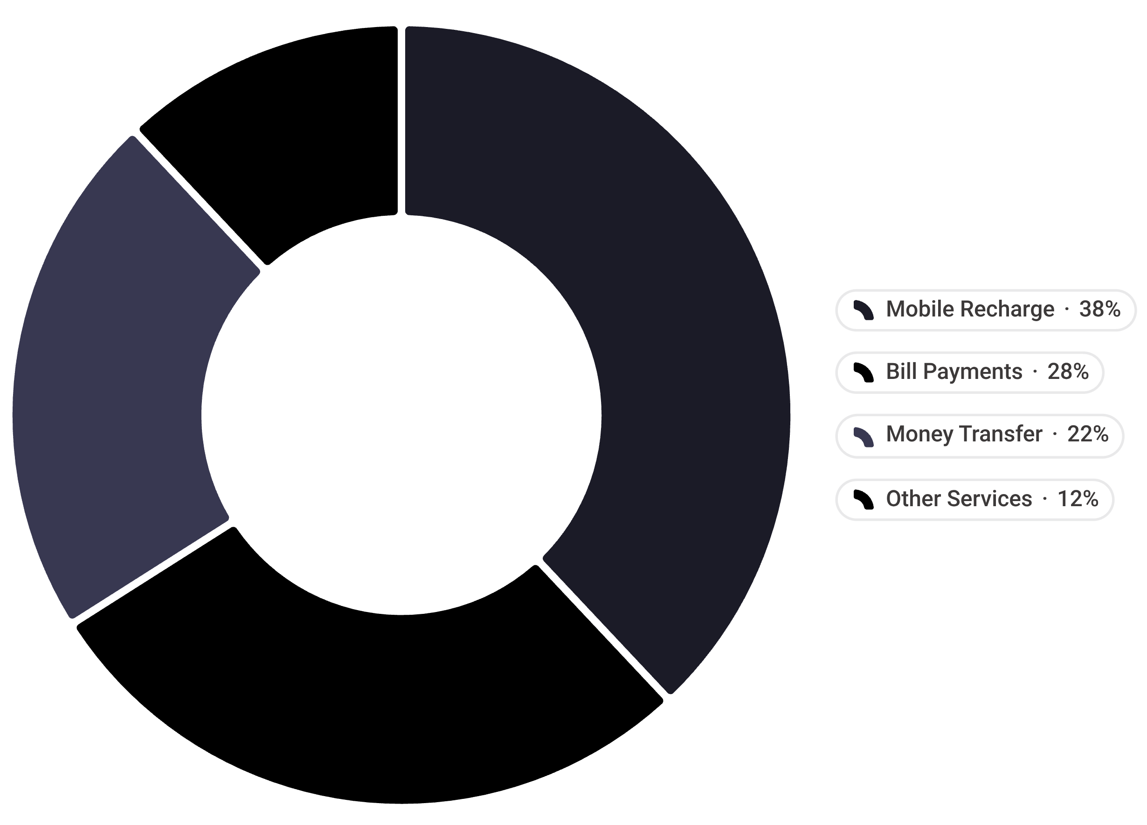
Transaction by Service Type
Service Breakdown
📱 Mobile Recharge
🧾 Bill Payments
28% of volume · ₹1.2B value
38% of volume · ₹1.6B value
💸 Money Transfer
➕ Other Services
22% of volume · ₹1.1B value
12% of volume · ₹0.3B value

Slide 7


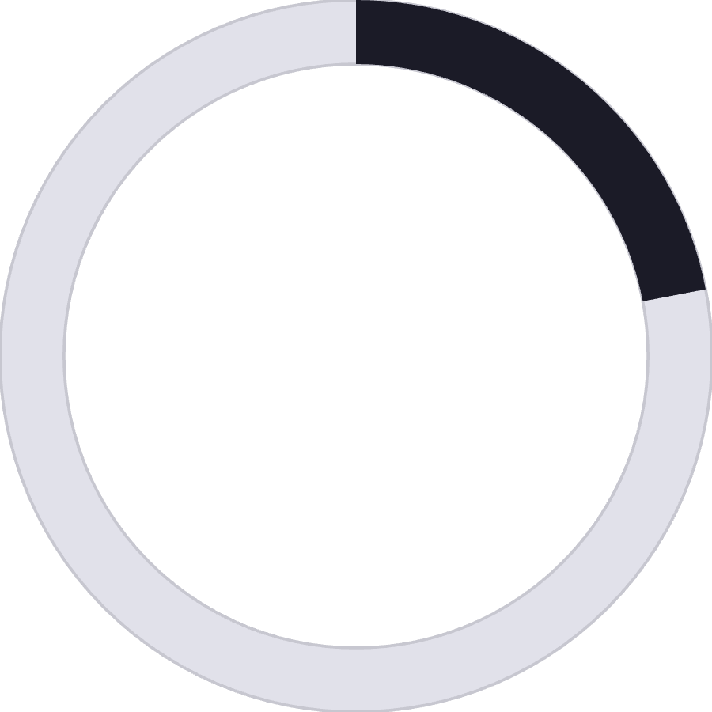
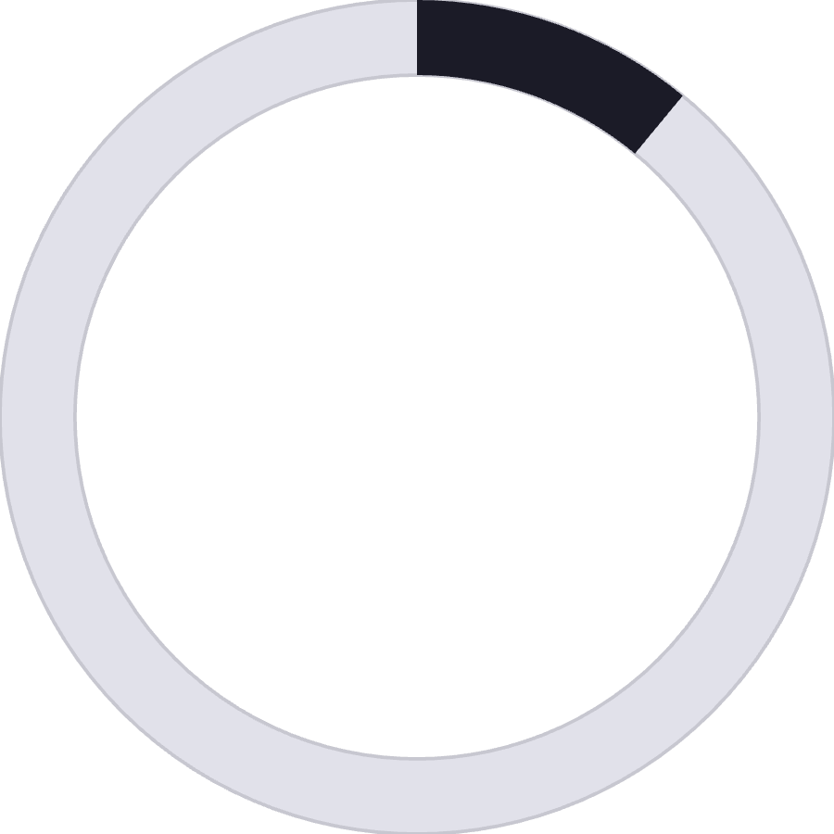
User Demographics by Age Segment
35%
32%
18–25 Years
26–35 Years
Highest engagement — the most active transaction segment on the platform
Highest value per transaction — the premium spending cohort
22%
11%
36–50 Years
50+ Years
Stable, consistent usage — a reliable mid-tier segment
Emerging adoption — significant growth opportunity with the right UX interventions

Slide 8
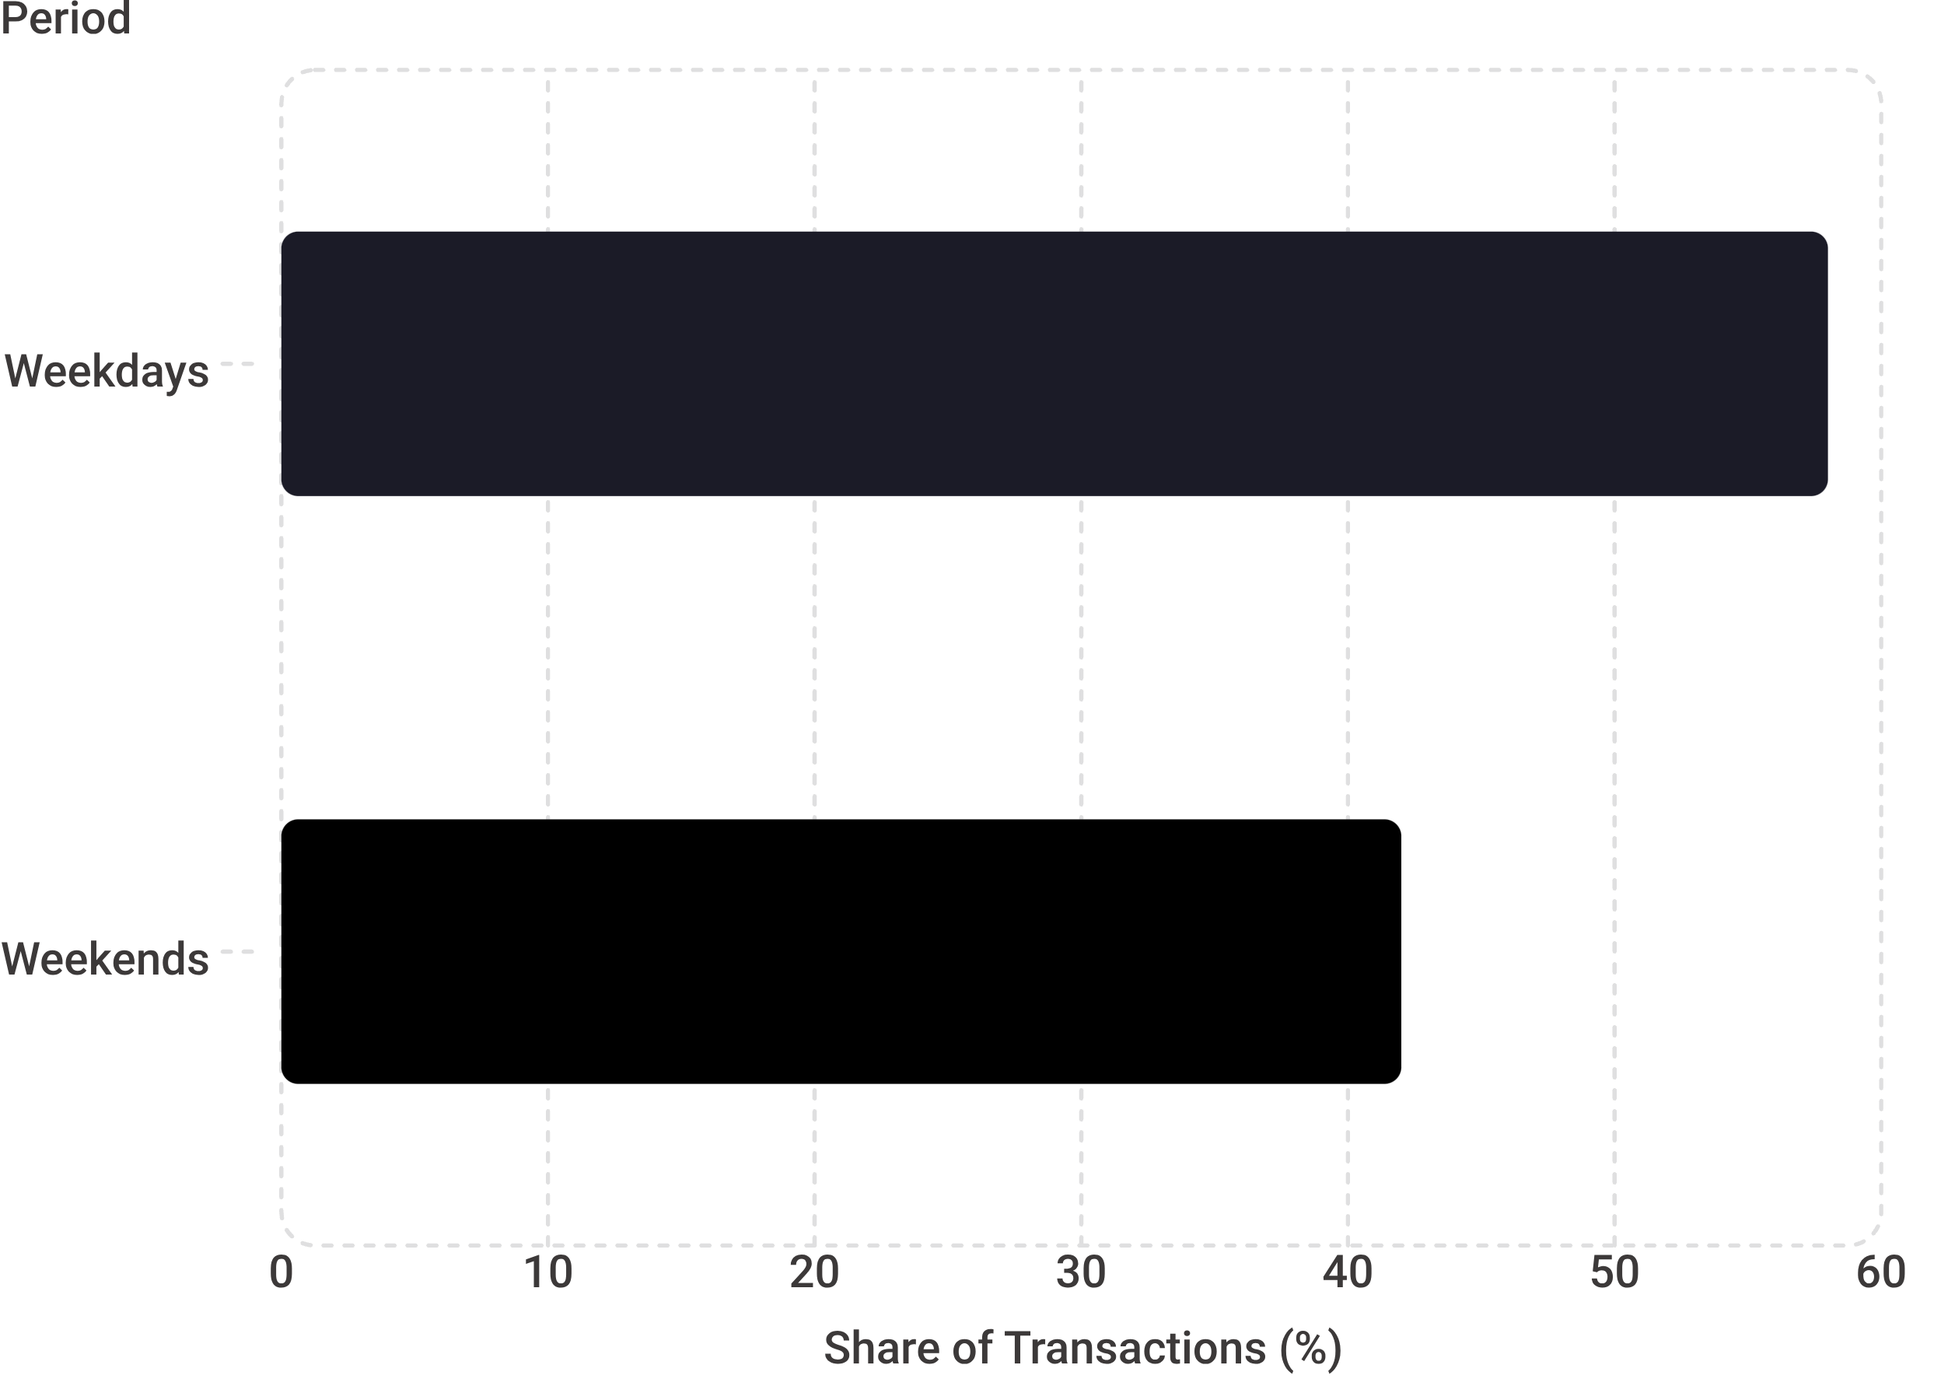
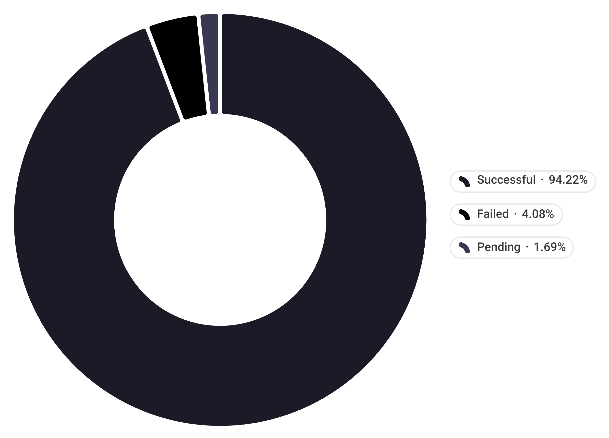

Weekday vs Weekend Behavior & Payment Status
Transaction Timing Patterns
Payment Status Breakdown
Weekend transactions carry 12% higher average value than weekday transactions — users spend more when time permits.
94.2% success rate — failed transactions are concentrated in bill payments, which register a 6.2% failure rate vs the platform average of 4.1%.

Slide 9
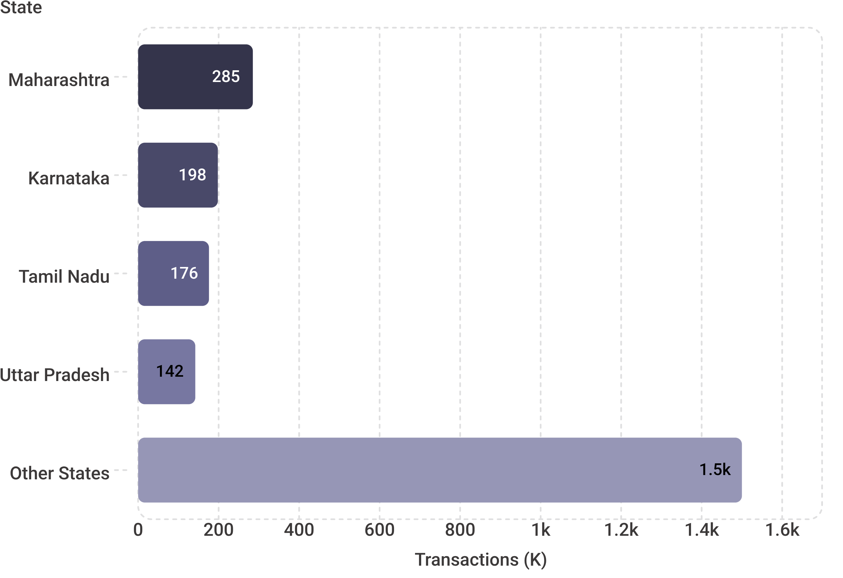
Regional Performance: Top 10 States
State-Level Highlights
State | Transactions | Value
Maharashtra | 285K | ₹1.2B
Karnataka | 198K | ₹0.85B
Tamil Nadu | 176K | ₹0.74B
Uttar Pradesh | 142K | ₹0.58B
Others | 1.5M | ₹1.85B
The top 4 states account for 34% of transactions — Maharashtra alone leads with ₹1.2B in total value.

Slide 10

Key Takeaways & Recommendations
Accelerate Growth Momentum
Sustained 18.5% MoM volume growth signals strong adoption — invest in infrastructure to sustain this trajectory.
Fix Bill Payment Failures
Bill payments have a 6.2% failure rate — nearly 50% above average. Priority engineering investigation recommended.
Target the 50+ Segment
Only 11% adoption among 50+ users presents a significant growth opportunity with UX simplification and onboarding support.
Expand Regional Reach
Other states collectively drive ₹1.85B — deeper regional penetration campaigns could unlock the next growth frontier.

