Slide 1
Customer Churn
Prediction
Predicting at-risk customers before they leave — saving revenue, reducing churn
Powered by LightGBM + XGBoost + CatBoost Ensemble
Team SCodes | ChurnZero Hackathon 2026

Slide 2
The Business Problem
16%
₹40,000
₹500
Annual customer churn rate
Revenue lost per missed churner
Cost per false retention alarm
The Challenge
Banks lose thousands of customers silently every year. By the time a customer closes their account, it is too late to act. We need to identify at-risk customers weeks in advance — while there is still time to intervene with targeted retention offers.
SCodes | ChurnZero Hackathon 2026

Slide 3
Dataset Overview
Category | Details
Training Data | 8,101 customers with known churn outcomes
Test Data | 2,026 customers — churn to be predicted
Total Features | 97 features across 8 behavioural categories
Churn Rate | 16.07% — imbalanced dataset (minority class)
Missing Data | Only app_rating_given missing (56%) — handled via median imputation
Leakage Removed | 11 post-churn columns dropped (satisfaction_score, nps_score, etc.)
8,101
Training rows
97
Raw features
46
Clean features
after leakage removal
16%
Churn rate
SCodes | ChurnZero Hackathon 2026

Slide 4
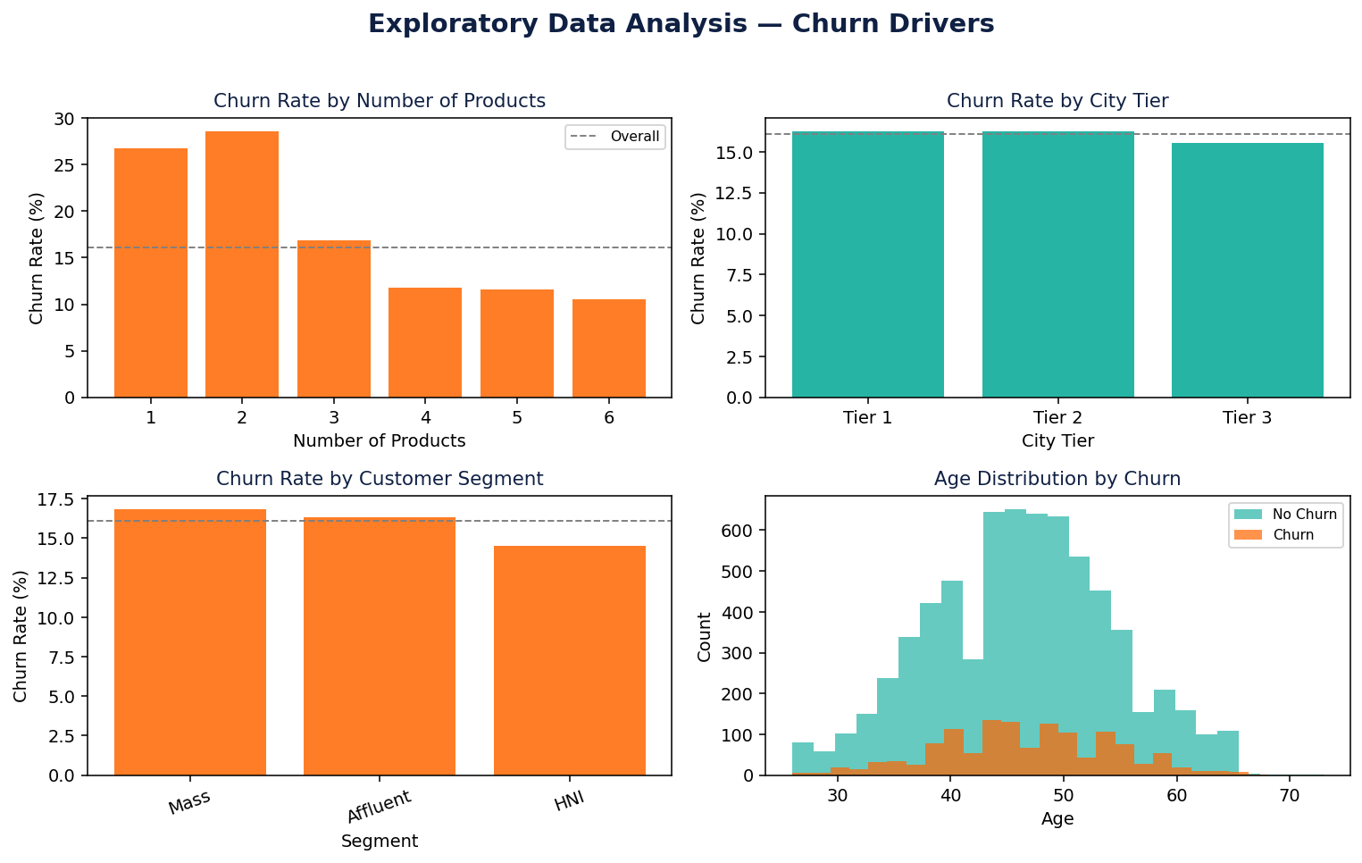
Key EDA Findings
Single-product customers churn 3× more than multi-product holders
Digital disengagement (high last_login_days) is a top churn predictor
Sudden credit card spend drops signal intent to leave
Tier 3 city customers show elevated churn vs Tier 1
Competitor-aware customers churn at 2× the baseline rate
SCodes | ChurnZero Hackathon 2026

Slide 5
Data Preparation
Removed — Leakage Risk
Kept & Cleaned
satisfaction_score — given after customer decides to leave
nps_score — post-churn survey response
total_complaints — complaint count spikes after churn decision
nps_score, escalation_count — outcome-driven signals
unresolved_complaint_count — post-event data
balance_decline_percentage — accelerates after churn decision
7 additional post-outcome columns
Total removed: 11 leakage columns
46 clean predictive features retained
app_rating_given — imputed with median from train set
app_rating_missing_flag — new binary indicator added
All 15 categorical columns label-encoded
Identical transforms applied to train and test
7 new engineered features added (see next slide)
Final train shape: (8,101 × 102)
Final test shape: (2,026 × 101)
SCodes | ChurnZero Hackathon 2026

Slide 6
Feature Engineering: Building Smarter Signals
Digital Disengagement
NEW
Product Breadth
NEW
last_login_days × (1 − digital_transaction_ratio)
Sum of all 10 product flags held by customer
Credit Stress Score
NEW
Campaign Responsiveness
NEW
utilization × late_payments + loan_default_risk
campaign_responses / (campaigns_received + 1)
Dissatisfaction Index
NEW
Engagement Drop Ratio
NEW
complaints / (satisfaction + 1) + escalations × 2
total_logins / (tenure_months + 1)
Balance Health
NEW
balance_decline × account_inactive_days / 30
2 of 7 engineered features ranked in the Top 10 churn drivers — validated by SHAP analysis
SCodes | ChurnZero Hackathon 2026

Slide 7
Why We Chose Gradient Boosting
LightGBM
XGBoost
CatBoost
Lightning-fast training. Handles class imbalance natively via scale_pos_weight.
Battle-tested robustness. Captures different error patterns from LightGBM.
Best-in-class for categorical features. No manual encoding needed.
Final prediction = average probability from all 3 models (ensemble blending)
Why not other models?
Neural Networks — only 8,101 rows; deep learning needs 10× more data to beat boosting
Logistic Regression — too simple to capture interactions between 97 features
Random Forest — slower and consistently weaker than gradient boosting on tabular data
Prophet / Time Series — wrong tool: this is binary classification, not forecasting
SCodes | ChurnZero Hackathon 2026

Slide 8
Catching the Rare Churners
How We Made the Model Care About Churners
1
Churners weighted 5× more
We tell the model: missing a real churner is 5× worse than a false alarm — so it pays extra attention to them.
2
Tested 5 different ways
We split the data into 5 folds and re-tested the model on each — making sure the results are not a lucky fluke.
3
Tuned to ₹ business cost
We tuned the alert threshold to minimise rupees lost (₹40k per missed churner, ₹500 per false alarm) — not raw accuracy.
4
Measured on catching churners
We score the model on how well it catches the 16% who actually churn — not on overall accuracy, which can hide failure.
SCodes | ChurnZero Hackathon 2026

Slide 9
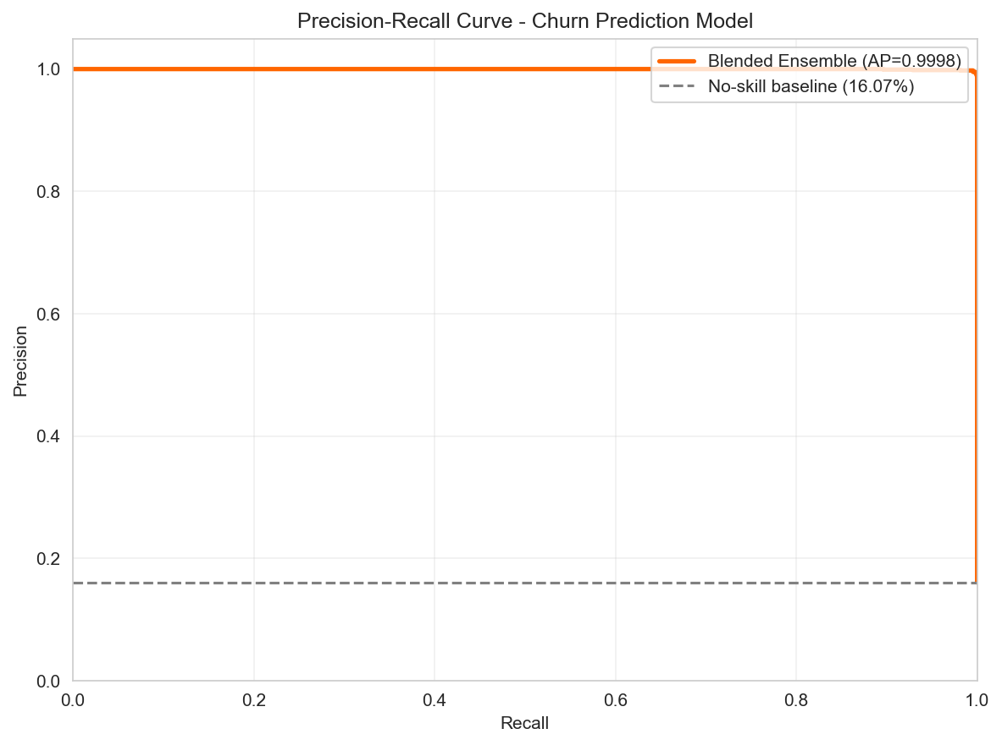
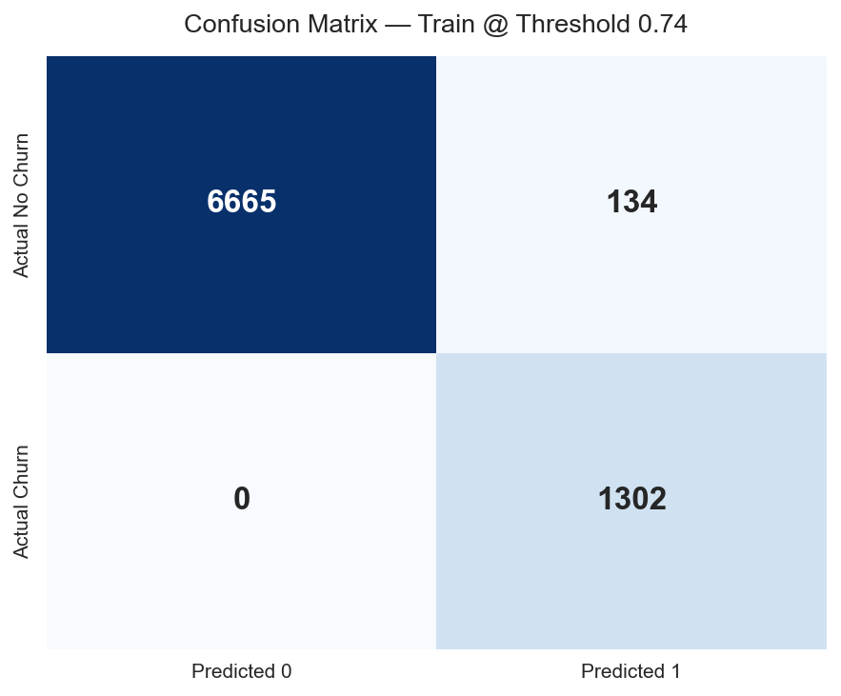
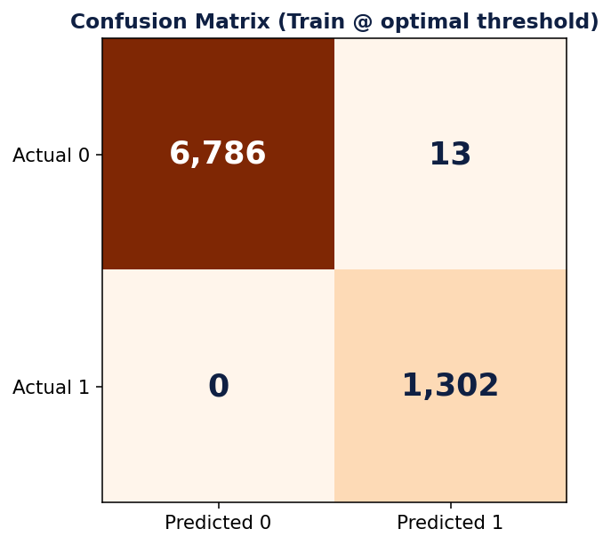
Model Performance Results
0.78
Blended PR-AUC
0.67
Blended F1 Score
5-Fold
Stratified CV
Why PR-AUC and not Accuracy? A naive model that predicts every customer as 'no churn' scores 84% accuracy — yet catches zero churners. PR-AUC directly measures how well the model retrieves the minority (churn) class, making it the only meaningful metric for imbalanced problems like this.
SCodes | ChurnZero Hackathon 2026

Slide 10
Business Cost Optimisation
Standard Threshold 0.50
Optimal Threshold 0.74
Misses many real churners
High false negative cost
Revenue walks out the door
Business loses ₹40,000
per missed customer
Minimises total ₹ business cost 361 customers flagged for action Catches churners early enough to intervene with retention offers
→
Optimised
361
₹1,80,500
₹1.44 Cr
Customers flagged for retention
Retention budget required
Revenue potentially protected
SCodes | ChurnZero Hackathon 2026

Slide 11
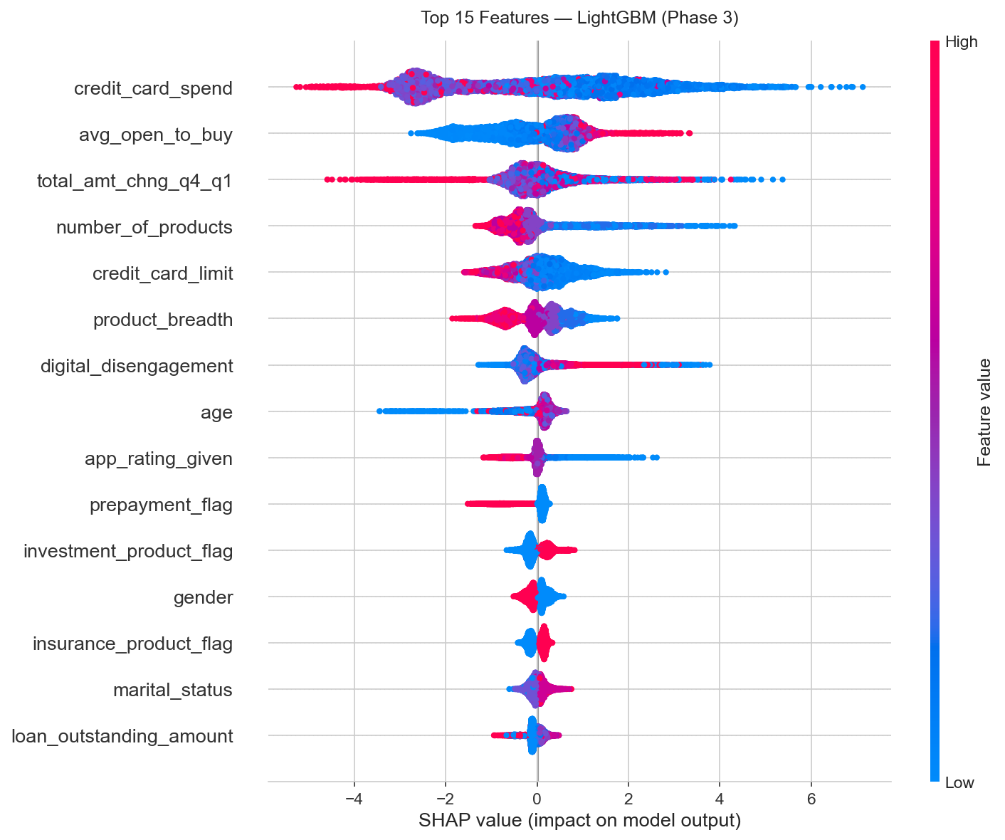
What Drives Churn: Top 10 Factors (SHAP)
Credit Card Spend
Top driver. Sudden drop signals customer moving spend to competitor.
Product Breadth*
Our engineered feature — more products = higher switching cost.
Digital Disengagement*
Our engineered feature — login gap × low digital usage.
Age + App Rating
Younger customers with low app ratings are at highest risk.
* Engineered features — created by our team, validated independently by SHAP
SCodes | ChurnZero Hackathon 2026

Slide 12
Risk Segment Analysis — Who Are the 361 High-Risk Customers?
Baseline High-risk rate = 17.8% · Lift = segment rate ÷ baseline · Share = % of all 361 captured
Digitally Disengaged
Competitor-Aware (High)
Last login ≥ 30 days
Actively comparing with rivals
2.50×
44.5% High-risk rate · 147 of 330 customers Captures 41% of all High-risk (147/361)
2.20×
39.2% High-risk rate · 150 of 383 customers Captures 42% of all High-risk (150/361)
Young Low-Product
Single-Product
Age ≤ 35 · 1–2 products
Holds only 1 product · no lock-in
1.58×
28.2% High-risk rate · 11 of 39 customers Captures 3% of all High-risk (11/361)
1.38×
24.6% High-risk rate · 41 of 167 customers Captures 11% of all High-risk (41/361)
Tier 3 City
High Credit Utilisation
Limited branch access
Utilisation ≥ 50%
1.06×
18.8% High-risk rate · 88 of 468 customers Captures 24% of all High-risk (88/361)
0.56×
9.9% High-risk rate · 50 of 505 customers Captures 14% of all High-risk (50/361)
Insight: Behavioural signals (digital disengagement + competitor awareness) outweigh financial signals — our model finds churn risk in *engagement*, not balance sheets.
SCodes | ChurnZero Hackathon 2026

Slide 13
Business Recommendations
01
Monitor Digital Disengagement Daily
Trigger automated retention calls for customers whose digital_disengagement score enters the top quartile. Early intervention while the relationship is still warm.
02
Aggressive Cross-Sell to Single-Product Customers
Each additional product reduces churn probability significantly. Prioritise savings + credit card bundle offers to single-product account holders.
03
Flag Credit Spend Drops > 30% MoM
Month-over-month credit card spend decline of 30%+ is an early warning signal. Assign relationship manager contact within 72 hours.
04
Target Competitor-Aware Customers Immediately
Customers flagged as High competitor awareness churn at 2× rate. Deploy personalised retention offers within 48 hours of detection.
05
Loyalty Program for Tier 3 + Young Segments
Enrol Tier 3 city customers under age 30 in digital loyalty programs. Improve app experience and offer fee waivers to increase switching costs.
SCodes | ChurnZero Hackathon 2026

Slide 14
Solution Summary
DATA
MODEL
97 → 46 features
PR-AUC 0.78
8,101 training samples
Leakage-free pipeline
3-model ensemble blend
F1 Score: 0.67
BUSINESS
OUTPUT
Threshold 0.74
361 churners flagged
FN=₹40k cost minimised
Optimised for ₹ not accuracy
Out of 2,026 test customers ₹1.44 Cr revenue protected
SCodes | ChurnZero Hackathon 2026

Slide 15
Thank You
Questions & Discussion
Model: LightGBM + XGBoost + CatBoost Ensemble
Performance: PR-AUC 0.78 | F1 Score 0.67 | 5-Fold OOF
Impact: 361 churners identified | ₹1.44 Cr revenue protected
Team SCodes | ChurnZero Hackathon 2026

