Slide 1
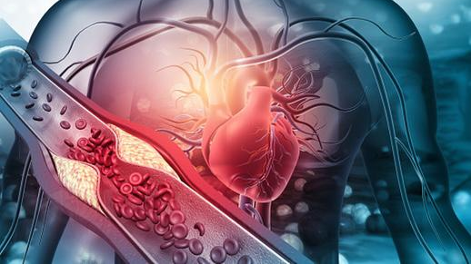
PREDICTION AND PREVENTION OF HEART DISEASE
By -
Siddhesh Bhande, Pranit Deshpande, Aksheetha Muthunooru, Harika Tamma

Slide 2
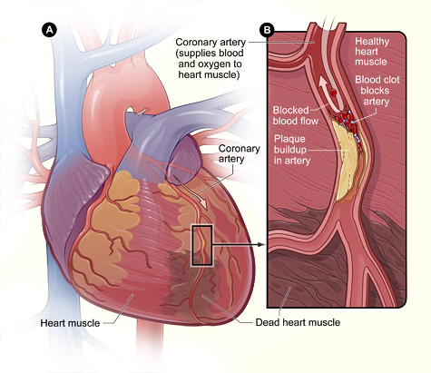
Motivation
Nowadays, Heart-attack is the most common life- threatening problem all over the world.
Blockages occur when fat, cholesterol, and other substances build up, forming deposits called plaques in blood vessels.
These plaques can become damaged over time and may lead to heart attacks.

Slide 3
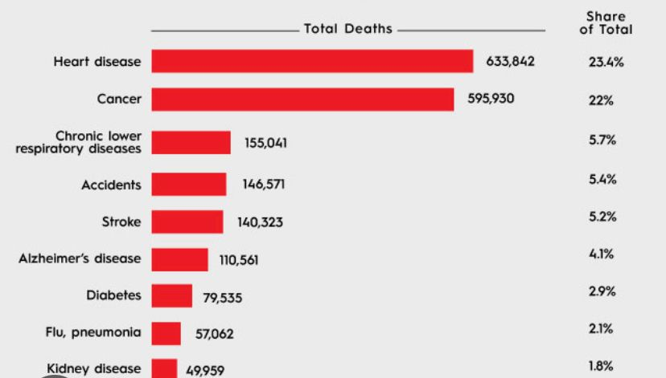
Heart disease - the number one killer of both men and women in the United States.
“In united states someone has a heart attack every 40 seconds. Every year, about 805,000 people in the United States have a heart attack. Of these, 633,842 are deaths recorded”
American heart association news

Slide 4
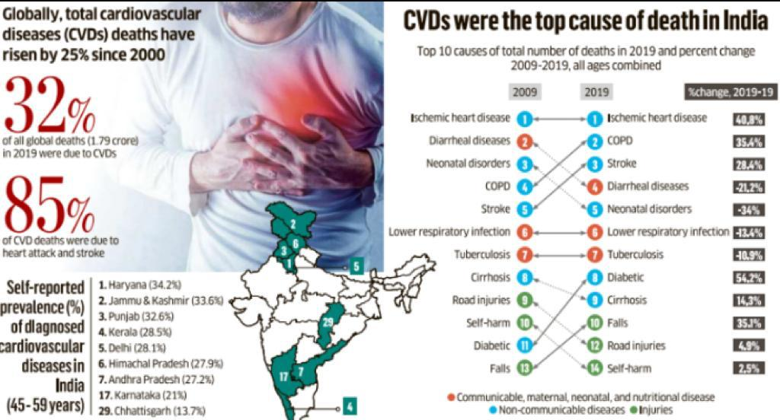
In the same vein, India has become the chronic heart disease capital of the world. According to a recent report 70% of cardiac deaths were recorded between 30-60 age group.
The number of deaths due to heart attacks in India has remained constantly over 28000 in the last 3 years.

Slide 5
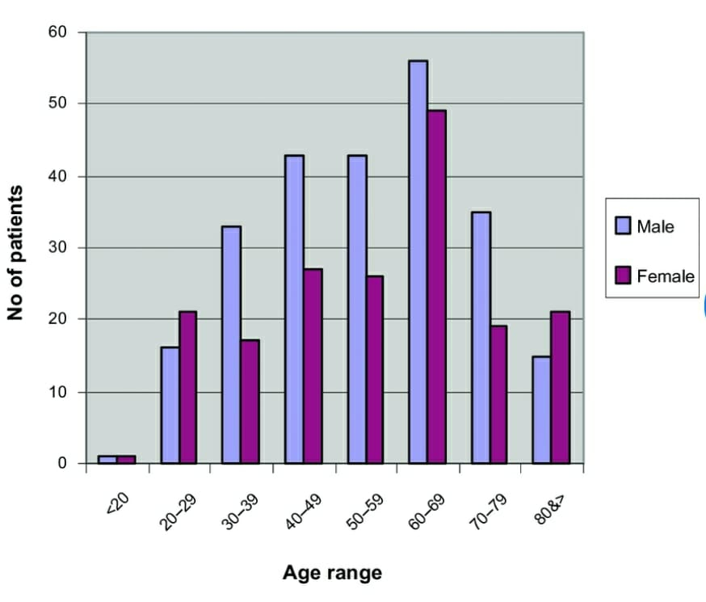
Heart attack victims are middle-aged or older, the truth is that heart disease can affect anyone, of any age.
Even those who exercise and eat all the right foods.
Can we prevent it if detected at an early stage?

Slide 6
Why Machine Learning?
Limited number of cardiac experts available.
- As per cdc.gov around 8 Lac people had heart attack in last 2 years.
- Number of cardiologists in US is only 38000
Results will be delivered faster
Extended access to healthcare
Predict Severity – Predict causes – Predict methods for prevention

Slide 7
Problem Statement
Given : A real medical data set
Phase 1 – Prediction of Heart Disease.
Phase 2 – Prevention of Heart Disease by finding out the cause of the same from Phase 1
Algorithms which can be used-
For phase 1 – Regression (Logistic Regression to Neural Networks).
For phase 2 – For Preventing the heart disease we would be using data mining techniques and other NLP models(BERT).
Success Parameters-
Whether the model has predicted & recommended accurately.

Slide 8

Proposed Architecture
Different ML Algorithms
Real Data
Output
{Numberic Prediction}
Predictor
Data
preprocessing
Finding out the probable causes of heart diseases
Data Mining & NLP
Proposing the remedies

Slide 9
Problem Modeling
Phase 1 –
Input Parameters
X = {age, sex, chest pain type, blood pressure, cholesterol, blood sugar, electrocardiogram results, heart rate , induced angina, number of blood vessels, thal}
Output = {0,1}
Phase 2 –
Input Parameters
Input = {Data (from internet), different clusters created according to the maximum causes of heart disease from phase 1}
Output = {Different ways to prevent heart disease}

Slide 10
Potential Datasets
We have collected some datasets after researching from the internet for prediction of heart diseases
https://archive.ics.uci.edu/ml/datasets/heart+Disease
This is the primary dataset we’ll be using but we would like to explore more regarding the prevention problem at hand and add more attributes into the dataset.

Slide 11
Dataset Information
This database contains 76 attributes, but all published experiments refer to using a subset of 14 of them.
The "goal" field refers to the presence of heart disease in the patient. It is integer valued from 0 (no presence) to 4.
Attributes info: age, sex, chest pain(cp), blood pressure(trestbps), cholesterol level (chol), fasting blood sugar (fbs), ECG measure at resting condition (restecg), max heart rate achieved (thalch),
Categorical values: exang ,oldpeak, slope, ca, thal, num.

