Slide 1
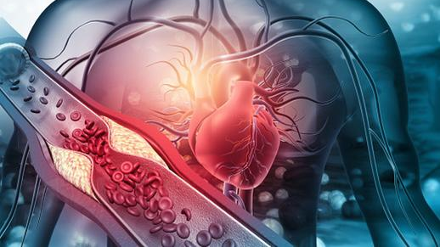
PREDICTION AND PREVENTION OF HEART DISEASE
By -
Aksheetha Muthunooru, Harika Tamma, Siddhesh Bhande, Pranit Deshpande,

Slide 2
Motivation
Nowadays, Heart attack is the most common life threatening problem all over the world.
Blockages occur when fat, cholesterol and other substances buildup, forming deposits called plaques in blood vessels
These plaques can become damaged over time and may lead to heart attacks

Slide 3
Problem Statement
Given : A real medical data set
Phase 1 – Prediction of Heart Disease.
Phase 2 – Prevention of Heart Disease by finding out the cause of the same from Phase 1
Algorithms which can be used-
For phase 1 – Regression (Logistic Regression to Neural Networks).
For phase 2 – For Preventing the heart disease we would be using data mining techniques and other NLP models(BERT).
Success Parameters-
Whether the model has predicted & recommended accurately.

Slide 4
Problem Modeling
Phase 1 –
Input Parameters
X = {age, sex, education, cigarettes per day, current smoker, cholesterol, BP meds, diabetes, BP, Stroke, BMI, glucose, heart rate}
Output = {0,1}
Phase 2 –
Input Parameters
Input = {Data (from internet), different clusters created according to the maximum causes of heart disease from phase 1}
Output = {Different ways to prevent heart disease}

Slide 5
Dataset
Framingham dataset is used for the project.
It has 4240 records and 16 features associated to it.
This dataset is on-going research.

Slide 6
Data Info:
NOMINAL:
sex: Male(1) or Female(0)
currentSmoker: Whether the patient is smoker or not. Yes(1) and No(0)
BPMeds: Whether the patient was on blood pressure medications. Yes(1) and No(0)
prevalentStroke: Whether the patient had a stroke before. Yes(1) and No(0)
prevalentHyp: Whether the patient has history of Hypertension. Yes(1) and No(0)
diabetes: Whether the patient has diabetes. Yes(1) and No(0)
TenYearCHD: This is our target variable which we will be predicting. Yes(1) and No(0)

Slide 7
ORDINAL:
education: Defined in classes 1-4. Tells us how much our patient is educated.
CONTINUOUS:
age: Contains ages of our patients in whole numbers.
cigsPerDay: Contains the average of cigarettes smoked by the patients in one day.
totChol: Contains total cholesterol level of each patient.
sysBP: Contains systolic blood pressure levels of each patient.
diaBP: Contains diastolic blood pressure levels of each patient.
BMI: Contains body mass index of each patient.
heartRate: Contains the average heart rate of the patient.
glucose: Contains the glucose level of each patient.

Slide 8
Exploratory Data Analysis
We have done different data analysis for feature selection to see the impact on the prediction.

Slide 9
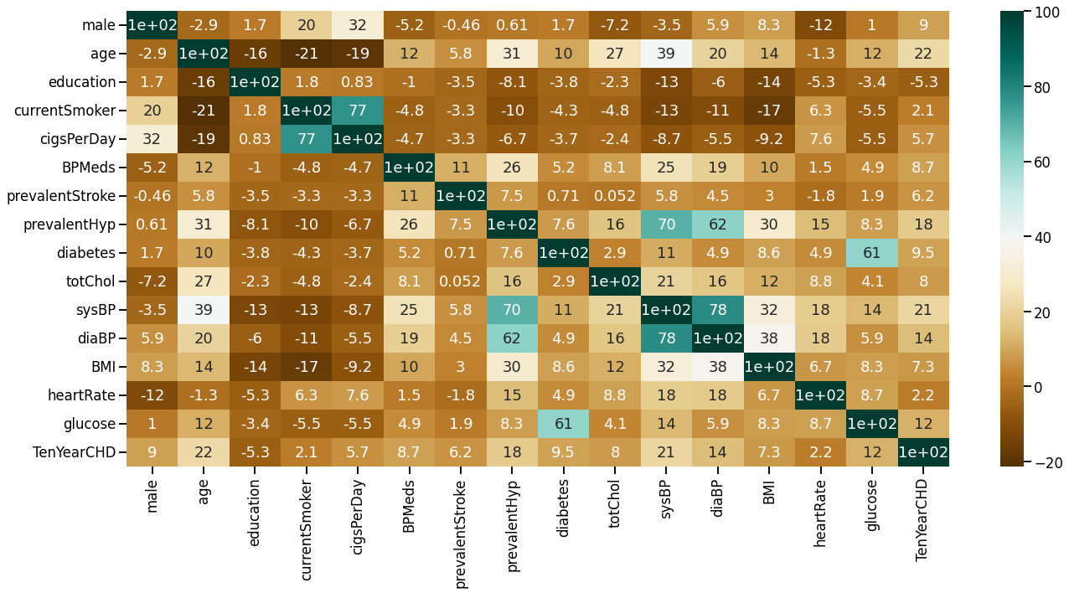
Heatmap to explain which features are relevant for the prediction.

Slide 10
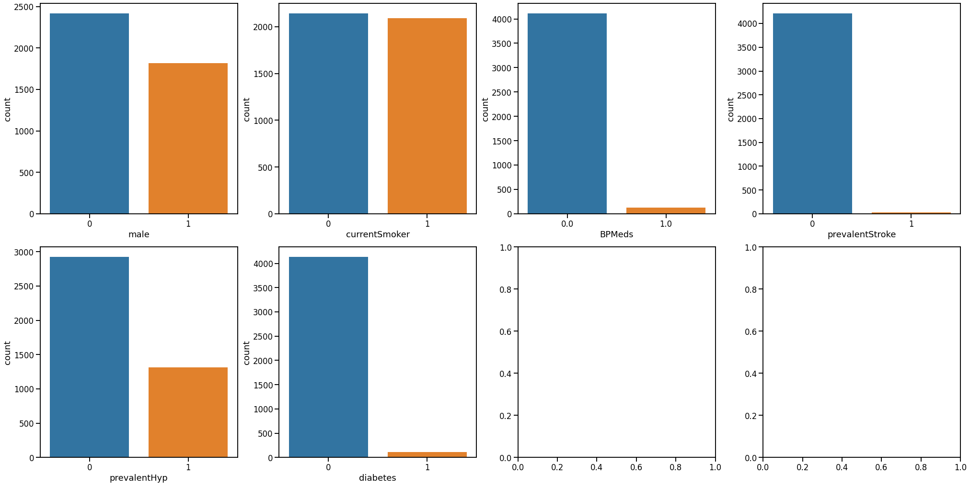
Count plot between the categorical features

Slide 11
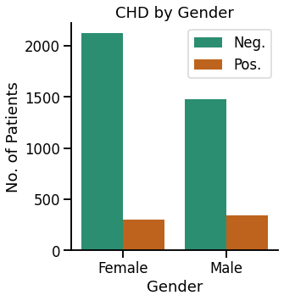
Bivariate Analysis plot Gender wise absence / presence of Chronic Heart Disease (CHD)

Slide 12
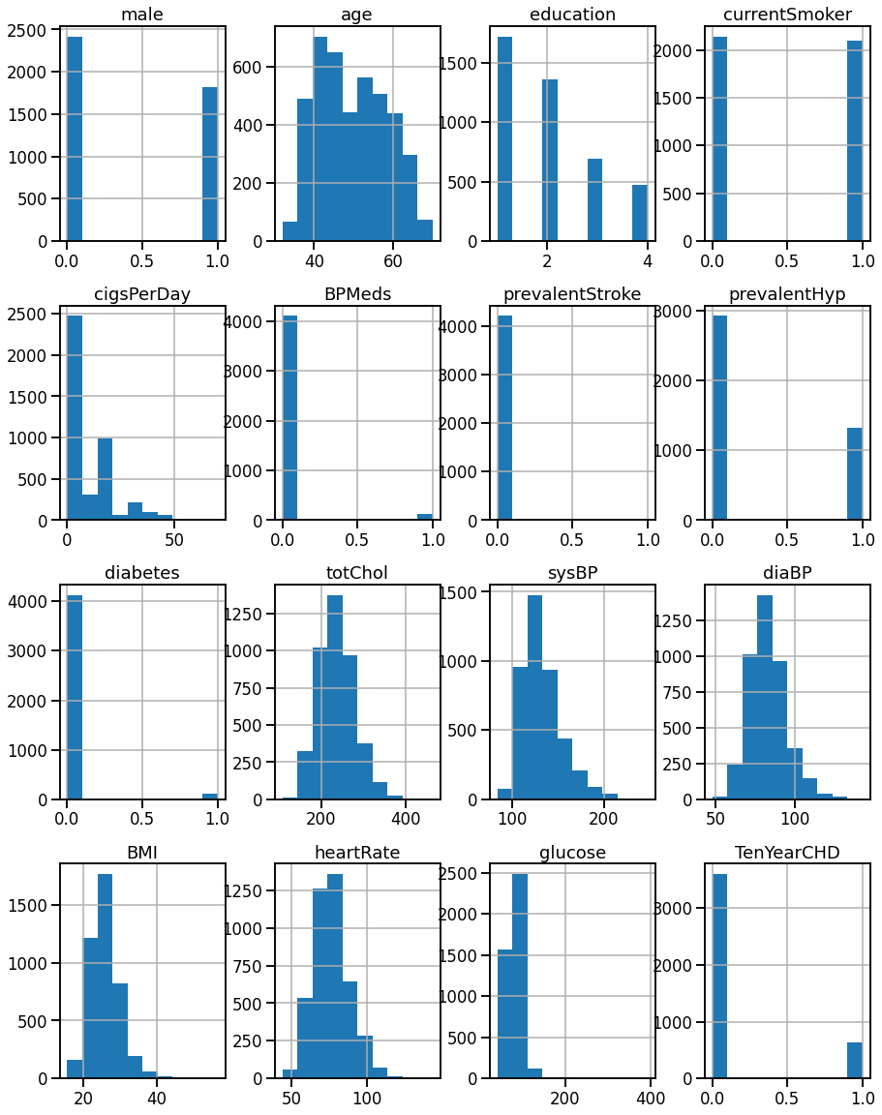
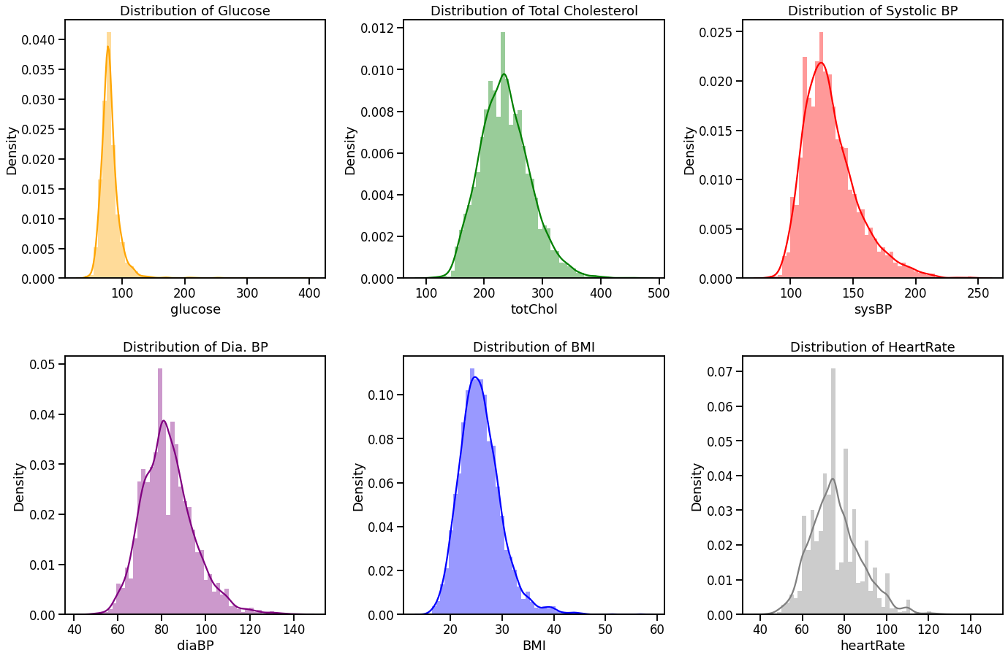
Distributions of Features

Slide 13
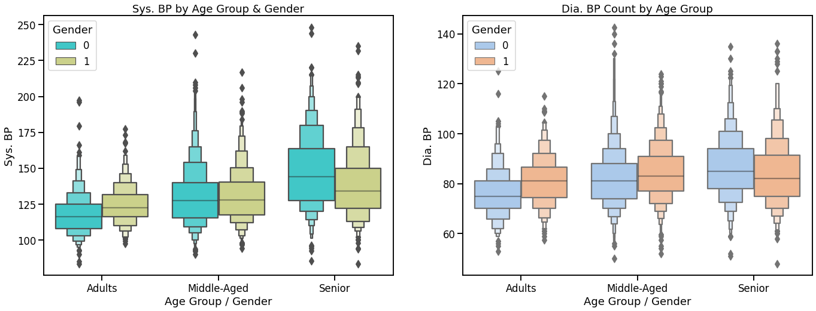
Plots against Sys. BP by Age Group & Gender and Dia. BP Count by Age Group

Slide 14
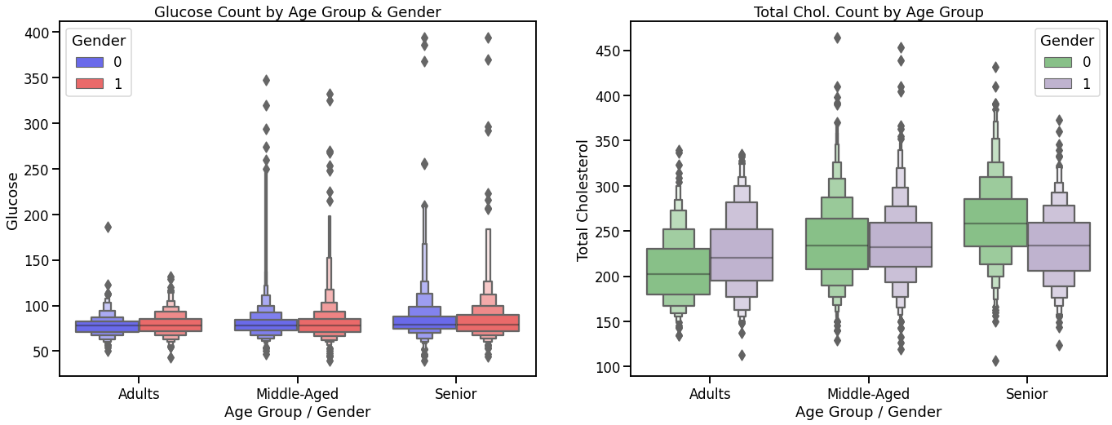
Plots against Glucose Count by Age Group & Gender

Slide 15
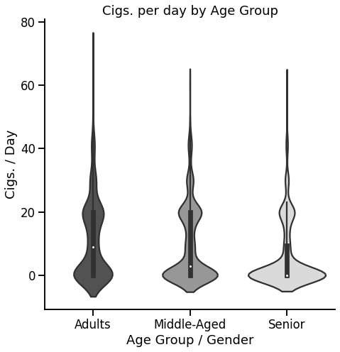
Violin Plot of Cigsperday by age group

Slide 16
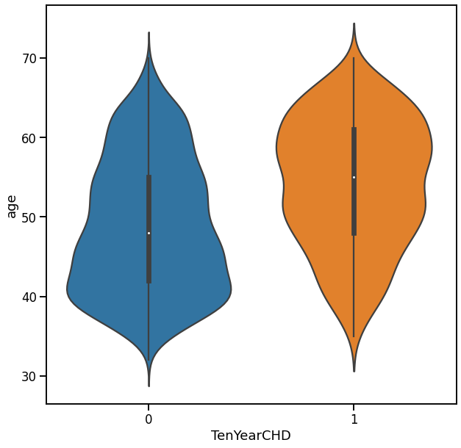
Violin plot against age and TenYearCHD

Slide 17
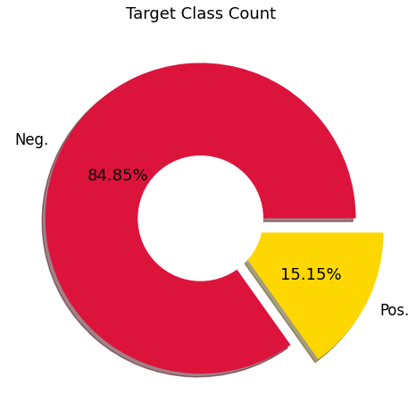
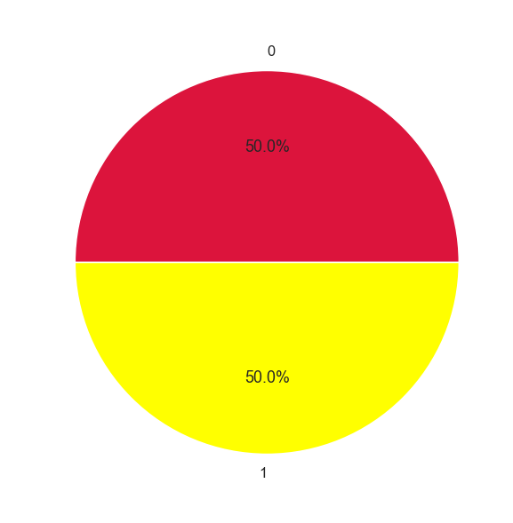
Target class count
Before Resampling
After Resampling

Slide 18
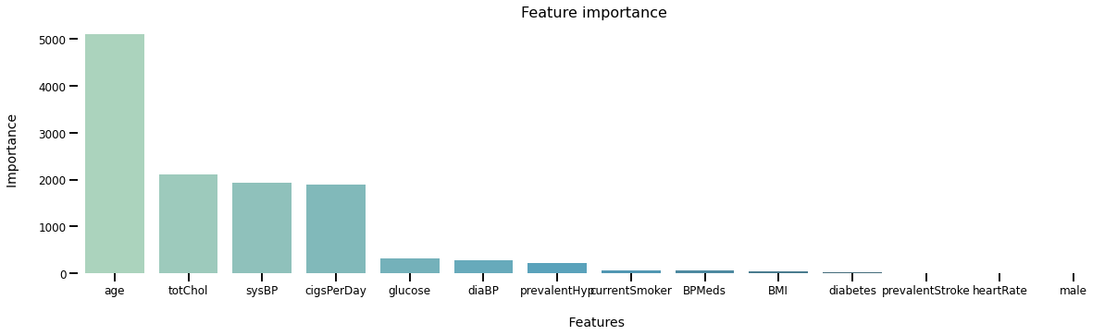
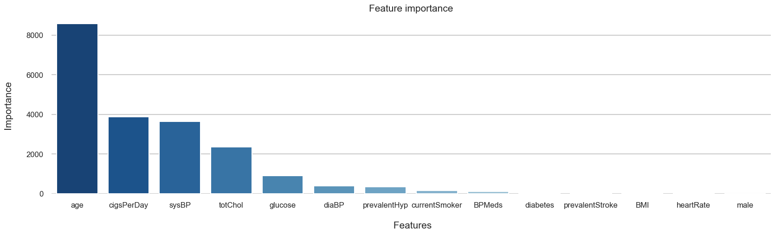
Feature Importance
Before Resampling
After Resampling

Slide 19
Models Explored
Before Resampling
After Resampling
Models | Accuracy
Logistic Regression | 85%
Random Forest | 84%
K – Nearest Neighbour | 84%
Gradient Boosting Classifier | 83%
Support Vector Classifier | 85%
Decision Tree | 83%
Models | Accuracy
Logistic Regression | 67%
Random Forest | 96%
K – Nearest Neighbour | 90%
Gradient Boosting Classifier | 98%
Support Vector Classifier | 71%
Decision Tree | 91%

Slide 20
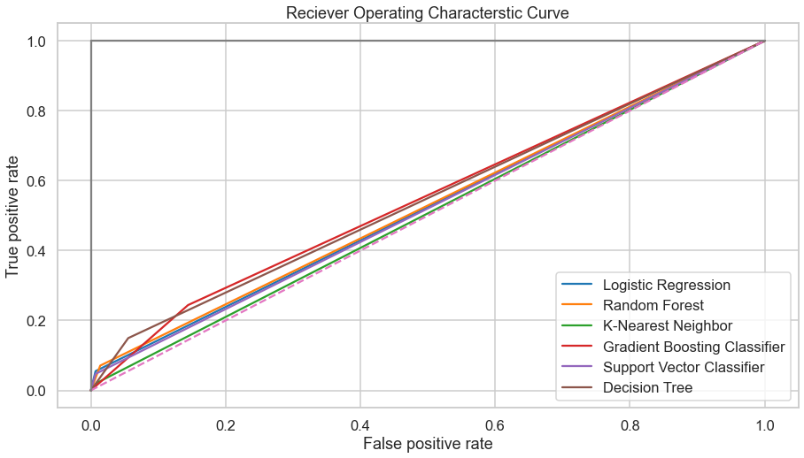
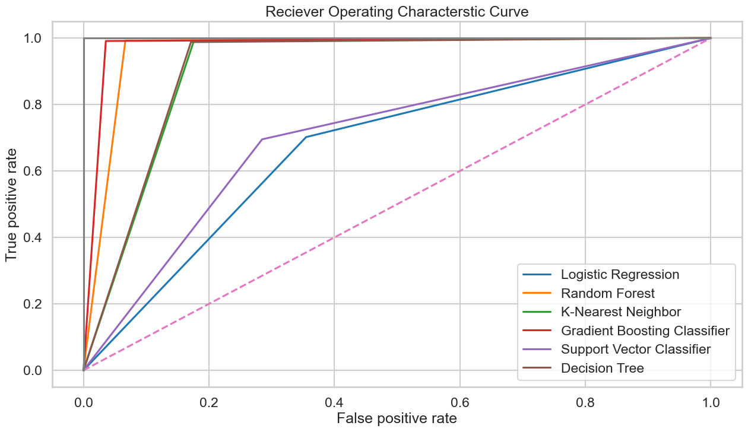
ROC curve for the explored models
Before Resampling
After Resampling

Slide 21
What Next?
Use the best working model to find predictions.
Apply LIME or Nearest neighbors on the model predictions.
Suggest remedies based on the factors that cause a positive prediction.

Slide 22
Local Interpretable Model-Agnostic Explanations
LIME is a technique that approximates any black box machine learning model with a local, interpretable model to explain each individual prediction.
Using this find factors that most affect the prediction

Slide 23
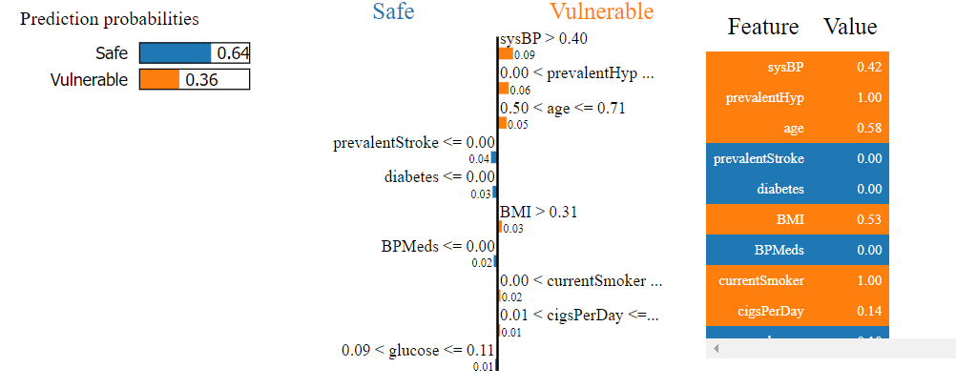
LIME using Random Forest Classifier Model
- for negative datapoint

Slide 24
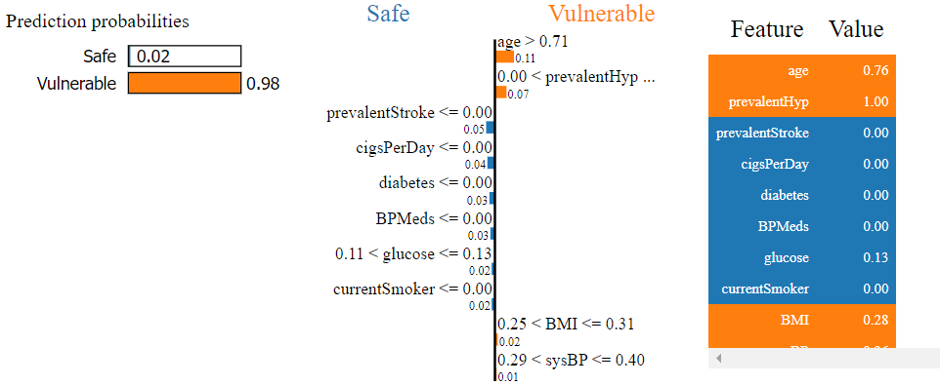
LIME using Random Forest Classifier Model
- for positive datapoint

Slide 25
Thank You!

