Slide 1
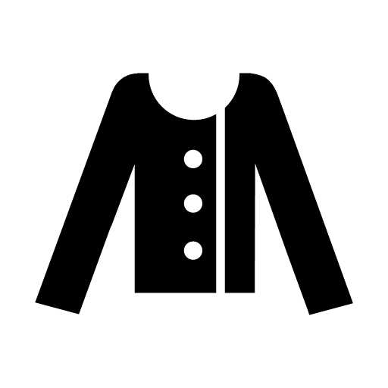


Project : Trend Analysis of Tops And Making Predictions
Prepared and Submitted by : Mr. Siddhesh B Nawale
Date : 06- October-2020

Slide 2
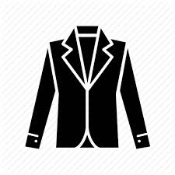


God made man and tailor made gentleman.

Slide 3
Buissness Case:
Omnilytics is a fashion analytics and insights software that makes real-time competitor data accessible, simplifies decision-making and drives higher profit.
In Our Generation Clothes play a important role in defining the various aspect of human life our goal is to provide the best user experience ever generated in era of fashion
The most appreciated form is the user experience as it gave us an idea “ how our product gave the performance when tested it at its all calibre.
The Objective is to Study the Given Trends Dataset which has a count of 261 entries giving us a deep knowledge about the popularity of tops and thus help us in making predictions

Slide 4

Flow Of Project :
Data set
Analysis Tool
Data Analysis
Univariate Plotting
Bivariate Plotting
Multivariate Plotting
Observations
Insights

Slide 5
The Data :
The Dataset cotains the information about the different types of tops based on their popularity Counts and its is collected for the five years namely 2012,2013,2014,2015,2016 and three quraters of 2017
Attribute Information
Top 1 : this the type of top available for sale ,it contains numeric value which the popularity count of the top

Slide 6
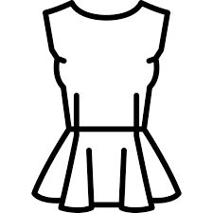
Analysis Tools:
Python Language was used for programming and thus the foll libraries ad tools were used for the analysis
Pandas
Numpy
Seaborn
Tableau
Matplotlib

Slide 7
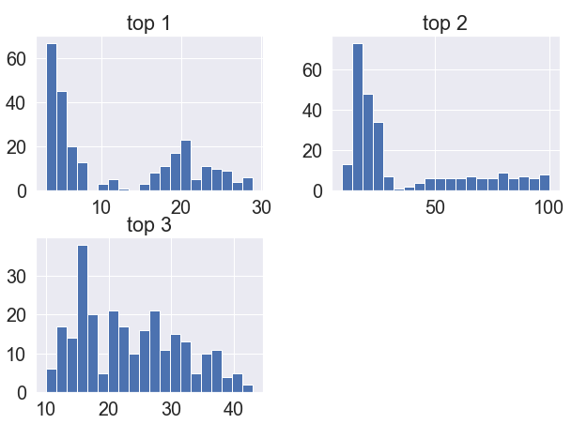
Data Analysis Univariate
The Following Graphs Shows us an Histograms Of All The Tops
Further we can clearly See that the Top 2 has highest spread
Univariate analysis helps us to understand each variable distinctively

Slide 8
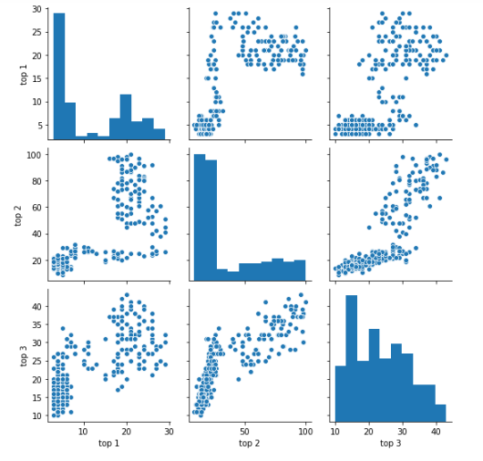
Bivariate Analysis
Bivariate Analysis helps us to understand the relationship between two variables
Bivariate Also helps us to understand the dependacy factors of the variable
The Figure Beside shows the scatter plot and the histogram of the variables
We see the distribution to be a not normal one
Thus having a details analysis will help us in understand the importance of variables while model building

Slide 9
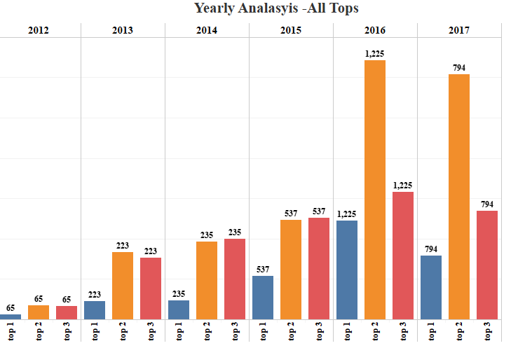
Observations :
Which is performing best. Elaborate on how you defined
"best performance". ??
Also quantify the best top.
We See That the Top 2 Had The best performance over other tops compared to the all the years
The performance factor was decided by the overall counts of the popularity for each top

Slide 10
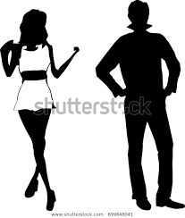
Look at the predictions.csv file - there are three fits for each trend, comment on which you find to be best. Done biasness ,why?
Looking at the predictions.csv file we conclude that the fit one has the best fit of all
The Reason For Selecting the first fit is that the model is low biased and has a low variance compared to the other types of fits thus making it quite robust to be deployed

Slide 11
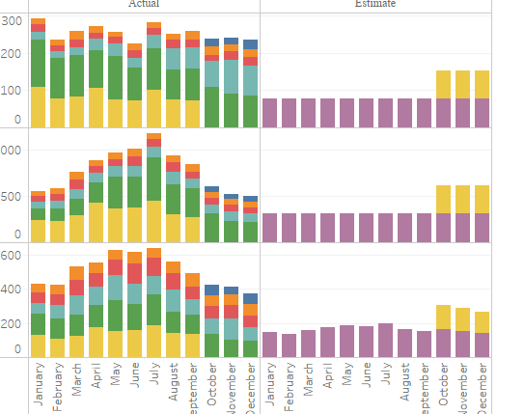
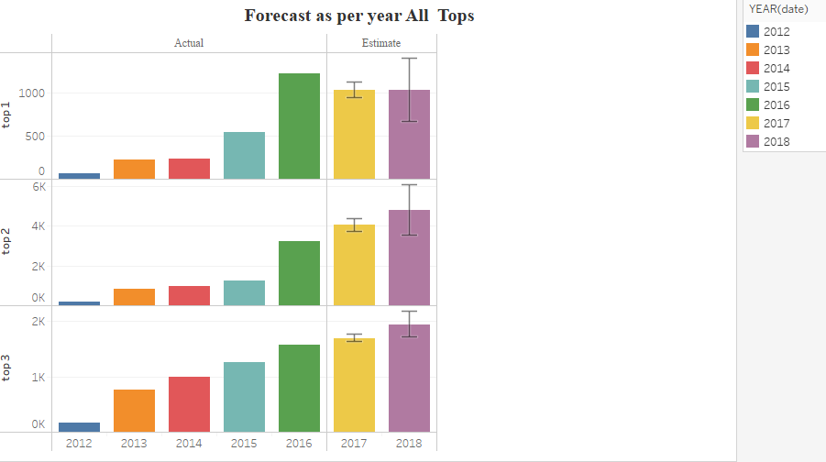
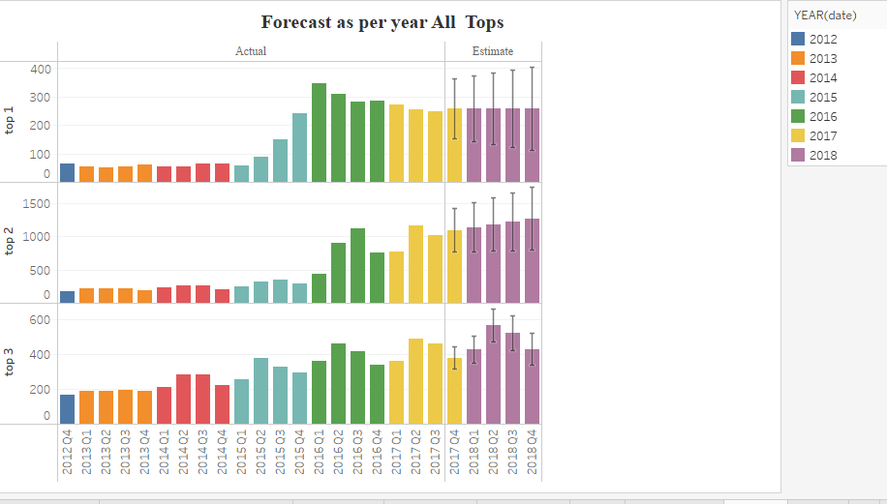

Quantify these predictions into an assessment of how you would expect the demand to change over the next 3, 6, 12 months.
Demand Change over 3,6,12 Months For Tops

Slide 12
Insights
Monitor certain social media topics
Focus on Right Customers
Include Innovative Offers
Keep Monitoring the different Trends And Store Them For Furture analysis
Be ready to change with times
Neva sell things in loss

Slide 13
Thank You
We appreciate your time and patience moreover we grateful to you for a giving us a chance for explaining the dataset and thus try implementing the machine learning concept in detail
We hope you have a wonderful day and a pleasant time ahead

