Slide 1
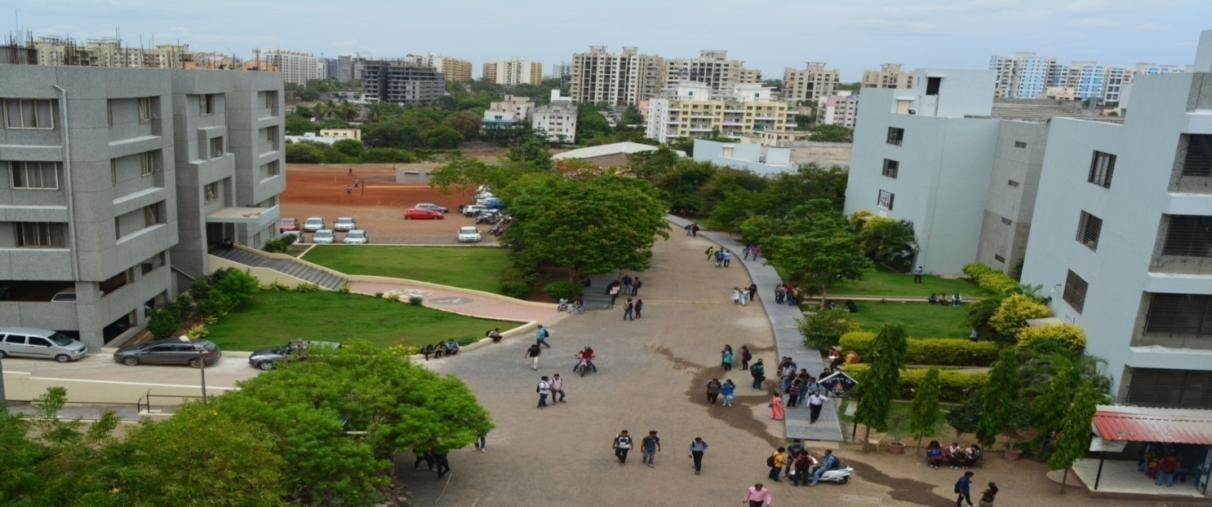
Bansilal Ramnath Agarwal Charitable Trust’s
Vishwakarma Institute of Information Technology, Pune
Department of AI & DS
Name | PRN No. | Roll No.
Siddhant Shinde | 22010835 | 272049
Rhishikesh Ravindra Sonawane | 22010585 | 272053
Siddhesh Ramesh Songire | 22010862 | 272054
Shreyas Tornekar | 22010693 | 272059
Sakshi Wani | 22010850 | 272062
PBL Phase 1
Advance Data Structure
GROUP 10

Slide 2
IMAGE COMPRESSION USING
HUFFMAN CODING

Slide 3

IMAGE COMPRESSION
Data compression is a process of encoding, restructuring, or otherwise modifying data in order to reduce its size.
Image compression is minimizing the size in bytes of a graphics file without degrading the quality of the image to an unacceptable level.
The reduction in file size allows more images to be stored in a given amount of disk or memory space. It also reduces the time required for images to be sent over the Internet or downloaded from Web pages.
There are several different ways in which image files can be compressed. For Internet use, the two most common compressed graphic image formats are the JPEG format and the GIF forma.

Slide 4
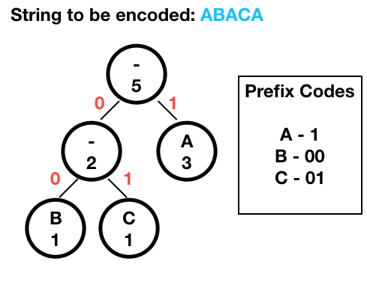
Huffman Coding
Huffman coding is a lossless data compression algorithm.
The most frequent character gets the smallest code, and the least frequent character gets the largest code.
The variable-length codes assigned to input characters are Prefix Codes.
When applying Huffman encoding technique on an Image, the source symbols can be either pixel intensities of the Image, or the probability of occurrence of a certain pixel intensity value.

Slide 5
STEPS
The first step of Huffman coding technique is to reduce the input image to a ordered histogram, where the probability of occurrence of a certain pixel intensity value is as
prob_pixel = numpix/totalnum
where numpix is the number of occurrence of a pixel with a certain intensity value and totalnum is the total number of pixels in the input Image.
There are 2 essential steps to build a Huffman Tree :
Build a Huffman Tree :
Combine the two lowest probability leaf nodes into a new node.
Replace the two leaf nodes by the new node and sort the nodes according to the new probability values.
Continue the steps (a) and (b) until we get a single node with probability value 1.0. We will call this node as root
Backtrack from the root, assigning ‘0’ or ‘1’ to each intermediate node, till we reach the leaf nodes

Slide 6
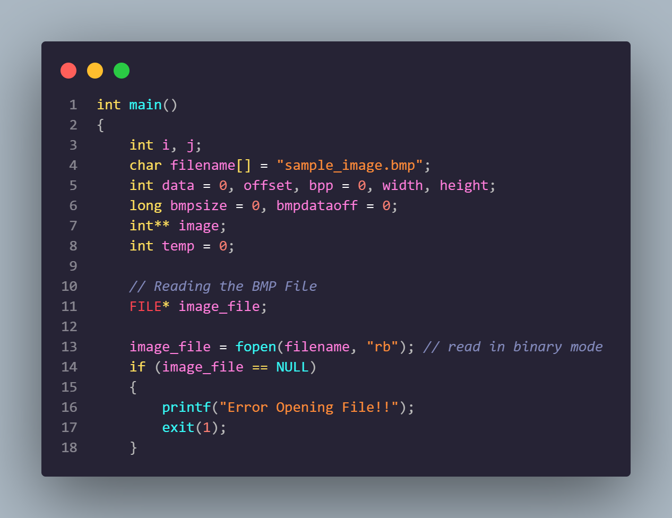
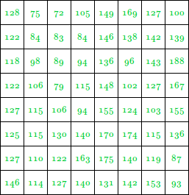
Step 1 : Read the Image into a 2D array(image).
Notes:
Siddhant

Slide 7
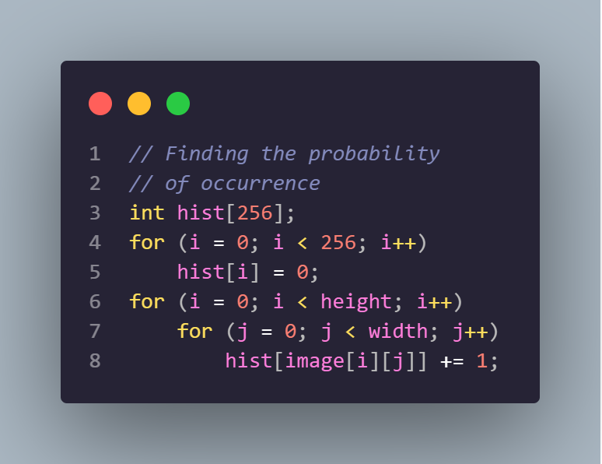
Step 1.1 : Create a Histogram of the pixel intensity values present in the Image

Slide 8
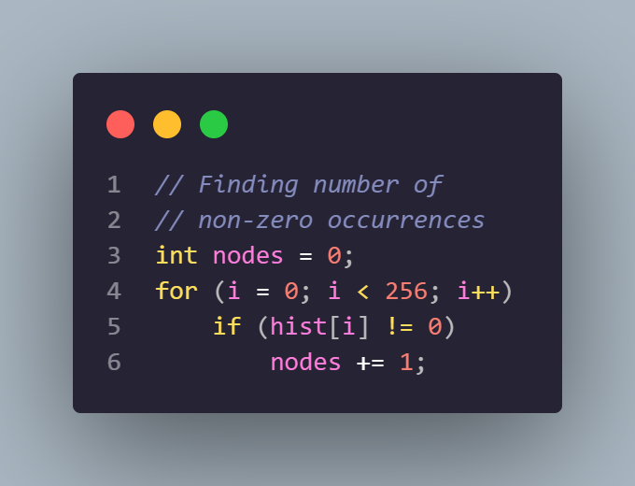
Step 1.2
Find the number of pixel intensity values having non-zero probability of occurrence

Slide 9
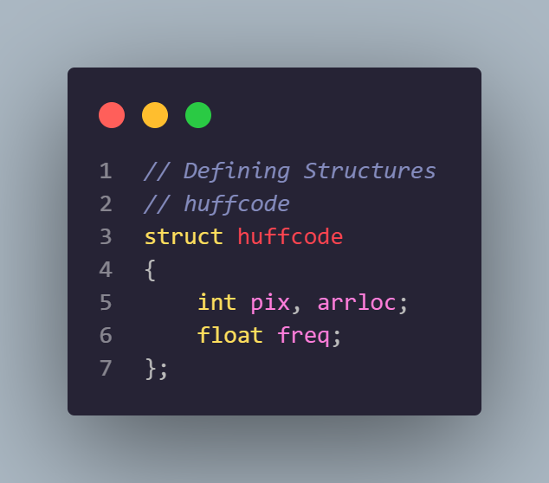
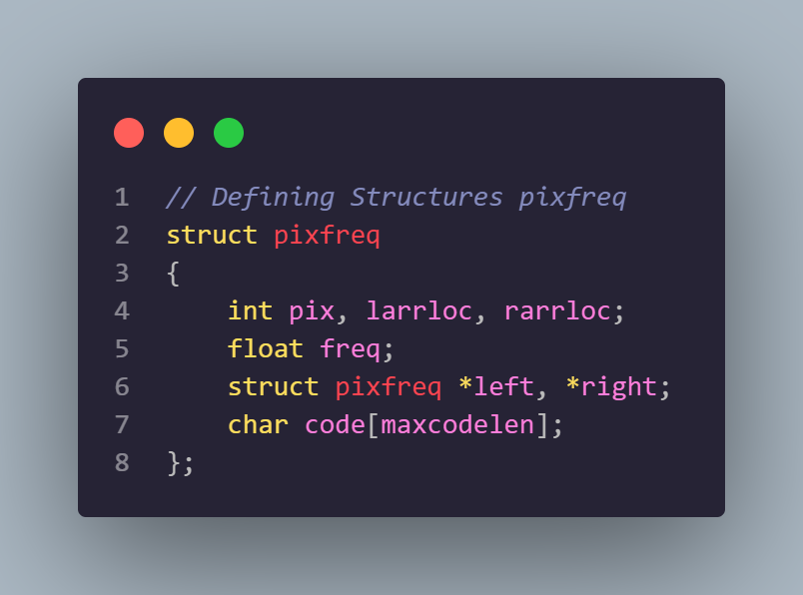
Step 2 Define a struct which will contain the pixel intensity values(pix), their corresponding probabilities(freq), the pointer to the left(*left) and right(*right) child nodes and also the string array for the Huffman code word(code).
Step 3 Define another Struct which will contain the pixel intensity values(pix), their corresponding probabilities(freq) and an additional field, which will be used for storing the position of new generated nodes(arrloc).

Slide 10
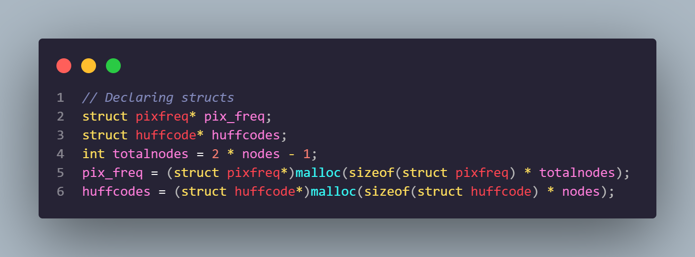
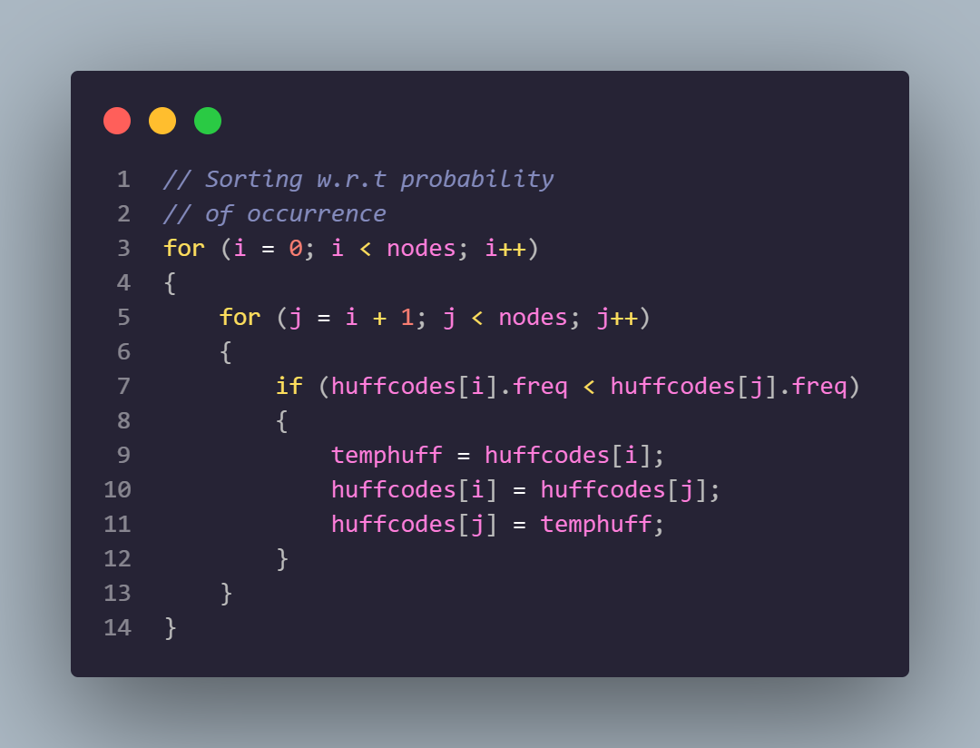
Step 5 Initialize the two arrays pix_freq and huffcodes with information of the leaf nodes.
Step 6
Sorting the huffcodes array according to the probability of occurrence of the pixel intensity values

Slide 11
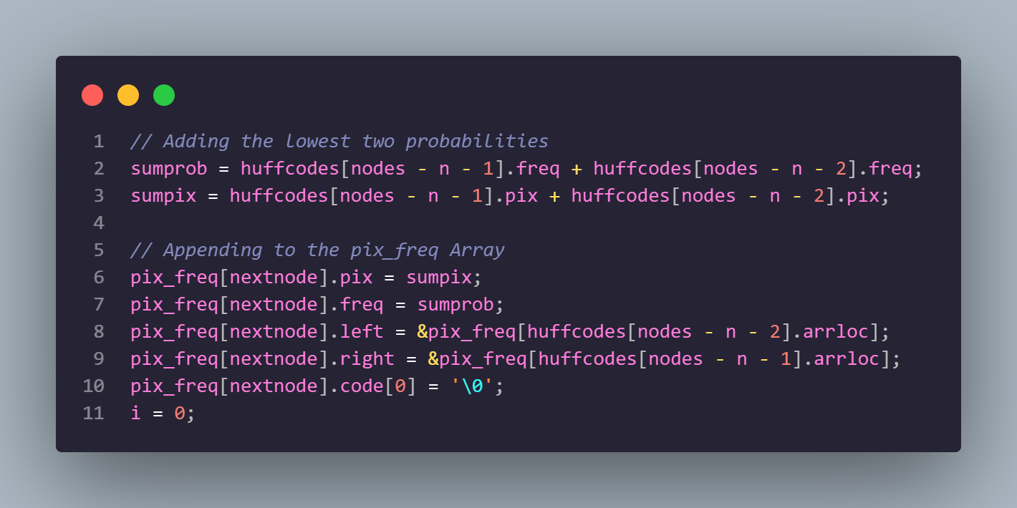
Step 7 Building the Huffman Tree

Slide 12
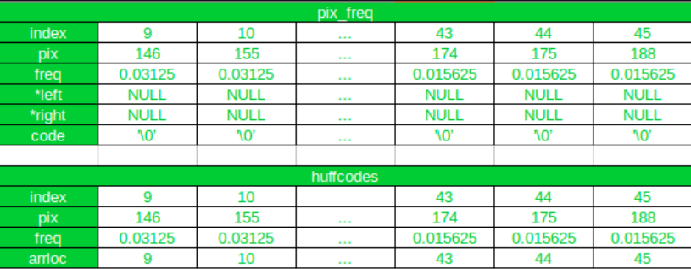
How does the code works ?
Initially

Slide 13
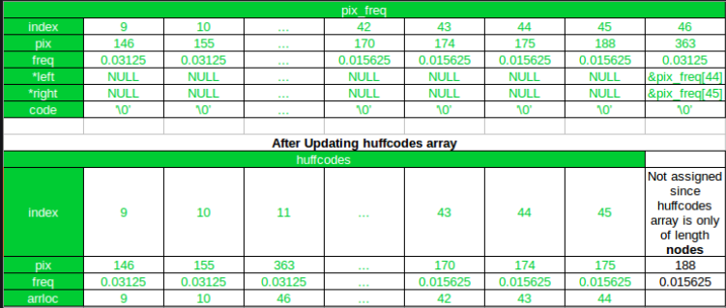
After the First Iteration

Slide 14
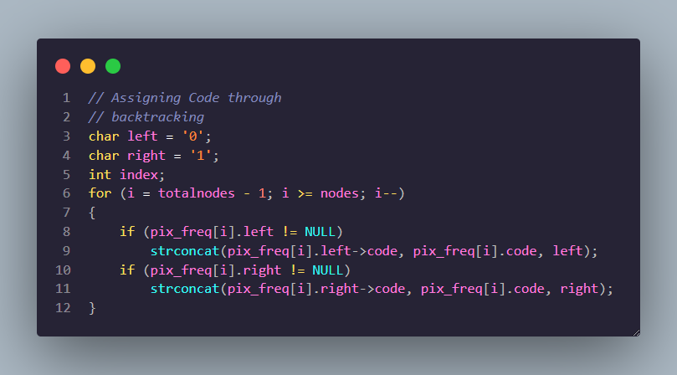
Step 8
Backtrack from the root to the leaf nodes to assign code words

Slide 15
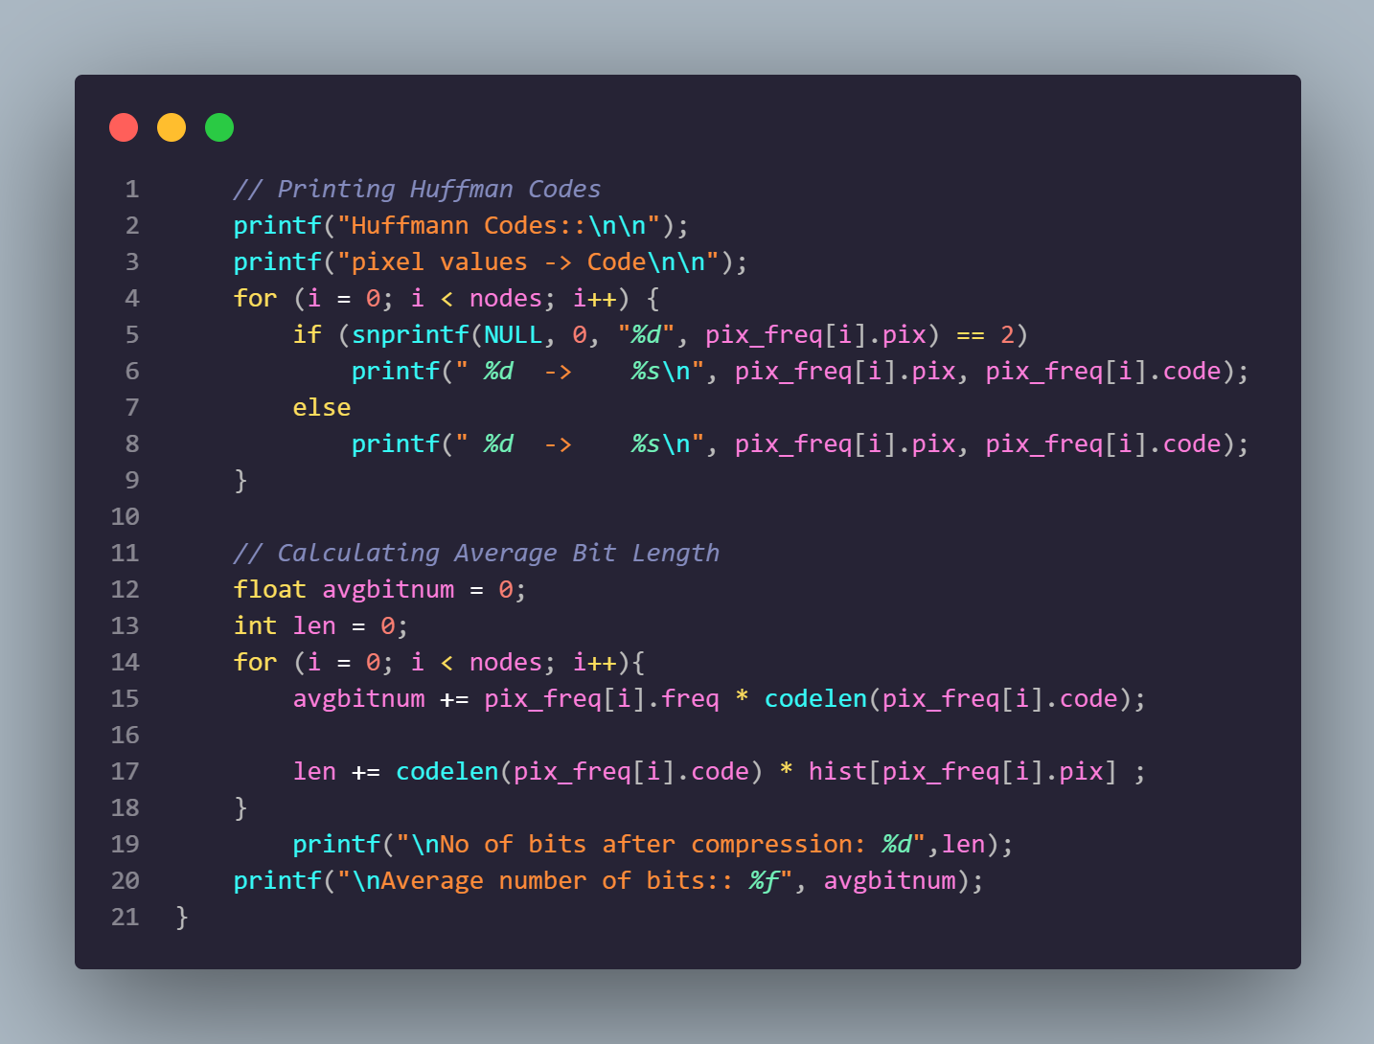
Final Step Encode the Image

Slide 16


Slide 17
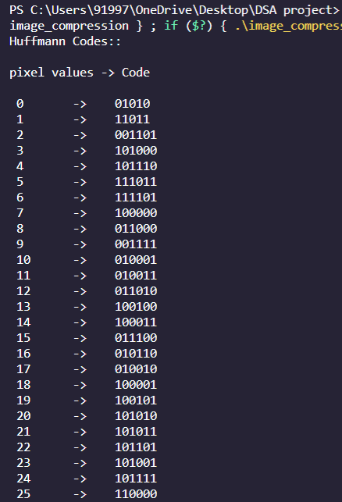
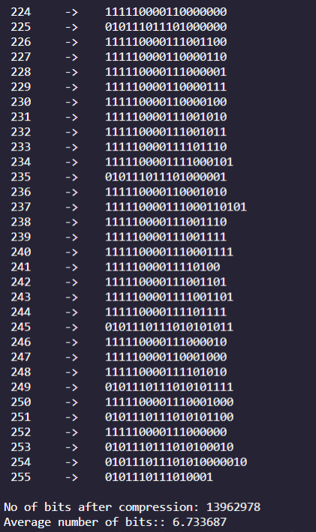
OUTPUT

Slide 18
1745.37225 bits
Total 4,331‬ bits
are compressed which is
71 % compression

Slide 19
FUTURE SCOPE
We all are in the revolution of computer technology but computers are yet not able to be as fast as the human brain in image processing. If we try to capture an image in a high-quality DSLR camera then it can be good but not as good as our vision. This new era of technology leading to more and more data usage too. So image compressing and processing are important in future too.

Slide 20
References
Sartaj Sahani: Data structures, Algorithms and Applications in C++
Thomas H. Cormen, Charles E. Leiserson, Ronald Rivest, Clifford Stein : Introduction to Algorithms
http://www.itl.nist.gov/div897/sqg/dads/HTML/codingTree.html
http://encyclopedia2.thefreedictionary.com/Huffman+tree
http://en.wikipedia.org/wiki/Huffman_coding
https://www.geeksforgeeks.org/huffman-decoding/?ref=lbp
https://www.barracuda.com/glossary/data-compression
http://en.wikipedia.org/wiki/Huffman_coding

Slide 21
THANK YOU !

Slide 22
Work Distribution
Siddhant - Read the Image into a 2D array(image).
Rhishikesh - Define a struct which will contain the pixel intensity values(pix), their corresponding probabilities(freq).
Siddhesh- Sorting the huffcodes array according to the probability of occurrence of the pixel intensity values.
Shreyas - Building the Huffman Tree.
Sakshi - Backtrack from the root to the leaf nodes to assign code words and finally Encode the Image.

