Slide 1

QUASAR 5.0 — ROUND 1 · EDTECH TRACK · VPPCOE & VA · T&P CELL · QUASAR 5.0 — ROUND 1 · EDTECH TRACK · VPPCOE & VA · T&P CELL · QUASAR 5.0 — ROUND 1 · EDTECH TRACK · VPPCOE & VA · T&P CELL ·
SUBMISSION DECK
ROUND 1 — ONLINE PPT
LIVE EVAL — 5 MINUTES
23–24 JAN 2027 — OFFLINE HACKATHON
PRAVEGA.
EVIDENCE-VERIFIED PLACEMENT INTELLIGENCE
ONE PROFILE · ONE TRAIL · EVERY DECISION EXPLAINED
Self-declared skills become evidence-gated verified states. AI drafts; the officer decides. Every action appends to an audit trail — for college Training & Placement cells.
3/3
GOLDEN FLOW PASSING — PLAYWRIGHT
₹0
INFRASTRUCTURE AT PILOT SCALE
LIVE
REPO · README · CI — PUBLIC NOW
PRAVEGA · VERIFIED PLACEMENT INTELLIGENCE · QUASAR 5.0 EDTECH TRACK · DOCS/ROUND1-FACTS.MD
01 / 10
Notes:
OPEN (0:05) — “This is Pravega. College placements run on two broken ledgers: the student's word, and nobody's audit. We fix both.”
BEATS: 0:05–0:30 problem · 0:30–0:50 competitive gap · 0:50–1:00 solution line · 1:00–3:30 live demo (3 acts) · 3:30–4:20 engineering · 4:20–4:50 feasibility + outcomes · 4:50–5:00 the ask.
Q&A READY: (1) “Why does placement friction persist?” → unverifiable claims + reactive training; cite ISR 56.35% employability (docs/research-brief.md). (2) “What is honestly AI here?” → deterministic engines with reason codes + mandatory human gate; no LLM on the critical path. (3) “What breaks at scale?” → tenant_id on every table; the officer queue scales by role, matrix approval.

Slide 2
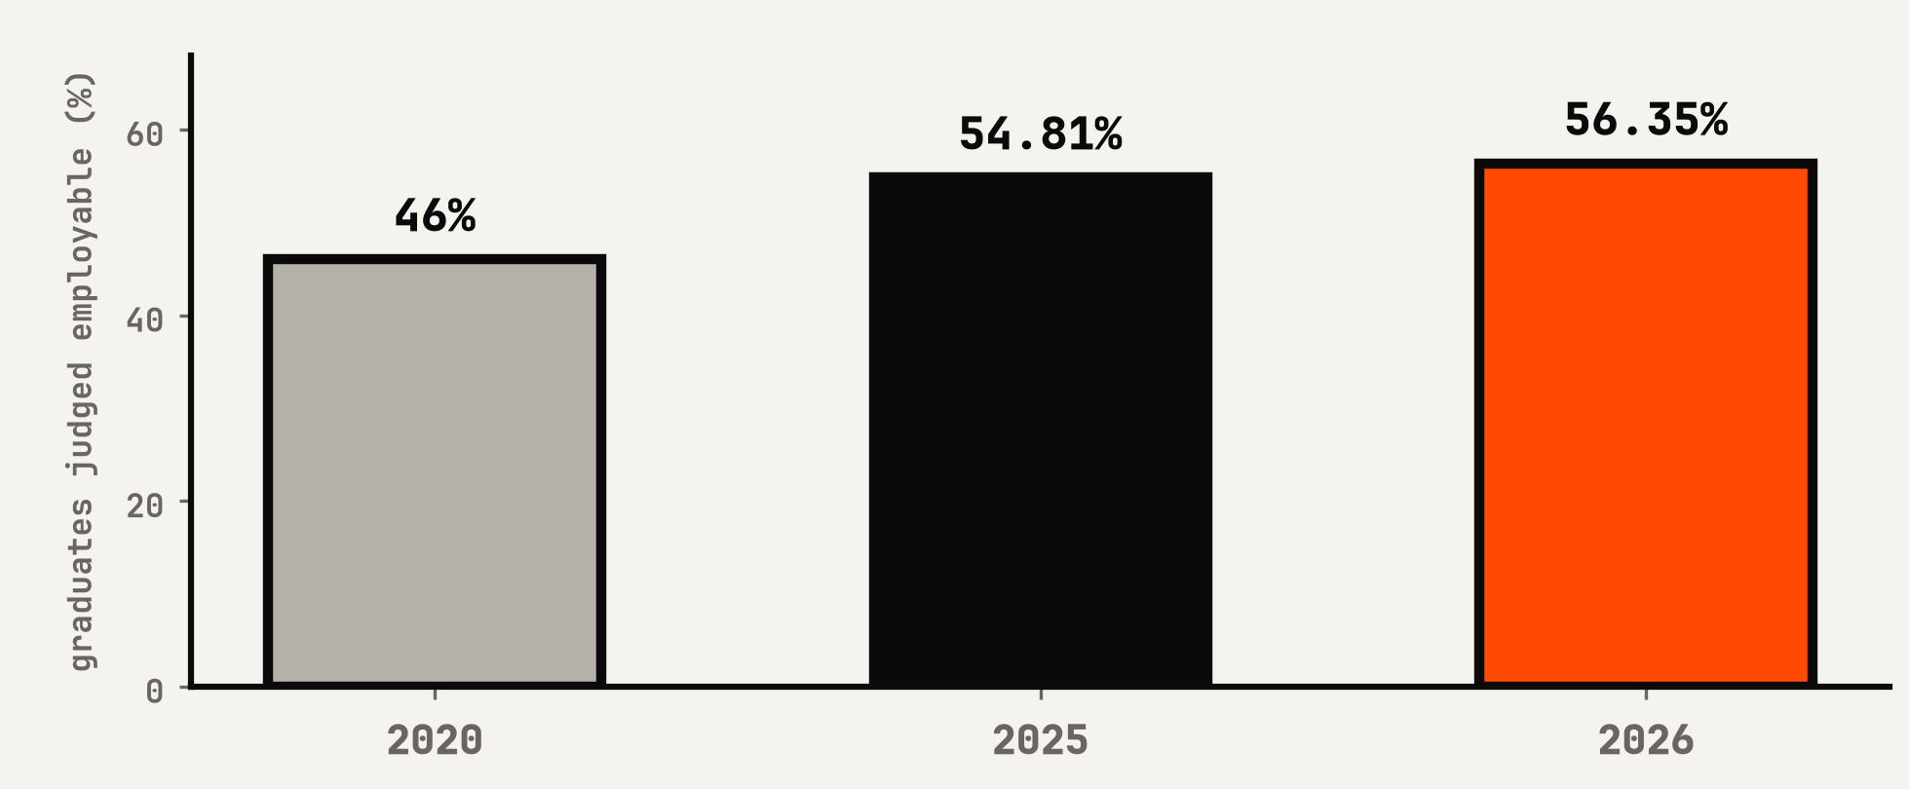
EVIDENCE OVER CLAIMS · ONE PROFILE — ONE TRAIL · APPEND-ONLY — NO DELETE PATH · EVIDENCE OVER CLAIMS · ONE PROFILE — ONE TRAIL · APPEND-ONLY — NO DELETE PATH ·
THE PROBLEM — PLACEMENTS RUN ON UNVERIFIABLE CLAIMS
PROBLEM
56.35%
GRADUATE EMPLOYABILITY — INDIA (%)
of graduates are “employable” — and no employer can tell you WHICH.
11.2%
graduate unemployment — about 3× the national rate
Wheebox ISR trend · PIB (Jul 2026) records the same rise from 46% (2020) — docs/research-brief.md
THE COST OF CLAIMS — TODAY
Placements on gut
T&P filters in spreadsheets — no version, no appeal, no audit
42.6%
Evidence orphaned
repos & tests exist but never become trusted skill state
judged industry-ready on a stricter lens (2025)
Training reacts, never predicts
cohort weakness surfaces only after a failed drive
MATCH, NOT VOLUME — THE PS'S OWN WORDS
NAAC outcomes by hand
numbers live in Excel — nothing traces back to an action
Sources: Wheebox India Skills Report 2026 · PIB (Jul 2026) · PLFS 2025 · Graduate Skill Index 2025 — DOCS/RESEARCH-BRIEF.MD
02 / 10
Notes:
0:05–0:30 — “Half of graduates are judged employable, and the employer still cannot pick. The failure is not supply; it is verified visibility.”
Numbers on this slide are all cited on-slide: Wheebox ISR 2026 (54.81% → 56.35% YoY), PIB Jul 2026 (same trend, 46% in 2020), PLFS 2025 (~11.2% graduate unemployment, ≈3× national), Graduate Skill Index 2025 (~42.6% industry-ready). Nothing invented.
Q&A: (1) “Why not just certify everyone?” → certificates age; we verify liveness and track expiry — SQL expires yearly, attestations carry cadence. (2) “Is this problem money-material?” → delayed offers = lost salary months + recruiter cost of bad hires; we deliberately do not invent a rupee figure here. (3) “Do colleges feel this?” → NAAC/NIRF pressure: one-click CSV export ships in this build.

Slide 3
EVIDENCE OVER CLAIMS · ONE PROFILE — ONE TRAIL · APPEND-ONLY — NO DELETE PATH · EVIDENCE OVER CLAIMS · ONE PROFILE — ONE TRAIL · APPEND-ONLY — NO DELETE PATH ·
THE GAP — WHAT EXISTS VS WHAT'S MISSING
LANDSCAPE
EVERY TOOL DIGITISES THE QUEUE.
NONE VERIFIES THE PERSON.
CAPABILITY
SUPERSET
TCS iON
LINEUPX
SPREADSHEETS
PRAVEGA
Campus logistics — post, apply, schedule
✓
✓
✓
✓
✓
Evidence-gated skill states, expiry-tracked
—
—
—
—
✓
Explainable eligibility — versioned rules
—
—
—
—
✓
AI drafts; human approves / overrides
—
—
—
—
✓
Append-only audit for NAAC / NIRF
—
—
—
—
✓
Appeal path on every decision
—
—
—
—
✓
40% vs 10%
61%
of new backend JDs ask Docker — 10% of the batch has it (PS)
of recent backend JDs ask SQL — our own cohort data (db/seed.ts)
Sources: joinsuperset.com (manual eligibility tracking admitted) · TCS iON NQT · LineupX vs Superset · DOCS/RESEARCH-BRIEF.MD · PS: DOCS/PLAN.MD
03 / 10
Notes:
0:30–0:50 — “They built logistics. We built trust.”
Respect the incumbents: Superset won campus logistics; TCS iON is a respectable point-in-time exam; LineupX adds AI mocks. The gap is specifically the trust layer — evidence-gated states with governance rails. Nobody mainstream ships it (gap statement: docs/research-brief.md).
Q&A: (1) “Why has not Superset done this?” → their model monetises volume; evidence gating is an afternoon-of-product decision away, but it raises the bar for candidates. (2) “The TCS exam is objective — why live evidence?” → point-in-time ≠ current state; evidence ages, so we decay it (expiry) and refresh on demand. (3) “Spreadsheets are free.” → free plus invisible mistakes; our CSV export feeds what they already produce — we do not replace, we verify.

Slide 4
EVIDENCE OVER CLAIMS · ONE PROFILE — ONE TRAIL · APPEND-ONLY — NO DELETE PATH · EVIDENCE OVER CLAIMS · ONE PROFILE — ONE TRAIL · APPEND-ONLY — NO DELETE PATH ·
THE SOLUTION — ONE LINE, THREE ACTS
SOLUTION
CLAIMS IN. EVIDENCE OUT. A HUMAN ON THE FINAL SWITCH.
STATE
CLAIMED
self-declared — nobody checked
EVIDENCE GATE
REPO → ANALYZER
language bytes · commit cadence · test presence
✓ VERIFIED
expiry-tracked · evidence chain cited
I
Evidence over claims
II
The number moves
III
AI helps, human decides
— GitHub scan — language bytes, cadence, tests
— Mock drive flags the weak skill
— Agents draft sets, sweeps, schedules
— Claimed → Verified flip, expiry tracked
— Learning-path tasks produce real evidence
— Officer approves or overrides — reason mandatory
— Every flip cites its evidence chain
— Retest delta shows growth — not vibes
— Every action → append-only audit + fairness scan
LEDGER · ANALYZER
GAP ENGINE · PATH BUILDER
AGENT RUNS · AUDIT LOG
ONE PROFILE · ONE TRAIL · EVERY DECISION EXPLAINED — THE PRODUCT IN A SINGLE LINE
PS PILLARS: EVIDENCE-BASED COMPETENCY PROFILING · SKILL-GAP BRIDGING · AGENTIC PLACEMENT INTELLIGENCE · GOVERNANCE & TRUST — DOCS/ROUND1-FACTS.MD
04 / 10
Notes:
0:50–1:00 — one sentence per act: “I — your repos speak. II — your gaps close, measurably. III — your officer decides; the AI drafts and sulks.”
Map to the PS pillars explicitly so judges score fit, not theatre: Act I = Evidence-Based Competency Profiling; Act II = Skill-Gap Bridging; Act III = Governance & trust (human gate, fairness parity, audit).
Q&A: (1) “What if there is no repo?” → lab work, certificates and contests are first-class evidence; consent center shows exactly what is shared. (2) “How fair is the AI?” → four-fifths parity scan on every shortlist + override is mandatory with a written reason + every decision carries a rule version. (3) “Why agent orchestration?” → placement peak timeliness: sweeps in minutes with a named human accountable — automation without losing accountability.

Slide 5
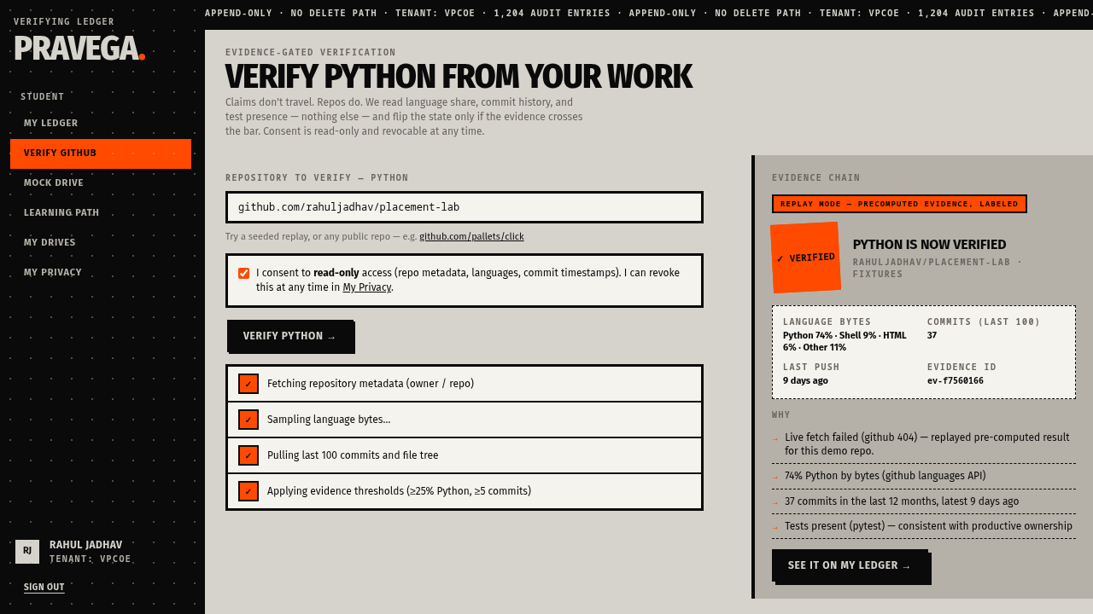
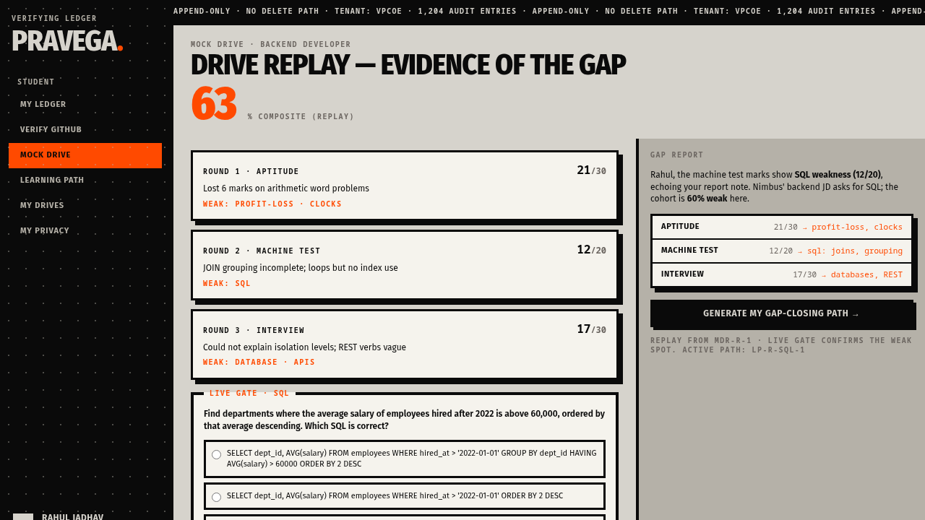
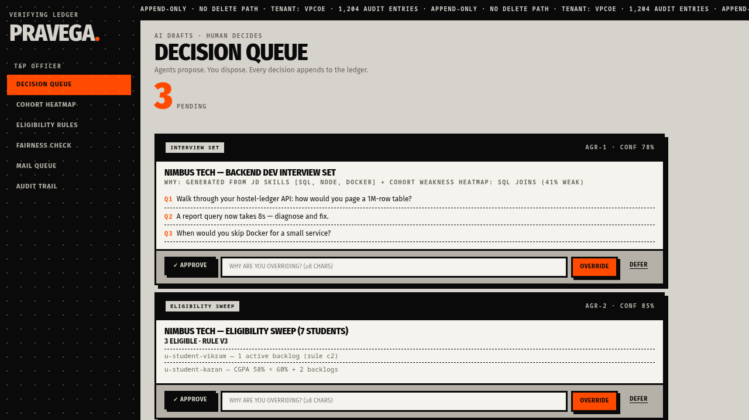
EVIDENCE OVER CLAIMS · ONE PROFILE — ONE TRAIL · APPEND-ONLY — NO DELETE PATH · EVIDENCE OVER CLAIMS · ONE PROFILE — ONE TRAIL · APPEND-ONLY — NO DELETE PATH ·
PROOF — THREE ACTS OF WORKING PRODUCT
DEMO
THIS IS NOT A MOCK. EVERY SCREEN EXISTS.
Replay-labeled proof — the analyzer says so on screen, never silently.
ACT I — CLAIM FLIPS TO VERIFIED
Python 74% language bytes · 37 commits · tests found — evidence chain logged, replay labeled
ACT II — GAP NAMED, PATH ASSIGNED
Aptitude 21/30 · machine 12/20 · interview 17/30 → 63% composite; cohort 60% weak in SQL
ACT III — AI PROPOSES, HUMAN DECIDES
3 proposals pending · approve / override (≥8 chars) / defer · rule v3 · conf 78% / 85%
REPLAY MODE IS LABELED ON SCREEN — A FAILED LIVE FETCH NEVER HIDES
GOLDEN FLOW 3/3 E2E
PUBLIC URL — SHIPS WITH SUBMISSION
SEED: 7 STUDENTS · FULL EVIDENCE CHAINS
Fixtures ↔ live: the analyzer's ports/adapters keep the demo alive when venue Wi-Fi lies — same evidence chain, labeled.
Screenshots: docs/screenshots/brutalist-{verify,mockdrive,officer-queue}.png — captured from the running app, 2026
05 / 10
Notes:
1:00–3:30 — run the demo exactly in this order:
ACT I (60s): ledger shows Python CLAIMED → Verify → consent gate → analyzer steps → stamp flips VERIFIED with the replay banner. Land the line: “It failed a live fetch honestly and kept working — nothing hidden.” Proof: 74% Python by bytes, 37 commits, tests present.
ACT II (60s): mock drive → machine note “JOIN grouping incomplete” → task t3 → evidence artifact → SQL flips Verified with expiry. Scores 21/30, 12/20, 17/30 → 63% composite; cohort is 60% weak here.
ACT III (60s): officer queue → approve interview set → override eligibility sweep with reason (≥8 chars enforced) → fairness flag four-fifths gap recorded. Close: “There is no delete button.”
Failure recovery: if the network is shy, replay mode is labeled on screen; swap to the recorded video — never dead air.
Q&A: (1) private repo? → consent explicit, read-only, revocable in one click. (2) fake data? → seeded cohort of 7 students, every row clickable, nothing decorative. (3) what would you not ship yet? → live LeetCode ingestion (unofficial API) — fixtures there, labeled clearly, roadmap item.

Slide 6
EVIDENCE OVER CLAIMS · ONE PROFILE — ONE TRAIL · APPEND-ONLY — NO DELETE PATH · EVIDENCE OVER CLAIMS · ONE PROFILE — ONE TRAIL · APPEND-ONLY — NO DELETE PATH ·
ENGINEERING — NO BLACK BOXES
HOW IT WORKS
HONEST PIPELINE. EVERY STEP TRACES.
Deterministic agents with reason codes — no LLM on the critical path.
1
2
3
4
5
GitHub, read-only
Analyzer
Evidence ledger
Rules engine
Human gate
Consent explicit + revocable. Metadata, languages, commits — nothing else.
Language bytes · cadence · tests. Fixtures ↔ live — every fallback labeled.
Postgres + Drizzle. Expiry-tracked states, append-only events.
Versioned clauses, parse-free — no eval(). Rule v3 history recorded.
Agents draft; officer approves or overrides with a mandatory reason.
PORT / ADAPTER
LABELS REPLAY
SUPABASE AP-SOUTH-1
EXPLAINABLE
AUDIT_LOG
STACK — BORING, PROVEN
NEXT.JS 16
REACT 19
TYPESCRIPT 5
TAILWIND V4
DRIZZLE ORM
POSTGRES · SUPABASE
PLAYWRIGHT 3/3
GITHUB REST
CLEVER, NOT MAGIC
Analyzers are ports/adapters — swap fixtures ↔ live GitHub with zero changes above the ledger. A failed fetch replays precomputed evidence, labeled on screen — never silent.
tenant_id on every row · data residency: Supabase ap-south-1 (Mumbai) · the PS explicitly allows rule-based AI — we ship that, and we say which is which.
Multi-tenancy: tenant_id on every row · data residency Supabase ap-south-1 (Mumbai) — README.MD, DOCS/PLAN.MD
06 / 10
Notes:
3:30–4:20 — 50 seconds, no code talk unless pressed:
“Three guarantees: (1) you never click a black box — every score carries its inputs; (2) failures are labeled, not hidden — fixtures say replay; (3) the AI proposes, the officer disposes — nothing writes without a human's name on it.”
Close-line if asked about architecture: “The ledger is the product. Screens come and go; the audit trail is the trust.”
Q&A: (1) “Where is the LLM?” → none on the critical path; agents are deterministic engines with reason codes and confidence; an LLM may draft interview questions behind a flag — optional, never deciding. (2) “Data residency?” → Supabase ap-south-1, Mumbai — India jurisdiction, DPDP-aligned posture. (3) “What is genuinely novel?” → expiry-tracked skill states + evidence chains + mandatory human override with reasons — the accountability loop, not the pixels.

Slide 7
EVIDENCE OVER CLAIMS · ONE PROFILE — ONE TRAIL · APPEND-ONLY — NO DELETE PATH · EVIDENCE OVER CLAIMS · ONE PROFILE — ONE TRAIL · APPEND-ONLY — NO DELETE PATH ·
FEASIBILITY & COST — BORING WINS
FEASIBILITY
₹0 INFRASTRUCTURE.
Free tiers end to end. Nothing experimental on the critical path.
₹0
INFRA AT PILOT — FREE TIERS
36 H
SOLO BUILD · BORING STACK
NO ML
RULE-BASED AI — PS ALLOWS IT
0
HIGH/CRITICAL NPM-AUDIT FINDINGS
WHAT BREAKS
WHAT WE DO
Venue network dies
Labeled fixture replay + recorded 90s video — the demo never freezes
GitHub rate-limits or 404
GITHUB_TOKEN supported; demo repo 404s — replay carries, honestly labeled
“AI could hallucinate” critique
No LLM on the critical path — deterministic rules + human gate; confidence shown
Students won't connect repos
Consent explicit & revocable; lab work, contests, certificates accepted
Judges break the demo link
Officer-only demo reset — factory reseed in seconds
Scale beyond one college
tenant_id on every row; NAAC export is one CSV; PS multi-tenant path intact
Pilot math: free tiers, one branch, no ML required — the PS says rule-based is allowed, and we say so out loud.
Costs & risks: DOCS/ROUND1-FACTS.MD · DOCS/SECURITY-NOTES.MD · README.MD (npm audit: 0 high/critical)
07 / 10
Notes:
4:20–4:35 — “Boring technology buys you a demo that never apologises.”
Cost math if pressed: Supabase free tier + Vercel hobby = genuinely ₹0 at pilot scale; one branch, one officer. Build: solo engineer, 36 hours, stack the team already maintains.
Q&A: (1) “Biggest risk?” → venue Wi-Fi; answer honestly: labeled replay + recorded 90s video, judges score substance not spectacle. (2) “Who maintains it?” → the T&P officer, email-grade alerts, nothing grows unbounded. (3) “Hidden confession?” → the seeded demo repo does not exist; verify says 404 and replays labeled — that is the feature, not a bug. Numbers: 0 high/critical npm-audit findings (README); full posture in docs/security-notes.md.

Slide 8
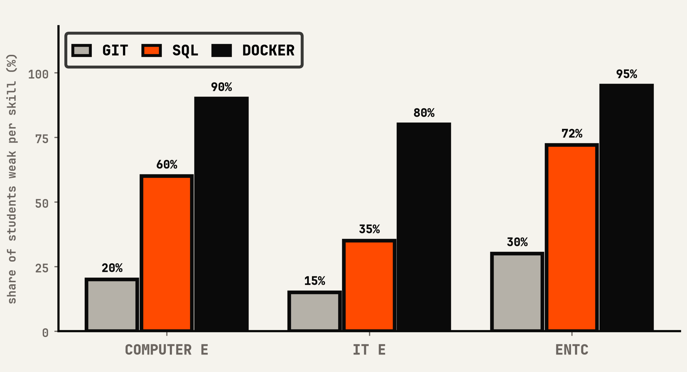
EVIDENCE OVER CLAIMS · ONE PROFILE — ONE TRAIL · APPEND-ONLY — NO DELETE PATH · EVIDENCE OVER CLAIMS · ONE PROFILE — ONE TRAIL · APPEND-ONLY — NO DELETE PATH ·
EXPECTED OUTCOMES — THE NUMBER THAT MATTERS
IMPACT
THE NUMBER MOVES — MEASURED, NOT VIBES.
Placement-rate target for a pilot batch — a hypothesis we measure, not a claim we print.
+8–15 pp
COHORT WEAK SHARE BY BRANCH (%)
60%
of the CompE batch is weak in SQL — the backend bottleneck (61% of JDs ask it)
64–78%
placement rate across branches today — the baseline the pilot moves (db/seed.ts)
NAAC / NIRF → CSV
the heatmap exports straight to the accreditation template — no manual collation
measured from mock drives + verified evidence — db/seed.ts
SIGNAL: SQL IS THE BOTTLENECK — ONE WORKSHOP, THEN GATE THE DRIVE ON THE RE-TEST
Cohort data: db/seed.ts (analytics + mock-drive replay) · target framing: DOCS/ROUND1-FACTS.MD
08 / 10
Notes:
4:35–4:50 — “The platform does not just report weakness; it closes it. Mock drive finds SQL weak, path assigns tasks that produce evidence, retest shows the delta — the loop closes in days, not placement seasons.”
The +8–15 pp figure is honestly framed on-slide as a TARGET/hypothesis for the pilot batch — measured before/after, not a printed result. Baseline placement rates (64–78%) come from db/seed.ts; weak-share chart is the product's own analytics.
Q&A: (1) “How will you prove impact?” → before/after on the pilot cohort: weak-share, retest delta, offer rate — all already exported. (2) “Is the workshop idea hand-wavy?” → the heatmap itself recommends the action (book one SQL workshop, gate the drive re-run on attendance). (3) “NAAC value?” → the exact numbers flow into the report template — no manual collation, no drift.

Slide 9
EVIDENCE OVER CLAIMS · ONE PROFILE — ONE TRAIL · APPEND-ONLY — NO DELETE PATH · EVIDENCE OVER CLAIMS · ONE PROFILE — ONE TRAIL · APPEND-ONLY — NO DELETE PATH ·
ROADMAP — PILOT FIRST, CREDENTIALS LAST
ROADMAP
PILOT FIRST. CREDENTIALS LAST.
PHASE 1 — FEB
PHASE 2
PHASE 3
PHASE 4
PILOT AT VPPCOE T&P
MULTI-BRANCH COHORTS
RECRUITER ONBOARDING
VERIFIABLE CREDENTIALS
One branch, live drives, measured before/after — the proof batch.
Heatmaps across branches; workshops targeted by weak-share evidence.
Evidence-first discovery — every match shows why, with the packet.
Open Badges 3.0 shape — tamper-evident, portable skill records.
OFFLINE HACKATHON: 23–24 JANUARY 2027 — WE BUILD THE FULL THING LIVE IN 36 HOURS
PUBLIC URL + GITHUB + README — SHIPS WITH SUBMISSION
DEMO VIDEO ≤ 90S RECORDED — NEVER DEAD AIR
5-MINUTE SCRIPT — SPEAKER NOTES ON EVERY SLIDE
Scope is managed, not hoped: trigger cuts are documented in advance — depth on the golden flow beats breadth everywhere.
Plan of record: DOCS/ROUND1-FACTS.MD · DOCS/PRE-COMPETITION-PLAN.MD
09 / 10
Notes:
4:50–4:55 — sequence, not a wishlist: “February pilot at VPPCOE with one branch and measured before/after; then multi-branch cohorts; then recruiters onboarding to evidence-first discovery; then verifiable credentials aligned to Open Badges 3.0.”
Q&A: (1) “Why not ship everything now?” → scope discipline: trigger cuts documented in advance (docs/round1-facts.md); depth on the golden flow beats breadth. (2) “What do you need from the college?” → one branch, one officer, two drives — the platform measures itself. (3) “Credentials – really?” → shape is standards-aligned now; full cryptographic issuance is honestly labeled a stretch goal, not a demo promise.

Slide 10

EVIDENCE OVER CLAIMS · ONE PROFILE — ONE TRAIL · APPEND-ONLY — NO DELETE PATH · EVIDENCE OVER CLAIMS · ONE PROFILE — ONE TRAIL · APPEND-ONLY — NO DELETE PATH ·
THE ASK
ASK
SELECT US.
SCAN → LIVE REPO
WE SHIP THE FULL BUILD LIVE IN THE 36 HOURS.
Round 1 selects the offline hackathon — 23–24 January 2027.
GITHUB.COM/SIDDHESH-AI-DEL/PRAVEGA
MIT LICENSED · CI GREEN · GOLDEN FLOW PASSING
Repo live now — github.com/Siddhesh-ai-del/pravega
3/3 E2E
CI GREEN
0 CRITICAL
Deploy target: public URL ships with the submission packet
Demo replays labeled proof if the network lies — never dead air
ONE PROFILE · ONE TRAIL · EVERY DECISION EXPLAINED — PRAVEGA
Submission package: this deck · public URL · GitHub repo · polished README — DOCS/ROUND1-FACTS.MD
10 / 10
Notes:
4:55–5:00 — close hard: “Select us. On January 23–24 you will watch this ship live — thirty-six hours, working software, no vaporware. The repo is public now; scan it while we talk.”
Leave the QR up through Q&A.
Q&A catch-alls: (1) data privacy → explicit read-only consent, revocable in one click, append-only audit, DPDP-style patterns (docs/security-notes.md). (2) hallucination → no LLM decides anything; deterministic rules + human gate + reason codes. (3) why not Superset → they verify nothing; we do not compete with the scheduler, we make it worth trusting. (4) cost → ₹0 infra at pilot, free tiers. (5) scale → tenant_id everywhere, NAAC export one CSV.

