Slide 1



2026
ROUND 1 · IDEA SUBMISSION
Organised by Dept. of Computer Engineering, PCCOE, Pune · CESA · ACM PCCOE Student Chapter
Final Round
Venue
Host Institute
23 October 2026
PCCOE, Pune
Pimpri Chinchwad College of Engineering, Pune
Strictly Maintain no of slides under 9
SaafScan: 10-second adulterant screening on any phone camera
Iodine and methylene-blue strips, read by any phone camera
Team Members
Team Details
Team Name | IRIS
Team Lead | Siddhesh Kadlag
College Name | Sapkal College of Engineering, Nashik
Theme | DETECT · Food Safety Intelligence
Solution Type | Both: Software (app) + test strip
Siddhesh Kadlag (Team Lead)
Harshal Pawar
Prachi Kale
Notes:
SaafScan, Round 1 idea submission for Tech4Food 2026, theme DETECT. The phone reads a printed reagent strip instead of asking a buyer to trust their eyes. Fill the team name, lead, member names, college name and contact email in the placeholders on this slide and on the closing slide before exporting the PDF.

Slide 2
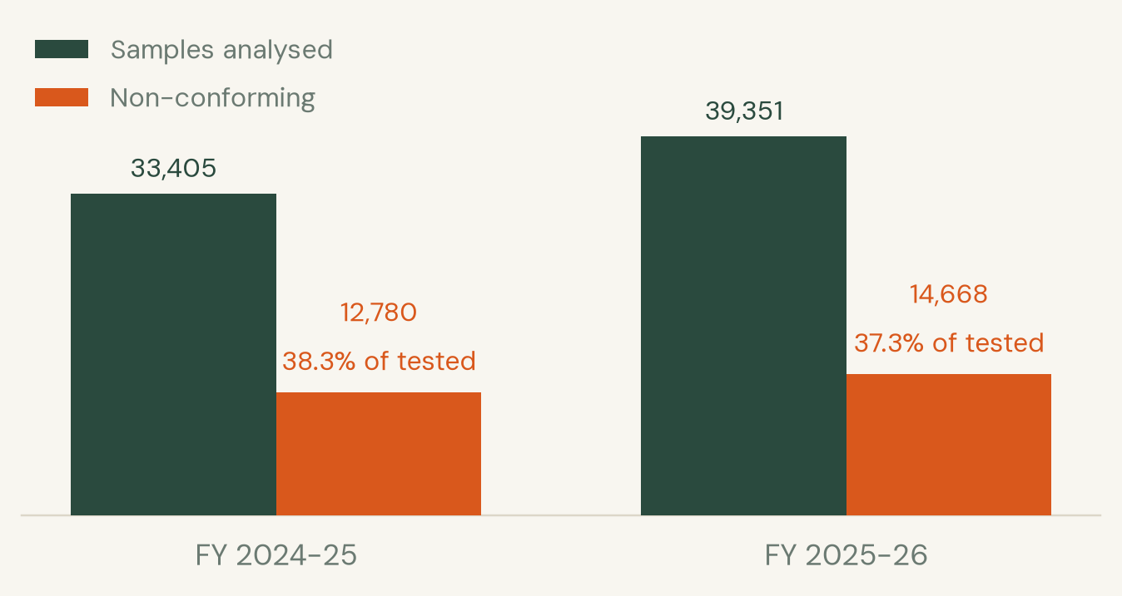
TECH4FOOD 2026 · ROUND 1 IDEA SUBMISSION
Problem Understanding
Loose milk is diluted with water, then thickened with starch and whitened with detergent so the dilution does not show. A buyer cannot check any of that before pouring it for a child.
866 M
foodborne illnesses a year worldwide
1.52 M
deaths a year linked to unsafe food
37.3%
of India's milk and dairy samples failed FSSAI tests in FY 2025-26
FSSAI SURVEILLANCE, TWO YEARS RUNNING
What a buyer has today
A lab sample takes days and costs more than the milk. Rapid kit strips exist, but they read by eye, so two people get two answers and nobody keeps a record.
WHO THIS PUTS A CHECK IN THE HANDS OF
Street vendors
Canteens & hostels
Dairy collection centres
Mothers buying loose milk
Mess committees
Food inspectors
FSSAI data tabled in Parliament, Lok Sabha Unstarred Q 1092, 24 July 2026
Tech4Food 2026 · New Era of Smarter Food Safety · PCCOE, Pune · 02
Notes:
WHO updated its food safety fact sheet on 4 June 2026: 866 million illnesses and 1.52 million deaths a year, US$ 310 billion in lost productivity and medical costs. The India-specific number is the sharper one for this audience: FSSAI told Parliament on 24 July 2026 that 14,668 of 39,351 milk and dairy samples failed in FY 2025-26. Note the rate is marginally down on FY 2024-25 while the absolute number of failures rose, so the deck shows both bars rather than claiming a worsening trend.

Slide 3
TECH4FOOD 2026 · ROUND 1 IDEA SUBMISSION
Proposed Solution & Innovation
A printed card with two reagent zones. One drop of the sample, one photo, one verdict with a confidence you can argue with.
01
Print the card
White, grey and black patches plus two reaction zones
02
Add one drop
Iodine for starch, methylene blue for detergent
03
Photograph it
Any phone camera, any light, no app store
04
Read the colour
The app compares each zone against the printed patches
05
Keep the record
Every test is logged and gets a PDF with a QR code
WHAT IT CALLS OUT
AGAINST WHAT EXISTS
Starch
Detergent
Both
None
Inconclusive
Time to answer
Needs a lab
Keeps a record
Works offline
Lab test
days
yes
yes
no
Starch turns iodine blue-black. Detergent shifts methylene blue. Both zones are measured as ΔE against the printed reference patches.
Rapid kit strip
minutes
no
no
yes
The refusal to guess
Confidence is temperature-calibrated, so a reported 90% means 90%. Anything below the threshold returns no verdict at all and is marked inconclusive. A wrong answer a family acts on is worse than no answer.
SaafScan
under 10 s
no
yes, with QR
yes
Lab and rapid-strip columns are how those methods are described in the FSSAI and WHO material cited on slide 7; SaafScan timings are measured.
Tech4Food 2026 · New Era of Smarter Food Safety · PCCOE, Pune · 03
Notes:
The card is the only consumable. Everything else is software already on a phone. The differentiator to land with judges is the fifth class: the model is allowed to return inconclusive, which is what makes a screening tool honest. Comparison rows for lab tests and rapid strips are qualitative and the SaafScan row is measured.

Slide 4
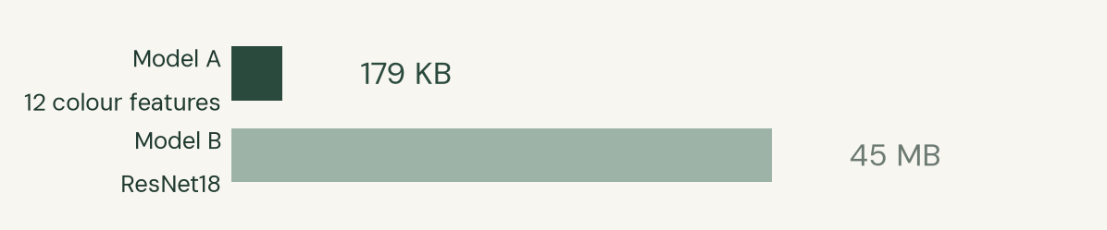
TECH4FOOD 2026 · ROUND 1 IDEA SUBMISSION
Technical Architecture
Camera or
upload
Card calibration
white/grey/black
Strip region
auto-detected
Zone colour
Lab + ΔE vs card
12 colour and
ΔE features
Gradient
boosting
Calibrated
confidence
confidence ≥ 0.55 → verdict, severity and advice, or inconclusive and sent to a lab
Below threshold the pipeline writes an inconclusive entry, not a guess. A deterministic rule table stays reachable as a fallback if the ML runtime fails to load.
SERVES AND STORES
Append-only
SQLite
PDF + QR
report
Batch id on
every test
Recall scoped to
a batch
PWA frontend,
no install
WHY THE SMALLER MODEL SHIPS
Both models tie on accuracy, so the tie broke elsewhere
A 12-feature gradient booster and a ResNet18 both scored 1.000 at 0.800 coverage on held-out lighting. The booster ships: 179 KB against 45 MB, and it answers at 0.55 confidence where the network needs 0.999, which leaves room to still answer when a real phone camera shifts the colour.
Stack: Python 3.12 · OpenCV · scikit-learn · ONNX Runtime on CPU · FastAPI · SQLite · browser frontend. No GPU is needed at inference.
Tech4Food 2026 · New Era of Smarter Food Safety · PCCOE, Pune · 04
Notes:
Every stage runs on the CPU in about six milliseconds, so the demo does not depend on a GPU being present at the venue. Both trained models scored identically on the held-out split, which is why the deck claims no accuracy advantage for the ML path over the rule table; the booster ships on artifact size and on abstention headroom.

Slide 5
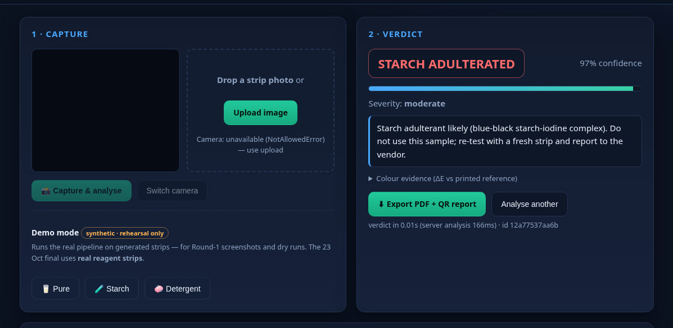
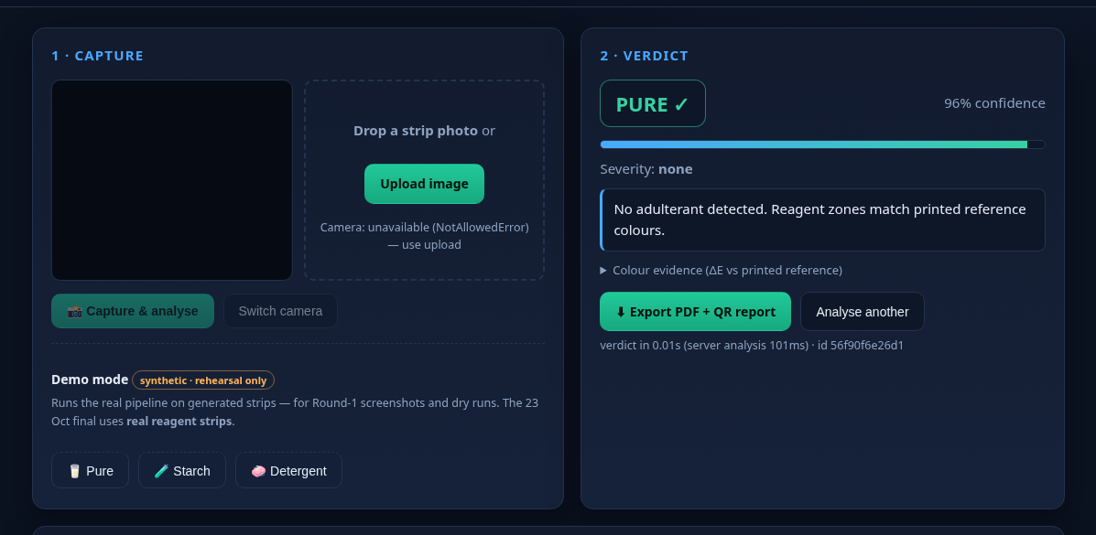
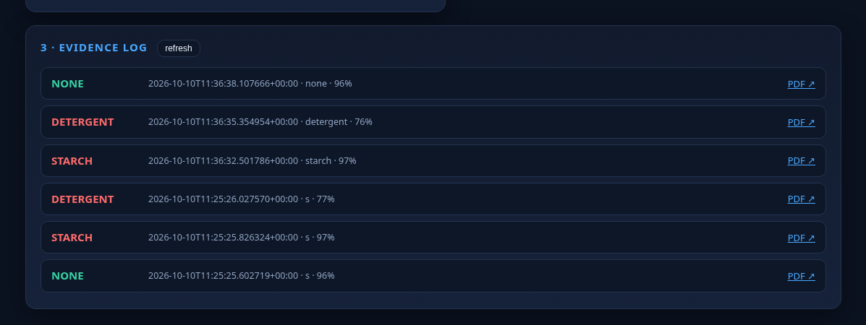
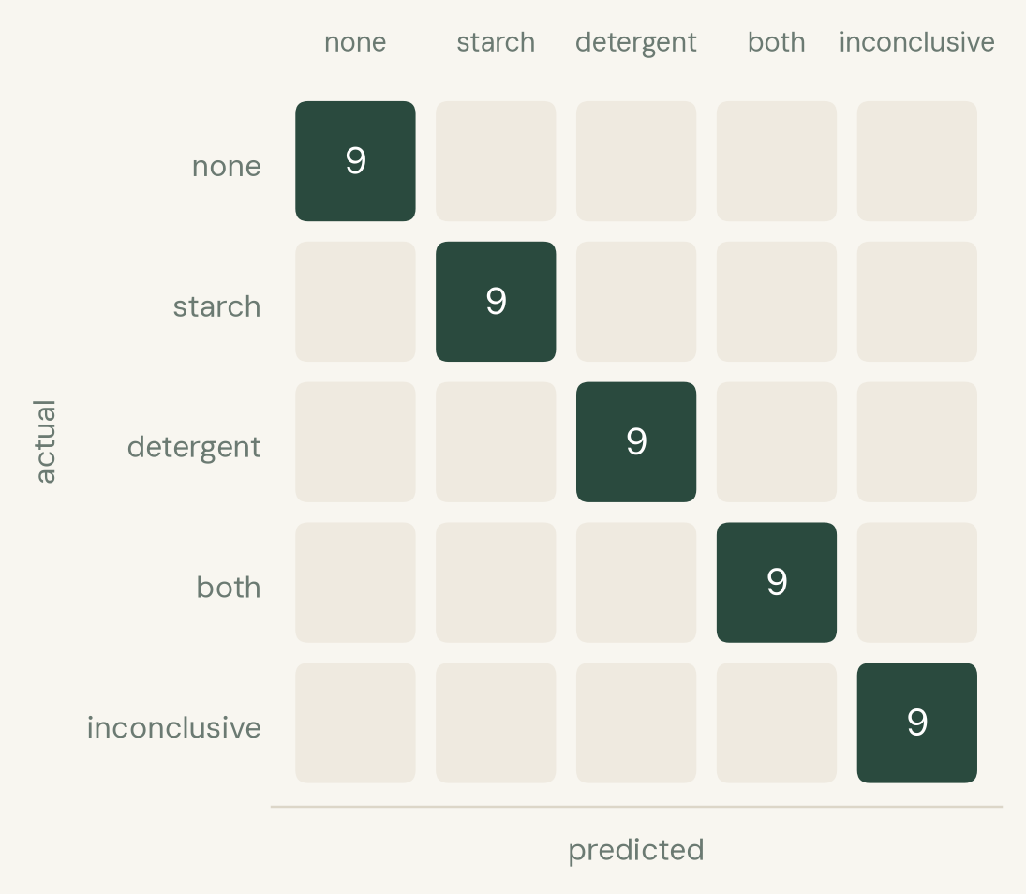
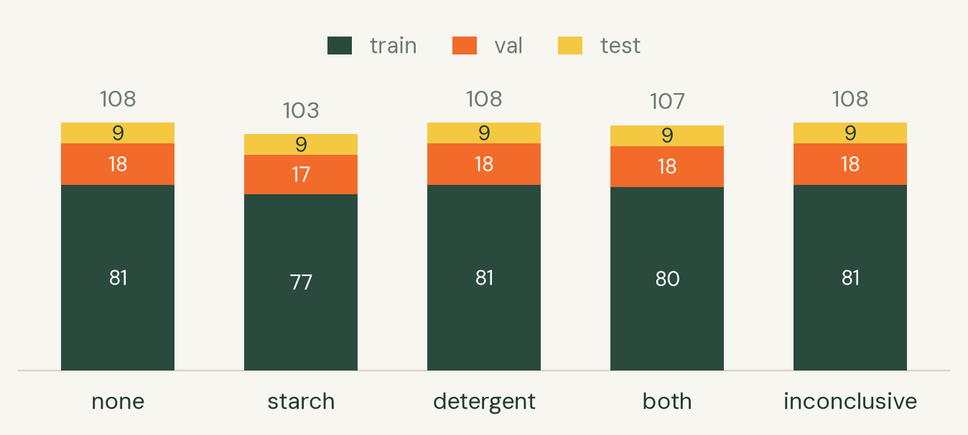
TECH4FOOD 2026 · ROUND 1 IDEA SUBMISSION
Implementation / Prototype
Verdict screen: type, confidence, severity, and what to do next
A clean sample comes back as none, not as a blank screen
Evidence log: every test stamped, each with a PDF and QR report
HELD OUT BY LIGHTING, NOT BY IMAGE
TRAINING SET, 534 SYNTHETIC STRIP IMAGES
6.0 ms
median analysis time, in-process (n=20)
19.3 ms
full HTTP request to verdict (n=12)
0.42 s
cold start, API ready to serve
Splits are assigned by lighting condition, so no condition appears in two splits. The model abstains on 9 of the 45 held-out samples, and those 9 are the 9 labelled inconclusive.
45 samples, 3 lighting conditions the model never saw in training
184 tests · 93% coverage
passing, ruff clean
Tech4Food 2026 · New Era of Smarter Food Safety · PCCOE, Pune · 05
Notes:
The screenshots are from the running prototype, not mockups. The confusion matrix is the honest headline: zero misclassifications across 45 held-out samples, with exactly 9 abstentions matching the 9 samples labelled inconclusive. Timings were measured with deck/bench.py on the build laptop and are reproducible from the repository.

Slide 6
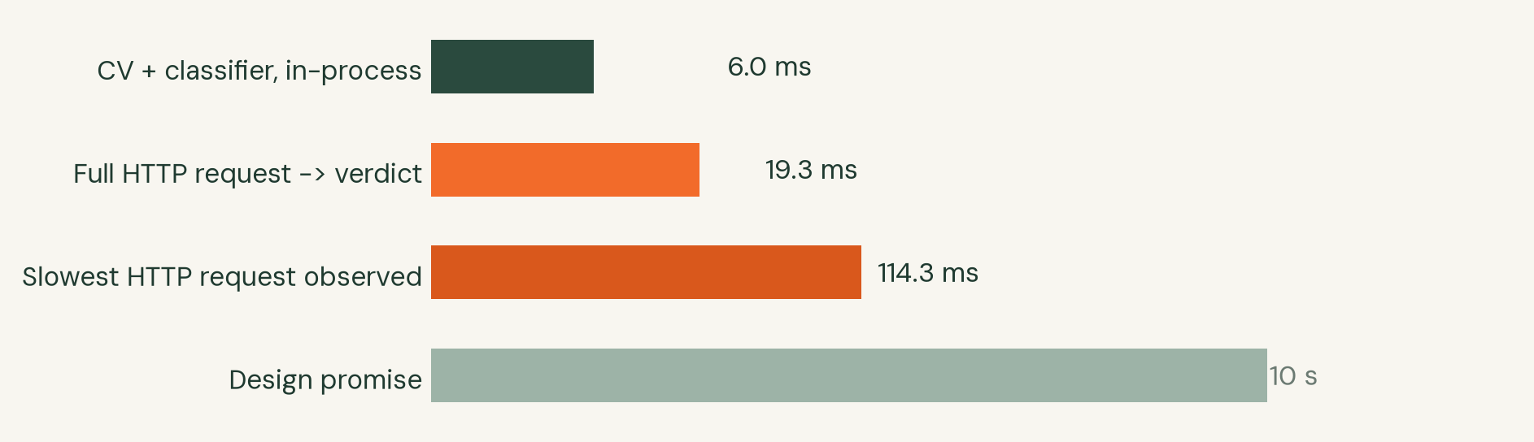
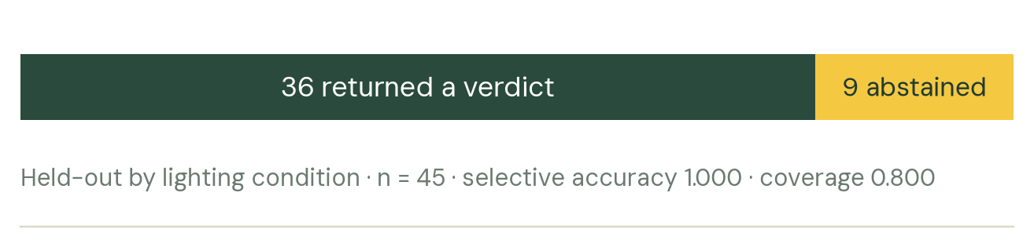
TECH4FOOD 2026 · ROUND 1 IDEA SUBMISSION
Feasibility & Impact
MEASURED SPEED, AGAINST THE 10-SECOND PROMISE
WHAT THE MODEL DOES WITH AMBIGUITY
Both bars are the same run: 36 answered, 9 declined.
Cost per test (estimate)
What a vendor actually needs
Printed cards, two dropper bottles and a phone. No app store, no account, no internet after the first page load, no calibration by hand.
The same card and app work for milk, water and any liquid the two reagents screen for.
Impact, and the road to 23 October
Every test carries a batch id and a QR, so a distributor can scope a recall to the batches that failed instead of pulling a whole product line.
15-21 Oct capture real strips and retrain · 22 Oct rehearsal · 23 Oct final, live on real reagents.
Printed card, two zones
≈ ₹2
One iodine or MB drop
≈ ₹1
Phone and network
already owned
≈ ₹3 per test, excluding the phone
Estimate only. Reagent prices are pending; the kit is being bought this week and the figure will be restated once.
Tech4Food 2026 · New Era of Smarter Food Safety · PCCOE, Pune · 06
Notes:
Speed matters here because the alternative is a test nobody performs at home. Cost is stated as an estimate and labelled as such on the slide: reagent prices are not yet confirmed, so the deck does not present the figure as measured. The recall-scoping point is the one to make if asked about impact, because it is the reason a trace layer sits behind the detection layer.

Slide 7
TECH4FOOD 2026 · ROUND 1 IDEA SUBMISSION
Research & References
Research papers & patents
Data, reports & regulations
Tools, datasets & field work
Fragkos N., Bouzembrak Y., Erasmus S. W. (2026)
The role of artificial intelligence in combating food fraud: a systematic literature review. Critical Reviews in Food Science and Nutrition. doi:10.1080/10408398.2026.2654710
FSSAI, tabled in Parliament 24 July 2026
Lok Sabha Unstarred Question No. 1092. 14,668 of 39,351 milk and dairy samples non-conforming in FY 2025-26.
Open-source stack
OpenCV, scikit-learn, ONNX Runtime, FastAPI, SQLite, Python 3.12. Model trained on an RTX 4050, served on CPU.
Food Chemistry 468:142439 (2025)
Recent advances on AI-based approaches for food adulteration and fraud detection: challenges and opportunities. PMID 39675268
WHO, Food safety fact sheet, 4 June 2026
866 million illnesses, 1.52 million deaths and US$ 310 billion a year; children under 5 carry 29% of the burden.
Dataset and field work
534 synthetic strip images across 5 lighting conditions. Real iodine and methylene-blue strips photographed 15-21 October, then retrained.
How the sources were used
WHO and FSSAI figures set the size of the problem on slide 2 and are quoted with their publication dates. The two review papers informed the decision to keep a rule-table fallback beside the learned model, since both reviews flag model opacity as the main barrier to regulatory adoption. No figure in this deck was rounded into existence; every number traces to a file in the repository or to a cited publication.
Tech4Food 2026 · New Era of Smarter Food Safety · PCCOE, Pune · 08
Notes:
Two review papers, two official sources, plus the toolchain and dataset. The WHO fact sheet was revised on 4 June 2026 and the older 600 million and 420,000 figures are superseded, so this deck uses the current 866 million and 1.52 million. If a judge asks where a number came from, the answer is a DOI, a Lok Sabha question number or a file path in the repository.

Slide 8
TECH4FOOD 2026 · ROUND 1 IDEA SUBMISSION
Conclusion
A printed card and a phone camera, turned into a repeatable adulteration screen that keeps its own record.
What is built and running
Capture, calibration, zone measurement, classification, abstention, evidence log, PDF and QR export, and a browser UI that works on a phone. The repository holds 11 commits of test-driven work and starts from a clean checkout in one command.
184
tests passing, 93% coverage
6.0 ms
median analysis time
What we are honest about
Colour thresholds are validated on synthetic reagent scenes, not yet on real chemistry. The 23 October final runs on real iodine and methylene-blue strips and the model is retrained on those photos first. A reading is a screening signal, not a legal test result.
5
verdict classes, one of them unsure
0
fabricated verdicts by design
ROADMAP TO 23 OCTOBER
14 Oct
Shortlist announced
15-21 Oct
Real strips photographed, model retrained, threshold re-tuned
22 Oct
Full rehearsal, three samples plus one deliberate inconclusive
23 Oct
Final, 10:00-13:00 at PCCOE, live on real reagents
Tech4Food 2026 · New Era of Smarter Food Safety · PCCOE, Pune · 07
Notes:
Close on the honest limit rather than hiding it. The organisers asked for a solution that works, so the strongest thing to say is that the software is finished and tested, the chemistry arrives this week, and the model is retrained on real strips before the final. Do not claim the ML beats the rule table; both scored 1.000 on the held-out split.

Slide 9
Thank You
IRIS · captainlevi252@gmail.com
Tech4Food 2026 · New Era of Smarter Food Safety · PCCOE, Pune · 09
Notes:
[Team Name] · [Contact email] go in the placeholder here. Every slide keeps the template footer and logos exactly as issued.

