Slide 1



2026
ROUND 1 · IDEA SUBMISSION
Organised by Dept. of Computer Engineering, PCCOE, Pune · CESA · ACM PCCOE Student Chapter
Final Round
Venue
Host Institute
24 October 2026
PCCOE, Pune
Pimpri Chinchwad College of Engineering, Pune
Strictly Maintain no of slides under 9
SaafScan: 10-second adulterant screening on any phone camera
Iodine and methylene-blue strips, read by any phone camera
Team Members
Team Details
Team Name | [ ]
Team Lead | [ ]
College Name | [ ]
Theme | DETECT · Food Safety Intelligence
Solution Type | Both: app + test strip
[Name] (Team Lead)
[Name]
[Name]
Notes:
SaafScan, Round 1 idea submission for Tech4Food 2026, theme DETECT. The phone reads a printed reagent strip instead of asking a buyer to trust their eyes. Fill the team name, lead, member names, college name and contact email in the placeholders on this slide and on the closing slide before exporting the PDF.

Slide 2
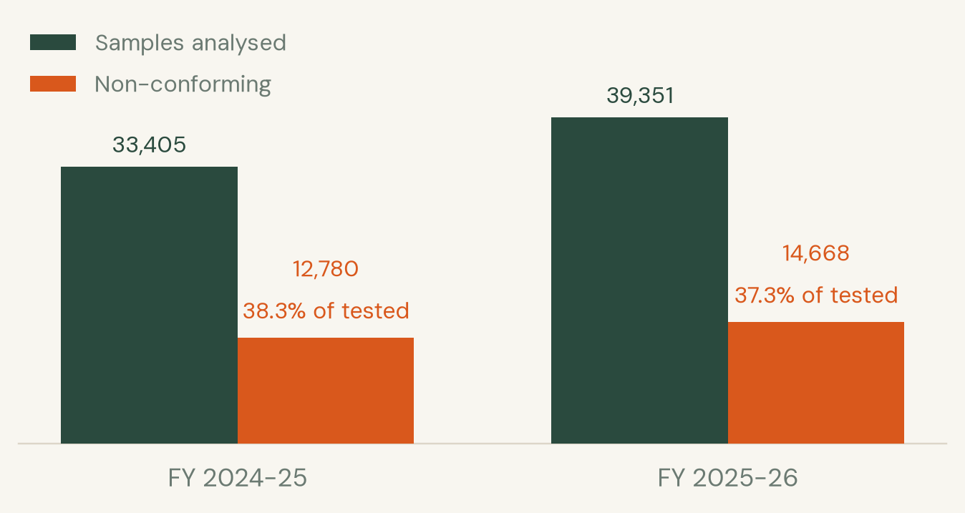
TECH4FOOD 2026 · ROUND 1 IDEA SUBMISSION
Problem Understanding
Loose milk is diluted with water, then thickened with starch and whitened with detergent so the dilution does not show. A buyer cannot check any of that before pouring it for a child.
866 M
foodborne illnesses a year worldwide
1.52 M
deaths a year linked to unsafe food
37.3%
of India's milk and dairy samples failed FSSAI tests in FY 2025-26
FSSAI SURVEILLANCE, TWO YEARS RUNNING
What a buyer has today
A lab sample takes days and costs more than the milk. Rapid kit strips exist, but they read by eye, so two people get two answers and nobody keeps a record.
WHO THIS PUTS A CHECK IN THE HANDS OF
Street vendors
Canteens & hostels
Dairy collection centres
Mothers buying loose milk
Mess committees
Food inspectors
FSSAI data tabled in Parliament, Lok Sabha Unstarred Q 1092, 24 July 2026
Tech4Food 2026 · New Era of Smarter Food Safety · PCCOE, Pune · 02
Notes:
WHO updated its food safety fact sheet on 4 June 2026: 866 million illnesses and 1.52 million deaths a year, US$ 310 billion in lost productivity and medical costs. The India-specific number is the sharper one for this audience: FSSAI told Parliament on 24 July 2026 that 14,668 of 39,351 milk and dairy samples failed in FY 2025-26. Note the rate is marginally down on FY 2024-25 while the absolute number of failures rose, so the deck shows both bars rather than claiming a worsening trend.

Slide 3
TECH4FOOD 2026 · ROUND 1 IDEA SUBMISSION
Proposed Solution & Innovation
A printed card with two reagent zones. One drop of the sample, one photo, one verdict with a confidence you can argue with.
01
Print the card
White, grey and black patches plus two reaction zones
02
Add one drop
Iodine for starch, methylene blue for detergent
03
Photograph it
Any phone camera, any light, no app store
04
Read the colour
The app compares each zone against the printed patches
05
Keep the record
Every test is logged and gets a PDF with a QR code
WHAT IT CALLS OUT
AGAINST WHAT EXISTS
Starch
Detergent
Both
None
Inconclusive
Time to answer
Needs a lab
Keeps a record
Works offline
Lab test
days
yes
yes
no
Starch turns iodine blue-black. Detergent shifts methylene blue. Both zones are measured as ΔE against the printed reference patches.
Rapid kit strip
minutes
no
no
yes
The refusal to guess
Confidence is temperature-calibrated, so a reported 90% means 90%. Anything below the threshold returns no verdict at all and is marked inconclusive. A wrong answer a family acts on is worse than no answer.
SaafScan
under 10 s
no
yes, with QR
yes
Lab and rapid-strip columns are how those methods are described in the FSSAI and WHO material cited on slide 7; SaafScan timings are measured.
Tech4Food 2026 · New Era of Smarter Food Safety · PCCOE, Pune · 03
Notes:
The card is the only consumable. Everything else is software already on a phone. The differentiator to land with judges is the fifth class: the model is allowed to return inconclusive, which is what makes a screening tool honest. Comparison rows for lab tests and rapid strips are qualitative and the SaafScan row is measured.

Slide 4
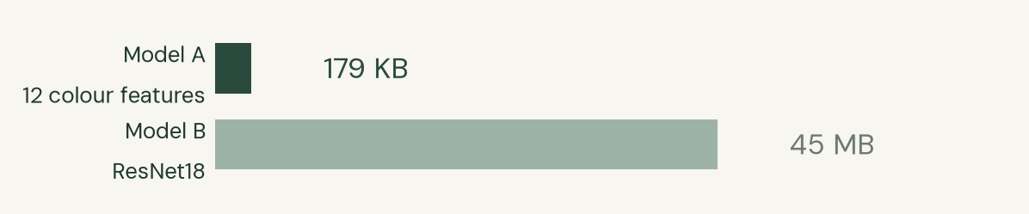
TECH4FOOD 2026 · ROUND 1 IDEA SUBMISSION
Technical Architecture
Camera or
upload
Card calibration
white/grey/black
Strip region
auto-detected
Zone colour
Lab + ΔE vs card
12 colour and
ΔE features
Gradient
boosting
Calibrated
confidence
confidence ≥ 0.55 → verdict, severity and advice, or inconclusive and sent to a lab
Below threshold the pipeline writes an inconclusive entry, not a guess. A deterministic rule table stays reachable as a fallback if the ML runtime fails to load.
SERVES AND STORES
Append-only
SQLite
PDF + QR
report
Batch id on
every test
Recall scoped to
a batch
PWA frontend,
no install
WHY THE SMALLER MODEL SHIPS
The model does not beat the rule table, so the deck does not claim it does
A 12-feature gradient booster and a ResNet18 were trained on the same split. On held-out lighting the booster scores 0.933 accuracy at 0.733 coverage, while the rule table scores 1.000 - a delta of -0.067, and the model abstains rather than guess. The ResNet18 abstains on all 45 held-out samples at its 0.999 threshold. The booster ships anyway: 179 KB against 45 MB, and it answers at 0.55 confidence, which leaves room to still answer when a real phone camera shifts the colour.
Stack: Python 3.12 · OpenCV · scikit-learn · ONNX Runtime on CPU · FastAPI · SQLite · browser frontend. No GPU is needed at inference.
Tech4Food 2026 · New Era of Smarter Food Safety · PCCOE, Pune · 04
Notes:
Every stage runs on the CPU in about six milliseconds, so the demo does not depend on a GPU being present at the venue. The rule table scores 1.000 on the held-out split and the booster scores 0.933, so the deck claims no accuracy advantage for the ML path over the rule table; the booster ships on artifact size and on abstention headroom.

Slide 5
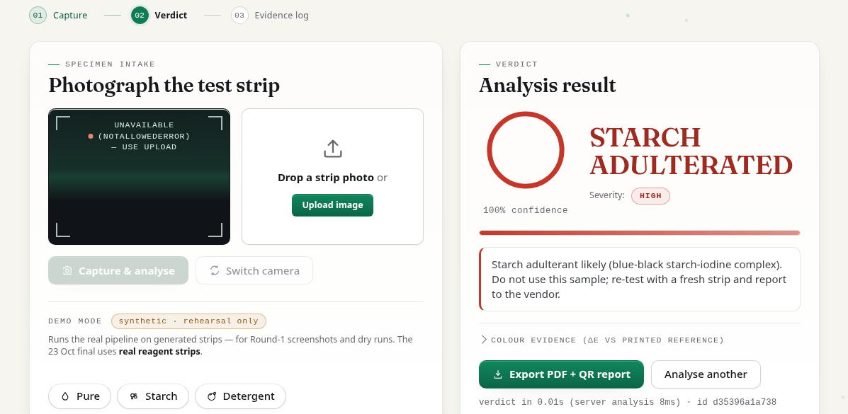
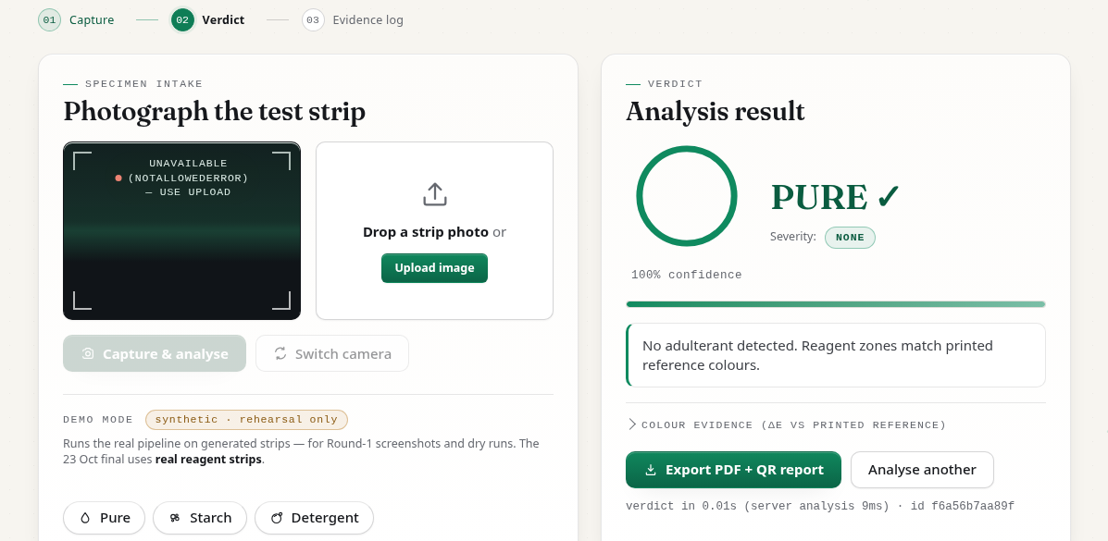
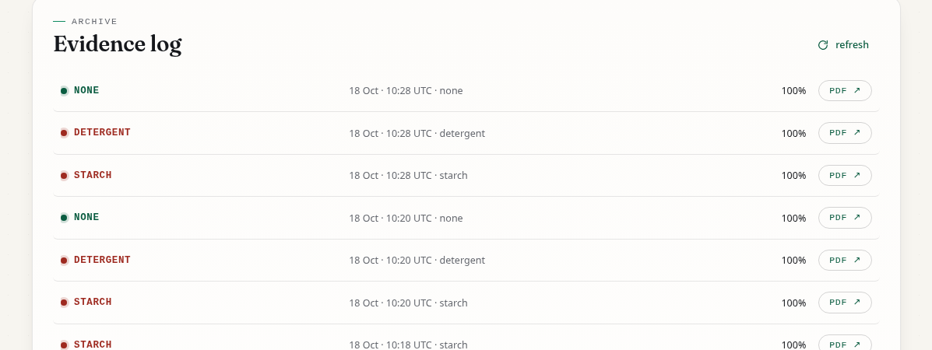
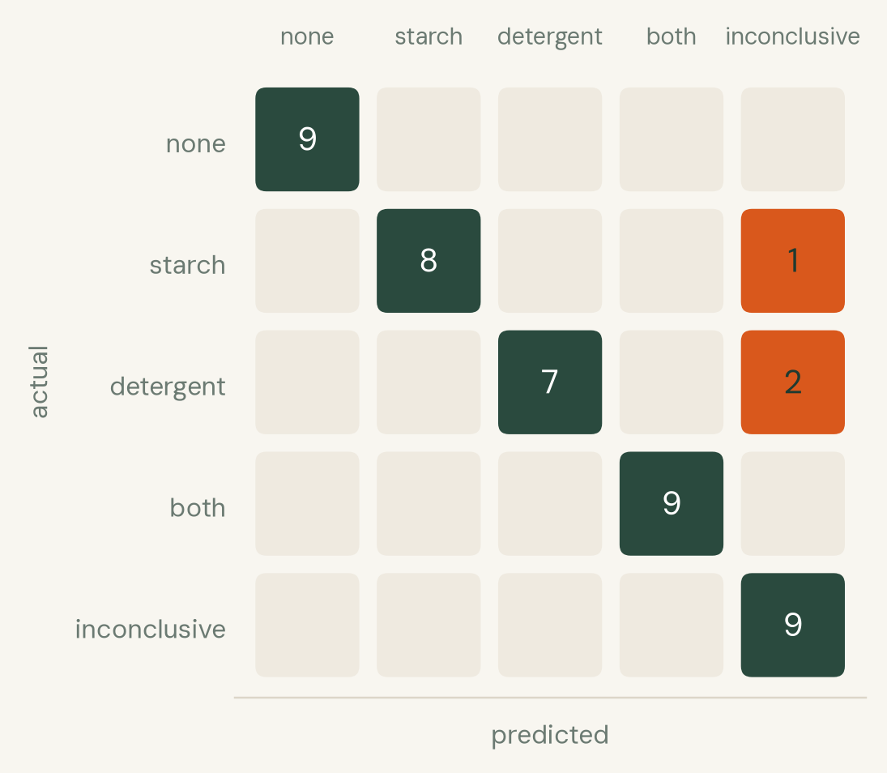
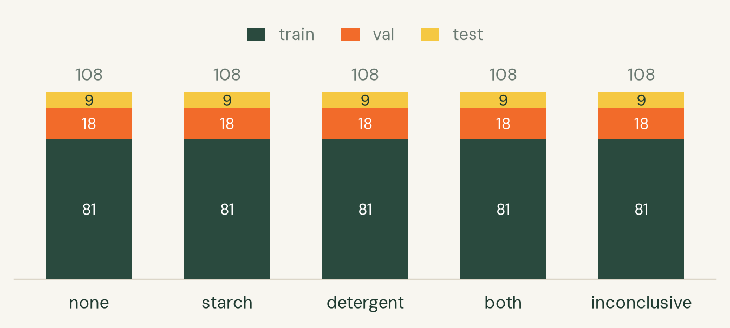
TECH4FOOD 2026 · ROUND 1 IDEA SUBMISSION
Implementation / Prototype
Verdict screen: type, confidence, severity, and what to do next
A clean sample comes back as none, not as a blank screen
Evidence log: every test stamped, each with a PDF and QR report
HELD OUT BY LIGHTING, NOT BY IMAGE
TRAINING SET, 534 SYNTHETIC STRIP IMAGES
6.0 ms
median analysis time, in-process (n=20)
19.3 ms
full HTTP request to verdict (n=12)
0.42 s
cold start, API ready to serve
Splits are assigned by lighting condition, so no condition appears in two splits. The model returns inconclusive on 12 of the 45 held-out samples: 9 are the 9 labelled inconclusive, and the other 3 are one starch and two detergent it declined to call rather than guess. On the 33 it does answer, it is right every time.
45 samples, 3 lighting conditions the model never saw in training
291 tests · 90% coverage
passing, ruff clean
Tech4Food 2026 · New Era of Smarter Food Safety · PCCOE, Pune · 05
Notes:
The screenshots are from the running prototype, not mockups. The confusion matrix is the honest headline: on the 33 samples it commits to a class it is right every time, and of the 12 it declines, 9 are genuinely the 9 labelled inconclusive while the other 3 are one starch and two detergent it would not call. Timings were measured with deck/bench.py on the build laptop and are reproducible from the repository.

Slide 6
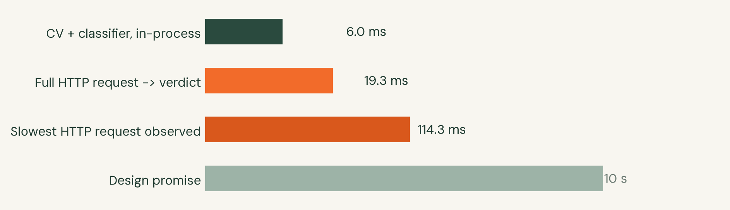
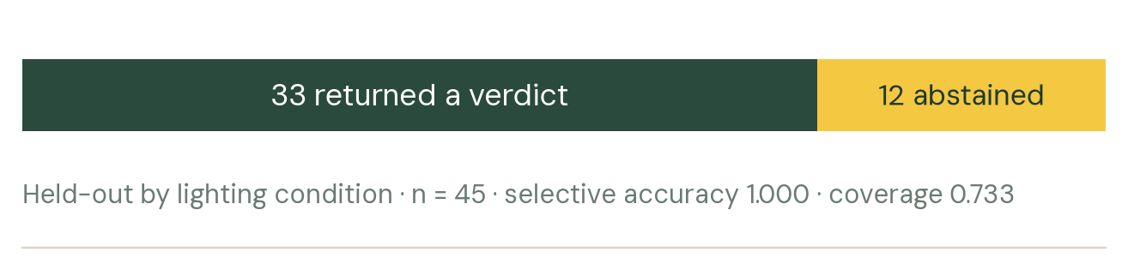
TECH4FOOD 2026 · ROUND 1 IDEA SUBMISSION
Feasibility & Impact
MEASURED SPEED, AGAINST THE 10-SECOND PROMISE
WHAT THE MODEL DOES WITH AMBIGUITY
Both bars are the same run: 33 answered, 12 declined.
Cost per test (estimate)
What a vendor actually needs
Printed cards, two dropper bottles and a phone. No app store, no account, no internet after the first page load, no calibration by hand.
The same card and app work for milk, water and any liquid the two reagents screen for.
Impact, and the road to 24 October
Every test carries a batch id and a QR, so a distributor can scope a recall to the batches that failed instead of pulling a whole product line.
23 Oct reagent shoot attempted, both stocks past date · 24 Oct final, live and offline.
Printed card, two zones
≈ ₹2
One iodine or MB drop
≈ ₹1
Phone and network
already owned
≈ ₹3 per test, excluding the phone
Estimate only. Reagent prices are pending; the kit is being bought this week and the figure will be restated once.
Tech4Food 2026 · New Era of Smarter Food Safety · PCCOE, Pune · 06
Notes:
Speed matters here because the alternative is a test nobody performs at home. Cost is stated as an estimate and labelled as such on the slide: reagent prices are not yet confirmed, so the deck does not present the figure as measured. The recall-scoping point is the one to make if asked about impact, because it is the reason a trace layer sits behind the detection layer.

Slide 7
TECH4FOOD 2026 · ROUND 1 IDEA SUBMISSION
Research & References
Research papers & patents
Data, reports & regulations
Tools, datasets & field work
Fragkos N., Bouzembrak Y., Erasmus S. W. (2026)
The role of artificial intelligence in combating food fraud: a systematic literature review. Critical Reviews in Food Science and Nutrition. doi:10.1080/10408398.2026.2654710
FSSAI, tabled in Parliament 24 July 2026
Lok Sabha Unstarred Question No. 1092. 14,668 of 39,351 milk and dairy samples non-conforming in FY 2025-26.
Open-source stack
OpenCV, scikit-learn, ONNX Runtime, FastAPI, SQLite, Python 3.12. Model trained on an RTX 4050, served on CPU.
Food Chemistry 468:142439 (2025)
Recent advances on AI-based approaches for food adulteration and fraud detection: challenges and opportunities. PMID 39675268
WHO, Food safety fact sheet, 4 June 2026
866 million illnesses, 1.52 million deaths and US$ 310 billion a year; children under 5 carry 29% of the burden.
Dataset and field work
534 synthetic strip images across 5 lighting conditions, plus printed colour targets photographed to validate the imaging half before any chemistry. A real-reagent shoot was attempted 23 October; both stocks were past date, so no chemistry was run.
How the sources were used
WHO and FSSAI figures set the size of the problem on slide 2 and are quoted with their publication dates. The two review papers informed the decision to keep a rule-table fallback beside the learned model, since both reviews flag model opacity as the main barrier to regulatory adoption. No figure in this deck was rounded into existence; every number traces to a file in the repository or to a cited publication.
Tech4Food 2026 · New Era of Smarter Food Safety · PCCOE, Pune · 08
Notes:
Two review papers, two official sources, plus the toolchain and dataset. The WHO fact sheet was revised on 4 June 2026 and the older 600 million and 420,000 figures are superseded, so this deck uses the current 866 million and 1.52 million. If a judge asks where a number came from, the answer is a DOI, a Lok Sabha question number or a file path in the repository.

Slide 8
TECH4FOOD 2026 · ROUND 1 IDEA SUBMISSION
Conclusion
A printed card and a phone camera, turned into a repeatable adulteration screen that keeps its own record.
What is built and running
Capture, calibration, zone measurement, classification, abstention, evidence log, PDF and QR export, and a browser UI that works on a phone. The repository holds 34 commits of test-driven work and starts from a clean checkout in one command.
291
tests passing, 90% coverage
6.0 ms
median analysis time
What we are honest about
The classifier is validated on synthetic reagent scenes, not real chemistry. A 23 October shoot found both stocks past date: degraded iodine gives false negatives, and reduced methylene blue reads colourless, which is what a positive looks like. Running them would have yielded results we could not separate from our own failure modes, so imaging was validated against printed targets instead. A reading is a screening signal, not a legal test result.
5
verdict classes, one of them unsure
0
fabricated verdicts by design
ROADMAP TO 24 OCTOBER
14 Oct
Shortlist announced
15-22 Oct
Printable targets, mid-grey backdrop and frame guide built
23 Oct
Reagent shoot attempted, both stocks past date, rehearsal
24 Oct
Final, 09:00-12:00 at PCCOE, live demo, offline
Tech4Food 2026 · New Era of Smarter Food Safety · PCCOE, Pune · 07
Notes:
Close on the honest limit rather than hiding it. The software is finished and tested, and the imaging half has been validated against photographed printed targets: every frame cleared every detector gate, and control-zone drift on one frame reached 46.3 against a 45 tolerance, so the pipeline refused it rather than diagnosing from an untrustworthy control. That refusal is the project's core principle working on real camera input, not on a rendering. The 23 October reagent shoot found both stocks past date, so no chemistry was run. If asked why we did not simply run them: expired iodine gives false negatives, and methylene blue that has already reduced reads colourless, which is exactly what a detergent positive looks like, so every result would have been uninterpretable. Do not claim the ML beats the rule table: the rule table scores 1.000 on the held-out split and the model scores 0.933, a delta of -0.067, so it ships on artifact size and abstention headroom instead.

Slide 9
Thank You
[Team Name] · [Contact email]
Tech4Food 2026 · New Era of Smarter Food Safety · PCCOE, Pune · 09
Notes:
[Team Name] · [Contact email] go in the placeholder here. Every slide keeps the template footer and logos exactly as issued.

