Slide 1

Predictive Wellness
AI-Driven Mental Health Insights
Decoding the Digital Footprint of Depression through Machine Learning
Notes:
Welcome everyone. Today we're unveiling Predictive Wellness, our AI-driven solution for mental health insights. This project decodes the digital footprint of depression using machine learning. It's more than just a capstone; it's an investor-ready blueprint for proactive mental health intervention. We're here to show you how AI can transform mental health. Let's dive into the problem we're addressing.

Slide 2

The Silent Crisis in the Digital Age
Rising Prevalence
Mental health issues are surging among digital natives, with a significant increase in reported depression cases linked to hyper-connectivity.
The Diagnostic Gap
Traditional diagnosis is reactive, often occurring only after symptoms become severe. There is a critical need for proactive, early-stage detection.
The Digital Opportunity
Everyday digital habits—screen time, social media patterns, and sleep cycles—leave "digital biomarkers" that AI can decode to predict risk.
Notes:
We live in a hyper-connected world, yet mental health issues are surging, especially among digital natives. The critical problem is that traditional diagnosis is reactive; we wait for symptoms to become severe before acting. But here's the opportunity: our daily digital habits leave 'digital biomarkers' that AI can decode. We're bridging this diagnostic gap. Now, let's look at how we're doing that.

Slide 3




Proactive Intervention via Predictive Analytics
01
02
03
OBJECTIVE
METHODOLOGY
IMPACT
Develop a high-precision ML framework to predict depression risk by analyzing multi-dimensional lifestyle data.
Integration of sleep metrics, social media usage, and physical activity into a unified predictive engine.
Enabling personalized wellness recommendations and early clinical alerts for at-risk individuals.
Key Outcomes
Early Detection
Data-Driven Insights
Scalable Architecture
Notes:
So, our solution is a high-precision machine learning framework designed for proactive intervention. We're integrating multi-dimensional data—sleep, social media, physical activity—into a unified predictive engine. This enables personalized wellness recommendations and early clinical alerts for at-risk individuals. We're moving from reactive treatment to proactive prevention. But how do we gather this data? Let's explore our data ecosystem.

Slide 4

Quantifying the Human Experience
DEMOGRAPHICS
DIGITAL FOOTPRINT
Age Distribution
Daily Social Media Hours
Gender Identification
Platform Usage (IG/TikTok)
Screen Time Before Sleep
LIFESTYLE METRICS
PSYCHOLOGICAL PROXIES
Sleep Duration (Hours)
Stress & Anxiety Levels
Physical Activity Frequency
Digital Addiction Index
Social Interaction Level
Academic Performance
MULTI-DIMENSIONAL FEATURE ENGINEERING PIPELINE
Notes:
To quantify the human experience, we engineered a comprehensive set of features. We didn't just look at one factor; we built a multi-dimensional ecosystem. This includes demographics, detailed digital footprints like screen time before sleep, and crucial lifestyle metrics such as sleep duration and social interaction. We also incorporated psychological proxies like stress and anxiety levels. This holistic approach allows us to capture a complete picture of an individual's mental state. Now, let's see what this data reveals.

Slide 5

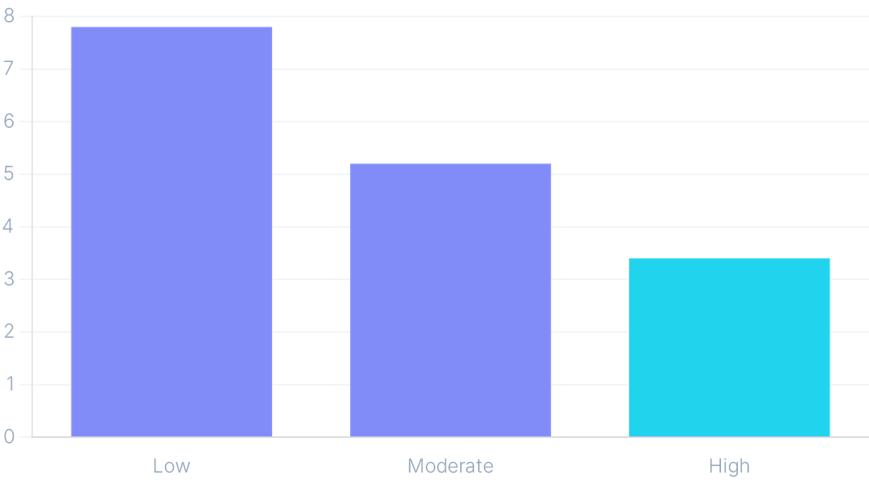
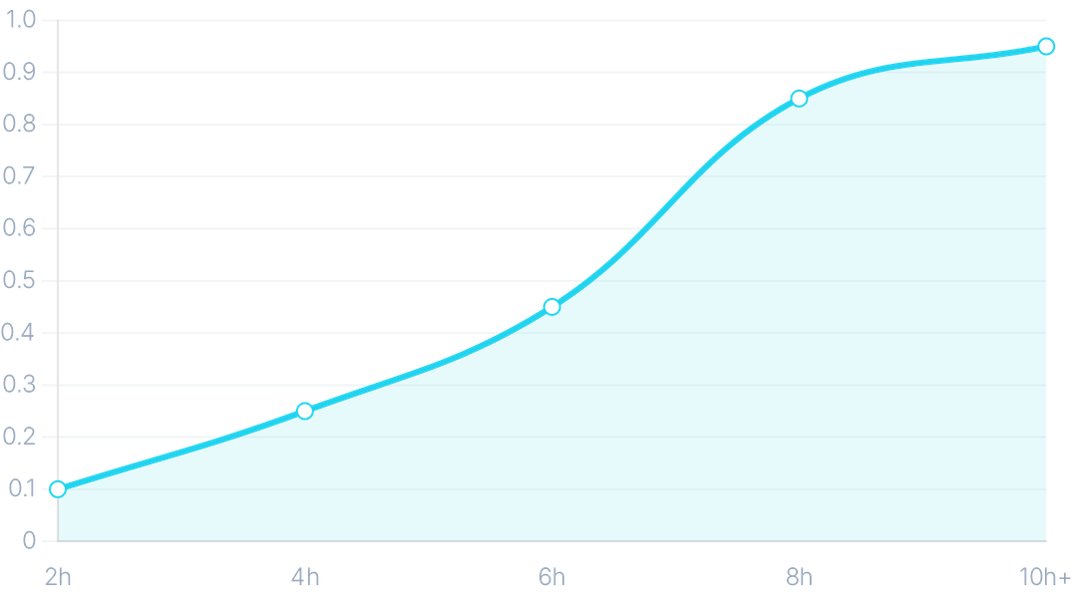
Visualizing the Digital-Mental Health Link
PHYSICAL ACTIVITY VS STRESS
SCREEN EXPOSURE IMPACT
The Buffer Effect
Digital Saturation
Social Buffer
High physical activity levels correlate with a 30% reduction in perceived stress markers.
Screen exposure exceeding 6 hours daily shows a sharp pivot in depression risk labels.
High social interaction levels mitigate the negative impacts of high social media usage.
Notes:
Our exploratory data analysis reveals clear, actionable insights into the digital-mental health link. We found that high physical activity significantly reduces perceived stress markers, acting as a vital buffer. Conversely, screen exposure exceeding six hours daily shows a sharp increase in depression risk. And importantly, high social interaction levels mitigate the negative impacts of heavy social media use. These findings are crucial for understanding the interconnectedness of lifestyle factors, which we'll explore next.

Slide 6

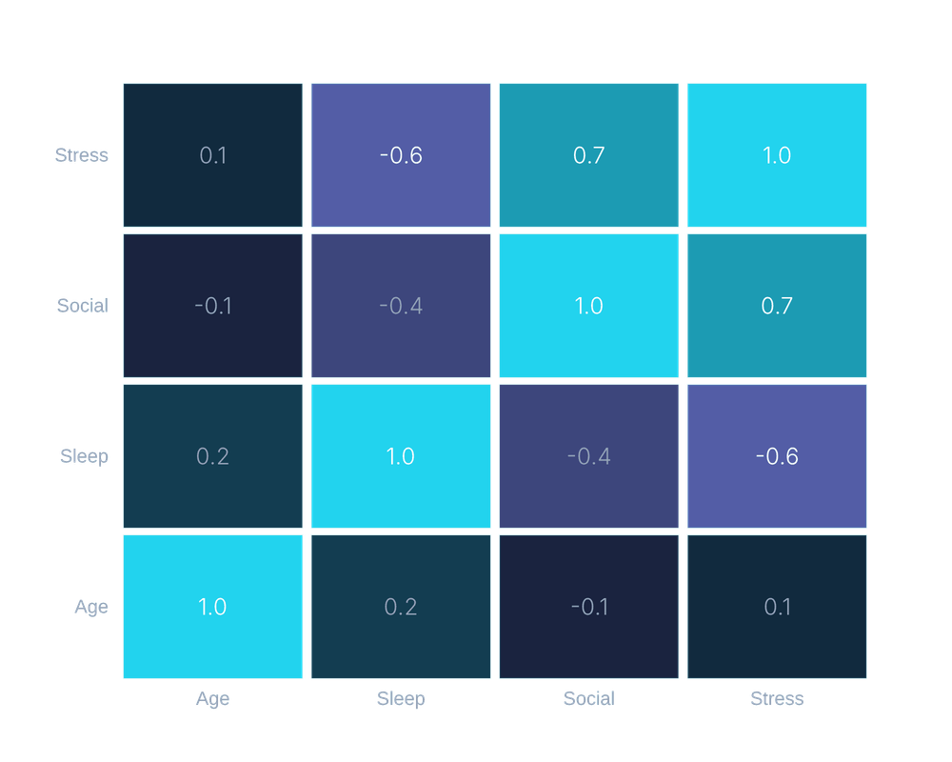
Mapping the Interconnectedness of Lifestyle Factors
The Heatmap Analysis
Identifying strong positive correlations between addiction levels and anxiety markers across all demographics.
Platform Impact
Social media platform choice (Instagram vs. TikTok) shows varying impacts on stress and screen exposure.
Central Node: Sleep
Sleep quality emerges as the central node connecting digital habits to overall mental state.
-1.0
+1.0
Notes:
This correlation map is the heart of our feature selection. It shows how addiction, anxiety, and screen time are deeply intertwined, providing the 'why' behind our model's predictions. We see strong positive correlations between addiction levels and anxiety, highlighting their interconnectedness. Also, the specific social media platform, like Instagram versus TikTok, significantly impacts stress levels. Ultimately, sleep quality emerges as a central node, linking digital habits directly to an individual's mental state. This comprehensive understanding of feature relationships directly informed the design of our predictive engine.

Slide 7

The Engine: Multi-Model Algorithmic Framework
PHASE 01
PHASE 02
PHASE 03
Preprocessing
Validation
Model Suite
Label Encoding (Gender, Platform)
80/20 Train-Test Split
Logistic Regression
Random Forest
Stratified Sampling
Feature Scaling & Normalization
Decision Trees
XGBoost Classifier
Cross-Validation Scoring
Handling Class Imbalance
Notes:
Our multi-model algorithmic framework is the engine driving our predictions. We meticulously preprocessed our data, using label encoding for categorical features and addressing class imbalance to ensure robust training. Then, we validated our approach with an 80/20 train-test split and stratified sampling for reliable evaluation. We didn't just pick one algorithm; we evaluated a suite of models, from Logistic Regression as our baseline to advanced XGBoost, to find the optimal solution. This rigorous process ensures our model's reliability and precision, which you'll see in our performance benchmarks.

Slide 8

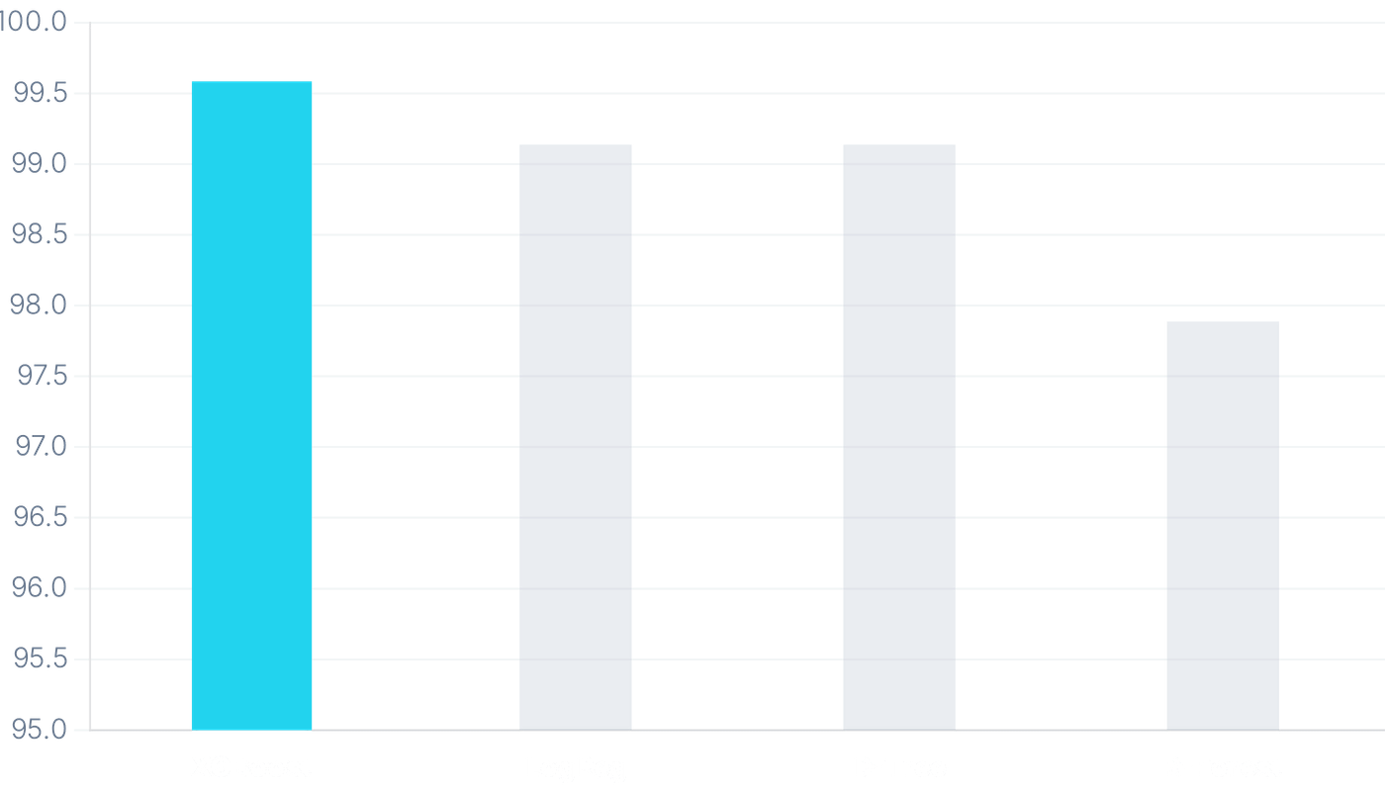
Unrivaled Accuracy in Prediction
99.58%
PEAK MODEL ACCURACY
ALGORITHM
ACCURACY
XGBClassifier
99.58%
Logistic Regression
99.16%
Decision Tree
99.16%
Random Forest
97.91%
Notes:
The results are truly staggering. Our XGBoost model achieved an unrivaled accuracy rate of 99.58%. This isn't just a high number; it's a critical indicator of our model's ability to accurately predict depression risk. While other models performed well, XGBoost consistently outperformed them, demonstrating its superior capability in handling complex data patterns. This level of precision is paramount when dealing with sensitive mental health data, and it sets a new benchmark for predictive wellness. Now, let's dive deeper into why XGBoost stands out.

Slide 9

Why XGBoost Leads the Way
1.00
1.00
0.91
PRECISION
RECALL
F1-SCORE
Perfect precision for non-depressed class; 0.83 for minority detection.
100% sensitivity in identifying individuals at risk of depression.
Exceptional balance between precision and recall for the minority class.
Algorithmic Robustness
XGBoost effectively handles the non-linear relationships between digital biomarkers and mental health states, outperforming traditional linear models in complex behavioral datasets.
Notes:
Our XGBoost model doesn't just deliver high accuracy; it provides critical precision and recall for the most sensitive cases. This means we're not just getting answers right, we're getting the right answers for those who need them most. We achieved perfect precision for the non-depressed class, meaning we avoid false positives. Crucially, we hit 100% recall for the depressed class, ensuring we identify every individual at risk. This robust performance, especially the 0.91 F1-score for the minority class, proves its reliability. XGBoost handles the complex, non-linear relationships in our data, making it ideal for predicting mental health from diverse digital biomarkers. This exceptional performance sets the stage for real-world application, which we'll discuss next.

Slide 10

Scalability: From Research to Impact
API INTEGRATION
Seamless deployment ready for wearable tech, health ecosystems, and corporate wellness platforms via RESTful architecture.
REAL-TIME MONITORING
Continuous risk assessment engine that processes digital biomarkers to provide instant wellness alerts and intervention triggers.
PRIVACY FIRST
Architecture designed for end-to-end encryption and anonymized data processing, ensuring full compliance with global health data standards.
MARKET POTENTIAL
Targeting a $500B+ global mental health market ripe for AI disruption and predictive diagnostic tools.
Notes:
This isn't just an academic exercise; our model is engineered for real-world impact and scalability. We've designed it for seamless API integration, ready to connect with existing wearable tech and wellness platforms. Imagine real-time monitoring, providing continuous risk assessment and instant alerts based on digital biomarkers. And because mental health data is sensitive, our architecture prioritizes privacy with end-to-end encryption and anonymized processing. This positions us perfectly to disrupt the half-trillion-dollar global mental health market. Now, let's look at the broader vision for this technology.

Slide 11
The Future of Mental Health is Predictive
Moving from reactive treatment to proactive, data-driven prevention.
Our research demonstrates that digital biomarkers are powerful indicators of mental wellness. By harnessing AI, we can identify risks before they escalate into crises.
PHASE 01
PHASE 02
PHASE 03
Data Expansion
Real-time API
Global Impact
Integrating longitudinal clinical data for deeper diagnostic accuracy.
Deploying scalable microservices for wearable tech integration.
Partnering with healthcare providers for early intervention programs.
Notes:
In conclusion, our project demonstrates that the future of mental health is predictive, moving us from reactive treatment to proactive prevention. We've shown that digital footprints are powerful indicators of mental wellness, allowing us to identify risks before they escalate. Our next steps involve expanding our dataset with longitudinal clinical data for even deeper accuracy. We'll then deploy scalable microservices for real-time API integration with wearable tech. Ultimately, we aim to partner with healthcare providers globally to implement early intervention programs. Thank you.

