Slide 1
Model Predictive Control for Frenet-Cartesian Trajectory Tracking of a Tricycle Kinematic Automated Guided Vehicle
Akash Subash, et al.
2024 IEEE/RSJ International Conference on Intelligent Robots and Systems (IROS)
Siddhesh Shingate
Aspects Implemented :
Vehicle Kinematics with Cartesian-Frenet Transformations
MPC Implementation ( Trajectory Tracking + Obstacle Avoidance )

Slide 2
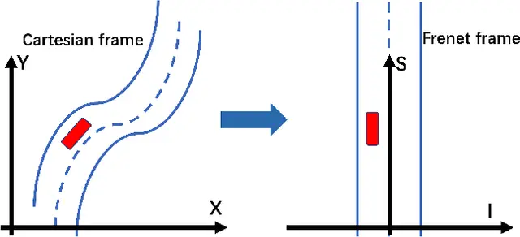
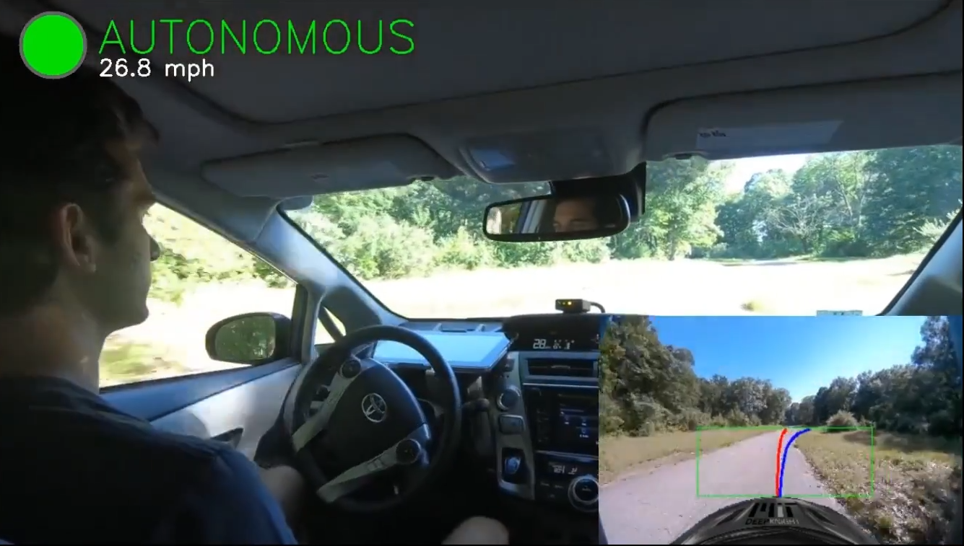
Frenet Frames Overview
Basically, a moving frame that follows a curve.
Axes => T (Tangent) , N (Normal), B (Binormal)

Slide 3

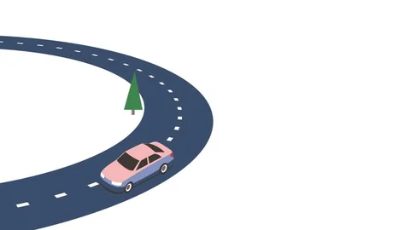
Block Diagram
MPC Controller
Horizon (N)
Augmented State Variable
Constraints
Optimal Control
Sequence
Reference Path
Frenet Parameters: s, x, y, heading, curvature
Cost Function
Progress (s)
Lateral Deviation (n)
Heading Diff
Control effort
Constraints
Curvature
Lateral bounds
Obstacle Avoidance
Control limits
Vehicle Dynamics.step()
Simulation Loop
Update state
Generate reference
Solve MPC
Apply controls
Visualization
State Conversions

Slide 4
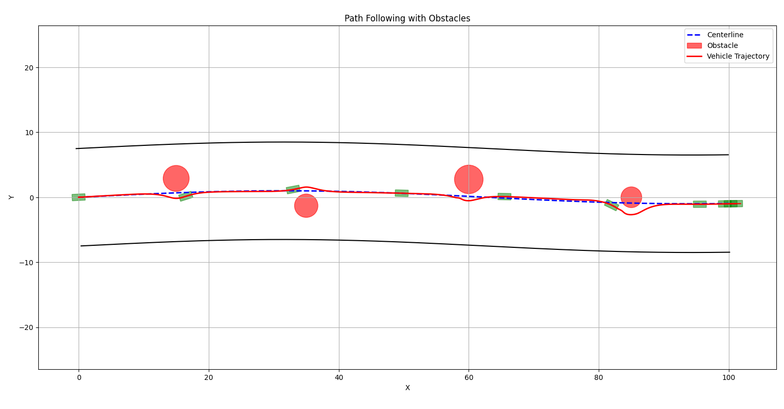

Slide 5
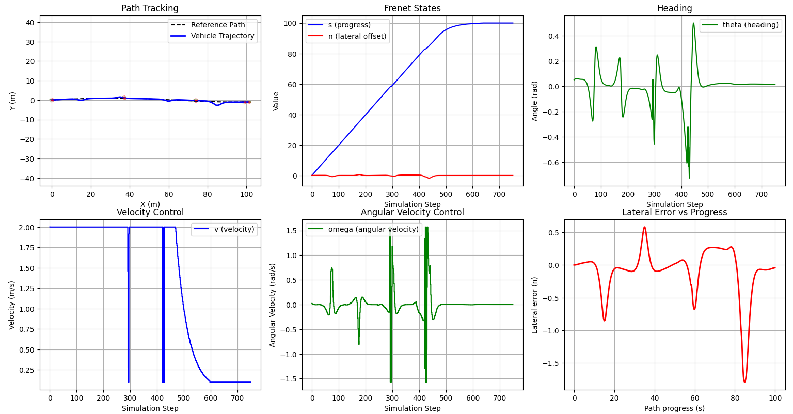

Slide 6
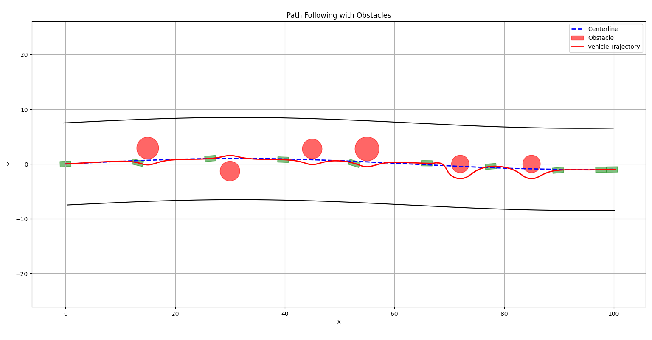

Slide 7
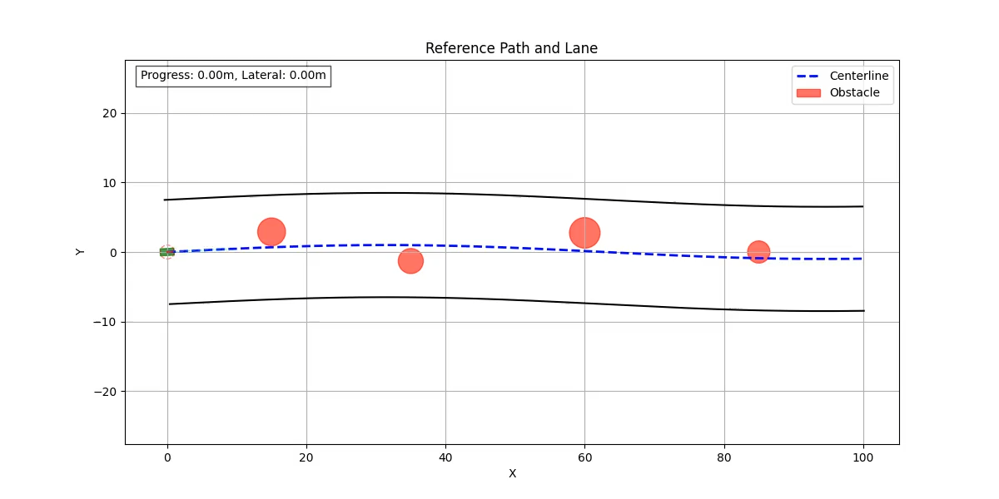

Slide 8
THANK YOU

