Slide 1
ATLAS
Agentic Technology for Literature Analysis and Synthesis
A literature-review agent that reads, follows citations, and keeps every claim
tied to a verbatim, checked quote from its source.
Siddhesh Acharya · Mrigakshi Kaul · Suhani Singh
Final Review · 3 October 2026

Slide 2
The Problem, and ATLAS's Answer: A Closed Foraging Loop
HOW TOOLS DO IT TODAY
HOW A RESEARCHER DOES IT
Search → take the top-k most similar abstracts → summarise. One pass: nothing read changes what is read next, and quotes can be paraphrased or invented.
Read the most promising paper → follow its references and citers → choose what to read next from what was just learned. Keep notes that point to the exact sentence.
Harvest
Rank
Read
Extract
Ground
Judge
Expand
Re-score
4 APIs → ~500
candidates
›
embed + score
the frontier
›
PDF → GROBID
sections
›
claims with
verbatim quotes
›
quote must match
source exactly
›
claim-pair
relations
›
references +
citations
›
what to read
next
↺ repeat until the budget or saturation stops it → then: concepts → 5 gap detectors → one-pass grounded report → dashboard + chat
SCORING THE FRONTIER (what to read next)
BUILT AND RUNNING
relevance · recency · novelty vs what was read · PageRank in the growing citation graph · contest (disputed claims)
Bands on arrival: drop / park / queue; a parked paper bridging two clusters can be promoted.
Python · FastAPI · React + Cytoscape dashboard (live graph, report, chat)
Neo4j · Qdrant · SQLite / Postgres · GROBID · local bge embeddings
Free-tier LLMs: Groq gpt-oss (claims, judge), Gemini (report)
ATLAS — Agentic Technology for Literature Analysis and Synthesis · Siddhesh Acharya, Mrigakshi Kaul, Suhani Singh · Final Review
2

Slide 3
Trust by Construction: Four Rules the Code Enforces
NO UNVERIFIED QUOTE
NO GAP WITHOUT CITATIONS
Every claim carries a quote that must match the normalised source text character for character. Failures are dropped and logged — never repaired by the LLM.
A research gap that cannot name the papers bounding it is filtered out before it is ranked, reported or shown.
NOTHING IT DID NOT READ
REPLAYABLE
The chat retrieves only from this run's claims. With nothing relevant it refuses — decided by retrieval, before any LLM is called.
Every LLM and API call is cached on its exact input. A re-run of the same query and config reproduces the run — measured, not assumed.
ATLAS — Agentic Technology for Literature Analysis and Synthesis · Siddhesh Acharya, Mrigakshi Kaul, Suhani Singh · Final Review
3

Slide 4
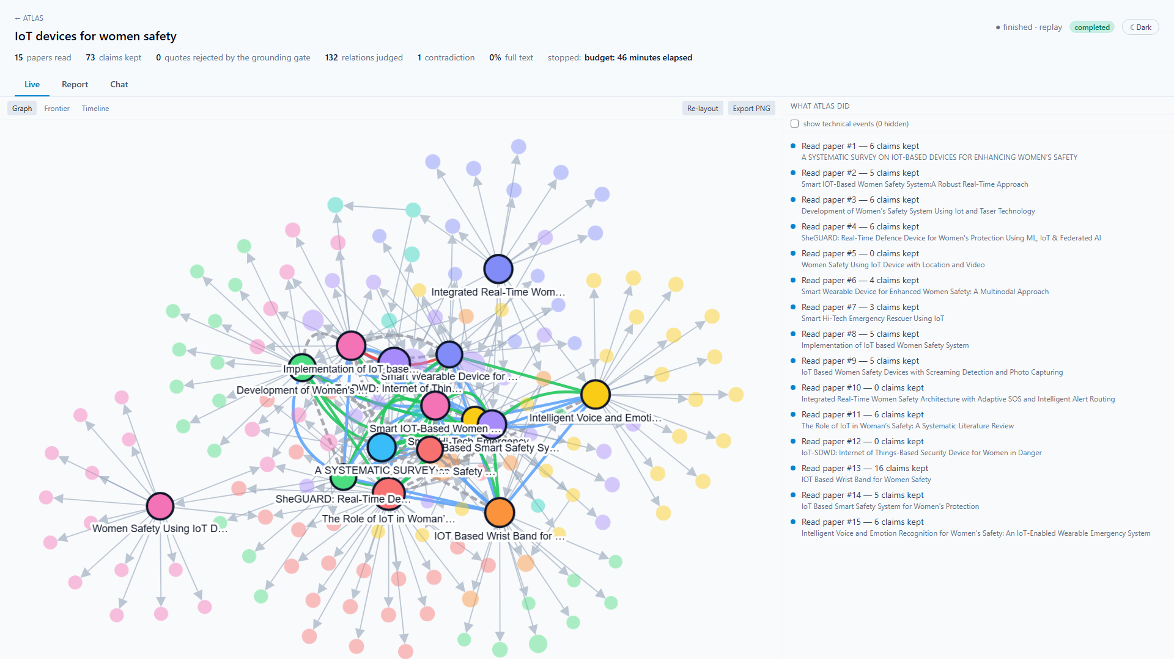
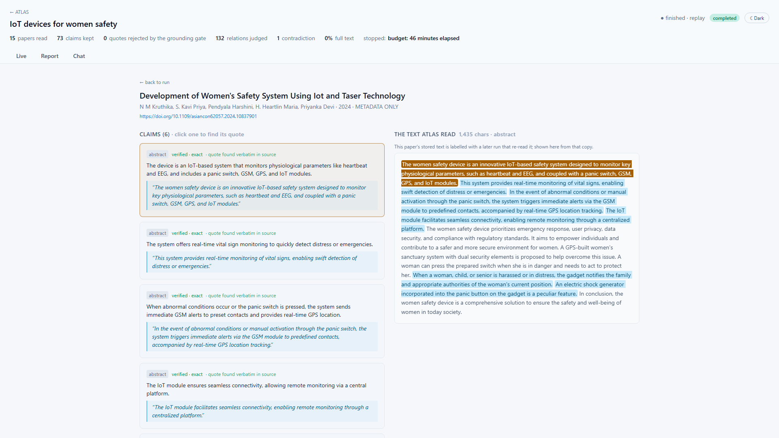
Demo — The Live Graph, and Every Claim Pointing to Its Sentence
Run a0e32253 (IoT devices for women's safety), built live paper by paper.
Click a claim: its quote lights up inside the text ATLAS actually read.
READING THE GRAPH
THE GROUNDING GATE, VISIBLE
Ringed nodes: the 15 papers read · faded: papers they cite. Size = PageRank, colour = citation cluster. Edges: grey cites · green supports · blue extends · dashed different scope · red contradicts.
'Quote found verbatim in source' is recomputed in the browser from stored offsets. Chat refuses 'Who won the 2018 FIFA World Cup?' — 'ATLAS did not read anything that addresses this.'
ATLAS — Agentic Technology for Literature Analysis and Synthesis · Siddhesh Acharya, Mrigakshi Kaul, Suhani Singh · Final Review
4

Slide 5
Result 1 — Does the Loop Read Differently from One-Shot Retrieval?
Run (query, papers read) | Overlap with cosine top-25 | Clusters ATLAS / baseline* | References reached ATLAS / baseline*
IoT safety, 15 | 53% | 8 / 9 | 115 / 92
IoT safety, 15 | 40% | 9 / 9 | 147 / 92
Federated learning, 14 | 36% | 10 / 8 | 355 / 332
Federated learning, 13 (GROBID) | 38% | 11 / 9 | 452 / 332
Gut microbiome, 9 (GROBID) | 56% | 7 / 8 | 381 / 365
HELD
ATLAS reads a substantially different set (36–56% overlap) and reaches 4–60% more of the reference network.
* baseline cut to the same number of papers; one OpenAlex citation graph and one Louvain clustering for both sets.
NOT SHOWN
CORRECTION WE MADE
At 9–15 papers it is not broader in citation-cluster coverage (−1, 0, +2, +2, −1). Bridge promotion never fired at this scale.
An earlier draft claimed '14 clusters vs ~1 for the baseline'. That compared two different metrics (citation clusters vs text-similarity clusters), on vectors a bug had overwritten. We found it, fixed both, and withdrew the figure. The table is the like-for-like result.
ATLAS — Agentic Technology for Literature Analysis and Synthesis · Siddhesh Acharya, Mrigakshi Kaul, Suhani Singh · Final Review
5

Slide 6
Result 2 — Are the Quotes Real?
49 / 50
4
3 / 198
0
quotes verbatim (98%)
live edits caught
claims dropped
repairs by the LLM
Each source re-fetched and checked as an exact substring.
Quotes the old fuzzy match let through: 'is set too high', 'a'→'an', a dropped 'that', a PDF page number.
Federated-learning run with GROBID — the gate rejects little once text is clean.
A failed quote is dropped and logged, never rewritten.
THE ONE FAILURE, TRACED
THE LOOPHOLE WE CLOSED
The quote said 'the last few 5 layers'. The paper says 'the last few layers'.
Checking the PDF: page 4 ends mid-sentence, page 5 opens with its number '5'. The PDF parser kept it; the LLM quoted what ATLAS read, faithfully.
Fixed at the source: page numbers are stripped.
A 97%-similarity fallback existed for PDF noise — but it also accepted 'increased'→'decreased' or 'p > 0.05'→'p < 0.05'.
Now a fuzzy match must be exact once only spacing, hyphenation, quote marks, case and reference markers are ignored. Checked against every stored fuzzy match before shipping.
ATLAS — Agentic Technology for Literature Analysis and Synthesis · Siddhesh Acharya, Mrigakshi Kaul, Suhani Singh · Final Review
6

Slide 7
Result 3 — Relations and Gaps: The Weakest Parts, Measured
Compared (12 single-label pairs) | Agreement | Cohen's κ
Human vs AI annotator | 2 / 12 | −0.17
Human vs ATLAS judge | 2 / 12 | −0.05
AI annotator vs ATLAS judge | 5 / 12 | 0.22
GAP QUALITY
IoT (10 gaps): 2 plausible · 4 trivial · 4 wrong
IoT (6 gaps): 0 plausible · 1 trivial · 5 wrong
Most 'unlinked concepts' are linked under other wording. AI-annotator ratings.
RELATIONS
Even the annotators disagree on 'supports' vs 'extends' vs 'different scope' (the human marked 3 of 15 pairs undecided), so a single judge-accuracy figure (57% or 36%) is not trustworthy.
IoT's only contradiction ('NodeMCU' vs 'Raspberry Pi Pico') was false. Gut microbiome's ('repeatedly associated with depression' vs 'clinical results are mixed') is a plausible tension for a human to judge.
A stricter judge prompt removed the false contradiction but lost 8 of 9 genuine 'supports' — a trade-off, not a fix.
Federated learning | PyMuPDF | GROBID
Full-text ratio | 14% | 23%
Claims extracted | 98 | 198
Gaps (5 detectors) | 0 | 0
GROBID doubles the claims per full-text paper, but open PDFs are scarce (IoT: 0 of 15), so the full-text gap detectors are starved, not broken — the remedy is scale. Gut microbiome (GROBID): 3 of 9 in full text, 30 / 65 / 13 claims vs 0–6 per abstract; 3 gaps survived (not yet rated).
ATLAS — Agentic Technology for Literature Analysis and Synthesis · Siddhesh Acharya, Mrigakshi Kaul, Suhani Singh · Final Review
7

Slide 8
Result 4 — Reproducible and Cheap
Identical
0
≤ $0.05
1–4 h
replay of a 15-paper run
new LLM calls on replay
per 15-paper run
fresh run, free tier
Same papers in the same order, 65 claims, 132 relations — compared field by field.
145 of 145 calls served from cache; 6.7 min.
At paid Groq rates, from measured tokens; free on free tiers.
Limit: 8K tokens/min and 200K/day per model — throughput, not money.
REPRODUCIBILITY BUGS FOUND AND FIXED ALONG THE WAY
Gap lists differed between two runs of the detectors on the same graph (6 vs 7 gaps) — Python's per-process set order steered clustering and tie-breaks; now byte-identical across processes.
Reading a paper silently overwrote its shared embedding, changing the next run's reading order.
Answers cut off by the output limit were never cached, so replays asked the LLM again.
Per-run facts (read order, gaps, contradictions) leaked between runs through shared paper nodes.
ATLAS — Agentic Technology for Literature Analysis and Synthesis · Siddhesh Acharya, Mrigakshi Kaul, Suhani Singh · Final Review
8

Slide 9
Limitations, Conclusion and Future Work
LIMITATIONS — STATED PLAINLY
WHAT ATLAS IS
• Scale: 9–15 papers per run, three questions; a real review covers hundreds.
• Breadth: reads differently, but broader citation coverage not yet shown.
• Relations: annotators disagree on the labels; the IoT contradiction was false.
• Gaps: mostly wording artefacts; 0–2 of 6–10 rated plausible.
• Full text: open PDFs are scarce (0–33%); much is read from abstracts.
• Annotation: one human on 15 pairs; other ratings by an AI annotator.
• Not run in time on the free tier: ablation for queries 2–3, a 75-paper deep run.
A working end-to-end research prototype: it harvests, reads, follows citations, builds a live graph and a grounded report, and answers only from what it read.
Dependable as an evidence finder — every claim traceable to a machine-checked sentence, runs reproducible. Its paper-to-paper relations are leads, not conclusions.
NEXT
Run at scale (75–200 papers) to test breadth and bridge promotion.
Sharpen the relation taxonomy; two or more human annotators; re-measure the judge.
Normalise concept wording before gap detection.
Paid or local LLM capacity to lift the free-tier ceiling.
ATLAS — Agentic Technology for Literature Analysis and Synthesis · Siddhesh Acharya, Mrigakshi Kaul, Suhani Singh · Final Review
9

Slide 10
Thank you
Questions · live demo on request
Siddhesh Acharya · Mrigakshi Kaul · Suhani Singh

