Slide 1
ATLAS
Agentic Technology for Literature Analysis and Synthesis
A literature-review agent that reads, follows citations, and keeps every claim
tied to a verbatim, checked quote from its source.
Siddhesh Acharya · Mrigakshi Kaul · Suhani Singh
Final Review · 3 October 2026

Slide 2
The Problem: Retrieval Is Solved. Reading Is Not.
HOW TOOLS DO IT TODAY
HOW A RESEARCHER DOES IT
Search the query → take the top-k most similar abstracts → summarise them.
One pass. Nothing read changes what gets read next. The summary can cite
things the model never saw, and quotes can be paraphrased or invented.
Read the most promising paper → follow its references and citers →
decide what to read next based on what was just learned → repeat.
Keep notes that point back to the exact sentence. Notice disagreements.
WHAT ATLAS SETS OUT TO TEST
1. A closed foraging loop reads differently from one-shot retrieval.
2. Every extracted claim can be forced to carry a verbatim quote that is machine-checked against the source — no paraphrase survives.
3. From what it read, it can report where papers agree, conflict, and leave gaps — and refuse to answer beyond what it read.
We measured each of these. Some held, some did not; this deck reports both.
ATLAS — Agentic Technology for Literature Analysis and Synthesis · Siddhesh Acharya, Mrigakshi Kaul, Suhani Singh · Final Review
2

Slide 3
The Idea: A Closed Foraging Loop
Harvest
Rank
Read
Extract
Ground
Judge
Expand
Re-score
4 APIs → ~500
candidates
›
embed + score
the frontier
›
PDF → GROBID
sections
›
claims with
verbatim quotes
›
quote must match
source exactly
›
claim-pair
relations
›
references +
citations
›
what to read
next
↺ repeat until the budget or saturation stops it → then: concepts → 5 gap detectors → one-pass grounded report → dashboard + chat
SCORING THE FRONTIER (what to read next)
BUILT AND RUNNING
relevance to the query · recency · novelty vs what was read
PageRank in the growing citation graph · contest (disputed claims)
Three bands on arrival: drop / park / queue. A parked paper whose
citations bridge two clusters can be promoted (bridge promotion).
Python · FastAPI · React + Cytoscape dashboard (live graph, report, chat)
Neo4j (graph) · Qdrant (vectors) · SQLite / Postgres (run state)
GROBID full-text parsing (hosted Space) · local bge embeddings
LLMs on free tiers: Groq gpt-oss (claims, judge), Gemini (report)
One command to run: atlas serve
ATLAS — Agentic Technology for Literature Analysis and Synthesis · Siddhesh Acharya, Mrigakshi Kaul, Suhani Singh · Final Review
3

Slide 4
Trust by Construction: Four Rules the Code Enforces
NO UNVERIFIED QUOTE
NO GAP WITHOUT CITATIONS
Every claim carries a quote that must match the normalised source text character for character. Failures are dropped and logged — never repaired by the LLM.
A research gap that cannot name the papers bounding it is filtered out before it is ranked, reported or shown.
NOTHING IT DID NOT READ
REPLAYABLE
The chat retrieves only from this run's claims. With nothing relevant it refuses — decided by retrieval, before any LLM is called.
Every LLM and API call is cached on its exact input. A re-run of the same query and config reproduces the run — measured, not assumed.
ATLAS — Agentic Technology for Literature Analysis and Synthesis · Siddhesh Acharya, Mrigakshi Kaul, Suhani Singh · Final Review
4

Slide 5
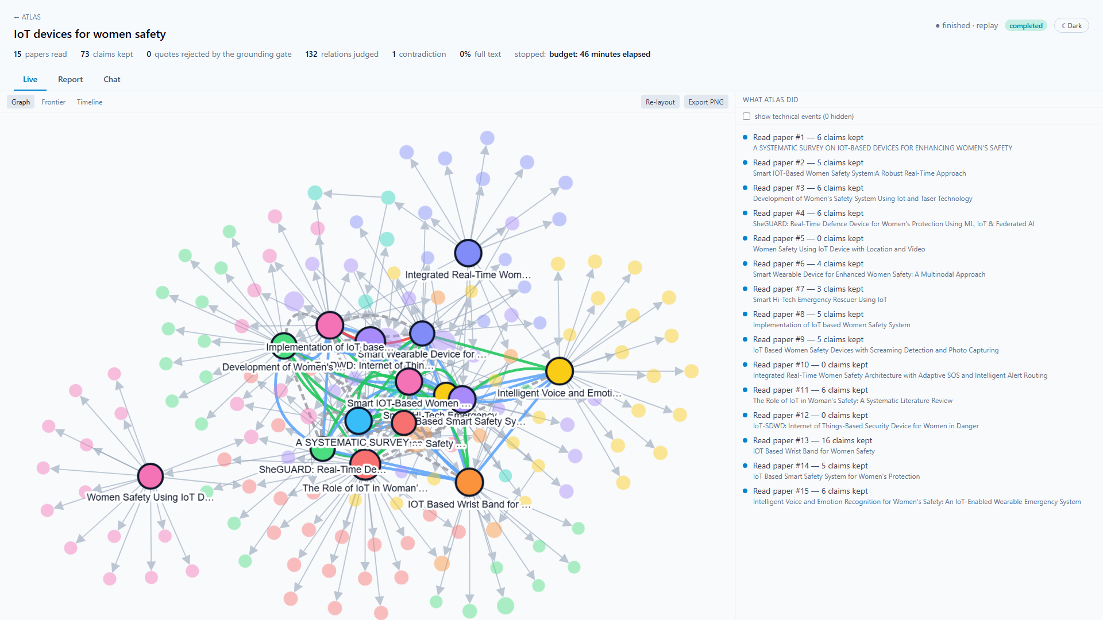
Demo 1 — The Graph ATLAS Builds While It Reads
HOW TO READ IT
Ringed, labelled nodes: the 15 papers ATLAS read.
Faded nodes: papers they cite — discovered, not read.
Size = PageRank. Colour = citation cluster.
Edges: grey cites · green supports · blue extends · dashed different scope · red contradicts.
Built live, paper by paper, streamed to the browser.
Run a0e32253 (IoT devices for women's safety) in the dashboard's light (projector) theme, 1920×1080.
ATLAS — Agentic Technology for Literature Analysis and Synthesis · Siddhesh Acharya, Mrigakshi Kaul, Suhani Singh · Final Review
5

Slide 6
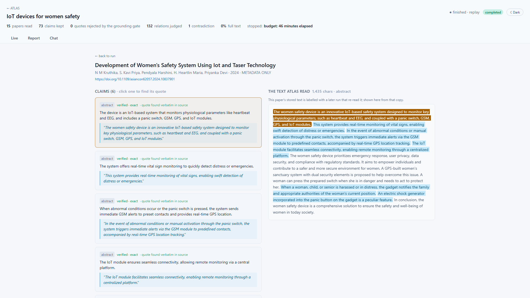
Demo 2 — Every Claim Points to Its Exact Sentence
WHAT THE BOARD SEES
Left: the claims ATLAS extracted from this paper.
Right: the normalised text it read, every verified quote highlighted in place.
'Quote found verbatim in source' is recomputed in the browser from the stored offsets — the grounding gate made visible.
Demo 3: the chat refuses 'Who won the 2018 FIFA World Cup?' — 'ATLAS did not read anything that addresses this.'
Click a claim: its quote lights up inside the text ATLAS actually read.
ATLAS — Agentic Technology for Literature Analysis and Synthesis · Siddhesh Acharya, Mrigakshi Kaul, Suhani Singh · Final Review
6

Slide 7
Result 1 — Does the Loop Read Differently from One-Shot Retrieval?
Run (query, papers read) | Overlap with cosine top-25 | Clusters ATLAS / baseline* | References reached ATLAS / baseline*
IoT safety, 15 | 53% | 8 / 9 | 115 / 92
IoT safety, 15 | 40% | 9 / 9 | 147 / 92
Federated learning, 14 | 36% | 10 / 8 | 355 / 332
Federated learning, 13 (GROBID) | 38% | 11 / 9 | 452 / 332
Gut microbiome, 9 (GROBID) | 56% | 7 / 8 | 381 / 365
HELD
ATLAS reads a substantially different set (36–56% overlap) and reaches 4–60% more of the reference network.
* baseline cut to the same number of papers; one OpenAlex citation graph and one Louvain clustering for both sets.
NOT SHOWN
CORRECTION WE MADE
At 9–15 papers it is not broader in citation-cluster coverage (−1, 0, +2, +2, −1). Bridge promotion never fired at this scale.
An earlier draft claimed '14 clusters vs ~1 for the baseline'. That compared two different metrics (citation clusters vs text-similarity clusters), on vectors a bug had overwritten. We found it, fixed both, and withdrew the figure. The table is the like-for-like result.
ATLAS — Agentic Technology for Literature Analysis and Synthesis · Siddhesh Acharya, Mrigakshi Kaul, Suhani Singh · Final Review
7

Slide 8
Result 2 — Are the Quotes Real?
49 / 50
4
3 / 198
0
quotes verbatim (98%)
live edits caught
claims dropped
repairs by the LLM
Each source re-fetched and checked as an exact substring.
Quotes the old fuzzy match let through: 'is set too high', 'a'→'an', a dropped 'that', a PDF page number.
Federated-learning run with GROBID — the gate rejects little once text is clean.
A failed quote is dropped and logged, never rewritten.
THE ONE FAILURE, TRACED
THE LOOPHOLE WE CLOSED
The quote said 'the last few 5 layers'. The paper says 'the last few layers'.
Checking the PDF: page 4 ends mid-sentence, page 5 opens with its number '5'. The PDF parser kept it; the LLM quoted what ATLAS read, faithfully.
Fixed at the source: page numbers are stripped.
A 97%-similarity fallback existed for PDF noise — but it also accepted 'increased'→'decreased' or 'p > 0.05'→'p < 0.05'.
Now a fuzzy match must be exact once only spacing, hyphenation, quote marks, case and reference markers are ignored. Checked against every stored fuzzy match before shipping.
ATLAS — Agentic Technology for Literature Analysis and Synthesis · Siddhesh Acharya, Mrigakshi Kaul, Suhani Singh · Final Review
8

Slide 9
Result 3 — How Papers Relate: The Weakest Part, Measured
Compared (12 single-label pairs) | Agreement | Cohen's κ
Human vs AI annotator | 2 / 12 | −0.17
Human vs ATLAS judge | 2 / 12 | −0.05
AI annotator vs ATLAS judge | 5 / 12 | 0.22
THE CONTRADICTIONS
IoT runs: the only one — 'uses a NodeMCU' vs 'uses a Raspberry Pi Pico' — was false: two independent devices, not a disagreement.
Gut microbiome: 'repeatedly associated with depression' vs 'clinical results are mixed' — same topic, a plausible tension for a human to judge.
WHAT THIS MEANS
Even two annotators do not agree whether two claims 'support', 'extend' or merely 'differ in scope' — the human marked 3 of 15 pairs as undecided.
So a single 'judge accuracy' number (57% or 36%, depending on the annotator) is not trustworthy. The label taxonomy needs sharper definitions before the judge can be scored.
WHAT WE TRIED
A stricter prompt (judge v2) removed the false contradiction and false 'extends' — but also lost 8 of 9 genuine 'supports'. A trade-off, not a fix; runs keep v1 and the result is reported as such.
ATLAS — Agentic Technology for Literature Analysis and Synthesis · Siddhesh Acharya, Mrigakshi Kaul, Suhani Singh · Final Review
9

Slide 10
Result 4 — Research Gaps and Full Text
GAP QUALITY
Federated learning | PyMuPDF | GROBID
Full-text ratio | 14% | 23%
Claims extracted | 98 | 198
Claims dropped | 1 | 3
Gaps (5 detectors) | 0 | 0
IoT run (10 gaps): 2 plausible · 4 trivial · 4 wrong
IoT run (6 gaps): 0 plausible · 1 trivial · 5 wrong
Most 'unlinked concepts' are linked in the corpus under different wording ('continuous monitoring' vs 'panic button'). Ratings by an AI annotator.
HONEST READING
GROBID doubles the claims a full-text paper yields and gives real sections. But in a 15-paper run on open-access PDFs only a handful of papers have full text (IoT: 0 of 15 had an open PDF), so no method or dataset appears in the two papers the full-text gap detectors need. The detectors are starved, not broken; the remedy is scale, not lower thresholds. Gut microbiome (GROBID): 3 of 9 papers in full text (33%), yielding 30, 65 and 13 claims against 0–6 per abstract — and 3 gaps survived (not yet rated).
ATLAS — Agentic Technology for Literature Analysis and Synthesis · Siddhesh Acharya, Mrigakshi Kaul, Suhani Singh · Final Review
10

Slide 11
Result 5 — Reproducible and Cheap
Identical
0
≤ $0.05
1–4 h
replay of a 15-paper run
new LLM calls on replay
per 15-paper run
fresh run, free tier
Same papers in the same order, 65 claims, 132 relations — compared field by field.
145 of 145 calls served from cache; 6.7 min.
At paid Groq rates, from measured tokens; free on free tiers.
Limit: 8K tokens/min and 200K/day per model — throughput, not money.
REPRODUCIBILITY BUGS FOUND AND FIXED ALONG THE WAY
Gap lists differed between two runs of the detectors on the same graph (6 vs 7 gaps) — Python's per-process set order steered clustering and tie-breaks; now byte-identical across processes.
Reading a paper silently overwrote its shared embedding, changing the next run's reading order.
Answers cut off by the output limit were never cached, so replays asked the LLM again.
Per-run facts (read order, gaps, contradictions) leaked between runs through shared paper nodes.
ATLAS — Agentic Technology for Literature Analysis and Synthesis · Siddhesh Acharya, Mrigakshi Kaul, Suhani Singh · Final Review
11

Slide 12
Limitations — Stated Plainly
• Scale: 9–15 papers per run, three questions. A real systematic review covers hundreds.
• Breadth: the loop reads differently, but broader citation coverage is not yet shown.
• Relations: annotators disagree on the labels; the IoT contradiction was false, the gut one needs a human.
• Gaps: mostly wording artefacts; 0–2 of 6–10 rated plausible.
• Full text: open PDFs are scarce (full-text ratio 0–33%); much is read from abstracts.
• Annotation: one human annotator on 15 pairs; other ratings by an AI annotator.
• Not run in time on the free tier: the ablation for queries 2–3 and a 75-paper deep run.
ATLAS — Agentic Technology for Literature Analysis and Synthesis · Siddhesh Acharya, Mrigakshi Kaul, Suhani Singh · Final Review
12

Slide 13
Conclusion and Future Work
WHAT ATLAS IS
NEXT
A working, end-to-end research prototype: it harvests, reads, follows citations, extracts claims, builds a live graph and a grounded report, and answers only from what it read.
Dependable as an evidence finder: every claim is traceable to a verbatim, machine-checked sentence, and runs are reproducible.
Where it relates papers to one another, its output is a set of leads for a researcher, not conclusions.
Run at scale (75–200 papers) to test whether breadth and bridge promotion appear.
Sharpen the relation taxonomy; annotate with two or more humans; re-measure the judge.
Normalise concept wording before gap detection.
Keep per-run facts off shared graph nodes (read order and gaps done; depth, PageRank next).
Paid or local LLM capacity to remove the free-tier throughput ceiling.
ATLAS — Agentic Technology for Literature Analysis and Synthesis · Siddhesh Acharya, Mrigakshi Kaul, Suhani Singh · Final Review
13

Slide 14
Thank you
Questions · live demo on request

Slide 15
Backup — Ablation of the Scoring Components (IoT query, preliminary)
Config (15 papers) | Clusters covered | Contradictions | Relations judged
full | 13 | 1 | 132
− PageRank | 12 | 1 | 120
− novelty | 13 | 1 | 156
− contest | 13 | 1 | 120
− recency | 10 | 0 | 84
relevance only | 10 | 0 | 84
CAVEATS
One query, 15 papers, one run per config — no variance estimate.
Recency carried most of the non-relevance signal here.
Cluster counts are the in-run measure; the like-for-like E1 comparison (slide 7) is the one to cite.
Queries 2–3 were not run in time on the free-tier quota.
ATLAS — Agentic Technology for Literature Analysis and Synthesis · Siddhesh Acharya, Mrigakshi Kaul, Suhani Singh · Final Review
15

