Slide 1
Handwritten Document Scanner
IMAGE PROCESSING & COMPUTER VISION · TEAM 15
Page detection, perspective correction, handwriting-specific enhancement and OCR for phone photos of notebook pages, implemented in handwritten_scanner_ocr.py
Vishesh Vigh
20233583
Siddhesh Choubey
20233569
Shreyash Kisan Khilare
20233566
Surya Pratap
20233283
Notes:
This project implements a pipeline that takes a phone photo of a handwritten notebook page and extracts its text, with an optional extractive summary. All code is in one Python file and runs on a CPU.

Slide 2
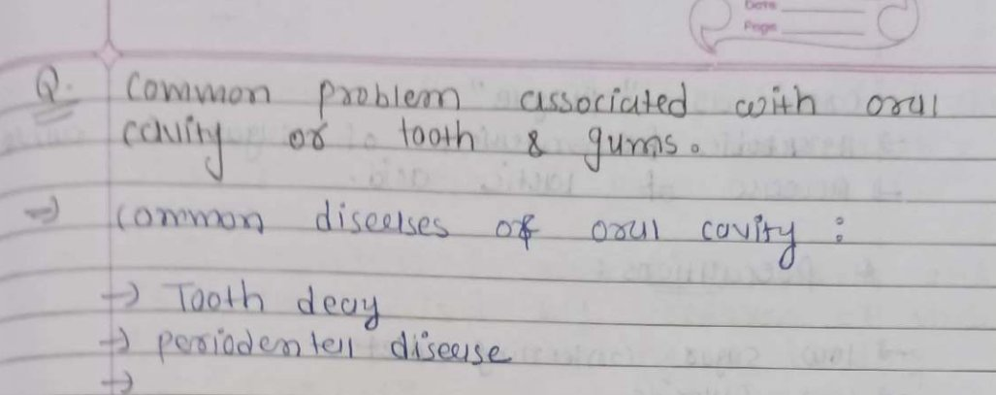




Problem and objectives
Geometric
Camera not parallel to the page: perspective distortion and tilted lines
Photometric
Shadows, uneven illumination, low-contrast blue ink
Test photo: 1027 × 407 px, 5 lines, 20 words, blue ink on ruled paper
Structural
Ruled and margin lines, header stamps, bleed-through from the reverse side
Objectives
Detect and flatten the page; remove rotation
Normalise contrast and lighting for handwriting
Recognise text and choose the best of several readings
Optional word correction and summary
Measure accuracy with CER and WER
Recognition
Joined, writer-specific handwriting; Tesseract is trained mostly on print
Notes:
A phone photo combines four kinds of degradation: geometric, photometric, structural and recognition-related. The objectives follow the pipeline: geometry first, then appearance, then recognition, post-processing and evaluation.

Slide 3
System overview
Page detection
Canny ×4, contours, contrast test
Perspective correction
Corner ordering, 3×3 homography
Deskew
Hough lines, median angle
1
2
3
Enhancement
2× upscale, CLAHE on L*, background division
Ruled-line suppression
Horizontal opening (optional)
Binarisation
Sauvola, adaptive Gaussian, closing
4
5
6
Recognition
EasyOCR / Tesseract, line grouping, score
Post-processing
Clean-up, optional lexicon matching
Summary
TextRank: TF-IDF + PageRank (optional)
7
8
9
Geometry · Appearance · Recognition · Language Output: final text, raw OCR text, enhanced image; --debug saves every stage
Notes:
The stages run in this order. Stage 2 runs only when stage 1 finds a valid page boundary. Stage 5, the lexicon in stage 8 and stage 9 are optional and controlled by command-line flags.

Slide 4
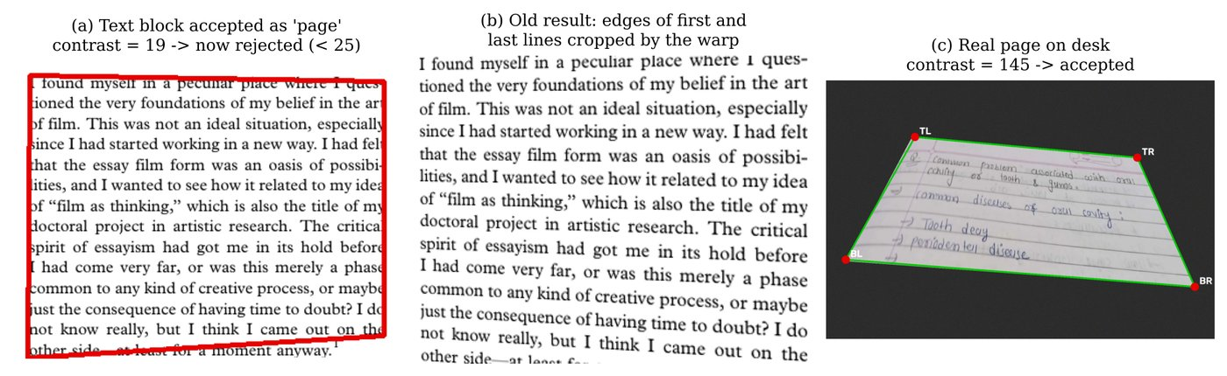
Stage 1 – Page boundary detection
1
Pre-processing
Resize to 800 px height, greyscale, 5×5 Gaussian blur
Boundary-contrast test
C = |median(inner ring) − median(outer ring)|, rings 8 px wide; accept if C ≥ 25
Page on a dark desk: C ≈ 145 (accepted)
Text block on a cropped page: C ≈ 19 (rejected)
2
Edge detection
Canny at (30,100), (50,150), (70,180), (100,200); 7×7 closing, twice
3
Contours
30 largest; Douglas–Peucker at 1.5–4% of perimeter; keep 4-vertex polygons
4
Validity checks
Area 15–105% of image, sides ≥ 40 px, aspect ratio ≤ 4; largest valid wins
5
Fallback
minAreaRect of largest contour (≥ 30% of frame); otherwise whole image
Left: false detection before the test; right: real page
Notes:
Several Canny thresholds are tried because the right sensitivity depends on lighting and background. The contrast test was added after finding that, on already-cropped photos, the dilated block of writing was accepted as the page and the warp cut off the first and last lines. On the real test photo no boundary is found, so stage 2 is skipped there.

Slide 5
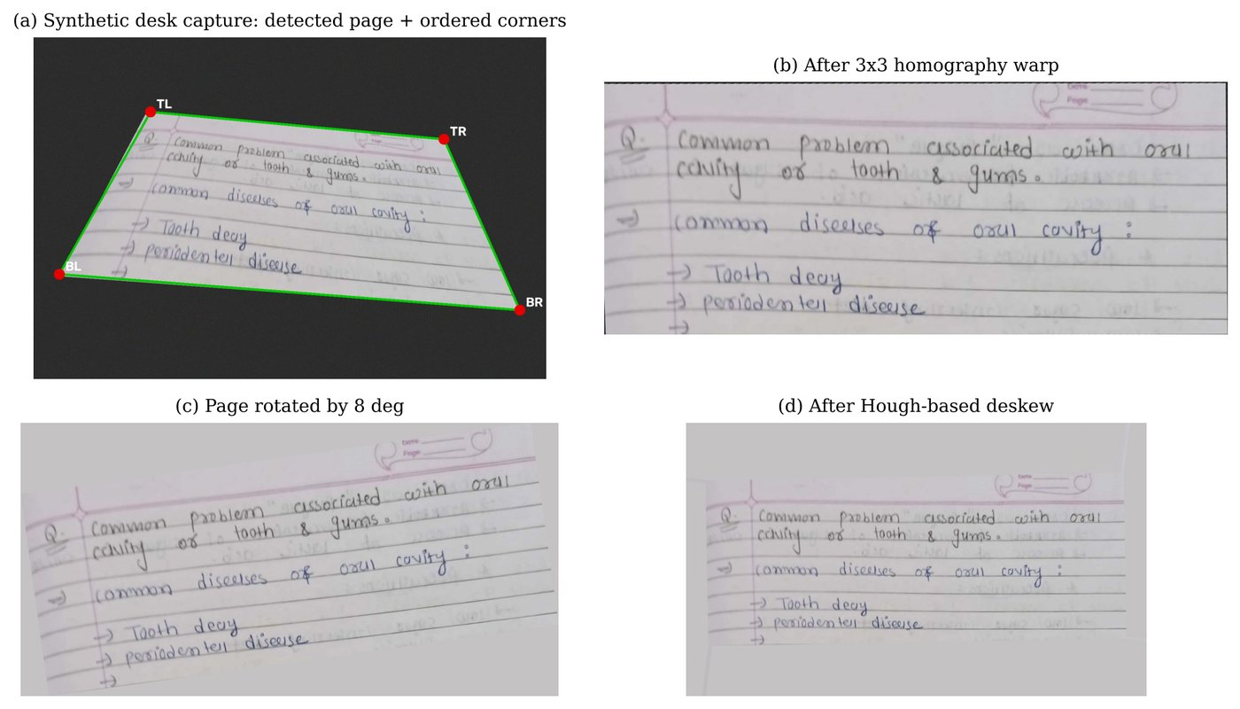
Stages 2–3 – Perspective correction and deskew
Corner ordering (y grows downward)
Corner | Rule
Top-left | smallest x + y
Bottom-right | largest x + y
Top-right | smallest y − x
Bottom-left | largest y − x
Homography
3×3 matrix, 8 unknowns from 4 point pairs (getPerspectiveTransform); bicubic warpPerspective; output size = longer of each pair of opposite sides
Synthetic test | Direct OCR | Pipeline
Rotated 8° | 77.8% | 39.7%
Desk, strong perspective | 62.7% | 44.4%
Deskew
HoughLinesP on Canny edges, segments ≥ W/5; keep |α| < 15°; median angle; skip if < 0.5°; rotate onto enlarged canvas W′ = H|sin α| + W|cos α|
Character error rate; lower is better
Notes:
Corners are sorted with x+y and y-x so that each maps to the right corner of the output rectangle. The homography has eight unknowns, solved from four point pairs. Deskew uses the probabilistic Hough transform on the ruled lines and text baselines; the median angle is robust to a few diagonal strokes.

Slide 6
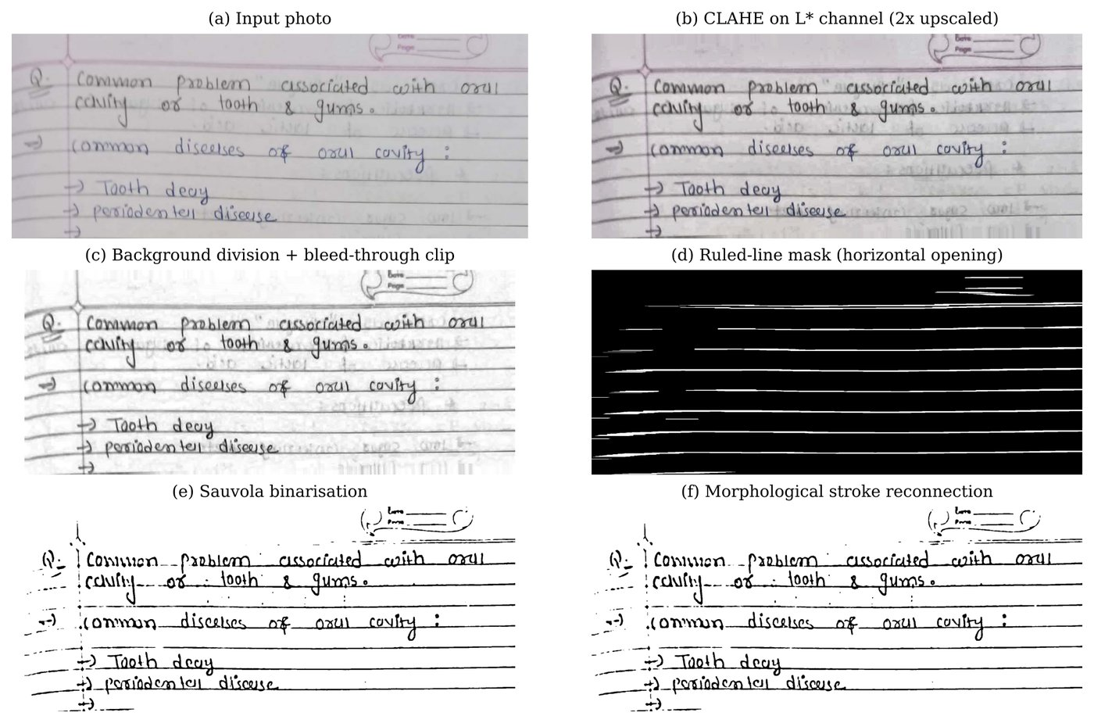
Stage 4 – Contrast and illumination normalisation
1
Upscale 2×
Bicubic; 1027 × 407 → about 2070 × 860 px
2
CLAHE on L* only
LAB colour space, 8×8 tiles, clip limit 2.2 → clahe_bgr
3
Background division
B = median₂₁(dilate₃₁(I)); N = normalise(255 − |I − B|)
4
Bleed-through + grain
Pixels above (80th percentile − 15) → white; bilateral filter d = 7 → enhanced_gray
EasyOCR input | CER
Raw photo | 50.0%
clahe_bgr | 40.5%
enhanced_gray | 42.9%
Panels a–f: input, CLAHE, background division, ruled-line mask, Sauvola, closing
Notes:
CLAHE equalises contrast per tile with a clip limit, so shadows are handled locally without amplifying paper grain. It is applied only to lightness so the ink colour is unchanged. The 31-pixel dilation removes pen strokes and leaves an estimate of the paper and shadows, which is divided out. On the test photo, the CLAHE colour version gave the lowest error with EasyOCR.

Slide 7
Stages 5–6 – Ruled lines and binarisation
Ruled-line suppression (--remove-lines)
Opening with a max(W/30, 25) × 1 px horizontal element keeps only long horizontal runs; mask grown 1 px and painted with local paper value; applied only if mask covers 0.3–15% of the page. On the test page: 42.9% → 46.8% CER, so it is off by default
Image versions and the engine that reads them
Version | Read by | CER (best)
clahe_bgr | EasyOCR | 40.5%
enhanced_gray | EasyOCR, Tesseract | 42.9%
sauvola | Tesseract | 72.2%
adaptive_gaussian | Tesseract | 130.2%
stroke_reconnected | Tesseract | 111.9%
Sauvola local threshold
Window 25 × 25, k = 0.22, R = 128; m and s from two box filters (≈ 16 ms per page)
T(x,y) = m · [1 + k (s / R − 1)]
Sauvola given to EasyOCR: 67.5% CER, so binary versions are read only by Tesseract. Values above 100% mean many extra inserted fragments.
Other variants
Adaptive Gaussian (block 31, C = 10); stroke reconnection by 3×3 elliptical closing of the Sauvola image
Notes:
The ruled-line step uses a morphological opening whose element is longer than any letter, so only the ruling survives in the mask. Sauvola lowers the threshold where the local standard deviation is small, keeping blank paper white. EasyOCR performed worse on binary images, so they are used only for Tesseract.

Slide 8
Stage 7 – Recognition and candidate selection
 | EasyOCR (default) | Tesseract 5 (fallback)
Detection | CRAFT: character and affinity maps | Layout analysis (PSM)
Recognition | CRNN (CNN + BiLSTM), CTC decoding | LSTM line recogniser (--oem 3)
Inputs | clahe_bgr, enhanced_gray | 4 versions × PSM 6, 11, 4, 3 = 16 runs
When used | auto / easyocr modes | if EasyOCR is missing, or --engine tesseract
Best CER, test page | 40.5% | 72.2%
Reading-order reconstruction
EasyOCR boxes sorted by vertical centre; a box joins the current line if within 0.7 × median box height of the line's mean centre; each line sorted left to right
Candidate score
S = 1.5·c̄ + 6·n≥3 − 1.5·n≤2 + 25·r_alnum − 40·r_noise. Test page: clahe_bgr 197.7 vs enhanced_gray 183.0 (CER 40.5% vs 42.9%). Less reliable for Tesseract output
Notes:
CTC lets the recogniser read a word as a sequence without segmenting individual characters, which suits joined handwriting. The quality score rewards confidence and words of three or more letters, and penalises short fragments and noise symbols. In Tesseract-only mode it selected a weaker candidate than the best one, which is noted as a limitation.

Slide 9
Stages 8–9 – Post-processing and summarisation
Generic clean-up
Remove “Date/Page/No.” stamp lines; drop a stray first line ≤ 4 characters; remove runs of _ - ~ |; collapse spaces. No word-specific rules
Lexicon matching (--lexicon)
Tokens ≥ 4 letters not in the vocabulary: undo confusions (0→o, 1/|→l, 5→s, leading ( → c), replace with closest word if sim = 2M/(|a|+|b|) ≥ 0.65; every change printed
TextRank (--summarize)
Split at . ! ? and line breaks; TF-IDF vectors (English stop-words removed); cosine-similarity graph; PageRank d = 0.85; top k sentences in original order
OCR token | Replaced by | Similarity | Outcome
covity | cavity | 0.83 | correct
looth | tooth | 0.80 | correct
Pable | palate | 0.73 | incorrect (problem)
Text | CER | WER
Raw engine output | 40.5% | 105.0%
After clean-up | 40.5% | 100.0%
After lexicon | 34.9% | 85.0%
Lexicon on the test page: 8 replacements, 6 correct and 2 incorrect. An earlier table of ~50 photo-specific substitutions (5.6% CER on this photo only) was removed.
Notes:
Clean-up only removes layout debris. The lexicon is optional and general: it matches tokens against a user-supplied subject vocabulary. Incorrect replacements happen when the true word is not in the vocabulary. The earlier substitution table was removed because it encoded the answers for one test image.

Slide 10
Evaluation method
CER = character edit distance ÷ reference characters
WER = word edit distance ÷ reference words
Test set: the real photo + six controlled copies
Condition | How it was made
Original photo | Unchanged (re-saved as JPEG)
Rotated 4° / 8° | Rotated on paper-coloured canvas
Desk, mild perspective | Warped onto a dark textured desk
Desk, strong perspective | Same, at a stronger angle
Side shadow | Light falls to 45% across the width
Blur + sensor noise | Gaussian blur σ = 1.2, noise σ = 12
Edit distance
Levenshtein distance (substitutions + insertions + deletions) by dynamic programming; texts lower-cased and whitespace collapsed first
Example
“looth jums” vs “tooth gums”: 2 edits ÷ 10 characters = 20% CER, but 2 ÷ 2 words = 100% WER, so CER is the main measure
Ground truth
handwrite_gt.txt: 126 characters, 20 words; bullet arrows not transcribed; --ground-truth prints both metrics
Same ground truth for every copy, so each condition isolates one degradation
Notes:
Accuracy is measured against a typed transcript of the test page. WER is close to 100% whenever most words contain at least one wrong character, so CER is the more informative measure here. Each synthetic copy keeps the same ground truth, so differences come only from the degradation applied.

Slide 11
Results – error by capture condition
Observations
Pipeline CER 38.1–45.2% across all 7 conditions; direct OCR 46.0–77.8%
Largest differences under rotation and perspective, where stages 1–3 act
Smallest difference with blur and noise (46.8% → 45.2%)
Lexicon lowers CER by a further 3.9–7.1 points
One real page and derived copies: indicative, not a benchmark
Notes:
Grey is EasyOCR applied directly to each degraded capture, blue is the full pipeline, green adds the lexicon. The pipeline values vary little across conditions. The evaluation uses one real page, so these figures show a trend rather than a general accuracy.

Slide 12
Results – ablation on the real photo
Engine | Input image | CER | WER
EasyOCR | Raw photo, no processing | 50.0% | 100.0%
EasyOCR | Greyscale only | 50.8% | 100.0%
EasyOCR | CLAHE in LAB (clahe_bgr) | 40.5% | 105.0%
EasyOCR | CLAHE + background division (enhanced_gray) | 42.9% | 110.0%
EasyOCR | enhanced_gray + ruled-line suppression | 46.8% | 115.0%
EasyOCR | Sauvola binarisation | 67.5% | 100.0%
Tesseract, PSM 6 | Sauvola binarisation | 72.2% | 110.0%
Tesseract, PSM 11 | Greyscale only | 79.4% | 150.0%
Tesseract, PSM 3 | Stroke-reconnected | 111.9% | 220.0%
Tesseract, PSM 6 | Adaptive Gaussian | 130.2% | 280.0%
Observations
CLAHE gave the lowest EasyOCR error on this page
Binary images raised EasyOCR error; they suit Tesseract better
Tesseract was not suitable for this handwriting
Ruled-line suppression did not help on faint ruling
Runtime (2-core CPU): image stages < 0.2 s; EasyOCR ≈ 16 s; Tesseract ≈ 11 s
Notes:
Each image version was read separately to see which processing step helps which engine. Values above 100 percent occur when the output contains many extra fragments. Runtime is dominated by recognition; all image processing together takes well under a second.

Slide 13

Corrections made to the code
Photo-specific word substitutions
Removed; replaced by generic clean-up + optional lexicon
Text block accepted as page boundary
Added the inside/outside contrast test
Tesseract fallback never executed
Now runs when EasyOCR is missing or returns nothing
--lang ignored by EasyOCR
Tesseract codes mapped (eng → en, hin → hi)
Tesseract path fixed to one user folder
TESSERACT_CMD, then PATH, then install folders
Summary treated bullet notes as one sentence
Line breaks are now sentence boundaries
No accuracy measurement
--ground-truth prints CER/WER; raw output saved
Unused matplotlib in requirements
Removed; dependencies grouped
Notes:
A final review of handwritten_scanner_ocr.py found eight inconsistencies. The first two affect the reported results; the others make the program behave as its options and messages describe.

Slide 14
Limitations
Recognition accuracy
CER of about 35–45% on joined handwriting; EasyOCR is trained mainly on printed text
1
Size of the evaluation
One real page and six copies derived from it; results show a trend, not a general accuracy
2
Lexicon matching
Helps only for words in the vocabulary, and can replace a word with a wrong vocabulary word
3
Page detection
Needs visible contrast between the page and its background
4
Candidate score
Selects well among EasyOCR readings, less reliably among Tesseract readings
5
Notes:
The main limitation is recognition accuracy on joined handwriting. The evaluation is small, so the reported figures describe this test page and its controlled copies rather than handwriting in general.

