Slide 1
CMB BANK CUSTOMER INSIGHTS REPORT
Presented by:-
Rakesh Kedar
Vedant Thapa
Pancham Desai
Siddhesh Gupta

Slide 2
Business Problem
Look out for meaningful insights that can be presented to the stakeholders
Predict the average spend of Customers for Credit Card based on previous transaction history and patterns

Slide 3
Why solve this problem ?
Business Impact:
Based on the insights provided by data-science team the CMB bank board members will be able to take better decision for the growth of bank
Based on the current credit card spending data we can provide predictions of next 3 months so that bank will have a basic idea of customer spending and based on that bank can take profitable business decisions

Slide 4
Hello!

Slide 5
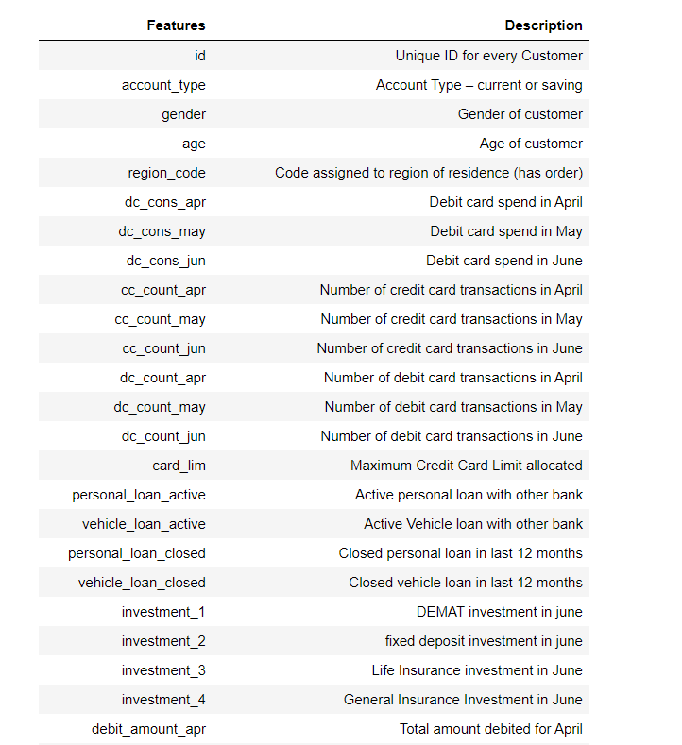
Overview of Customer Records:
There are in all 40 columns out of which 39 columns are features and 1 is target variable i.e “cc_cons” (credit card consumer spend)

Slide 6
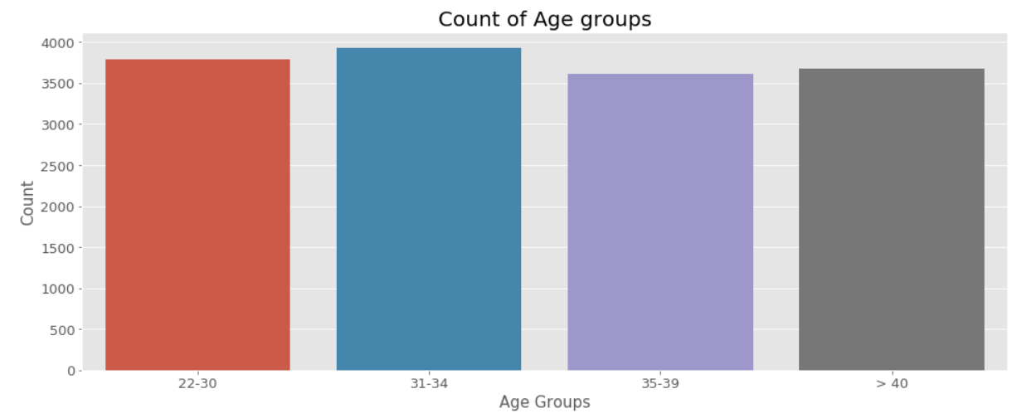
Customer Background :
Age group | count
22-30 | 3787
31-34 | 3926
35-39 | 3616
>40 | 3671

Slide 7
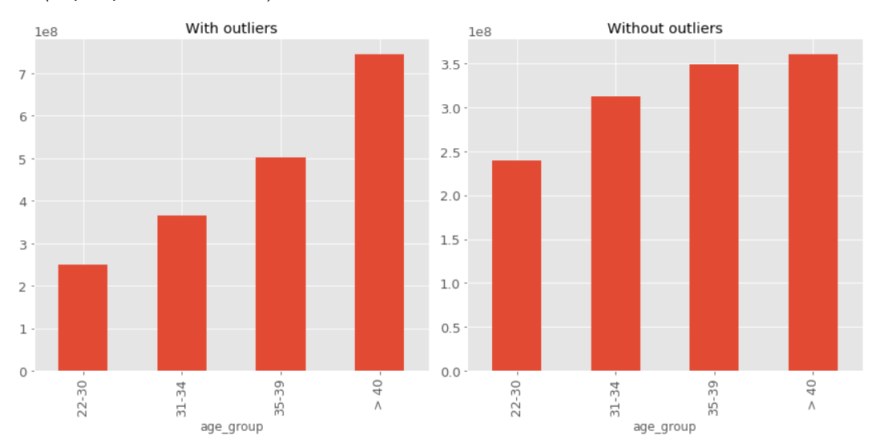

Slide 8
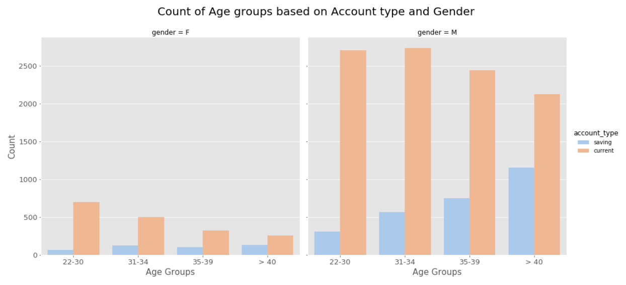

Slide 9
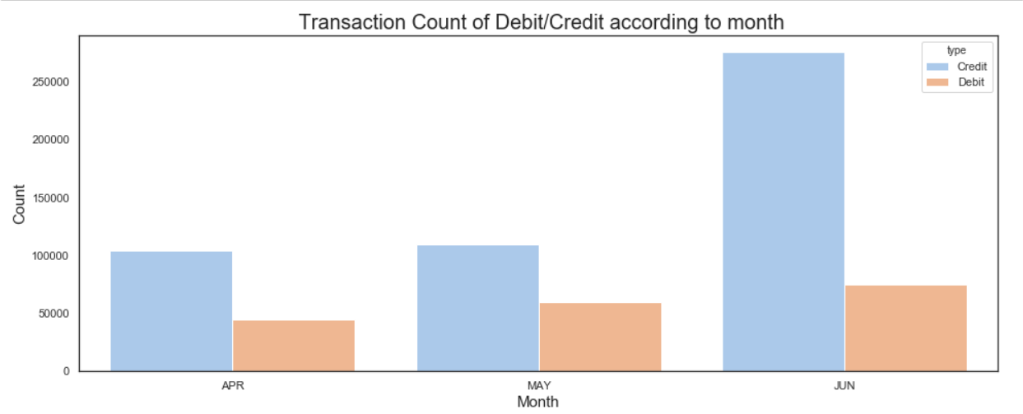
After observing the above count we can make out that cmb bank customers are using credit card more than debit card.
one can also observe that for both debit and credit card the number of transaction is increasing for each month.
It also seems like people are happy with credit card of cmb bank because they might be getting more rewards like cashbacks and discount for transaction made with credit card
The usage of debit card is less it might be possible that people might be having less savings in their bank account

Slide 10
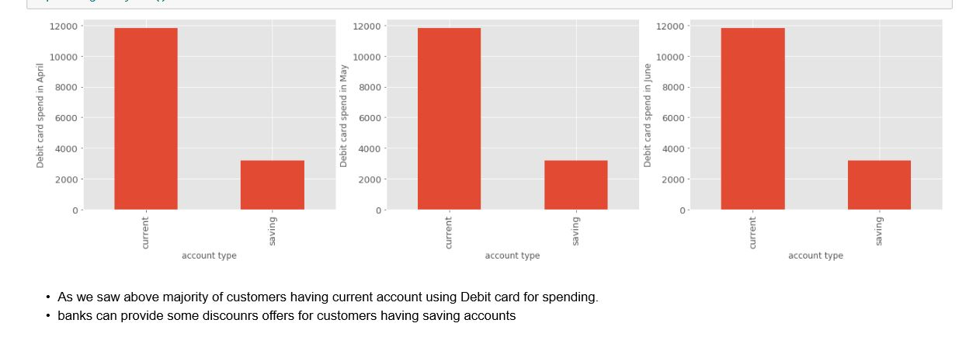
Month-wise Debit card spend

Slide 11
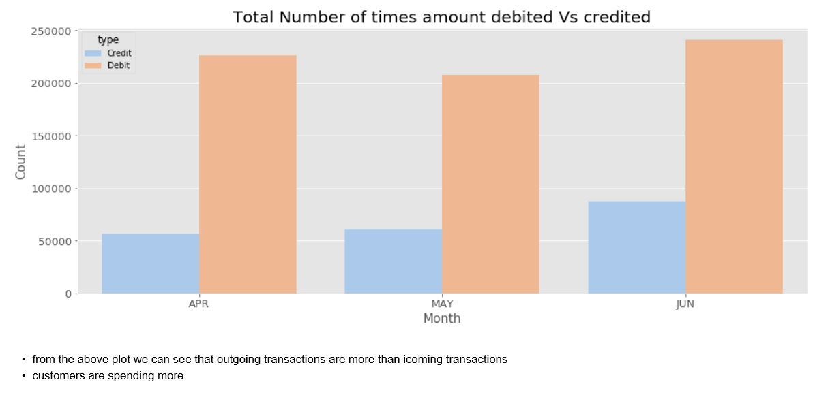

Slide 12
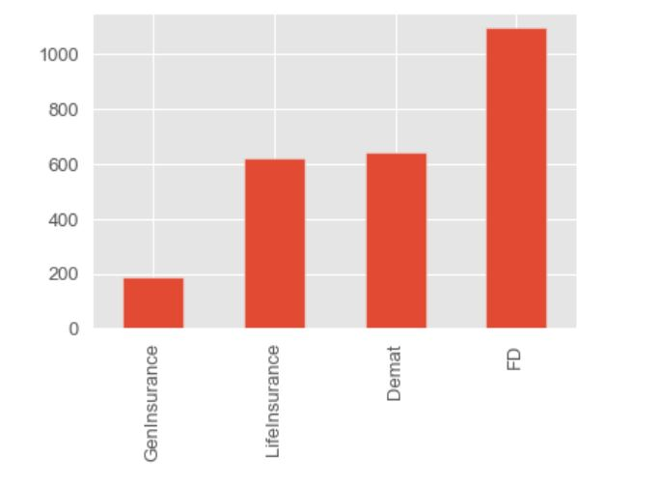
Accounts Based on Investment

Slide 13
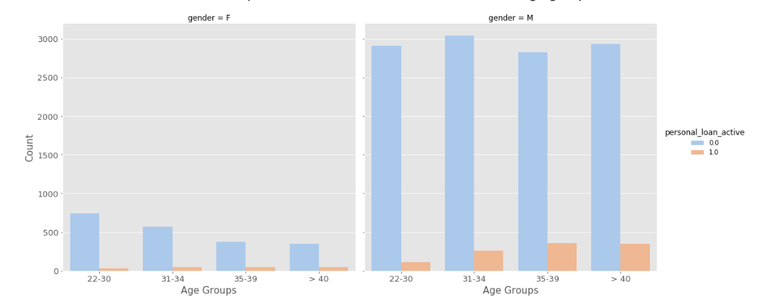
Customer Personal Loan Active with Other Banks

Slide 14
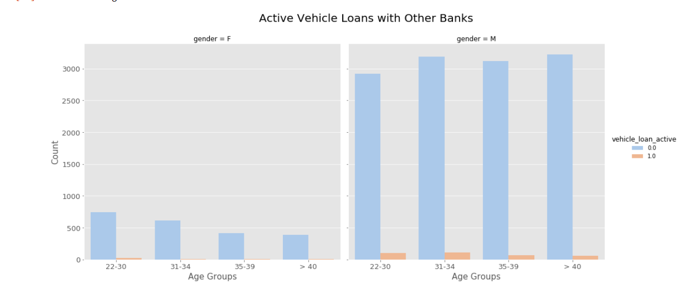

Slide 15
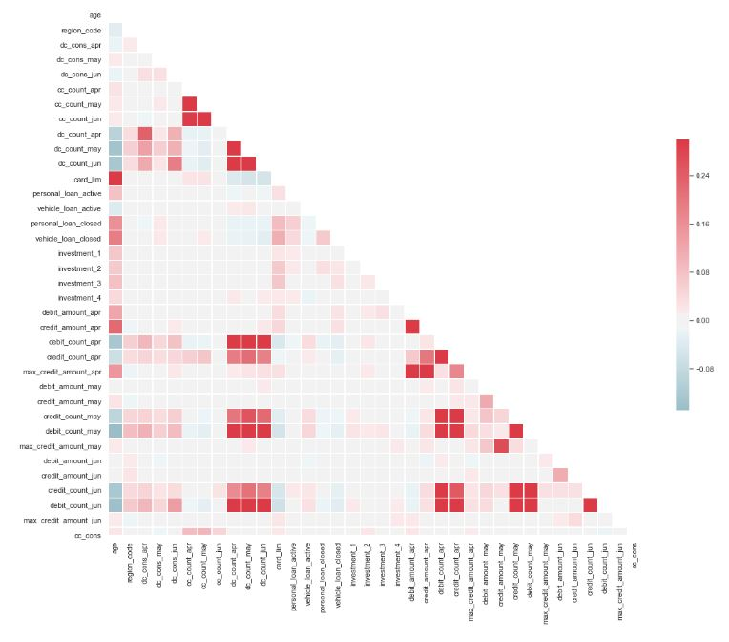
Correlation Visualization

Slide 16
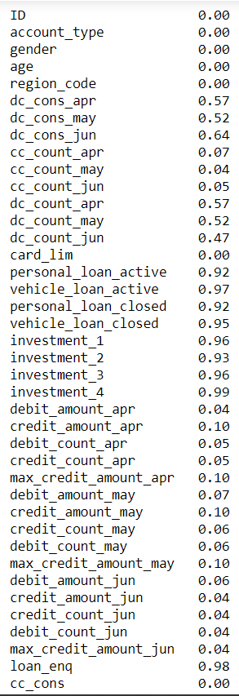
Null Values
Columns which were having null values more than 90% were dropped.
If the number of transaction is 0 then count is also 0.
Rest Values were filled by Median of the Column.

Slide 17
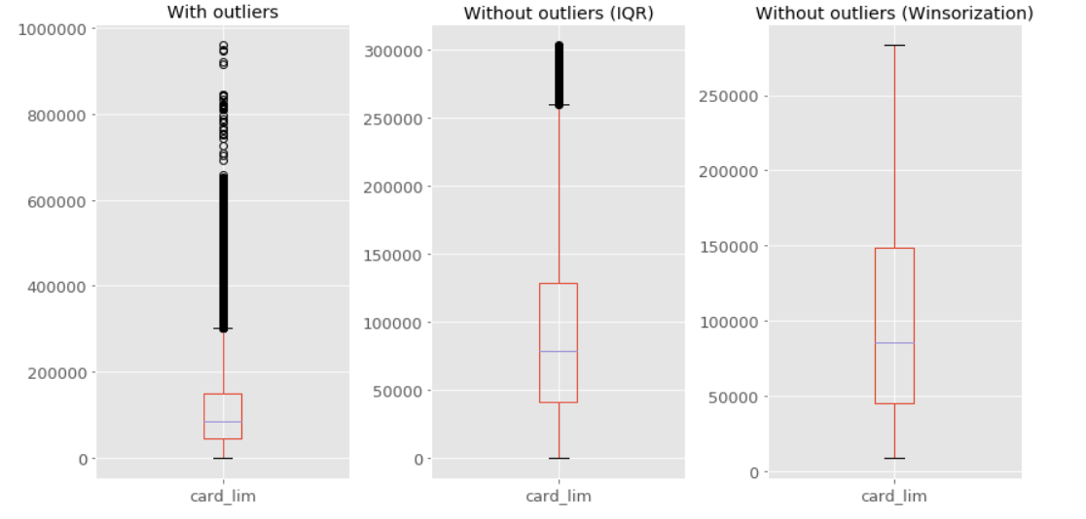
Example of Outlier Treatment
Winsorization

Slide 18
model | Rmsle score
Linear Regression | 1.05
Decision Tree | 1.03
XGboost | 1.07
Random Forest | 1.02

Slide 19
Feature Selection Technique:
Rfe – Recursive Feature Elimination
15 features were selected
Random forest feature importance technique
'cc_count_apr’, 'cc_count_may’, 'cc_count_jun’, 'card_lim’, 'debit_amount_apr’, 'credit_amount_apr’, 'debit_count_apr’, 'max_credit_amount_apr’, 'debit_amount_may’, 'credit_amount_may’, 'max_credit_amount_may’, 'debit_amount_jun’, 'credit_amount_jun’, 'debit_count_jun’, 'max_credit_amount_jun'

Slide 20
Hyper Parameter tuning using randomized search cv
Random Forest Parameters
n_estimators: 40
min_samples_split: 310
min_samples_leaf: 35
max_leaf_nodes: 8 max_depth': 19

