Slide 1
Implementation of Parking System with FSM Embedded Systems Programming 6/3/2019 Department of Computer Engineering, University of Denver Submitted By: Siddhesh Suresh Padwal DU ID (873305527) Submitted To: Dr. Goncalo Martins

Slide 2
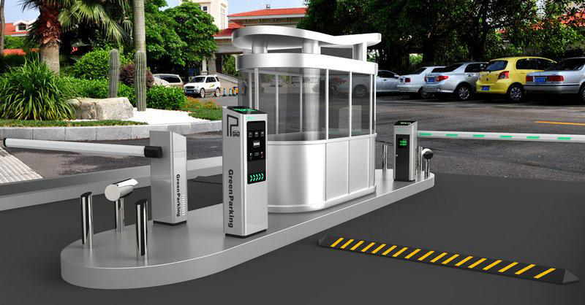
Parking System

Slide 3
Assignments
To implement the parking system we need to have sensor (button), LED’s and UART.
Sensors:
sensor_entrance (Button): To detect the car is entered in the parking lot.
LED’s:
Red LED: To display the door is closed and vehicle has to stop.
Green LED: To display that car can pass through the parking system.
Blue LED: To display that the vehicle is restricted.
Orange LED: Please wait while processing the information.
UART: To display messages for each conditions to communicate with the car driver.

Slide 4
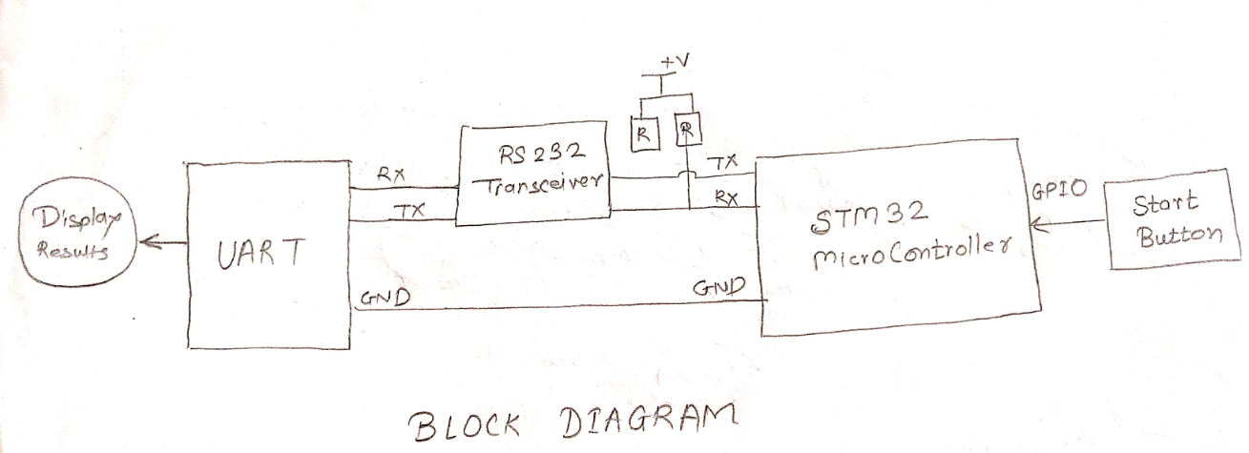
BLOCK Diagram for Parking System

Slide 5
Working
In the entrance of the parking system, there is a scanner to scan the smartcard which will detect a vehicle coming. Scanning the smartcard will generate interrupt service routine to the main code (actual code). Once the ISR is triggered, a password will be sent to the system and if it matched with the correct password, the gate will open to let the vehicle get in. Otherwise, the gate is still locked. If the vehicle goes in the parking, the count of the parking space will get updated. If there is no parking space available, the system will send the message as Parking is not available so that people will save time instead of going in the parking system.

Slide 6
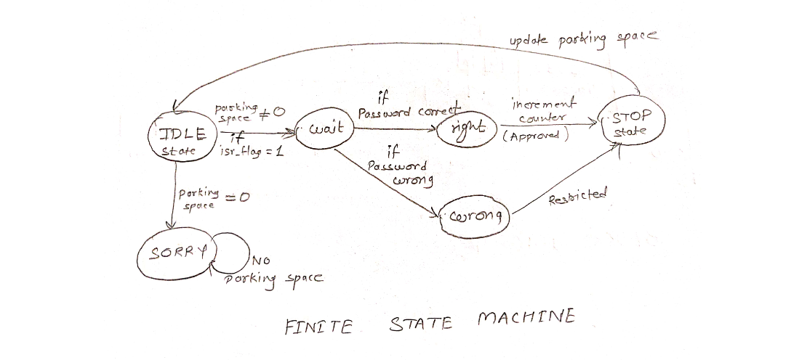
FSM diagram for Parking System

