Slide 1

AI
Deep Learning for
Sequential Data
Feburary 2025
Siddhesh S, Senior Analyst, EXL

Slide 2

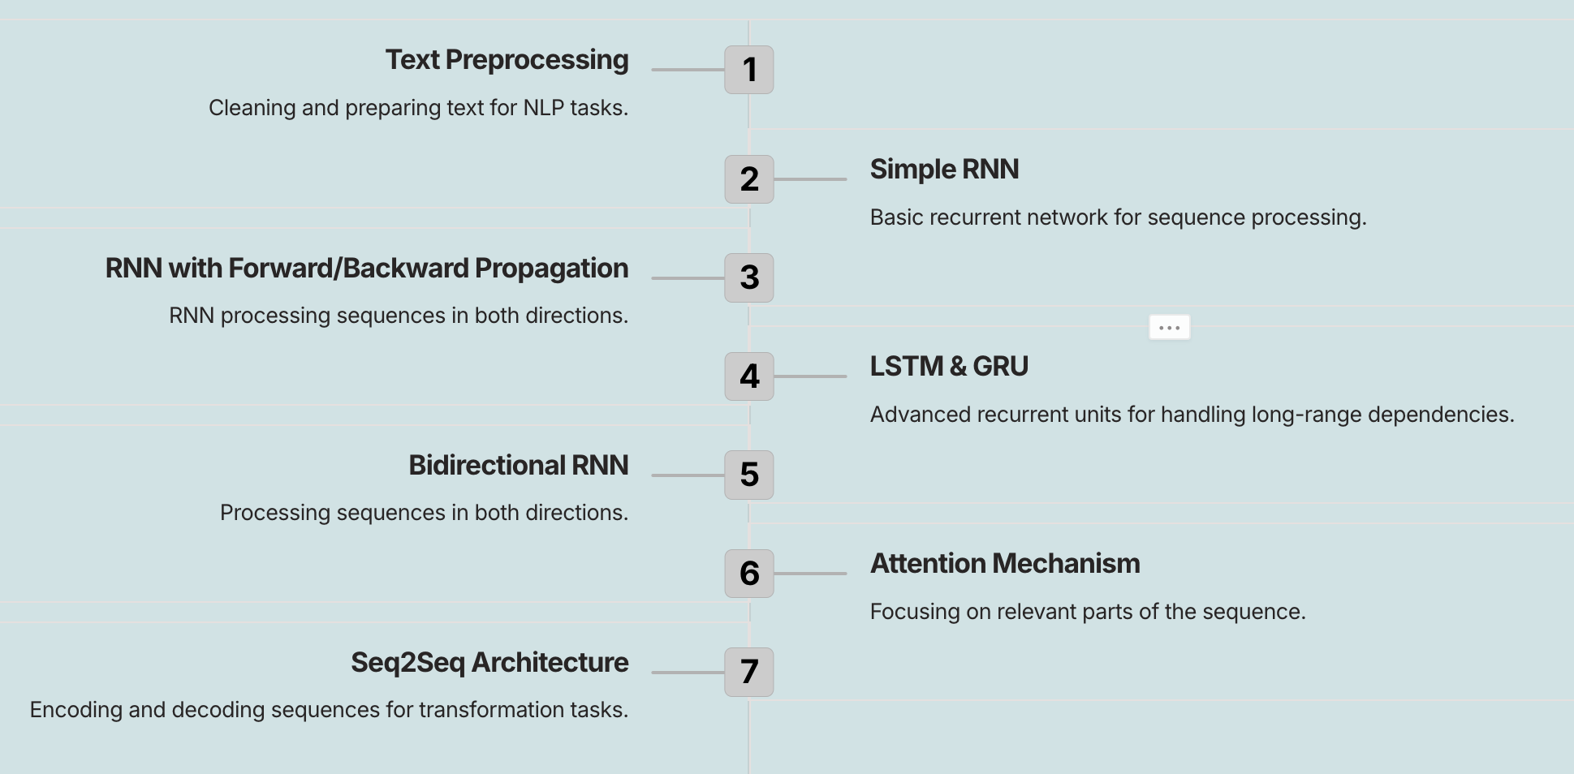
AGENDA

Slide 3

Our NLP Model Journey
Simple RNN
LSTM
LSTM Variants
1980's
2000's
Encoder - Decoder
Bi directional RNN
GRU
2014
Self Attention
Transformers
Gen AI

Slide 4
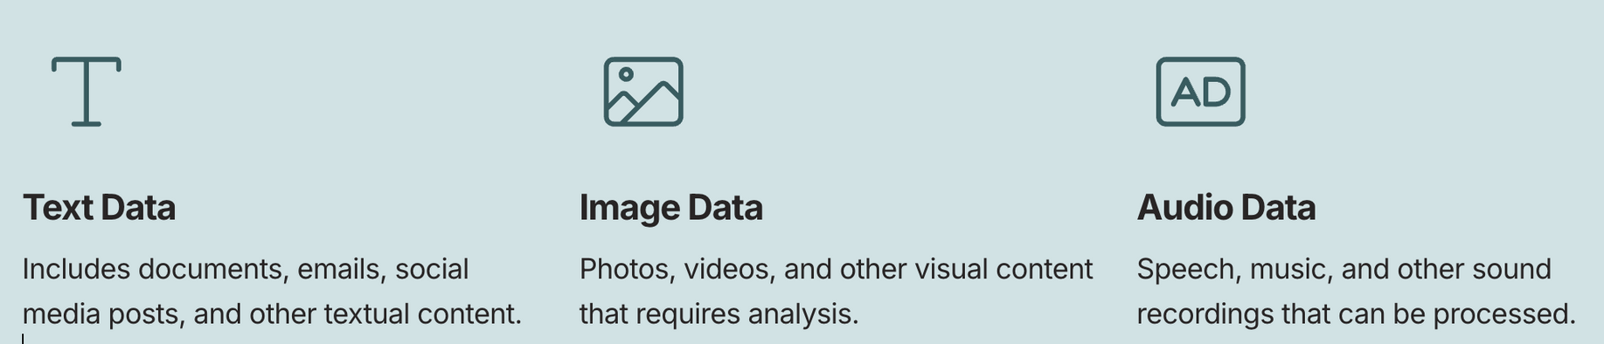
Types of Unstructured Data

Slide 5
Text Preprocessing
Dataset
Preprocessing - 1
Preprocessing - 2
Text to Vector
Tokenization
Lowering the case
Regular expression
Stemming
Lemmatization
Stopwords Removal
One hot encoding
Bag of words
IF-IDF
Word2Vec
NLP Models

Slide 6
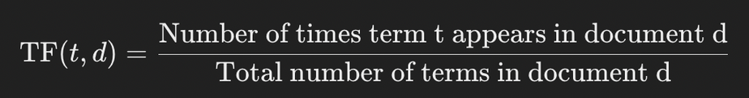
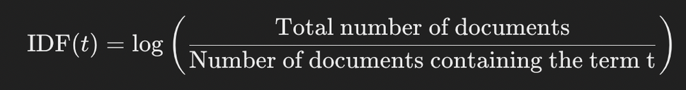

TF - IDF
TF-IDF is a numerical statistic used to reflect the importance of a word in a document relative to a collection of documents (or corpus).
It combines two components:
TF (Term Frequency): Measures how frequently a word appears in a document.
IDF (Inverse Document Frequency): Measures how important a word is across all documents in a corpus.

Slide 7
Word2vec
A popular deep learning algorithm for learning word embeddings. It maps words to dense vectors of fixed dimensions, capturing semantic information.
Word2Vec has two primary architectures for training word embeddings:
Continuous Bag of Words (CBOW):
Predicts a target word based on the surrounding context words.
Example: In the sentence "The cat sat on the mat," given "The", "sat", "on", "the", and "mat", predict "cat.
Skip-Gram:
Predicts the context words given a target word.
Example: Given "cat", predict words like "The", "sat", "on", "the", "mat".

Slide 8
Advantage and limitations
Technique | Advantages | Limitations
OHE, BOW | - Simple and easy to implement. | - High dimensionality (sparse representation).
 | - Represents each word uniquely as a vector. | - Does not capture word relationships (semantic meaning).
 | - Good for small datasets. | - Results in very sparse matrices for large vocabularies.
N-gram | - Captures word order and context (e.g., bigrams, trigrams). | - Increases dimensionality, making models slow and computationally expensive.
 | - Useful for modeling relationships between adjacent words. | - Overfitting risk with high n (large context).
 | - Useful for more advanced NLP tasks like language modeling. | - Rare n-grams may be missing or sparse in the training data.
TF-IDF | - Highlights important words in a document and penalizes common words. | - Does not capture semantic meaning or word relationships.
 | - Reduces impact of stop words that appear frequently across documents. | - Sensitive to corpus size, may need adjustments for large corpora.
 | - Can be used for document similarity, search engines, and classification tasks. | - Works poorly with short documents or documents with few terms.
Word2Vec | - Captures semantic relationships between words (e.g., synonyms, analogies). | - Computationally expensive to train on large datasets.
 | - Produces dense, low-dimensional word vectors. | - Requires a large corpus to train effectively.
 | - Can be used for a wide range of NLP tasks (e.g., sentiment analysis) | - Pre-trained models may not perform well on domain-specific terms.

Slide 9
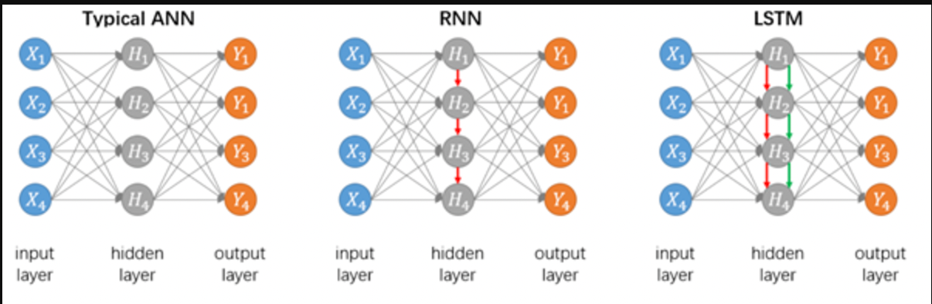
Models for Sequential Data

Slide 10
Models for Sequential Data
Feature | ANN (Artificial Neural Network) | RNN (Recurrent Neural Network)
Architecture | Feedforward (no loops) | Has recurrent loops in hidden layers
Data Type | Independent data points | Sequential data (time-dependent)
Memory | No memory of past inputs | Remembers previous inputs using hidden states
Flow of Data | One-directional (input → output) | Cyclic, allowing information persistence
Use Cases | Image classification, fraud detection, structured data analysis | Text generation, speech recognition, stock price prediction
Computational Cost | Lower | Higher due to sequential dependencies
Limitations | Cannot handle sequences | Suffers from vanishing gradient in long sequences

Slide 11
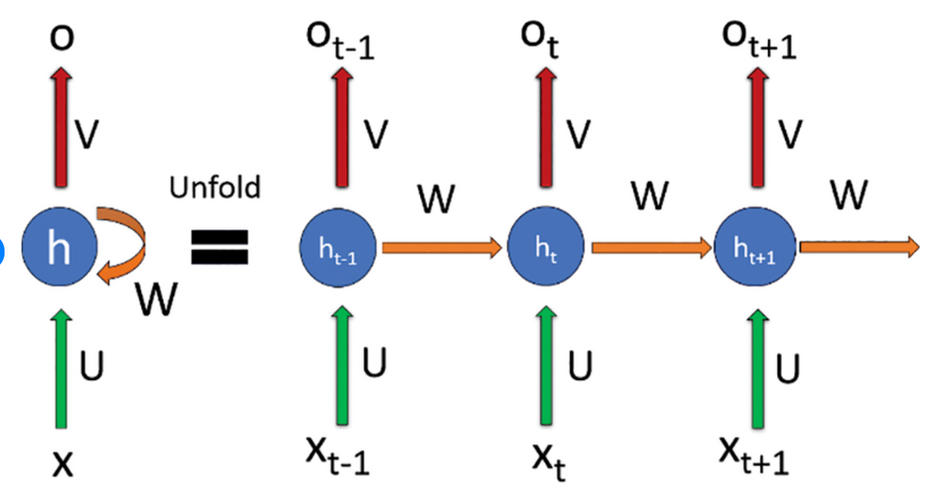
Forward Propagation in RNN
Unlike a standard ANN, where data moves in a single direction (input → hidden → output), RNNs handle sequential data by passing information from previous time steps to the next.

Slide 12
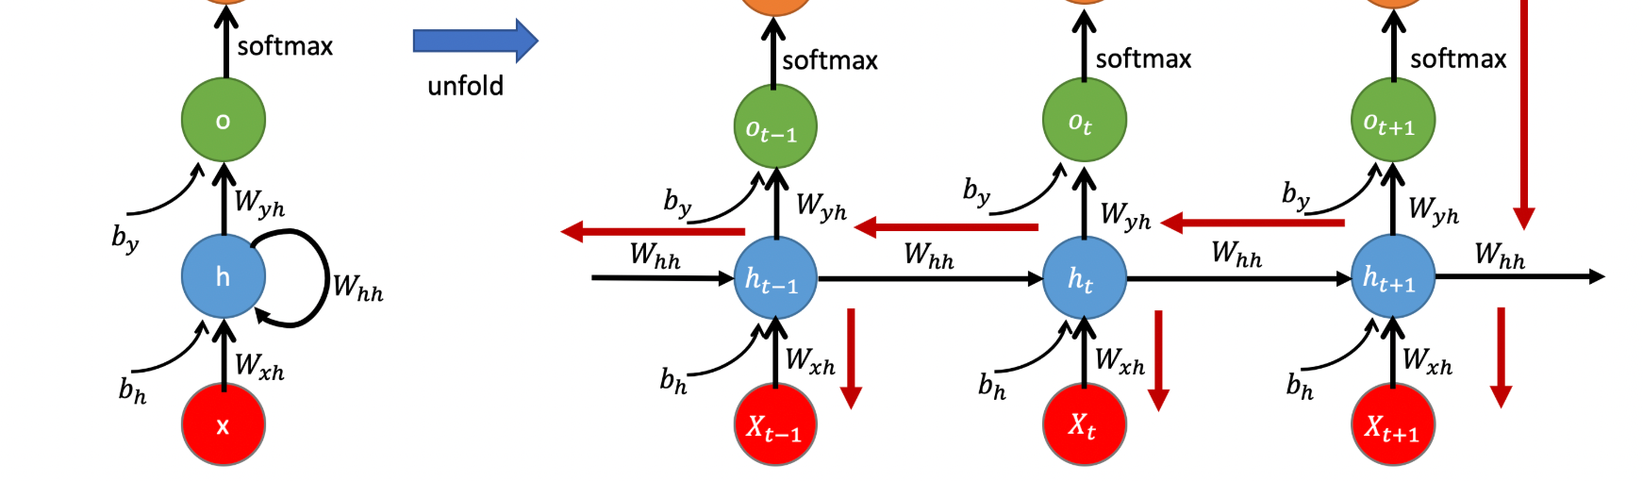
Backward Propagation in RNN
Unlike a standard ANN, where data moves in a single direction (input → hidden → output), RNNs handle sequential data by passing information from previous time steps to the next.

Slide 13
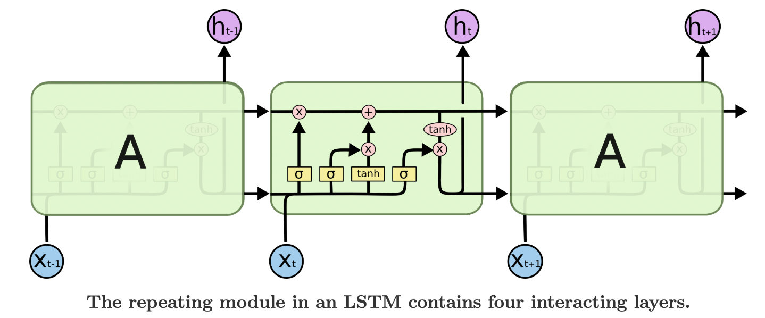
LSTM
LSTMs are a special type of Recurrent Neural Network (RNN) designed to solve the vanishing gradient problem, making them more effective at capturing long-term dependencies in sequential data.

Slide 14
LSTM
Unlike simple RNNs, which only have a single hidden state (h​), LSTMs maintain two states at each time step:
Hidden State (h): Short-term memory.
Cell State (C​): Long-term memory.
LSTMs have three gates that control information flow:
Forget Gate (f​) – Decides what to remove from the memory.
Input Gate (i​) – Decides what new information to store.
Output Gate (o​) – Determines the hidden state output.
Blog: https://colah.github.io/posts/2015-08-Understanding-LSTMs/

Slide 15
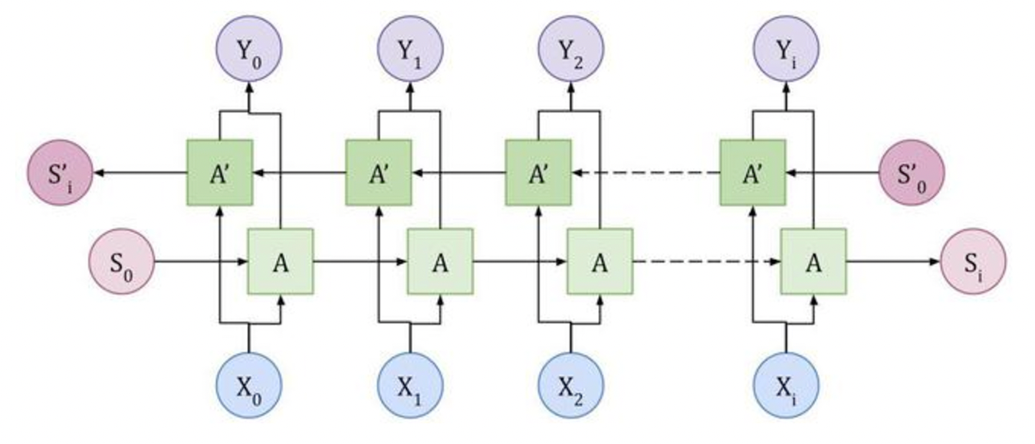
Bi-directional RNN
A Bidirectional Recurrent Neural Network (Bi-RNN) is an extension of a regular RNN that processes sequence data in both forward and backward directions to capture context from both past and future inputs.

Slide 16
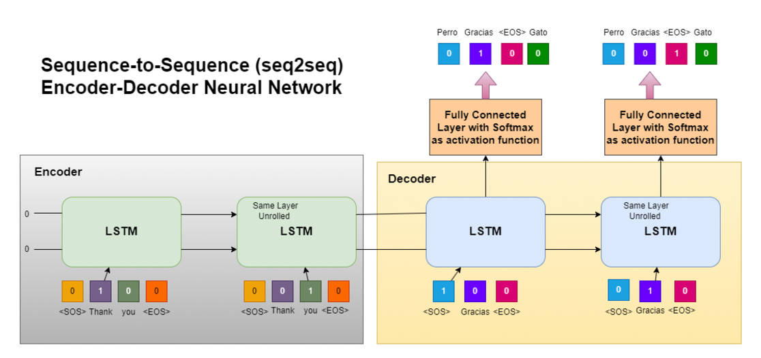
Seq2Seq
A Sequence-to-Sequence (Seq2Seq) model is used for tasks where the input and output sequences have different lengths. It consists of an Encoder-Decoder architecture, commonly used in Machine Translation, Text Summarization, and Chatbots.

Slide 17
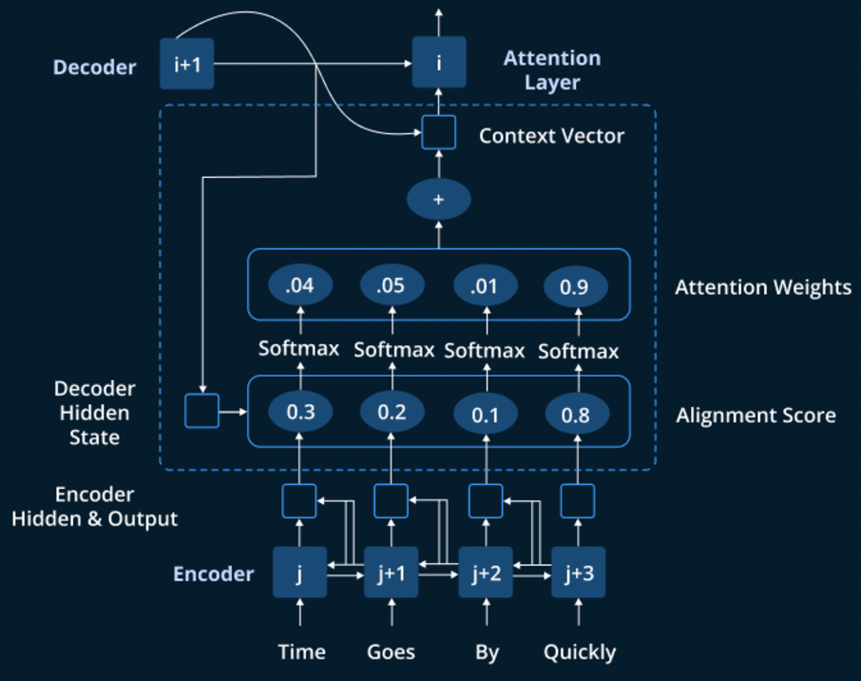
Attention Mechanism - Encoder
The Attention Mechanism is a technique that helps neural networks focus on relevant parts of an input sequence when making predictions.

Slide 18
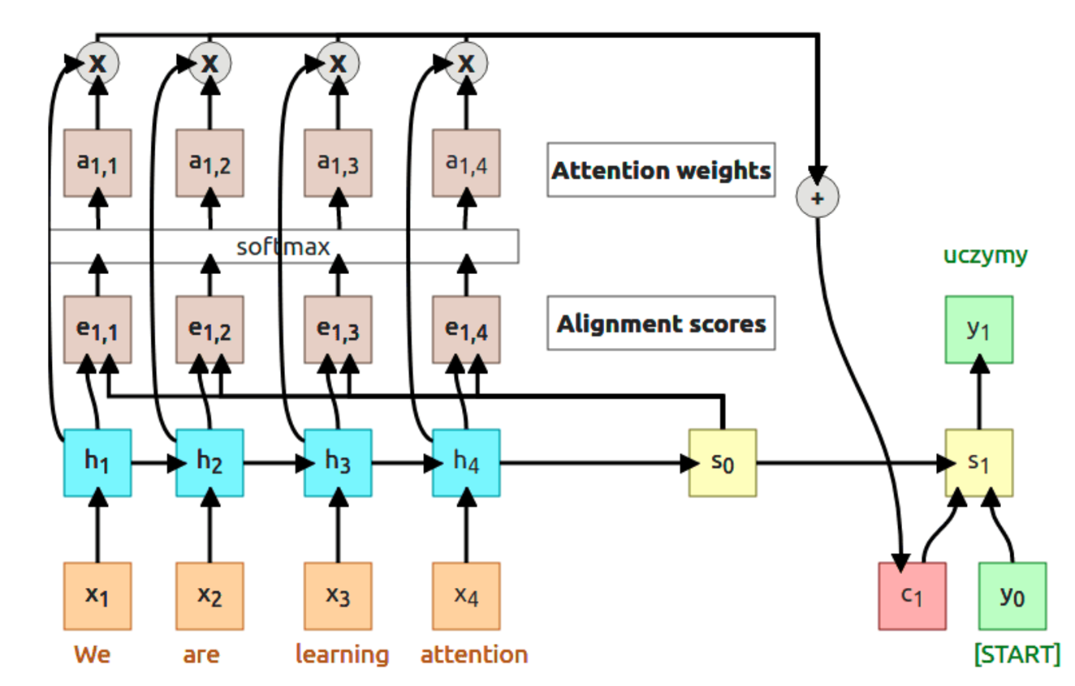
Attention Mechanism - Decoder
Blog: https://erdem.pl/2021/05/introduction-to-attention-mechanism

Slide 19
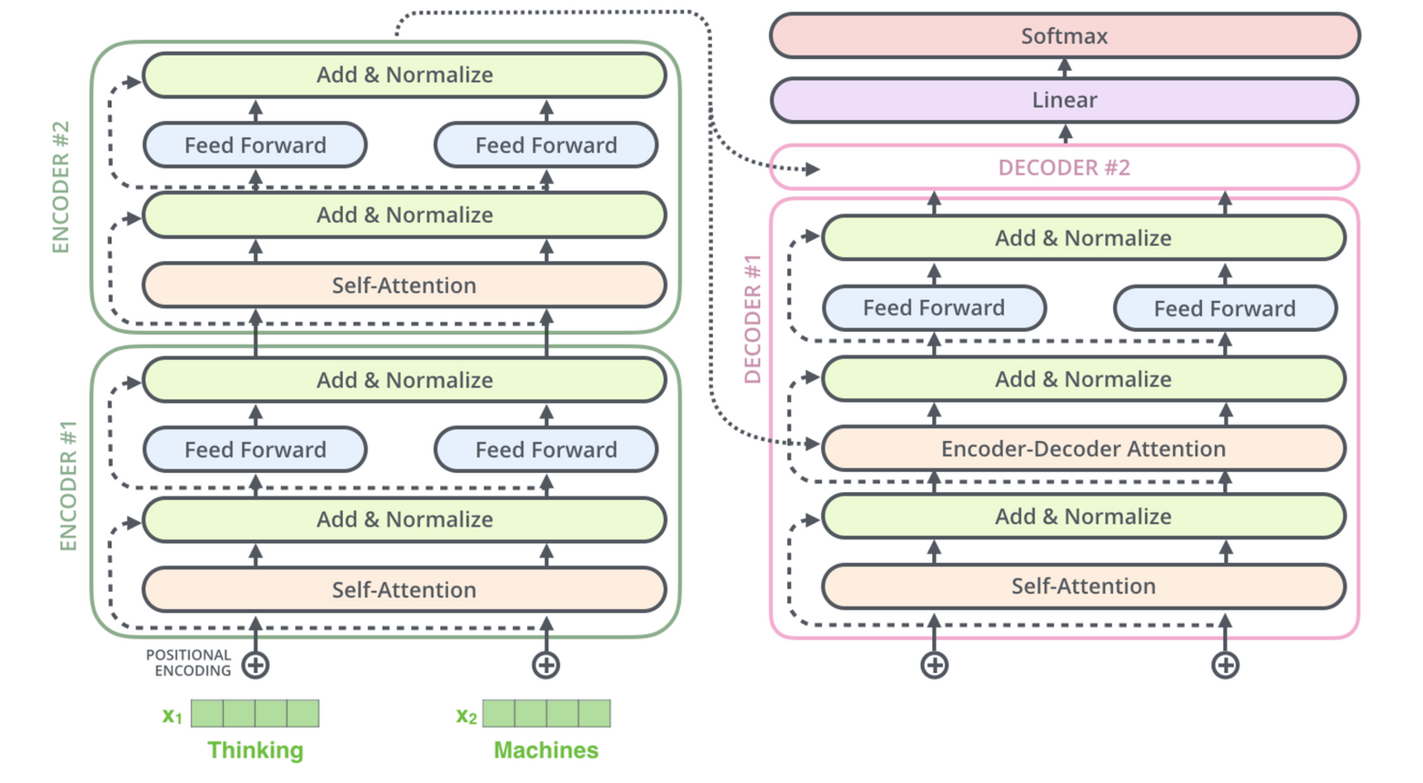
Transformers
Blog: https://jalammar.github.io/illustrated-transformer/

Slide 20

Q&A
Get In Touch
Email
Sidd.hesh.S@hotmail.com
LinkedIN
LinkedIn/Siddhesh S
Mobile
8667769766

