Slide 1
Department of Computer Engineering
Project Stage-I Presentation | AY 2026-27
MedIntel
A Multi-Agent AI Framework for Clinical Decision Support
Project Guide: Prof. G. P. Mohole
Presented by
1. Siddhesh Kishor Suryawanshi
2. Shantanu Avinash Patil
3. Omkar Abaji Musale
4. Tanmay Shriniwas Bagul
Notes:
Good morning, respected Head of Department, faculty members and friends. We are Siddhesh Suryawanshi, Shantanu Patil, Omkar Musale and Tanmay Bagul, and our BE project is MedIntel, a multi-agent AI framework for clinical decision support, guided by Prof. G. P. Mohole.
In this Project Stage I presentation we explain the problem we are solving, what existing work does and misses, the architecture we have designed, and how we will build and test it in Stage II next semester.
One point to keep in mind throughout: this stage is analysis and design, so every number you see today is a target for Stage II, not a measured result.

Slide 2
Table of Contents
Abstract
Introduction
Motivation Behind This Topic
Literature Survey(In Tabular Format only)
Goals and Objective
Problem Statement
System Architecture
Software Requirement Specification
    Project Scope
    User Classes & Characteristics
    Assumptions & Dependencies
Functional Requirements and Non-Functional Requirements
    Performance Requirements
    Security Requirements
System Requirements
    Database Requirements
    Software Requirements
    Hardware Requirements
UML Diagrams/ DFD
    Use Case Diagram
    Class Diagram
    Sequence Diagram(plz add other dig. in project report)
Mathematical Model
Methodology
Merits, Limitations and Conclusion
References

Slide 3
Abstract
Clinical decision support systems help clinicians interpret patient data, but systems built around one opaque model, or around a chain of language-model agents, rarely show which evidence produced a recommendation. MedIntel is a multi-agent framework for patient-level decision support that keeps learned, rule-based and retrieved evidence separate. Each validated patient record is analysed by an XGBoost classifier, a versioned clinical rulebase and a GraphRAG retriever built on FAISS and Neo4j. A locally served medical LLM (Meditron-7B) reconciles their typed outputs and names conflicts, and an explicit confidence function, C = αM + βR + γK − λD, fuses them into one scored recommendation. Every decision report carries an audit trail of features, rules, sources and versions, and a clinician reviews each report before any outcome re-enters the knowledge store. Patients are processed in parallel in isolated contexts. Stage I delivers the requirements, architecture, DFD and UML design and a 12-case test plan; an ML-only baseline on the Cleveland Heart Disease dataset reaches 87.0% test accuracy, and the full pipeline will be evaluated in Stage II.
Keywords:
Clinical decision support
Multi-agent systems
GraphRAG
Explainable AI
Confidence fusion
XGBoost
7
pipeline stages
6
components with typed outputs
9 + 7
functional and non-functional requirements
87.0%
ML baseline test accuracy
Notes:
This is our abstract.
MedIntel keeps machine-learning, rule-based and retrieved evidence separate, fuses them through one explicit confidence equation, and gives the clinician a report that shows where every part of the recommendation came from.
Stage I covers the design. Our ML-only baseline already reaches 87.0% accuracy on the held-out Cleveland heart disease test split, and Stage II will build and evaluate the full pipeline.

Slide 4





1. Introduction & Motivation
Clinical decision support systems (CDSS) help clinicians interpret patient data through alerts, risk estimates and suggested next steps [7].
Large language models (LLMs) have widened what CDSS can do [11], yet reviews keep reporting the same weaknesses: calibration, validation and transparency [7].
Weaknesses reported in reviews [7]
Calibration
Validation
Transparency
Where single-model systems fall short
Messy real-world data
Opaque recommendations
Clinicians must verify
One record can hold missing fields, mixed units, repeated observations and free-text notes.
When one model writes the answer, nobody can see which evidence produced it [1], [2].
Model output, rules fired, sources and versions should travel with every recommendation [7].
Our goal: every recommendation should carry its own record of how it was reached, so it stays traceable, auditable and clinician-reviewed.
Notes:
Clinical decision support systems help doctors interpret patient data, for example by raising alerts, estimating risk or suggesting next steps. Large language models have made these systems far more capable, but published reviews keep reporting the same weaknesses: calibration, validation and transparency.
In practice we see three problems, shown in the three boxes. First, hospital data is messy: a single record can have missing fields, mixed units, repeated observations and free-text notes. Second, when one generative model reads everything and writes the answer, nobody can see which evidence led to the recommendation. Third, a clinician has to be able to check a recommendation before acting on it.
That is our motivation: every recommendation should carry its own record, meaning the model output, the rules that fired, the sources used and the versions in use.

Slide 5





2. Problem Statement
Problem Statement
Design an implementable, modular pipeline for patient-level decision support that accepts imperfect patient data, keeps learned, rule-based and retrieved evidence separate, combines it through an explicit confidence function and gives clinicians a traceable report, while processing many patients in parallel without mixing their contexts.
Imperfect patient data
Separate evidence, explicit fusion
Many patients, isolated contexts
Traceable clinician report
Missing fields, mixed units, duplicates and free-text notes
Learned, rule-based and retrieved evidence combined by one confidence function
Cases run in parallel without mixing their data
Each recommendation links to its features, rules and sources
Fig. 1.1: What MedIntel must achieve, from imperfect input to a traceable report
Notes:
This is our problem statement. We want an implementable, modular pipeline that accepts imperfect patient data, keeps learned, rule-based and retrieved evidence separate, combines that evidence through an explicit confidence function and gives the clinician a traceable report, while processing many patients in parallel without mixing their data.

Slide 6





3. Objectives
To design a modular multi-agent architecture in which every agent returns a typed output contract that the other components can rely on.
1
Stage I
To develop a traceable reporting scheme that links each recommendation back to the features, rules and sources behind it.
2
Stage I
To implement a parallel prototype that analyses many patients at once while keeping each patient's context isolated.
3
Stage II
To evaluate the system in stages against baselines, using ablation studies and calibration checks.
4
Stage II
To establish a clinician review loop so that only validated outcomes are re-indexed into the knowledge store.
5
Stage II
Notes:
These are our five objectives, each written as an action we commit to. The first two belong to Stage I and are complete: the modular architecture, in which each agent has a defined output contract, and the traceable reporting design, in which each report links back to its features, rules and sources.
The other three belong to Stage II: building the parallel prototype, running a staged evaluation with baselines, ablation and calibration checks, and adding the clinician review loop, so that only validated outcomes are allowed back into the knowledge store.

Slide 7
4. Literature Survey
Author [Ref.] | Year | Strength | Approach | Key limitation
Öğdü et al. [1] | 2025 | Fuses biomedical RAG with live web evidence; an adaptive loop re-checks low-confidence answers (94% on MedQA) | Adaptive multi-agent LLM CDSS with biomedical RAG and data fusion | Hard to trace which component produced a recommendation
Tang et al. [2] MedAgents | 2024 | Training-free: role-playing LLM experts discuss and reach consensus (83.7% on MedQA with GPT-4) | Role-based LLM agents that discuss and reach consensus | No dedicated ML model or deterministic rules
Lu et al. [3] ClinicalRAG | 2024 | Adds structured and unstructured medical knowledge during generation to reduce hallucination | Multi-agent pipeline with heterogeneous knowledge retrieval | Tabular ML and rules lack a common interface with retrieval
Zuo et al. [4] KG4Diagnosis | 2025 | GP-to-specialist agent hierarchy mirrors real referral and covers 362 diseases | Hierarchical LLM agents with a medical knowledge graph | Knowledge graph adds knowledge-engineering requirements
Abdullahi et al. [5] | 2024 | Transparent PubMed retrieval ranks rare diagnoses without labelled training data | Ensemble of retrieval-based and predictive diagnosis | Focus is diagnostic ranking, not an auditable per-patient pipeline
Li et al. [10] MACD | 2025 | Agents learn reusable diagnostic knowledge; up to 22.3% gain over clinical guidelines on 4,390 cases | Multi-agent diagnosis with self-learned knowledge | Governance of self-learned knowledge not fully addressed
Table 1.1: Six works closest to MedIntel, out of the twelve reviewed (full comparison in the project report)
Notes:
We reviewed twelve recent works; this table shows the six closest to our project.
The adaptive multi-agent system by Öğdü and colleagues is our first base paper. It combines specialist agents with biomedical retrieval and web evidence, but with so many reasoning components it becomes hard to tell which one produced a recommendation. MedAgents, our second base paper, lets role-based language-model agents discuss a question and agree, but the whole analysis stays inside language models.
ClinicalRAG and KG4Diagnosis improve grounding through heterogeneous retrieval and a medical knowledge graph. Abdullahi and colleagues show that combining retrieval with prediction helps diagnostic ranking. MACD shows the potential of self-learned knowledge, but also makes its governance problem visible.
Each work is valuable, and each leaves part of our problem open. The complete comparison of all twelve works is in Table 2.2 of our report.

Slide 8
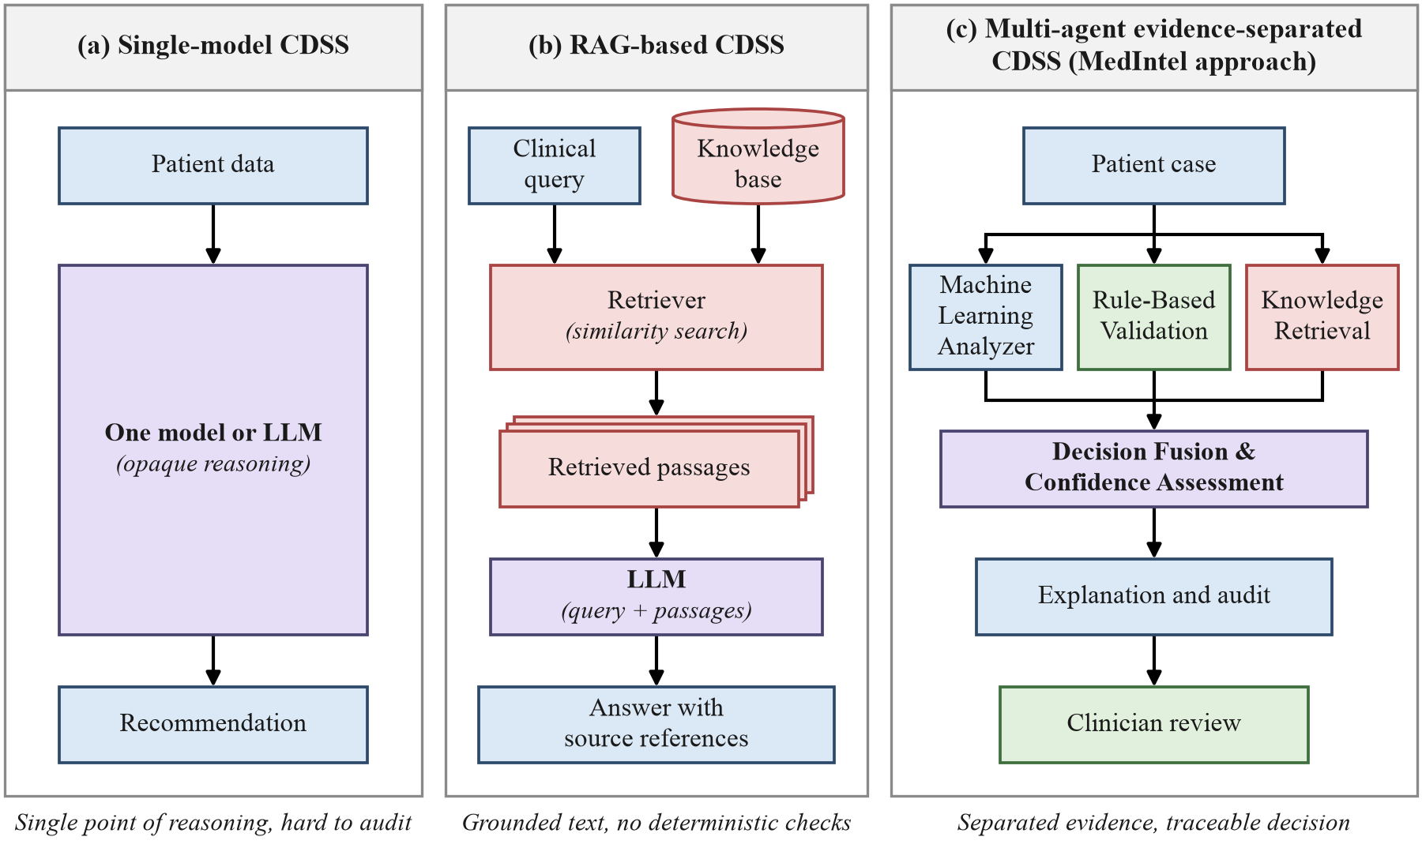




5. Research Gap
Untraceable outputs
Single models and chained LLM agents do not link a recommendation to the feature, rule or source behind it [1], [2].
No common interface
Tabular ML, deterministic rules, retrieval and LLM synthesis do not meet at one interface for each patient [3], [5].
Incomplete evaluation
Few studies show what each component adds or whether the confidence is calibrated [3], [4], [7].
Fig. 1.2: Single-model, RAG-based [6] and evidence-separated multi-agent [1], [2] CDSS designs
MedIntel addresses all three: separate evidence production, explicit fusion and clinician-controlled knowledge updates.
Notes:
Putting the survey together, we found three gaps.
First, outputs are not traceable: single models and chains of language-model agents do not link a recommendation to the specific feature, rule or source behind it. Second, there is no common interface: tabular machine learning, deterministic rules, retrieval and language-model synthesis do not meet at one patient-level interface. Third, evaluation is incomplete: a multi-component system must show what each component adds and whether its confidence is calibrated, which one benchmark accuracy cannot show.
The figure compares three design styles. A single-model system is one opaque step. A retrieval-based system grounds its answer in sources but applies no deterministic checks. MedIntel follows the third style: each kind of evidence is produced separately and fused explicitly, and a clinician reviews the result.

Slide 9
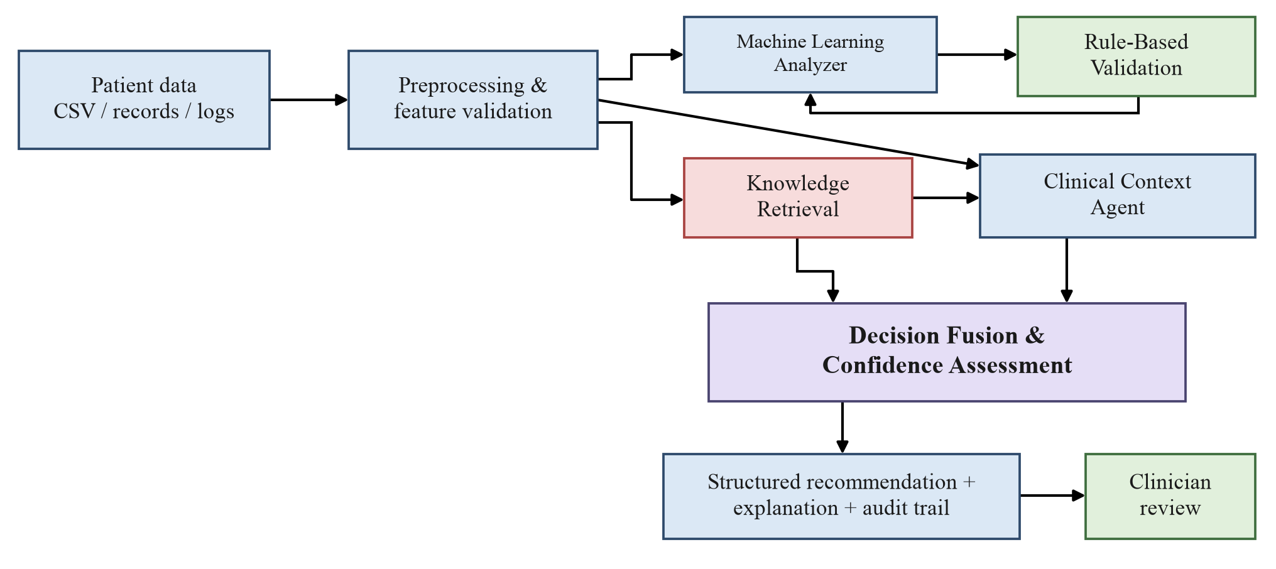
6. Proposed Architecture
2
3
1
4
5
Seven pipeline stages
1
Data ingestion & validation
2
ML analysis (XGBoost [14])
6
3
Rule-based validation
4
Knowledge retrieval (GraphRAG [17])
5
Clinical context synthesis (LLM [16])
7
6
Decision fusion & confidence scoring
7
Explanation & audit report
Fig. 1.3: MedIntel system architecture; numbers mark the seven pipeline stages
Typed agent outputs are fused into one scored recommendation, and the clinician reviews every report.
Notes:
This is the MedIntel architecture.
Patient data arrives as CSV files, records or event logs and is first validated: data types, missing fields, duplicates, units and identifiers are all checked before a case is built.
Each valid case then goes to the analysis agents. The Machine Learning Analyzer finds learned patterns in the structured features. Rule-Based Validation applies explicit clinical thresholds and policies. Knowledge Retrieval brings supporting evidence from approved guidelines and articles. The Clinical Context Agent uses a language model to reconcile these outputs and to report any conflict between them.
Decision Fusion and Confidence Assessment combines all of this into one recommendation with a confidence score. The result is a structured recommendation with its explanation and audit trail, and it always goes to a clinician for review.

Slide 10







7. The Seven Pipeline Stages
1
2
3
4
Data Ingestion & Validation
ML Analysis
Rule-Based Validation
Knowledge Retrieval
CSV records checked for types, missing fields, duplicates and units
Classifier finds learned patterns in structured features
Deterministic thresholds applied to the case
Vector search plus graph traversal (GraphRAG [17])
pandas + pydantic
XGBoost [14] / scikit-learn
Versioned JSON rulebase
FAISS + Neo4j
5
6
7
Clinical Context Synthesis
Decision Fusion & Confidence
Explanation & Audit
Clinician Review
LLM reconciles agent outputs and names conflicts
Explicit confidence equation combines all evidence
Structured report with full audit trail
Every report is reviewed; the clinician keeps the final decision
Meditron-7B [16] via Ollama
C = αM + βR + γK − λD
DecisionReport + AuditRecord
Streamlit dashboard
Fig. 1.4: The seven pipeline stages and the tool planned for each
Notes:
Here are the seven stages one by one, with the tool we plan to use at each step.
Records are validated first. Then three evidence agents work on the case: the ML classifier, the versioned JSON rulebase and GraphRAG retrieval over FAISS and Neo4j. Meditron-7B, served locally through Ollama, reconciles their outputs and names any conflict.
The fusion stage turns everything into one confidence score, and the last stage writes the decision report and audit record that the clinician reviews on the dashboard.

Slide 11
8. Agents & Output Contracts
AGENT
INPUT
OUTPUT CONTRACT
ML Analysis Agent
Validated patient features
MLResult: prediction, probabilities, SHAP importance [15], model version
Rule Validation Agent
Patient features + active rulebase
RuleResult: triggered rules, action, reason, rulebase version
Knowledge Retrieval Agent
Clinical query + FAISS & Neo4j index
EvidenceItem list: source id, passage, similarity score
Clinical Context Agent
MLResult + RuleResult + EvidenceItems
ContextSummary: summary, conflicts, unsupported statements
Decision Fusion Engine
All of the outputs above
FusionResult: decision, confidence C, disagreement D
Explanation & Audit
FusionResult + all evidence
DecisionReport + AuditRecord: with versions and timestamp
Every output is typed, so any agent can be replaced without redesigning the others.
Fig. 1.5: Agents, their inputs and their typed output contracts
Notes:
Each component has one job and one output contract, and this is what makes the system auditable.
The ML Analysis Agent returns a prediction with class probabilities, feature importance and the model version. The Rule Validation Agent applies a versioned JSON rulebase and returns the triggered rules, the action taken and the reason. The Knowledge Retrieval Agent returns passages with source identifiers and similarity scores, or states that nothing relevant was found.
The Clinical Context Agent is the only place where a language model reasons over the case. It summarizes the evidence, names conflicts and lists any statement the evidence does not support. The Decision Fusion Engine computes the decision, the confidence and the disagreement, and the Explanation and Audit layer turns everything into a readable report and an audit record.
Because every output is typed, any one agent can be replaced without redesigning the others.

Slide 12

9. Decision Fusion & Confidence Scoring
C = αM + βR + γK − λD
Equation (4.2): confidence of the fused decision. Weights are tuned only on a held-out validation split, never on the test set.
M
ML support
Probability of the class the model predicts
Rule precedence: a triggered clinical rule always takes precedence over the learned ML prediction
Decision reported with its confidence C
α = 0.45
Yes
R
Rule consistency
1 if rules agree; 0 if an elevating or suppressing rule contradicts the prediction
C ≥ threshold?
β = 0.25
Decision Fusion Engine
computes C
Either way, the clinician reviews the report
K
Retrieval support
Mean similarity of retrieved passages; 0 when nothing relevant is found
γ = 0.20
No
Reported as uncertain and flagged for the clinician
D
Disagreement
Conflicts reported by the Context Agent ÷ 3, capped at 1
λ = 0.10
Fig. 1.6: Decision fusion: four evidence terms, rule precedence and the confidence threshold
Notes:
Fusion is an explicit equation, not a hidden judgment.
M is the machine-learning support, the probability of the class the model predicts. R is rule consistency: it is one, unless an elevating or suppressing rule contradicts the prediction, in which case it is zero. K is retrieval support, the average similarity of the retrieved passages, and zero when nothing relevant is found. D is disagreement: the number of conflicts the context agent reports, divided by three and capped at one.
So confidence rises when the evidence agrees and falls when the sources conflict.
Three rules complete the design, shown in the flowchart. The weights alpha, beta, gamma and lambda will be tuned only on a separate validation split. A triggered rule always takes precedence over the learned prediction. And if C falls below the threshold, the case is reported as uncertain and flagged for the clinician.

Slide 13



10. Mathematical Model: Research Gap Matrix
Gap(S) = U \ E(S) where U = {M, R, K, D, C, A} and E(S) is what system S provides
addressed
partly
not addressed
System [Ref.]
M
ML model
R
Rules
K
Retrieval
D
Conflict measure
C
Confidence score
A
Audit trail
Coverage
addressed = 1, partly = 0.5
Öğdü et al. [1] 2025
1.5/6
MedAgents [2] 2024
0.5/6
ClinicalRAG [3] 2024
1.5/6
KG4Diagnosis [4] 2025
1.5/6
Abdullahi et al. [5] 2024
3/6
MACD [10] 2025
0.5/6
MedIntel (ours)
6/6
No surveyed system combines M, R, K and D with an explicit confidence score and a per-patient audit trail. MedIntel's equation C = αM + βR + γK − λD is built to close this gap.
Fig. 1.7: Research gap matrix: model terms covered by each surveyed system (our assessment of [1]–[5], [10])
Notes:
This slide turns the research gap into the terms of our mathematical model.
The columns are the evidence terms of the fusion equation: M for a learned ML model, R for deterministic rules, K for knowledge retrieval and D for a disagreement measure. We added C for an explicit confidence score and A for a per-patient audit trail. For each surveyed system we marked whether it covers the term, covers it partly, or leaves it out, based on our literature review.
Retrieval is well covered, but no system combines all four evidence terms, and none produces an explicit confidence score together with a per-patient audit trail. The coverage bar shows this at a glance. MedIntel is designed to fill every column, which is exactly what the equation on the previous slide does.

Slide 14

11. Comparison with Existing Work
Work | Dataset / benchmark | Reported result
Öğdü et al. [1] | MedQA, PubMedQA, MedBullets (50 questions each) | 94% / 88% / 84% accuracy
Tang et al. [2] MedAgents | MedQA, zero-shot, GPT-4 | 83.7% accuracy
Lu et al. [3] ClinicalRAG | Proof-of-concept study | No accuracy reported
Zuo et al. [4] KG4Diagnosis | Framework covering 362 diseases | No accuracy reported
Abdullahi et al. [5] | 30 rare NEJM cases | MRR 0.35 (ranking metric)
Li et al. [10] MACD | 4,390 real cases, 7 diseases | Up to +22.3% accuracy over guidelines
MedIntel (ours) ML-only baseline | Cleveland Heart Disease [13], held-out test (n = 46) | 87.0% accuracy
Fig. 1.8: Accuracy reported by each system on its own benchmark
Table 1.2: Reported results of the surveyed works and the MedIntel baseline
The benchmarks differ (exam-style medical QA vs. heart-disease classification), so this is not a head-to-head ranking. The full pipeline will be scored on the same split in Stage II.
Baseline 5-fold cross-validation accuracy (all 303 records): 82.2% ± 2.4%
Notes:
Our guide asked us to place MedIntel next to the published results of the works we surveyed.
Öğdü and colleagues report 94% on MedQA, and MedAgents reports 83.7% on MedQA with GPT-4. ClinicalRAG and KG4Diagnosis do not publish an accuracy figure. Abdullahi and colleagues use a ranking metric, mean reciprocal rank, and MACD reports gains of up to 22.3% over clinical guidelines.
Our ML-only XGBoost baseline reaches 87.0% accuracy on a held-out test set of 46 patients from the Cleveland heart disease dataset, and 82.2% ± 2.4% in five-fold cross-validation.
These numbers come from different datasets and tasks, so they are not a ranking. In Stage II we will measure the full pipeline on the same split, which gives a fair comparison against our own baseline.

Slide 15
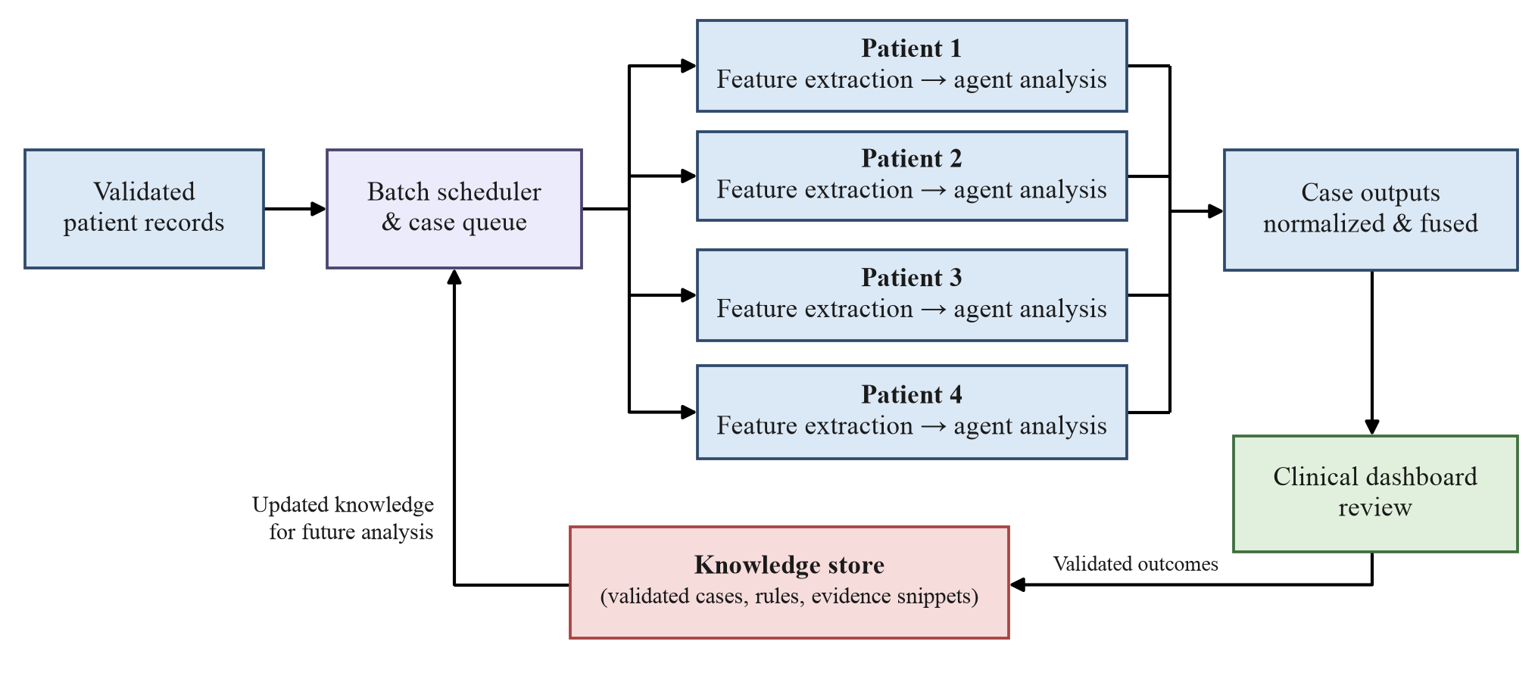




12. Parallel Execution & Governed Knowledge Updates
Fig. 1.9: Parallel patient processing with governed knowledge updates
Isolated contexts (NFR2)
Concurrent agents
Governed updates
Reproducible audit trail
No data, rule result or retrieved evidence from one patient can reach another's report.
ML, rule and retrieval agents run concurrently; synthesis and fusion wait for all of a case's evidence.
Only clinician-validated, curator-approved outcomes enter the index, with a new version stamp.
Each report records its model, rulebase and index versions, so older reports can be reproduced exactly.
Notes:
MedIntel is designed to analyze a batch of patients at once.
The batch scheduler gives every patient an isolated lane, so no data, rule result or retrieved evidence from one patient can reach another patient's report. Within each case the machine-learning, rule and retrieval agents run concurrently, because rule evaluation reads only the case data, while synthesis and fusion wait until all of that case's evidence has arrived.
Validated outcomes flow back into the knowledge store, but not automatically. The store can change through one method only, after clinician review and approval by the Knowledge Curator. This matters because an automatic loop could turn one wrong recommendation into a permanent source of future errors. Each approved change also creates a new index or rulebase version, so an older report can still be reproduced against the knowledge it actually used.

Slide 16
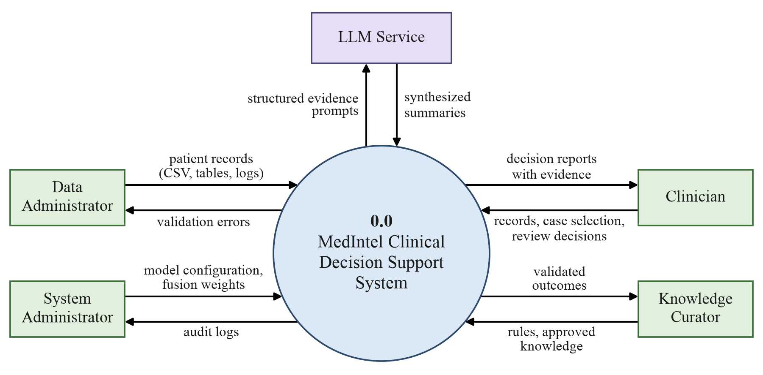
13. System Design: Level 0 Data Flow Diagram
Fig. 1.10: Level 0 DFD: MedIntel as a single process (0.0) with its five external entities
Notes:
These two diagrams summarize the system design from Chapter 4 of our report.
The Level 0 data flow diagram treats MedIntel as a single process with five external entities. The Data Administrator supplies patient records and receives validation errors. The Clinician uploads or selects cases, receives decision reports with their evidence, and returns review decisions. The Knowledge Curator supplies rules and approved knowledge. The System Administrator sets the model configuration and fusion weights and reads the audit logs. The LLM Service receives structured evidence prompts and returns synthesized summaries.

Slide 17
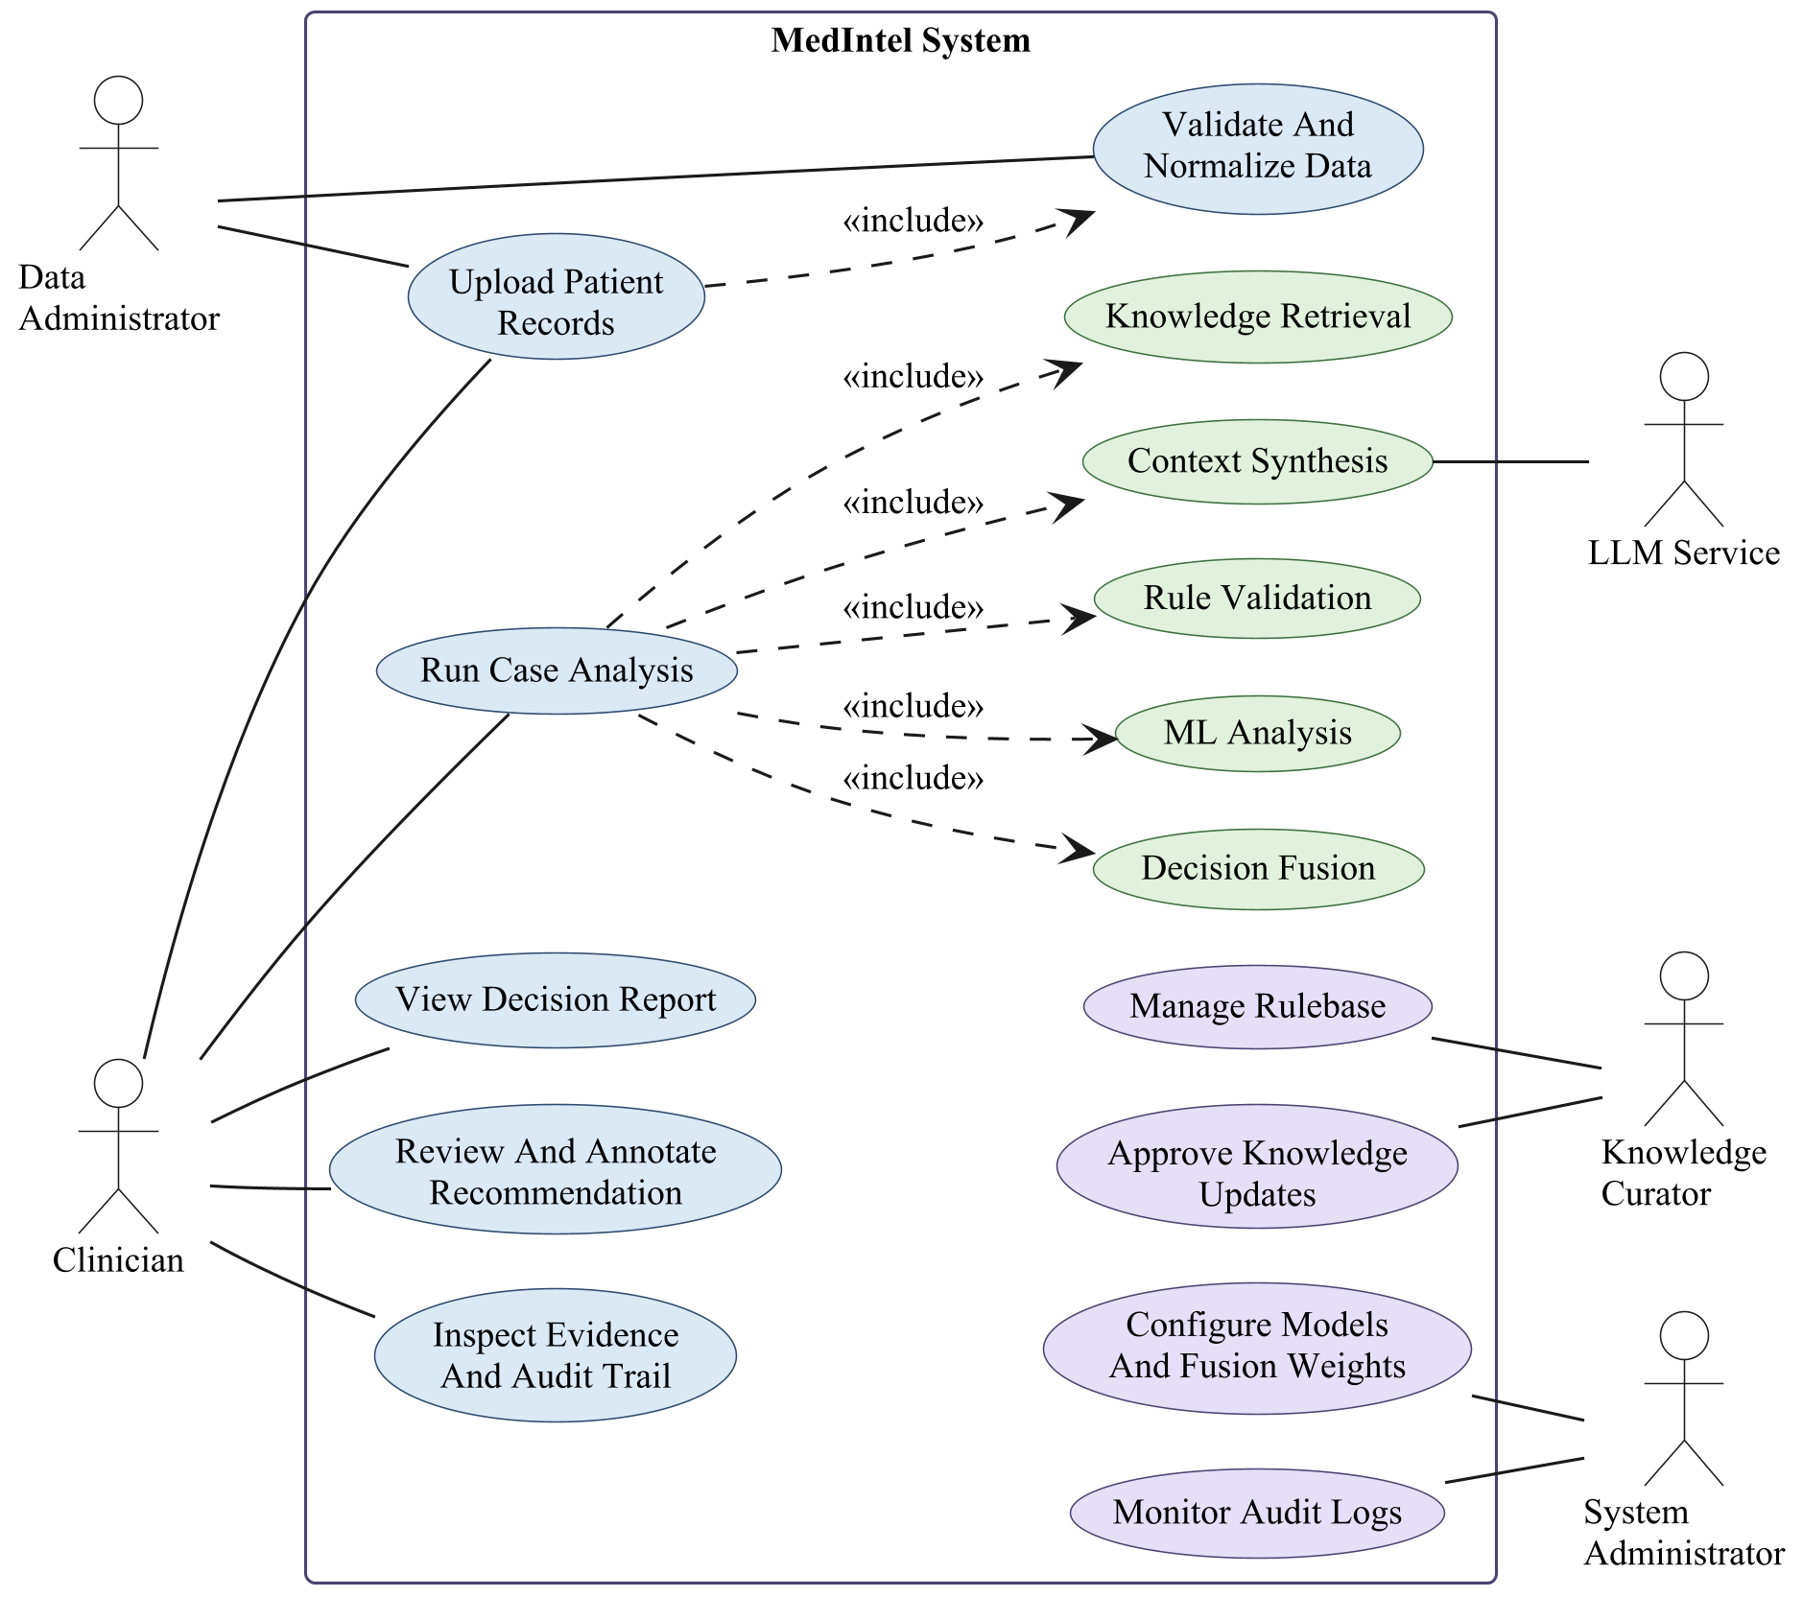




14. System Design: Use Case Diagram
Primary use cases
Run Case Analysis
Includes ML analysis, rule validation, knowledge retrieval, context synthesis and decision fusion
Review Decision Report
Clinician validates or overrides the recommendation
Update Knowledge Store
Curator approves validated outcomes for re-indexing
Configure System
Admin sets fusion weights, model endpoints and rulebase
The report also contains the Level 1 DFD, the class diagram and two sequence diagrams.
Fig. 1.11: Use case diagram of the MedIntel system
Notes:
The use case diagram shows the same actors from the user's side. Run Case Analysis includes ML analysis, rule validation, knowledge retrieval, context synthesis and decision fusion.
Our report also contains the Level 1 data flow diagram, the class diagram and two sequence diagrams.

Slide 18









15. Software Requirement Specification
Functional requirements (FR1–FR9)
Non-functional requirements (NFR1–NFR7)
FR1
Accept and validate patient records (CSV/API)
NFR1
End-to-end latency ≤ 30 s per case
FR2
Run ML classifier, return probabilities + SHAP scores [15]
Strict patient context isolation
NFR2
FR3
Evaluate versioned clinical rulebase
NFR3
Append-only audit log (tamper-evident)
FR4
Retrieve evidence via FAISS + Neo4j (GraphRAG [17])
FR5
Synthesize evidence with LLM, name conflicts
NFR4
Every report field present in 100% of runs
FR6
Compute confidence C using the fusion equation
NFR5
Reproducible results (fixed seed, pinned versions)
FR7
Generate DecisionReport + AuditRecord
NFR6
ML and rule stages < 1 s each
FR8
Present reports on a Streamlit clinician dashboard
Accept clinician review; update knowledge store
NFR7
Runs on a single workstation (≥16 GB RAM)
FR9

Slide 19







16. Technology Stack
API / DASHBOARD
FastAPI + Streamlit + Plotly
REST backend and clinician-facing dashboard
ACROSS ALL LAYERS
Interface
EXPERIMENT TRACKING
MLflow
ORCHESTRATION
LangGraph
Agent workflow with conditional re-retrieval loops
Model versioning, metrics and run comparisons
Orchestration
MACHINE LEARNING
scikit-learn + XGBoost + SHAP
Classifier training, inference and explainability [14], [15]
KNOWLEDGE RETRIEVAL
sentence-transformers + FAISS + Neo4j
GraphRAG [17]: vector search + graph traversal
LLM / CONTEXT
Meditron-7B [16] via Ollama
Medical LLM for context synthesis, runs locally
Agents & models
FEDERATED LEARNING
Flower (Flwr)
Federated simulation across two hospital datasets
DATA & VALIDATION
pandas + pydantic
Load, clean and validate patient records
AUDIT / STORAGE
SQLite / PostgreSQL
Append-only audit log and patient case storage
Data & storage
TESTING
pytest + Git
LANGUAGE
Python 3.11
Core implementation language
Test suite: 12 planned cases, TC-01 to TC-12
Foundation
Fig. 1.12: Layered technology stack; the tools on the right serve every layer

Slide 20


17. Testing & Evaluation Plan (Stage II)
Ablation study: four cumulative conditions on one data split
Design targets (Stage I → Stage II)
4
Full fusion
All agents + confidence scoring
≤ 30 s
< 1 s
3
+ Retrieval
FAISS + Neo4j GraphRAG
End-to-end latency per case
ML and rule stages, each
2
+ Rules
Clinical rulebase overlay
1
ML only
XGBoost classifier baseline
100%
12
Reports with all mandatory fields
Planned test cases, TC-01 to TC-12
Fig. 1.13: Four cumulative ablation conditions; each adds one component
Metrics
DATASET
Cleveland Heart Disease (UCI)
303 rows · 13 features [13]
Accuracy · Precision · Recall · F1 · ROC-AUC
Calibration error (ECE)
Evidence precision @ 5
Disagreement rate
End-to-end latency
Cost per case
Notes:
Our Stage II evaluation answers two questions: does each component add measurable value, and does the complete system stay reliable?
We will compare four conditions of increasing richness on the same data split: the ML model alone, then with the rules, then with retrieval, and finally the full fusion pipeline. An ablation study will then remove one component at a time, to check that the system does not depend too heavily on any single agent.
Beyond accuracy, precision, recall, F1 and ROC-AUC, we will measure calibration error, evidence precision at five, disagreement rate, latency and per-case cost.
The numbers at the bottom are design targets, not results: one case processed end to end within 30 seconds, the ML and rule stages each under one second, and every report containing all its mandatory fields. Twelve test cases are already planned.

Slide 21
18. Dataset Split & Cross-Validation Folds
A. Hold-out split used for the reported results
Cleveland Heart Disease [13]: 303 records
Training set
212 records · 70%
97 disease / 115 healthy
Validation set
45 records · 15%
21 disease / 24 healthy
Test set
46 records · 15%
21 disease / 25 healthy
fits the XGBoost [14] model
kept aside to tune fusion weights in Stage II
used once, for the confusion matrix
B. 5-fold stratified cross-validation (robustness check)
Training folds
Test fold
Fold 1
Fold 2
Fold 3
Fold 4
Fold 5
Accuracy
F1-score
Round 1
Test · 61
Train
Train
Train
Train
80.3%
77.8%
Round 2
Train
Test · 61
Train
Train
Train
80.3%
79.3%
Round 3
Train
Train
Test · 61
Train
Train
85.2%
84.2%
Round 4
Train
Train
Train
Test · 60
Train
80.0%
76.0%
Round 5
Train
Train
Train
Train
Test · 60
85.0%
82.4%
Each round trains on 242–243 records and tests on the remaining 60–61. Mean ± SD:
82.2%±2.4%
79.9%
Fig. 1.14: Data split and 5-fold cross-validation: in round k, fold k is the test fold and the other four folds train the model
Notes:
Our guide asked which part of the data we train on and which part we test on.
For the reported results we use one fixed split: 212 records for training, 45 for validation and 46 for testing. The split is stratified, so each part has the same share of disease cases, and the random seed is 42. The model is trained only on the training set. The validation set is kept aside for tuning the fusion weights in Stage II, and the test set is used once, for the confusion matrix on the next slide.
As a robustness check we also run five-fold cross-validation. The 303 records are divided into five folds. In round one, fold one is the test fold and folds two to five train the model, and so on for each round. Accuracy ranges from 80.0% to 85.2% across the folds, with a mean of 82.2% ± 2.4%.

Slide 22
19. Baseline Results: Confusion Matrix
Predicted class
Accuracy
Precision
No disease
Disease
87.0%
82.6%
Actual
No disease
21
4
(TP + TN) / N
TP / (TP + FP)
Recall (sensitivity)
Specificity
True negatives (TN)
healthy, predicted healthy
False positives (FP)
healthy, flagged as disease
90.5%
84.0%
TP / (TP + FN)
TN / (TN + FP)
Actual
Disease
2
19
F1-score
ROC-AUC
86.4%
0.949
False negatives (FN)
disease missed by the model
True positives (TP)
disease, correctly detected
2 · P · R / (P + R)
area under the ROC curve
5-fold cross-validation accuracy (303 records): 82.2% ± 2.4%
Fig. 1.15: Confusion matrix, XGBoost [14] baseline, test set (n = 46)
These are ML-only results. In Stage II the full fusion pipeline is scored on the same split, so the gain from each added agent can be measured against this baseline.
Trained on the 212-record training set; scored once on the 46-record test set (stratified, seed 42, threshold 0.5). Data: Cleveland Heart Disease [13].
Notes:
This is the confusion matrix of our ML baseline on the 46 held-out test patients.
The model found 19 of the 21 patients who had heart disease and missed 2, which gives a recall of 90.5%. It flagged 4 healthy patients as having disease, so precision is 82.6% and specificity is 84.0%. Overall accuracy is 87.0%, the F1-score is 86.4% and the ROC-AUC is 0.949.
Because the test set is small, we also ran five-fold cross-validation on all 303 records, which gives 82.2% ± 2.4%. In Stage II these numbers become the baseline that the rules, retrieval and fusion stages have to improve on.

Slide 23



20. Conclusion & Future Scope
Stage I outcomes
Future scope
9 functional + 7 non-functional requirements specified
Stage II: build and evaluate the full prototype
Hospital integration: EHR exports, HL7 FHIR, access control
Architecture with explicit typed agent output contracts
Ontologies, knowledge graphs and specialized medical models
Level 0 & 1 DFDs and three UML diagrams
Longitudinal data from repeated patient visits
Reference module logic and 12-case test plan
External validation across multiple institutions
Federated learning across hospital nodes (Flower framework)
Research paper submitted to IJAICMES (October 2026)
Extended GraphRAG: PubMed-integrated knowledge base
Every recommendation traceable to its evidence; the final decision always stays with the clinician.
Notes:
To conclude, Stage I has produced a complete design. On the left: the requirement specification with nine functional and seven non-functional requirements; the architecture with explicit agent output contracts; the data flow and UML diagrams; reference logic for each module; and a twelve-case test plan. We have also written a research paper on this design and submitted it to the International Journal of Artificial Intelligence, Computational Management and Engineering Systems in October 2026.
On the right is our future scope. In Stage II we will build and evaluate the prototype. After that, MedIntel could connect to hospital systems through EHR exports and HL7 FHIR with proper access control, add ontologies, knowledge graphs and specialized medical models, follow patients across repeated visits, and be validated across institutions.
Throughout, the principle stays the same: every recommendation traceable to its evidence, and the final decision always with the clinician.

Slide 24
References
[1] Ç. U. Öğdü, K. Arslanoğlu and M. Karaköse, "An Adaptive Multi-Agent LLM-Based CDSS Integrating Biomedical RAG and Web Intelligence," IEEE Access, vol. 13, 2025.
[2] X. Tang et al., "MedAgents: Large Language Models as Collaborators for Zero-shot Medical Reasoning," Findings of ACL 2024.
[3] Y. Lu, X. Zhao and J. Wang, "ClinicalRAG: Enhancing Clinical Decision Support through Heterogeneous Knowledge Retrieval," KnowLLM Workshop, 2024.
[4] K. Zuo et al., "KG4Diagnosis: A Hierarchical Multi-Agent LLM Framework with Knowledge Graph Enhancement for Medical Diagnosis," PMLR, vol. 281, 2025.
[5] T. Abdullahi et al., "Retrieval-Based Diagnostic Decision Support: Mixed Methods Study," JMIR Medical Informatics, vol. 12, 2024.
[6] S. Liu et al., "Improving large language model applications in biomedicine with retrieval-augmented generation," JAMIA, vol. 32, 2025.
[7] S. Delourme et al., "Measured Performance and Healthcare Professional Perception of LLMs Used as CDSS: A Scoping Review," Stud. Health Technol. Inform., 2024.
[8] C. Wang et al., "Potential for GPT Technology to Optimize Future Clinical Decision-Making Using RAG," Annals of Biomedical Engineering, 2024.
[9] S. Kresevic et al., "Optimization of hepatological clinical guidelines interpretation by LLMs: a RAG-based framework," npj Digital Medicine, 2024.
[10] W. Li et al., "MACD: Multi-Agent Clinical Diagnosis with Self-Learned Knowledge for LLM," arXiv:2509.20067, 2025.
[11] A. J. Thirunavukarasu et al., "Large language models in medicine," Nature Medicine, vol. 29, 2023.
[12] A. Patel et al., "Fine-Tuning, RAG, and Hybrid Adaptation of LMs for Clinical Decision-Making," J. Med. Internet Res., 2026.
[13] A. Janosi, W. Steinbrunn, M. Pfisterer and R. Detrano, "Heart Disease," UCI Machine Learning Repository, 1989, doi: 10.24432/C52P4X.
[14] T. Chen and C. Guestrin, "XGBoost: A Scalable Tree Boosting System," in Proc. 22nd ACM SIGKDD Int. Conf. Knowledge Discovery and Data Mining, 2016, pp. 785–794.
[15] S. M. Lundberg and S.-I. Lee, "A Unified Approach to Interpreting Model Predictions," in Advances in Neural Information Processing Systems 30 (NeurIPS), 2017.
[16] Z. Chen et al., "MEDITRON-70B: Scaling Medical Pretraining for Large Language Models," arXiv:2311.16079, 2023.
[17] D. Edge et al., "From Local to Global: A Graph RAG Approach to Query-Focused Summarization," arXiv:2404.16130, 2024.
Notes:
These are the main references behind our work.
References one and two are our base papers: the adaptive multi-agent clinical decision support system by Öğdü and colleagues, and MedAgents by Tang and colleagues. The others cover retrieval-augmented clinical systems, knowledge-graph agents, systematic and scoping reviews of language models in medicine, and self-learned clinical knowledge.
The complete reference list, with DOIs, is in our report.
References 13 to 17 cite the dataset and the main tools we use: the UCI Cleveland heart disease dataset, XGBoost, SHAP, the Meditron medical language model and GraphRAG.

Slide 25
Thank You
Questions and suggestions are welcome
ML
Fusion
Rules
Context
Retrieval
The clinician stays at the center
Notes:
Thank you for your attention. We would be happy to answer your questions.
We would especially welcome suggestions on the choice of dataset and clinical task for Stage II, since that decision will shape our model, our rules and our evaluation.

