Slide 1







MedIntel
ML
A Multi-Agent AI Framework for Clinical Decision Support
Fusion
Rules
BE Computer Engineering | Project Stage I Presentation | AY 2026-27
PRESENTED BY
Siddhesh Kishor Suryawanshi
Shantanu Avinash Patil
Omkar Abaji Musale
Tanmay Shriniwas Bagul
Context
Retrieval
Guide: Prof. G. P Mohole, Head of Computer Department
Department of Computer Engineering, JESITMR, Nashik
The clinician stays at the center
Notes:
Good morning, respected Head of Department, faculty members and friends. We are Siddhesh Suryawanshi, Shantanu Patil, Omkar Musale and Tanmay Bagul, and our BE project is MedIntel, a multi-agent AI framework for clinical decision support, guided by Prof. G. P. Mohole.
In this Project Stage I presentation we explain the problem we are solving, what existing work does and misses, the architecture we have designed, and how we will build and test it in Stage II next semester.
The diagram on the right is the idea in one picture: several specialized agents, one each for machine learning, rules, retrieval, context and fusion, all working around the clinician, who keeps the final decision.
One point to keep in mind throughout: this stage is analysis and design, so every number you see today is a target for Stage II, not a measured result.

Slide 2
Outline
Introduction & Motivation
Agents & Decision Fusion
1
5
Problem Statement & Objectives
System Design: DFD & UML
2
6
Literature Survey & Research Gap
Technology & Evaluation Plan
3
7
Proposed Architecture
Conclusion & Future Scope
4
8
Notes:
This is the flow of our talk.
We begin with the background and motivation, then state the problem and our objectives. Next we summarize the literature survey and the research gap it reveals.
The two items in red are the core of the project: the proposed architecture, and the agents together with the decision-fusion step that turns their outputs into one recommendation with a confidence score.
After that we show the system design through a data flow diagram and a use case diagram, then the technology stack and the evaluation plan for Stage II. We close with our conclusions and future scope, and then we will be happy to take your questions.

Slide 3




Introduction & Motivation
Clinical decision support systems (CDSS) help clinicians interpret patient data through alerts, risk estimates and suggested next steps.
Large language models (LLMs) have widened what these systems can do, yet reviews keep reporting the same weaknesses: calibration, validation and transparency [7].
Messy real-world data
One record can hold missing fields, mixed units, repeated observations and free-text notes.
Opaque recommendations
When one generative model writes the answer, nobody can see which evidence produced it.
Our goal: every recommendation should carry its own record of how it was reached.
Clinicians must verify
Model output, rules fired, sources and versions should travel with every recommendation.
Notes:
Clinical decision support systems help doctors interpret patient data, for example by raising alerts, estimating risk or suggesting next steps. Large language models have made these systems far more capable, but published reviews keep reporting the same weaknesses: calibration, validation and transparency.
In practice we see three problems, shown on the right. First, hospital data is messy: a single record can have missing fields, mixed units, repeated observations and free-text notes. Second, when one generative model reads everything and writes the answer, nobody can see which evidence led to the recommendation. Third, a clinician has to be able to check a recommendation before acting on it.
That is our motivation: every recommendation should carry its own record, meaning the model output, the rules that fired, the sources used and the versions in use.

Slide 4







Problem Statement & Objectives
Problem Statement
Objectives
Design an implementable, modular pipeline for patient-level decision support that accepts imperfect patient data, keeps learned, rule-based and retrieved evidence separate, combines it through an explicit confidence function and gives clinicians a traceable report, while processing many patients in parallel without mixing their contexts.
Modular architecture
Separate agents with defined output contracts
Stage I
Traceable reporting
Reports link back to features, rules and sources
Stage I
Parallel prototype
Concurrent analysis in isolated patient contexts
Stage II
Staged evaluation
Baselines, ablation and calibration checks
Stage II
Clinician review loop
Only clinician-validated outcomes are re-indexed
Stage II
Notes:
On the left is our problem statement. We want an implementable, modular pipeline that accepts imperfect patient data, keeps learned, rule-based and retrieved evidence separate, combines that evidence through an explicit confidence function and gives the clinician a traceable report, while processing many patients in parallel without mixing their data.
On the right are our five objectives. The first two belong to Stage I and are complete: the modular architecture, in which each agent has a defined output contract, and the traceable reporting design, in which each report links back to its features, rules and sources.
The other three belong to Stage II: building the parallel prototype, running a staged evaluation with baselines, ablation and calibration checks, and adding the clinician review loop, so that only validated outcomes are allowed back into the knowledge store.

Slide 5
Literature Survey
Work | Approach | Limitation
[1] Öğdü et al., 2025 | Adaptive multi-agent LLM CDSS with biomedical RAG, web evidence and data fusion | With many reasoning components it is hard to tell which one produced a recommendation
[2] Tang et al., 2024 (MedAgents) | Role-based LLM agents that discuss a question and reach consensus | Analysis stays within LLM agents, with no dedicated ML model or deterministic rules
[3] Lu et al., 2024 (ClinicalRAG) | Multi-agent pipeline with heterogeneous knowledge retrieval | Tabular ML and rules do not share a common interface with retrieval
[4] Zuo et al., 2025 (KG4Diagnosis) | Hierarchical LLM agents with a medical knowledge graph | The knowledge graph adds knowledge-engineering requirements
[5] Abdullahi et al., 2024 | Ensemble of retrieval-based and predictive diagnosis | Focus is diagnostic ranking, not an auditable pipeline for each patient
[10] Li et al., 2025 (MACD) | Multi-agent diagnosis with self-learned knowledge | Makes the governance of self-learned knowledge more visible
Twelve works were reviewed in total; the full comparison is Table 2.2 of the report.
Notes:
We reviewed twelve recent works; this table shows the six closest to our project.
The adaptive multi-agent system by Öğdü and colleagues is our first base paper. It combines specialist agents with biomedical retrieval and web evidence, but with so many reasoning components it becomes hard to tell which one produced a recommendation. MedAgents, our second base paper, lets role-based language-model agents discuss a question and agree, but the whole analysis stays inside language models.
ClinicalRAG and KG4Diagnosis improve grounding through heterogeneous retrieval and a medical knowledge graph. Abdullahi and colleagues show that combining retrieval with prediction helps diagnostic ranking. MACD shows the potential of self-learned knowledge, but also makes its governance problem visible.
Each work is valuable, and each leaves part of our problem open. The complete comparison of all twelve works is in Table 2.2 of our report.

Slide 6
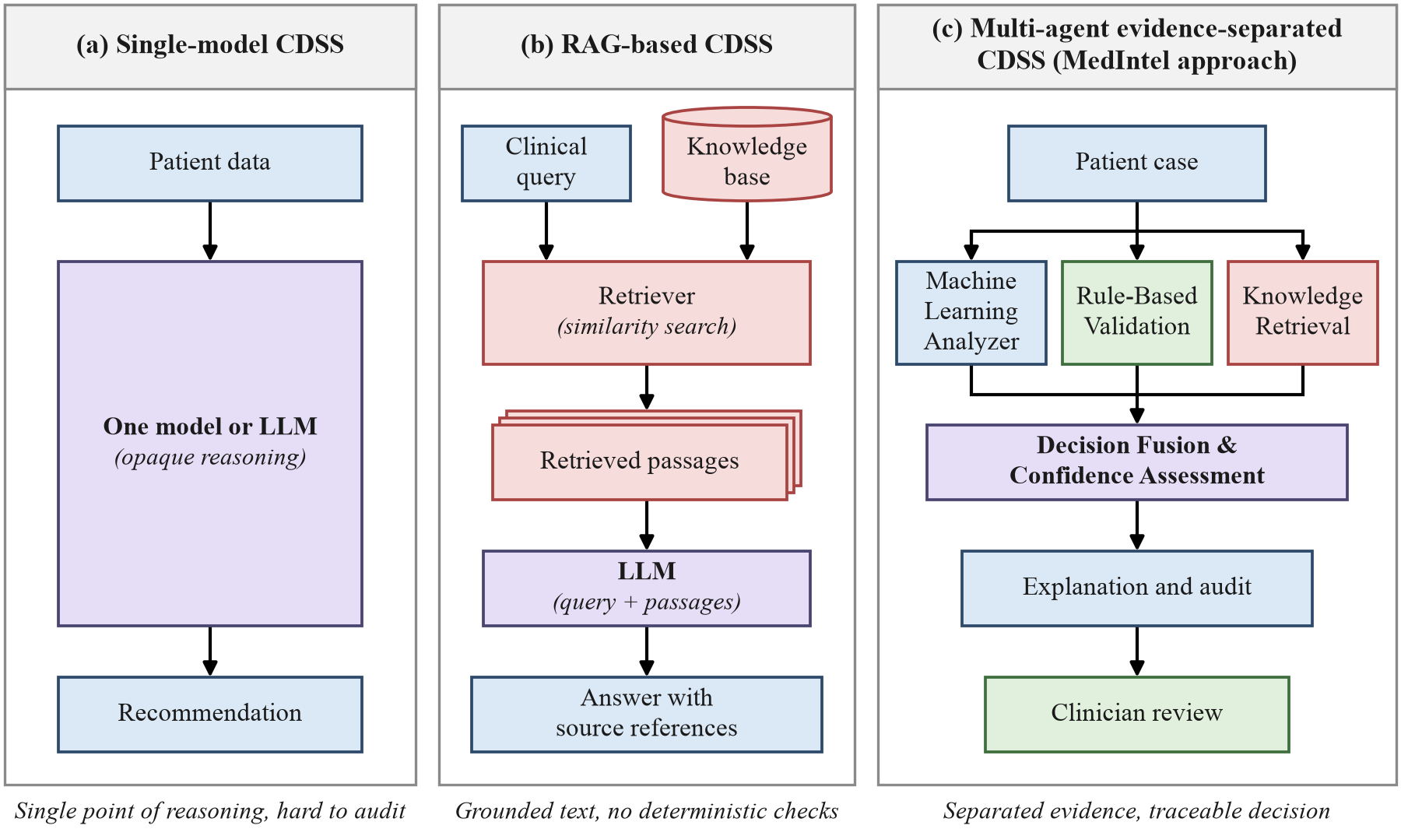
Research Gap
Untraceable outputs
Single models and chained LLM agents do not link a recommendation to the feature, rule or source behind it.
No common interface
Tabular ML, deterministic rules, retrieval and LLM synthesis do not meet at one interface for each patient.
Incomplete evaluation
Few studies show what each component adds or whether the confidence is calibrated.
MedIntel: separate evidence, explicit fusion, clinician in charge.
Single-model, RAG-based and evidence-separated multi-agent CDSS designs
Notes:
Putting the survey together, we found three gaps.
First, outputs are not traceable: single models and chains of language-model agents do not link a recommendation to the specific feature, rule or source behind it. Second, there is no common interface: tabular machine learning, deterministic rules, retrieval and language-model synthesis do not meet at one patient-level interface. Third, evaluation is incomplete: a multi-component system must show what each component adds and whether its confidence is calibrated, which one benchmark accuracy cannot show.
The figure compares three design styles. A single-model system is one opaque step. A retrieval-based system grounds its answer in sources but applies no deterministic checks. MedIntel follows the third style: each kind of evidence is produced separately and fused explicitly, and a clinician reviews the result.

Slide 7
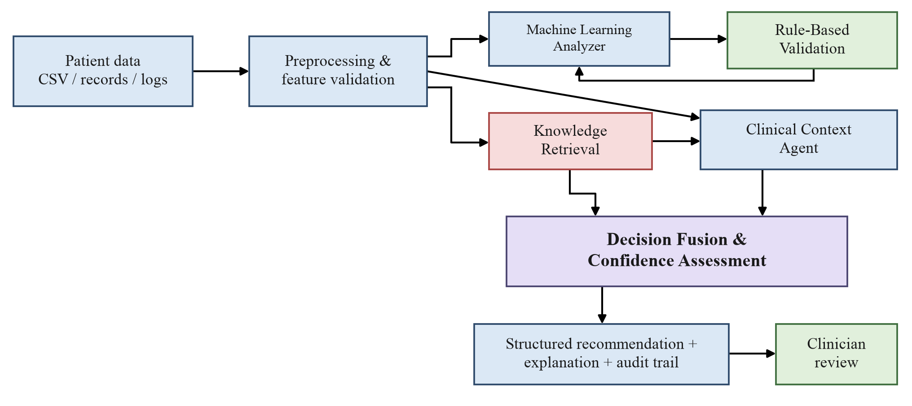
Proposed Architecture
Typed agent outputs are fused into one scored recommendation, and a clinician reviews every report.
Notes:
This is the MedIntel architecture.
Patient data arrives as CSV files, records or event logs and is first validated: data types, missing fields, duplicates, units and identifiers are all checked before a case is built.
Each valid case then goes to the analysis agents. The Machine Learning Analyzer finds learned patterns in the structured features. Rule-Based Validation applies explicit clinical thresholds and policies. Knowledge Retrieval brings supporting evidence from approved guidelines and articles. The Clinical Context Agent uses a language model to reconcile these outputs and to report any conflict between them.
Decision Fusion and Confidence Assessment combines all of this into one recommendation with a confidence score. The result is a structured recommendation with its explanation and audit trail, and it always goes to a clinician for review.

Slide 8

Agents & Output Contracts
ML Analysis Agent
Rule Validation Agent
Knowledge Retrieval Agent
Learned patterns in structured features
Deterministic thresholds and policies from a versioned JSON rulebase
Evidence from approved guidelines and articles in a FAISS index
MLResult: prediction, class probabilities, feature importance, model version
RuleResult: triggered rules, action, reason, rulebase version
EvidenceItem list: source id, passage, similarity score
Clinical Context Agent
Decision Fusion Engine
Explanation & Audit
LLM synthesis that names conflicts and invents nothing
Combines all evidence with an explicit confidence function
Readable report for review plus an append-only audit trail
ContextSummary: summary, conflicts, unsupported statements
FusionResult: decision, confidence C, disagreement D
DecisionReport and AuditRecord with versions and timestamp
Notes:
Each component has one job and one output contract, and this is what makes the system auditable.
The ML Analysis Agent returns a prediction with class probabilities, feature importance and the model version. The Rule Validation Agent applies a versioned JSON rulebase and returns the triggered rules, the action taken and the reason. The Knowledge Retrieval Agent returns passages with source identifiers and similarity scores, or states that nothing relevant was found.
The Clinical Context Agent is the only place where a language model reasons over the case. It summarizes the evidence, names conflicts and lists any statement the evidence does not support. The Decision Fusion Engine computes the decision, the confidence and the disagreement, and the Explanation and Audit layer turns everything into a readable report and an audit record.
Because every output is typed, any one agent can be replaced without redesigning the others.

Slide 9


Decision Fusion & Confidence Scoring
C = αM + βR + γK − λD
Equation (4.2): confidence of the fused decision
M
ML support
R
Rule consistency
K
Retrieval support
D
Disagreement
Probability of the class the model predicts
1, or 0 when an elevating or suppressing rule contradicts the prediction
Mean similarity of retrieved passages; 0 when none is relevant
Conflicts reported by the Clinical Context Agent, divided by 3 and capped at 1
Weights α, β, γ, λ tuned only on a validation split
A triggered rule always takes precedence
C below the threshold: reported as uncertain
Notes:
Fusion is an explicit equation, not a hidden judgment.
M is the machine-learning support, the probability of the class the model predicts. R is rule consistency: it is one, unless an elevating or suppressing rule contradicts the prediction, in which case it is zero. K is retrieval support, the average similarity of the retrieved passages, and zero when nothing relevant is found. D is disagreement: the number of conflicts the context agent reports, divided by three and capped at one.
So confidence rises when the evidence agrees and falls when the sources conflict.
Three rules complete the design, shown at the bottom. The weights alpha, beta, gamma and lambda will be tuned only on a separate validation split. A triggered rule always takes precedence over the learned prediction. And if C falls below the threshold, the case is reported as uncertain and flagged for the clinician.

Slide 10

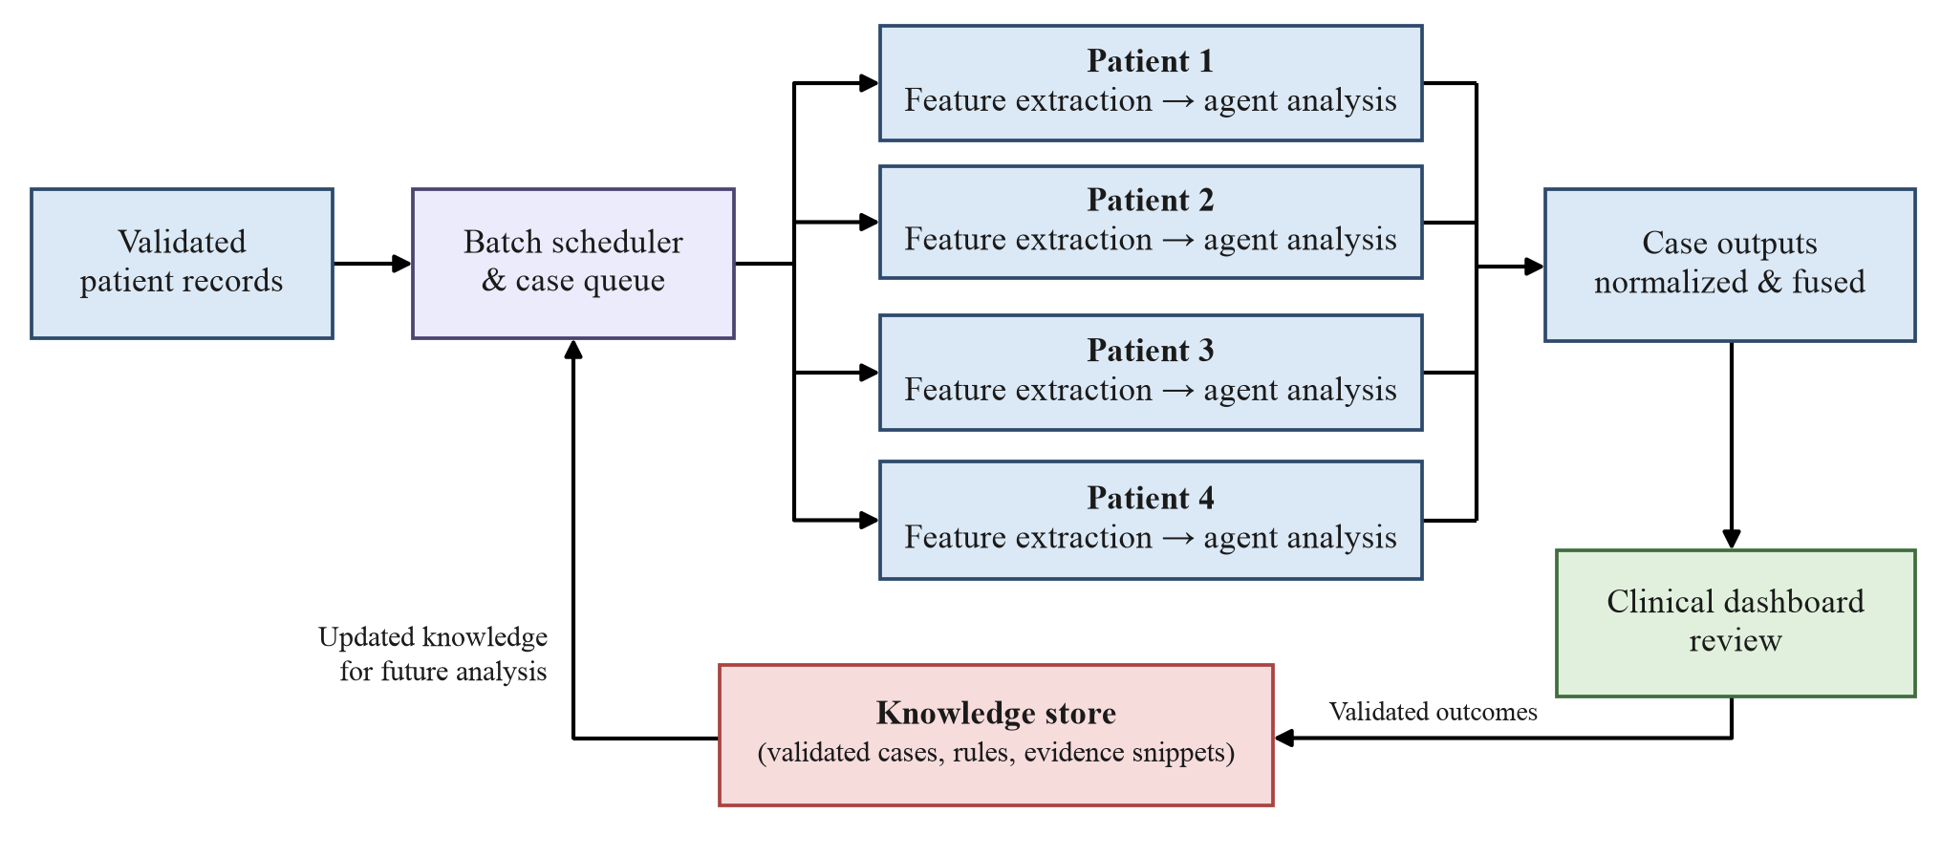


Parallel Execution & Governed Updates
Isolated contexts
No data or evidence from one patient reaches another patient’s report (NFR2).
Concurrent agents
ML, rules and retrieval run together; synthesis waits for all of a case’s evidence.
Governed knowledge
Only outcomes validated by a clinician and approved by the curator enter the index, with a new version.
One lane per patient; validated outcomes re-enter the knowledge store only after approval.
Notes:
MedIntel is designed to analyze a batch of patients at once.
The batch scheduler gives every patient an isolated lane, so no data, rule result or retrieved evidence from one patient can reach another patient's report. Within each case the machine-learning, rule and retrieval agents run concurrently, because rule evaluation reads only the case data, while synthesis and fusion wait until all of that case's evidence has arrived.
Validated outcomes flow back into the knowledge store, but not automatically. The store can change through one method only, after clinician review and approval by the Knowledge Curator. This matters because an automatic loop could turn one wrong recommendation into a permanent source of future errors. Each approved change also creates a new index or rulebase version, so an older report can still be reproduced against the knowledge it actually used.

Slide 11
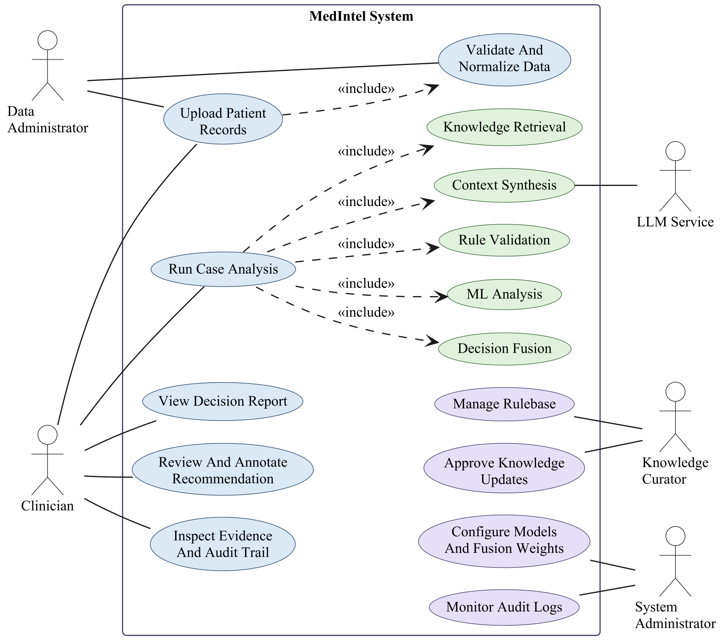
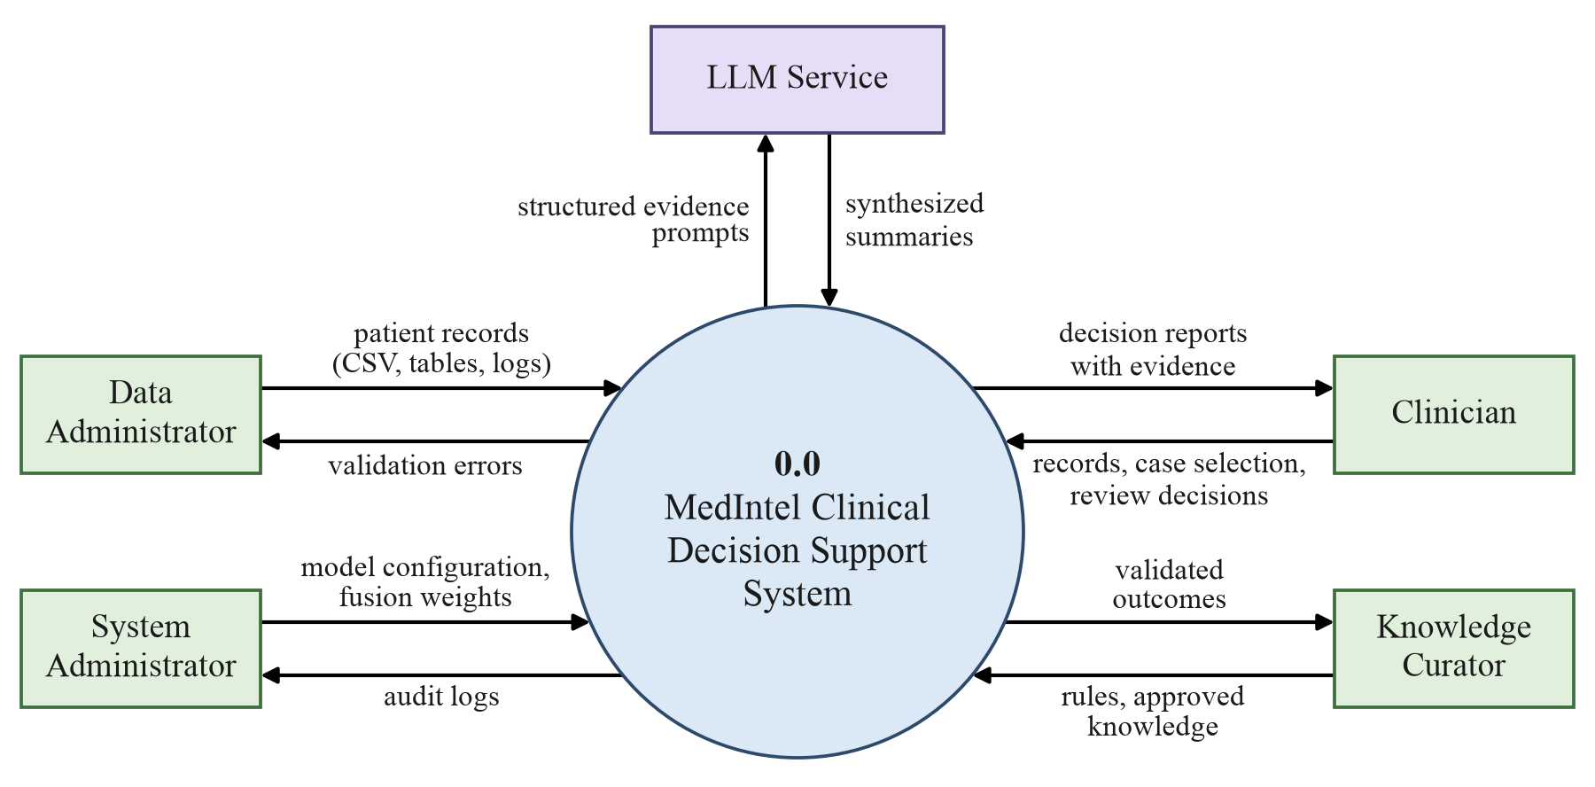
System Design: DFD & UML
Level 0 data flow diagram: MedIntel and its five external entities
Use case diagram for the primary actors
Notes:
These two diagrams summarize the system design from Chapter 4 of our report.
The Level 0 data flow diagram on the left treats MedIntel as a single process with five external entities. The Data Administrator supplies patient records and receives validation errors. The Clinician uploads or selects cases, receives decision reports with their evidence, and returns review decisions. The Knowledge Curator supplies rules and approved knowledge. The System Administrator sets the model configuration and fusion weights and reads the audit logs. The LLM Service receives structured evidence prompts and returns synthesized summaries.
The use case diagram on the right shows the same actors from the user's side. Run Case Analysis includes ML analysis, rule validation, knowledge retrieval, context synthesis and decision fusion.
Our report also contains the Level 1 data flow diagram, the class diagram and two sequence diagrams.

Slide 12



Technology Stack & Requirements
Interface
Streamlit dashboard · FastAPI REST backend
Requirements
Language model
Hosted API or a local model via Ollama
Language
Python 3.11
RAM
8 GB minimum, 16 GB recommended
GPU
Optional, for a local LLM
OS
Windows 10 or 11, Ubuntu 22.04, macOS 13
Storage
20 to 50 GB free SSD
Retrieval
sentence-transformers · FAISS vector index
Machine learning
scikit-learn · XGBoost
Data & rules
pandas · pydantic validation · JSON rulebase
Storage & testing
SQLite / PostgreSQL audit log · pytest · Git
Notes:
We chose a Python 3.11 stack against three criteria: every component's output must be inspectable, patient data must be able to stay on site, and every run must be reproducible.
pandas and pydantic load and validate the input, and the rules live in a JSON file that the Knowledge Curator can edit. scikit-learn and XGBoost provide the classifiers. sentence-transformers embeddings in a local FAISS index provide retrieval. The language model sits behind a configurable endpoint, either a hosted API or a local model served with Ollama, so case content can stay inside the institution when required.
FastAPI serves the backend, Streamlit provides the clinician dashboard, SQLite or PostgreSQL stores the audit log, and pytest drives the tests.
On the right are the requirements: a machine with 8 GB of RAM is enough for development, 16 GB is recommended, and a GPU is needed only for a local language model.

Slide 13
Testing & Evaluation Plan
1 ML only
2 + Rules
3 + Retrieval
4 Full fusion pipeline
Every condition uses the same data split; an ablation study then removes one component at a time.
Metrics: accuracy · precision · recall · F1 · ROC-AUC · calibration error
Also: evidence precision at 5 · disagreement rate · latency · cost per case
Stage II design targets, set in Stage I and not yet measured
≤ 30 s
< 1 s
100%
12
one case, end to end (NFR4)
each of the ML and rule stages
reports with every mandatory field
planned test cases, TC-01 to TC-12
Notes:
Our Stage II evaluation answers two questions: does each component add measurable value, and does the complete system stay reliable?
We will compare four conditions of increasing richness on the same data split: the ML model alone, then with the rules, then with retrieval, and finally the full fusion pipeline. An ablation study will then remove one component at a time, to check that the system does not depend too heavily on any single agent.
Beyond accuracy, precision, recall, F1 and ROC-AUC, we will measure calibration error, evidence precision at five, disagreement rate, latency and per-case cost.
The numbers at the bottom are design targets, not results: one case processed end to end within 30 seconds, the ML and rule stages each under one second, and every report containing all its mandatory fields. Twelve test cases are already planned.

Slide 14




Conclusion & Future Scope
Stage I Outcomes
Future Scope
Requirements: 9 functional, 7 non-functional
Stage II: build and evaluate the prototype
Architecture with explicit agent output contracts
Hospital integration: EHR exports, HL7 FHIR, access control
Level 0 and 1 DFDs and three UML diagrams
Ontologies, knowledge graphs and specialized medical models
Reference module logic and a 12-case test plan
Longitudinal data from repeated patient visits
Paper submitted to IJAICMES in October 2026
External validation across institutions
Every recommendation traceable to its evidence, and the final decision always with the clinician.
Notes:
To conclude, Stage I has produced a complete design. On the left: the requirement specification with nine functional and seven non-functional requirements; the architecture with explicit agent output contracts; the data flow and UML diagrams; reference logic for each module; and a twelve-case test plan. We have also written a research paper on this design and submitted it to the International Journal of Artificial Intelligence, Computational Management and Engineering Systems in October 2026.
On the right is our future scope. In Stage II we will build and evaluate the prototype. After that, MedIntel could connect to hospital systems through EHR exports and HL7 FHIR with proper access control, add ontologies, knowledge graphs and specialized medical models, follow patients across repeated visits, and be validated across institutions.
Throughout, the principle stays the same: every recommendation traceable to its evidence, and the final decision always with the clinician.

Slide 15
References
[1] Ç. U. Öğdü, K. Arslanoğlu and M. Karaköse, “An Adaptive Multi-Agent LLM-Based Clinical Decision Support System Integrating Biomedical RAG and Web Intelligence,” IEEE Access, vol. 13, 2025.
[2] X. Tang et al., “MedAgents: Large Language Models as Collaborators for Zero-shot Medical Reasoning,” Findings of ACL 2024, 2024.
[3] Y. Lu, X. Zhao and J. Wang, “ClinicalRAG: Enhancing Clinical Decision Support through Heterogeneous Knowledge Retrieval,” KnowLLM Workshop, 2024.
[4] K. Zuo, Y. Jiang, F. Mo and P. Lio, “KG4Diagnosis: A Hierarchical Multi-Agent LLM Framework with Knowledge Graph Enhancement for Medical Diagnosis,” PMLR, vol. 281, 2025.
[5] T. Abdullahi, L. Mercurio, R. Singh and C. Eickhoff, “Retrieval-Based Diagnostic Decision Support: Mixed Methods Study,” JMIR Medical Informatics, vol. 12, 2024.
[6] S. Liu, A. B. McCoy and A. Wright, “Improving large language model applications in biomedicine with retrieval-augmented generation: a systematic review,” JAMIA, vol. 32, 2025.
[7] S. Delourme, A. Redjdal, J. Bouaud and B. Seroussi, “Measured Performance and Healthcare Professional Perception of LLMs Used as Clinical Decision Support Systems: A Scoping Review,” Stud. Health Technol. Inform., 2024.
[8] C. Wang et al., “Potential for GPT Technology to Optimize Future Clinical Decision-Making Using Retrieval-Augmented Generation,” Annals of Biomedical Engineering, 2024.
[9] S. Kresevic et al., “Optimization of hepatological clinical guidelines interpretation by large language models: a retrieval augmented generation-based framework,” npj Digital Medicine, 2024.
[10] W. Li et al., “MACD: Multi-Agent Clinical Diagnosis with Self-Learned Knowledge for LLM,” arXiv:2509.20067, 2025.
[11] A. J. Thirunavukarasu et al., “Large language models in medicine,” Nature Medicine, vol. 29, 2023.
[12] A. Patel et al., “Fine-Tuning, Retrieval-Augmented Generation, and Hybrid Adaptation of Language Models for Clinical Decision-Making in Health Care: Systematic Review,” J. Med. Internet Res., 2026.
Notes:
These are the main references behind our work.
References one and two are our base papers: the adaptive multi-agent clinical decision support system by Öğdü and colleagues, and MedAgents by Tang and colleagues. The others cover retrieval-augmented clinical systems, knowledge-graph agents, systematic and scoping reviews of language models in medicine, and self-learned clinical knowledge.
The complete reference list, with DOIs, is in our report.

Slide 16
Thank You
ML
Questions and suggestions are welcome
Fusion
Rules
BE Computer Engineering | Project Stage I Presentation | AY 2026-27
PRESENTED BY
Siddhesh Kishor Suryawanshi
Shantanu Avinash Patil
Omkar Abaji Musale
Tanmay Shriniwas Bagul
Context
Retrieval
Guide: Prof. G. P Mohole, Head of Computer Department
Department of Computer Engineering, JESITMR, Nashik
The clinician stays at the center
Notes:
Thank you for your attention. We would be happy to answer your questions.
We would especially welcome suggestions on the choice of dataset and clinical task for Stage II, since that decision will shape our model, our rules and our evaluation.

