Slide 1
Towards Zero-Waste Inference
Hardware-Efficient SNNs
ECE274 Neuromorphic Computing Project
via Dynamic Gatekeeping & Early Exit

Slide 2
1. Motivation: The Edge Computing Bottleneck
The Promise of SNNs: Event-driven sparsity offers tremendous energy advantages for always-on edge sensors.
The Reality of CMOS Hardware: Fetching data from Memory (SRAM) costs 25x more energy than compute (MAC).
SRAM Read (45nm): ~ 5 pJ per access.
INT8 Addition: ~ 0.2 pJ per access.
The Problem: Current SNN research focuses on algorithmic accuracy but ignores the hardware cost of redundant memory reads caused by sensor noise.

Slide 3
2. Our Hardware-First Solution
We propose a natively digital, co-designed architecture that intercepts and drops redundant spikes before they can trigger expensive SRAM reads.
Three Core Contributions:
1. Dynamic Gatekeeper Filtering: Pre-processing input noise and burst redundancy.
2. Adaptive Activity Regulation: Hardware-efficient threshold adaptation to silence hidden-layer 'spike storms'.
3. Early-Exit FSM: Terminating the temporal processing window the moment the network reaches a confident prediction.

Slide 4
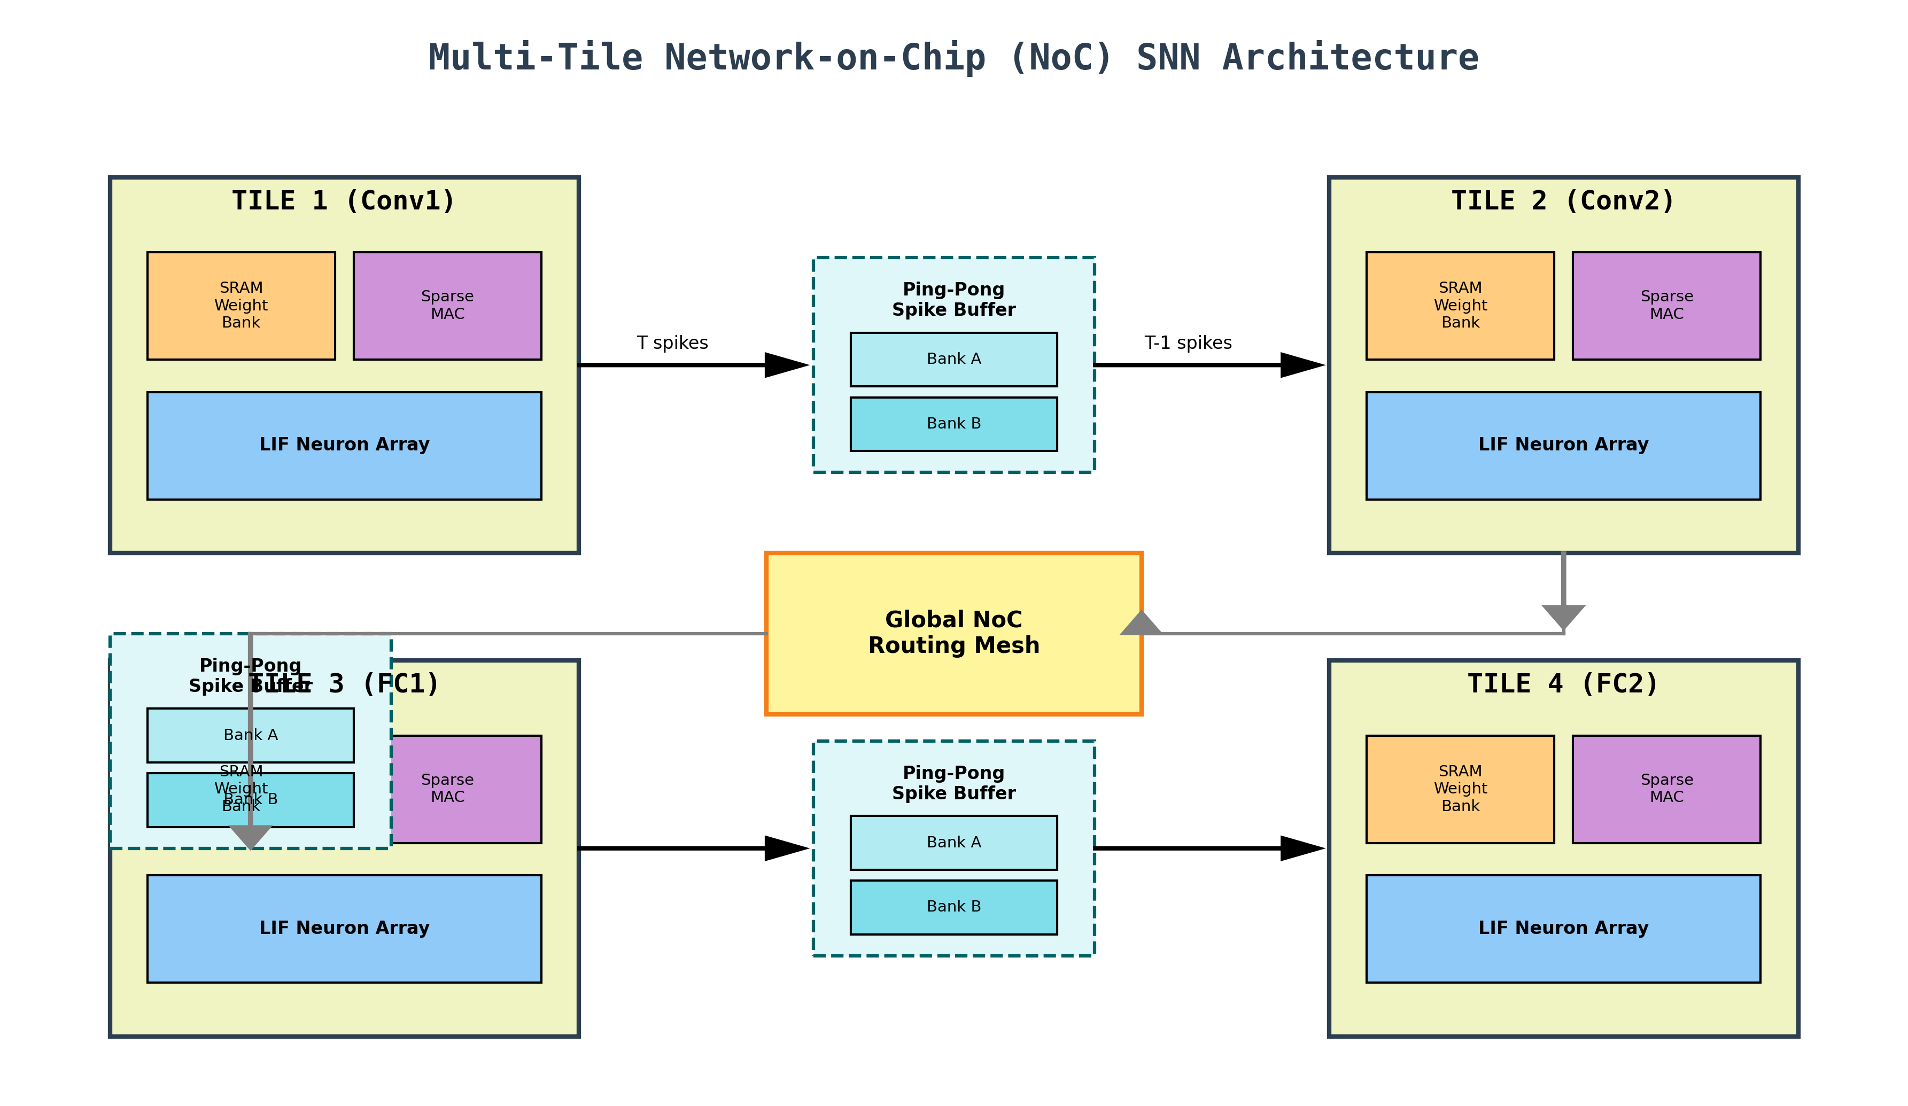
3. System-Level Architecture: Multi-Tile NoC
To avoid a massive centralized memory bottleneck, our architecture is partitioned into Tiles.
Each layer operates as an independent hardware engine with strictly local, private SRAM.

Slide 5
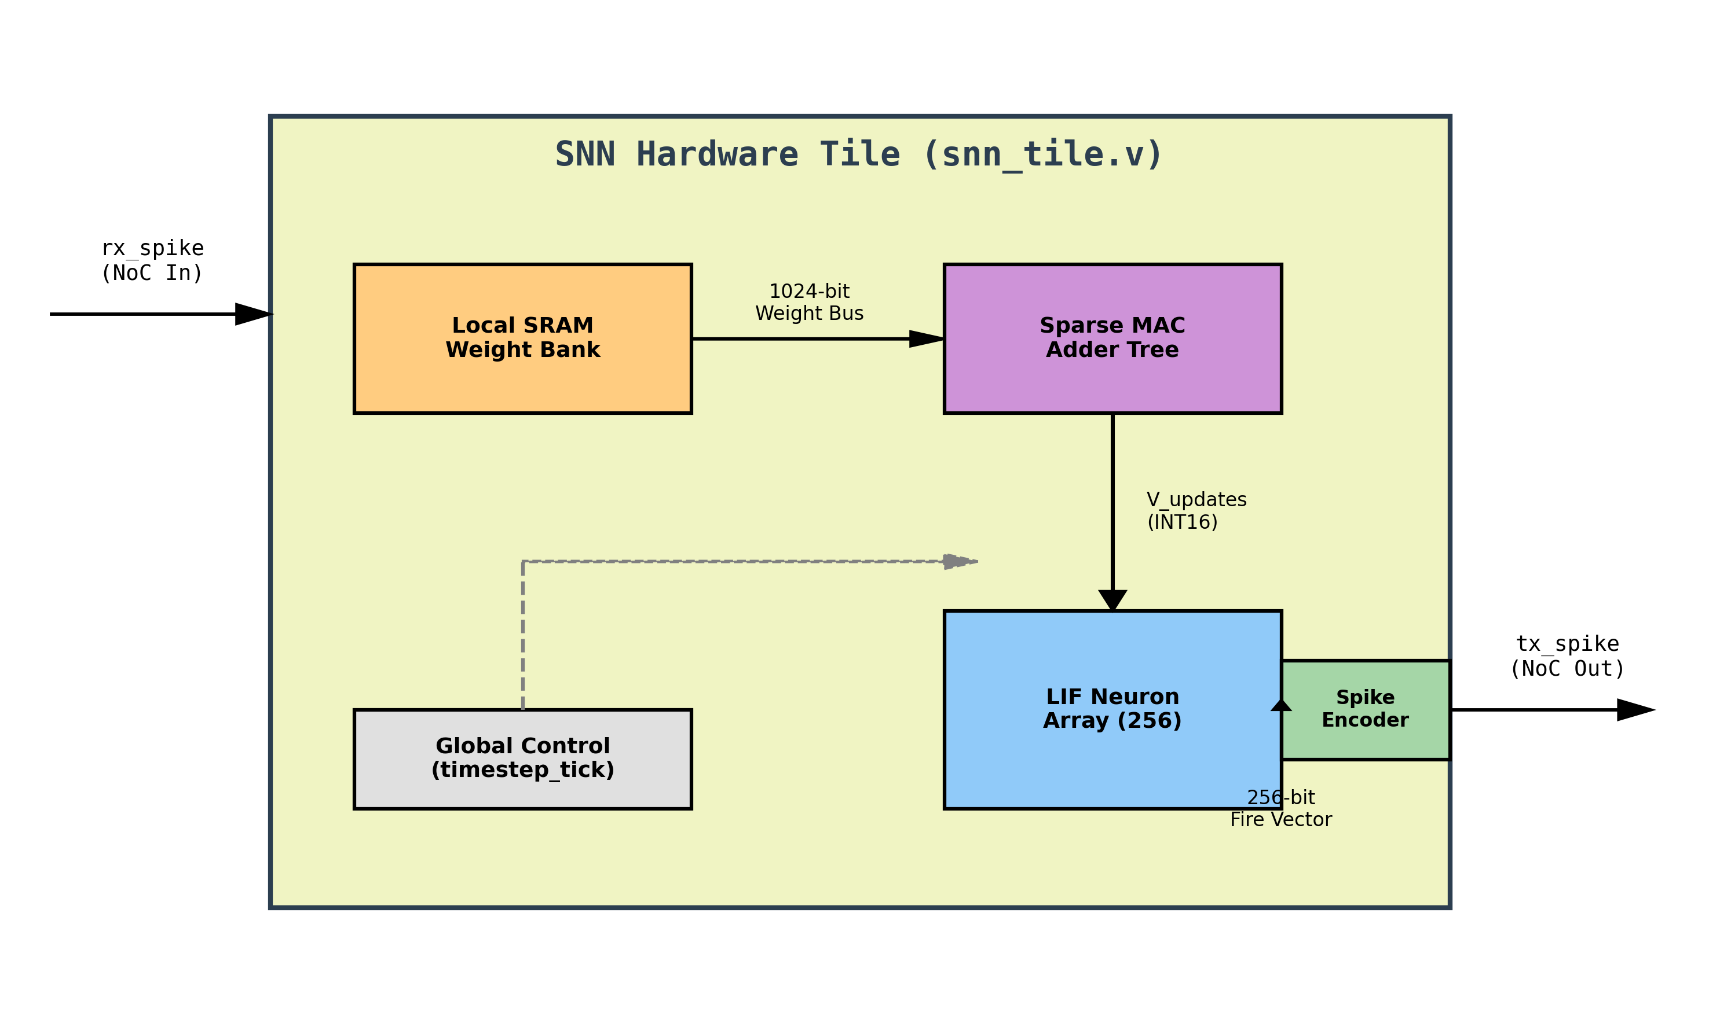
4. Inside the Datapath: The SNN Hardware Tile
Each Tile contains everything it needs to execute its layer:
Local SRAM Weight Bank: Stores INT8 quantized weights.
Sparse MAC Array: Adds weights conditionally based on binary spikes.
LIF Neuron Array: Handles leaky integration and thresholding.

Slide 6
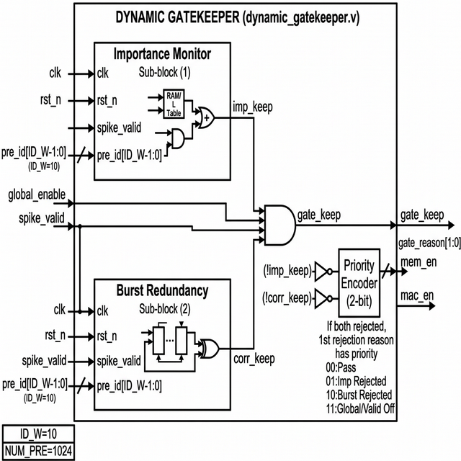
5. Core Innovation A: Dynamic Gatekeeper
Sits in front of the Conv1 tile to pre-filter raw camera input.
Importance Monitor: Filters Spatial Noise using an array of 4-bit saturating counters with global decay.
Burst Redundancy Filter: Filters Temporal Noise dropping consecutive identical spikes.

Slide 7
6. Core Innovation B: Early-Exit FSM
Sits at the output classifier layer to truncate execution in the temporal dimension.
Concept: Easy inputs (like a clear digit '1') don't need all 20 timesteps to be recognized.
Hardware: 10 simple integer accumulators track class spikes. When any hits ConfThreshold=8, a global Freeze signal is raised.
Result: The entire pipeline stops, saving 100% of the energy for the remaining temporal window.

Slide 8
7. Software Model & Training (PyTorch)
Hardware optimizations must be learned! We modeled the exact digital mechanics directly into a custom PyTorch LeNet-5 SNN.
Encoding: N-MNIST DVS data is cropped to 28x28 and binned to T=20 discrete steps.
Learning: Surrogate Gradient descent (STBP) with a cosine annealing schedule.
Co-Design: Gatekeeper logic, adaptive thresholds, and early exit are active during the forward pass.

Slide 9
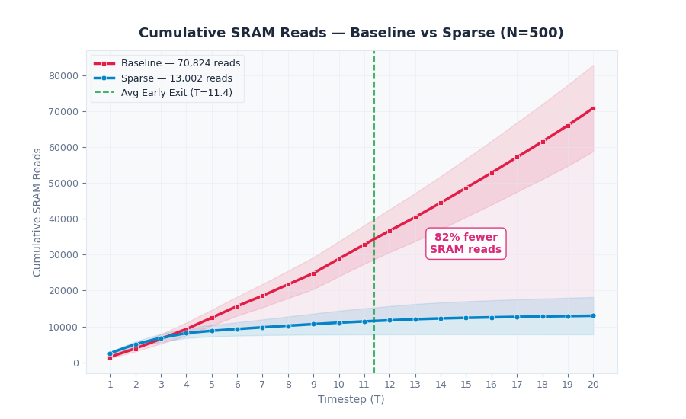
8. Results: Massive SRAM Reduction
By combining spatial filtering and temporal truncation, average SRAM reads dropped by 81.6%.

Slide 10
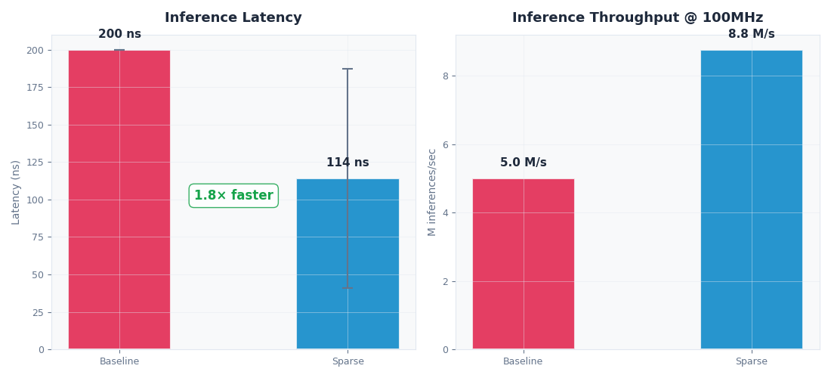
9. Results: Energy & Latency Scaling
Because SRAM dominates power, this 81.6% read reduction maps directly to an 81.6% reduction in estimated inference energy.
Average latency improved by 1.8x due to Early Exit stopping at T=11.4 on average.

Slide 11
10. Conclusion
Hardware-First SNNs: We proved that optimizing for algorithmic sparsity is not enough; we must optimize for memory access.
Zero-Waste Inference: Simple, highly-efficient digital blocks dramatically reduce the power footprint.
Future Work: Deploying the Verilog RTL onto an FPGA to gather physical synthesis, power, and timing reports.

