Slide 1
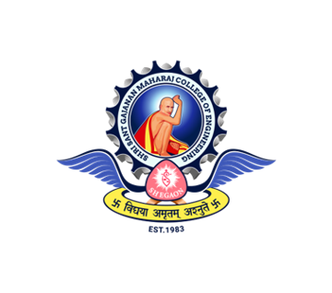
Shri Sant Gajanan Maharaj College of Engineering Shegaon, Dist- Buldhana – 444 203
Department of Mechanical Engineering

Slide 2
Real-time People Counting And Tracking System Using YOLOv8, DeepSort
Members: Siddhesh M. Wandile
Guided By: Dr. S. P. Trikal

Slide 3
Index
Sr. No. | Topics | Page No.
1 | Problem Statement | 1
2 | Solution Overview | 2
3 | Introduction | 3
4 | Flowchart | 5
5 | Working | 6
6 | Portal Design | 8
7 | Result and Performance | 10

Slide 4
Problem Statement
People Counting Challenges:
Tracking Difficulties:
Maintaining the identity of individuals across frames is challenging.
Retail Analytics:
Understanding customer behavior and optimizing store layouts.
Crowd Management:
Monitoring and controlling crowds in public spaces to ensure safety.
Security and Surveillance:
Enhancing security measures by tracking suspicious activities.
Manually counting is challenging and not efficient..
SSGMCE, Shegaon
Page No. 01

Slide 5
Solution Overview
Automated and Real-time:
YOLOv8 efficiently detects people in video frames.
DeepSORT tracks individuals with unique IDs for accurate counting.
Overcomes Tracking Difficulties:
DeepSORT handles occlusions and re-identification.
Real-time performance ensures smooth operation even in high traffic areas.
Enables Advanced Analytics:
Websocket transmits data for real-time visualization and analysis.
Reduced Errors:
Automates counting and tracking, minimizing human bias and leading to more accurate data.
SSGMCE, Shegaon
Page No. 02

Slide 6
Introduction
Objective:
Develop a system that counts and tracks people in real-time using advanced object detection and tracking algorithms.
Key Features:
Real-Time Processing: The system processes video frames in real-time to provide instant analytics.
High Accuracy: Utilizes YOLOv8 for precise object detection and Deep SORT for reliable tracking.
Scalability: Can be deployed across various environments such as retail stores, stadiums, and public transport hubs.
SSGMCE, Shegaon
Page No. 03

Slide 7
How It Works:
Video Capture: The system captures video input from a camera.
Object Detection: YOLOv8 detects people in each video frame.
Object Tracking: Deep SORT tracks detected individuals across frames.
Data Communication: Real-time data is sent to clients using WebSockets.
SSGMCE, Shegaon
Page No. 04

Slide 8
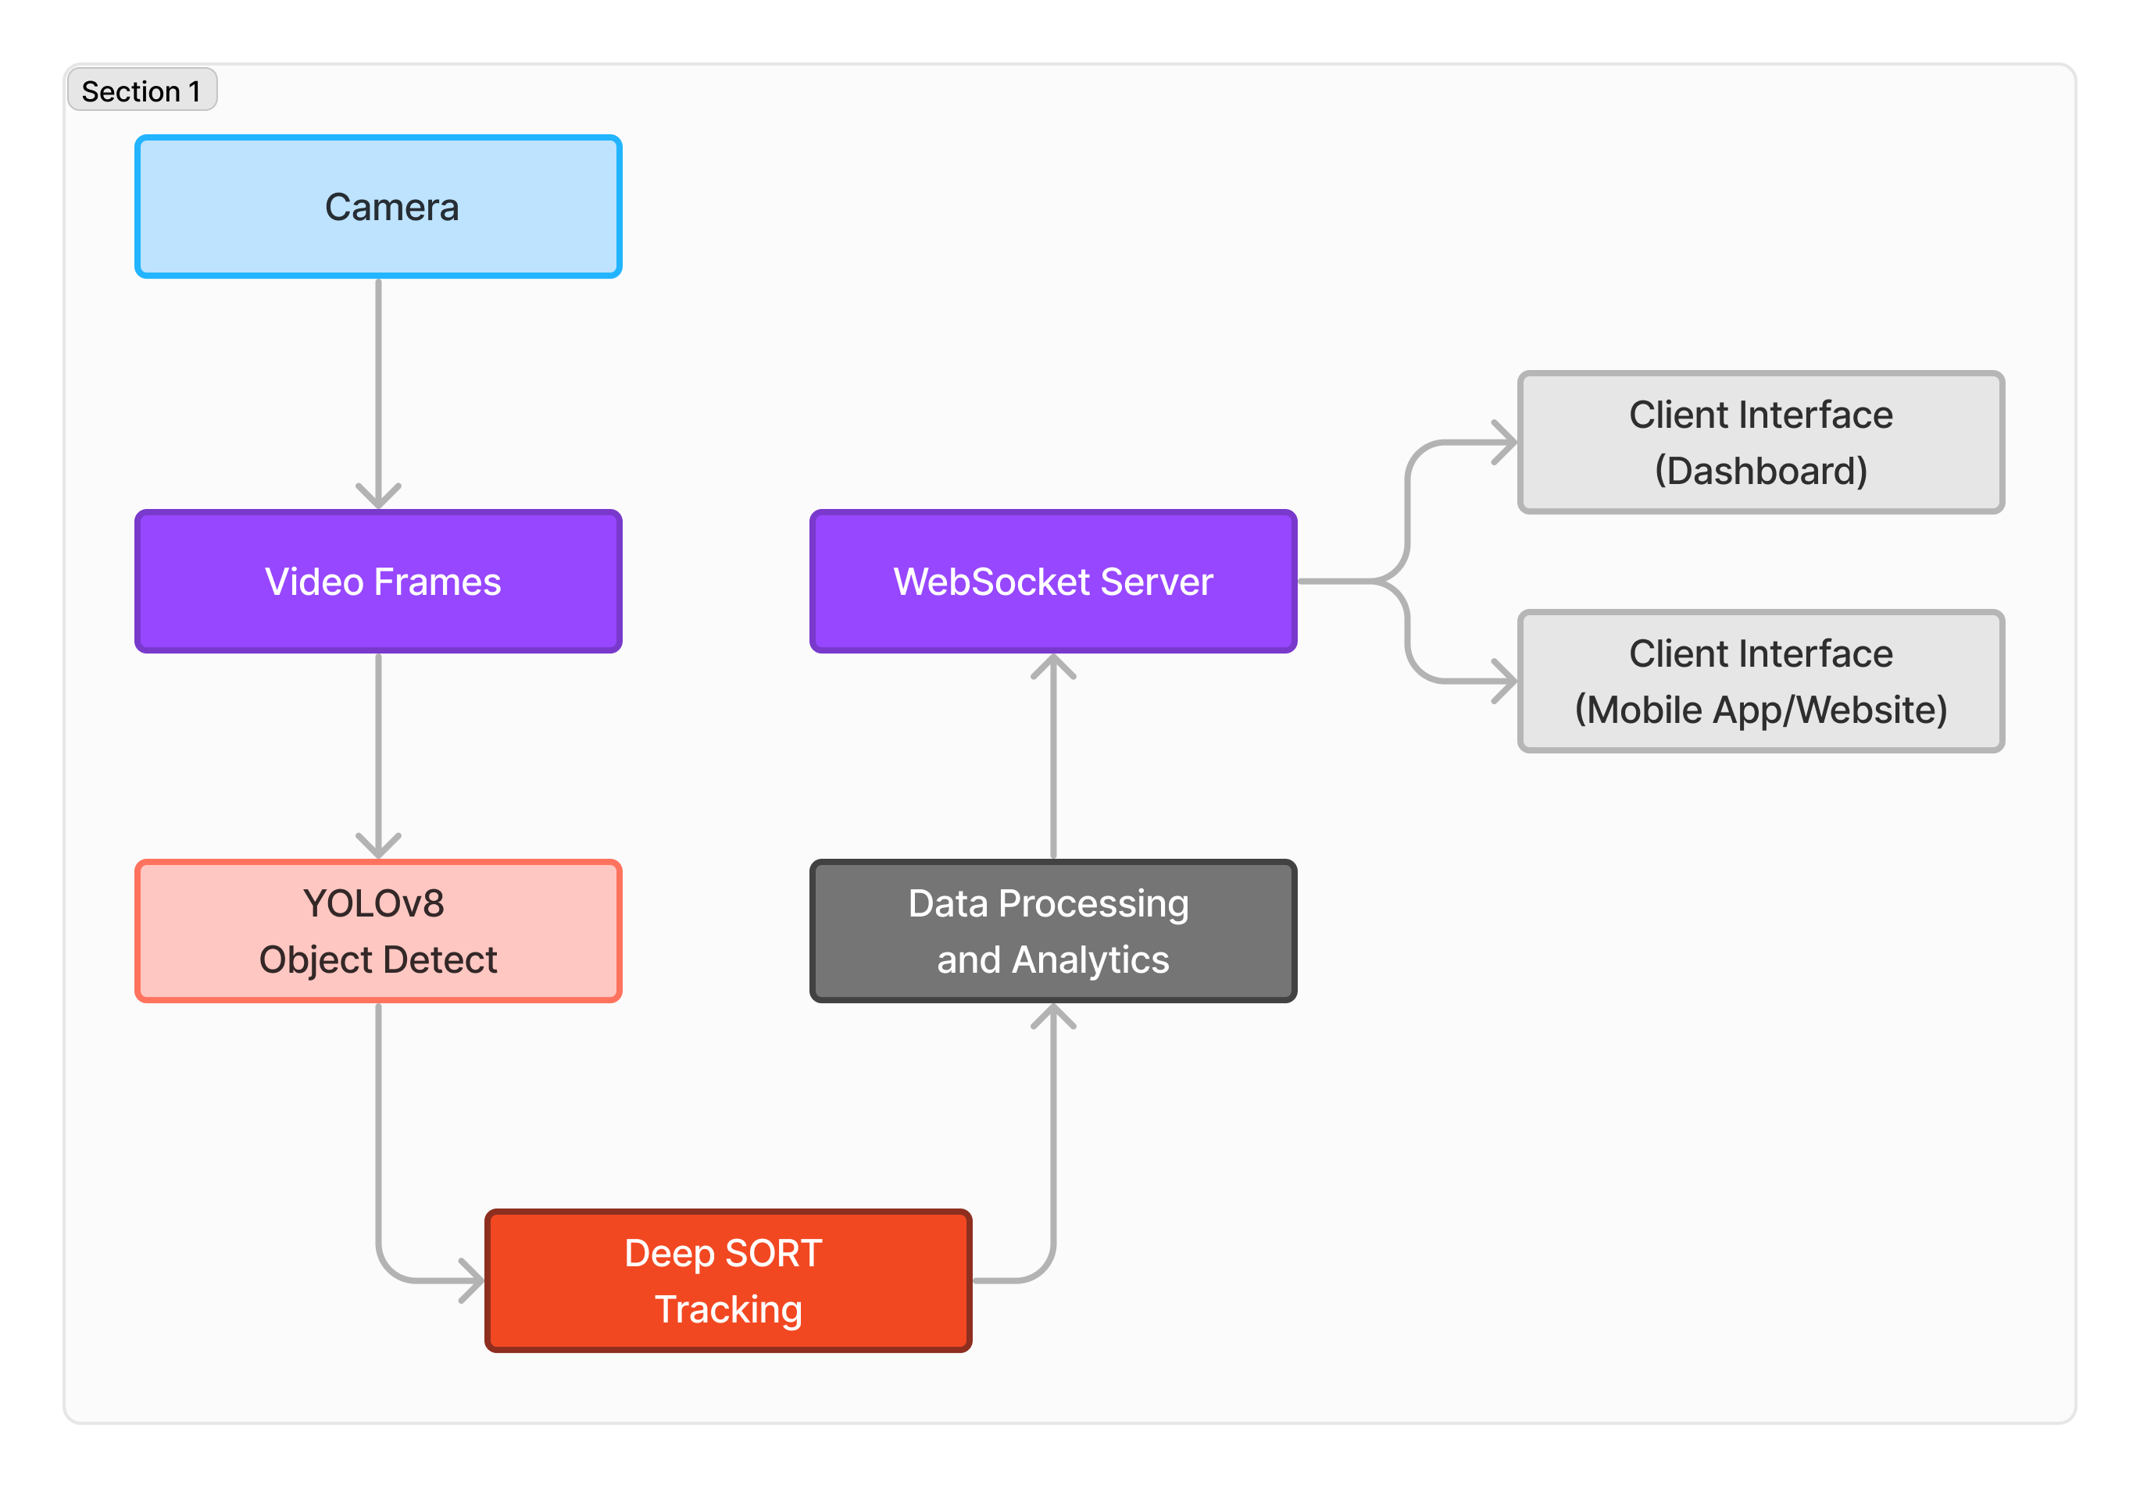
Flowchart
Figure 1: Working Flowchart
SSGMCE, Shegaon
Page No. 05

Slide 9
Working
1. Camera:
The system captures video footage from a camera.
2. Video Frames:
The captured video is separated into individual frames.
3. YOLOv8 Object Detection:
Each frame is then analyzed by YOLOv8, a deep learning model for object detection. YOLOv8 identifies and locates people within the frame.
4. Deep SORT Tracking:
Deep SORT, a tracking algorithm, then takes over. It keeps track of the detected people across multiple frames. This allows the system to differentiate between individual people and avoid counting the same person multiple times.
5. Data Processing and Analytics:
After Deep SORT, the data is processed and analyzed. This likely involves calculating the number of people currently in the frame.
SSGMCE, Shegaon
Page No. 06

Slide 10
WebSocket Server
The processed data is then sent to a WebSocket server. WebSocket is a communication protocol that enables real-time, two-way communication between a server and a client.
Client Interface
Client Interface (Dashboard): The data is delivered to a client interface, such as a dashboard, that displays the real-time people counting and tracking information. This could be a monitor or a web application.
Client Interface (Mobile App/Website): The data can also be sent to a mobile app or website, allowing users to access the information remotely.
SSGMCE, Shegaon
Page No. 07

Slide 11
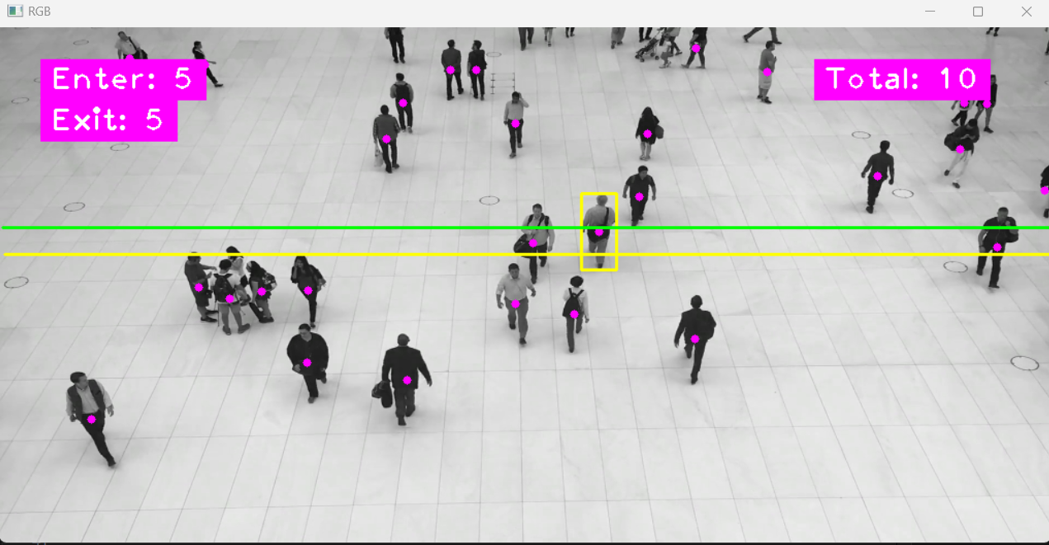
Portal Design:
Figure 2: Dashboard
SSGMCE, Shegaon
Page No. 08

Slide 12
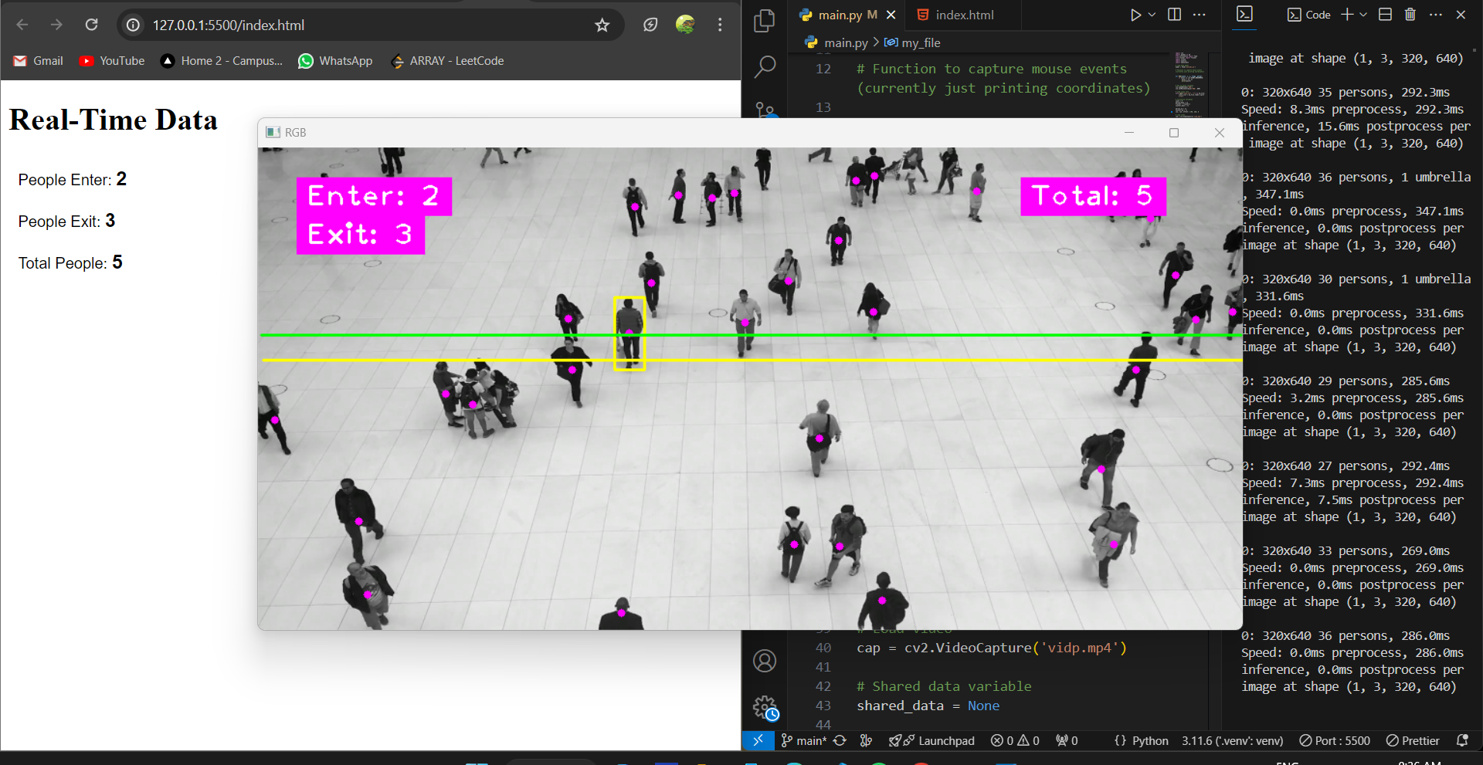
Figure 3: Realtime data
SSGMCE, Shegaon
Page No. 09

Slide 13
Results and Performance
Performance Metrics:
Accuracy:
High accuracy in detecting and tracking individuals.
Minimal false positives and false negatives.
Real-Time Processing:
Efficient frame processing and object detection.
Low latency in tracking and data transmission.
Scalability:
Capable of handling multiple video streams.
Performs well in various environments (e.g., retail stores, stadiums).
SSGMCE, Shegaon
Page No. 10

Slide 14
THANK YOU

