Slide 1

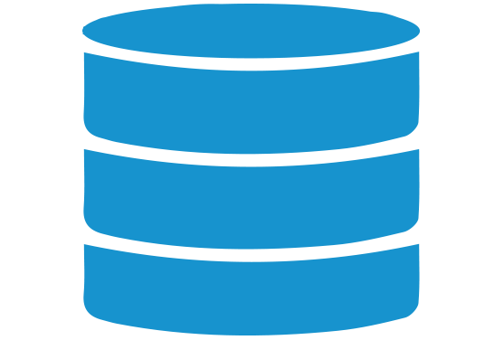






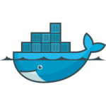

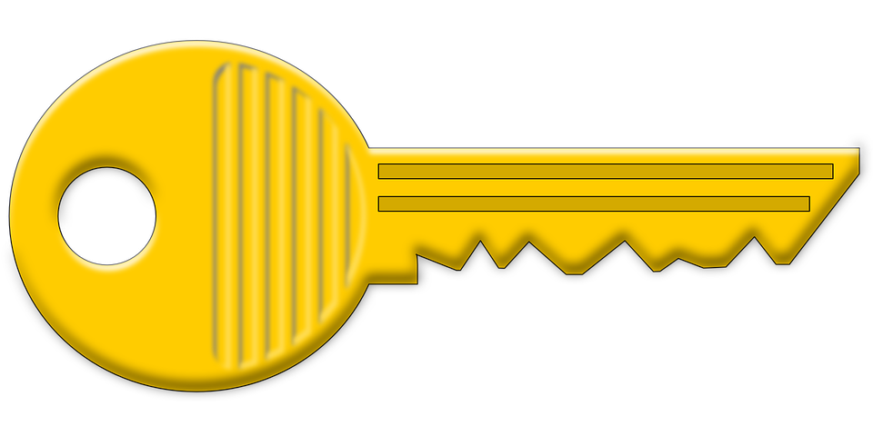

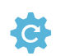

pull image and deploy
terraform.tfstate
Azure DevOps
Storage Account
Storage Account
Storage Account
Storage Account
Storage Account
Storage Account
Storage Account
Azure Container Registry
Azure Container Registry
Azure Container Registry
Azure Container Registry
Azure Container Registry
Azure Container Registry
Azure Container Registry
Azure Kubernetes Service
Azure Kubernetes Service
Azure Kubernetes Service
Azure Kubernetes Service
Terraform
Azure Kubernetes Service
Azure Repos
build/push
image
source code
Azure Pipelines
login as service principal
Docker Image
Docker Image
Docker Image
Docker Image
Docker Image
Kubernetes
Kubernetes
Kubernetes
Kubernetes
Kubernetes
store
secret
ARM Service
Connection
Key Vault
HPA
HPA
Deployment
HPA
Deployment
HPA
HPA

