Slide 1
Student Performance Prediction System
Submitted By : Siddhi Mohite
Technologies Used : Python, Pandas, NumPy, Matplotlib, Seaborn,
Scikit-learn, Flask

Slide 2

Problem Statement
Educational institutions often need to identify students who may face academic difficulties. Predicting student performance using traditional methods can be time-consuming and inaccurate.
This project aims to use Machine Learning techniques to predict a student's final marks based on factors such as attendance, study hours, and internal marks.
The prediction can help educators identify students who need additional support and improve overall academic performance.

Slide 3
Project Objectives
The main objectives of this project are:
To analyze student academic data.
To perform data cleaning and preprocessing.
To visualize important patterns using graphs and charts.
To build and train machine learning models for prediction.
To compare different machine learning algorithms.
To predict student final marks accurately.

Slide 4

Dataset Description
Feature | Description
Attendance | Student attendance percentage
Study Hours | Hours spent studying
Internal Marks | Internal assessment score
Final Marks | Final exam score (Target Variable)
• Dataset contains student academic information.
• Final Marks is the target variable used for prediction.

Slide 5
Data Preprocessing
Raw Dataset
Data Loading
Missing Value check
Duplicate Removal
Data cleaning
Cleaned Dataset
• Loaded the dataset using Pandas.
• Checked for missing values.
• Removed duplicate records.
• Cleaned and prepared the dataset for machine learning.
• Saved the cleaned dataset for further analysis.

Slide 6
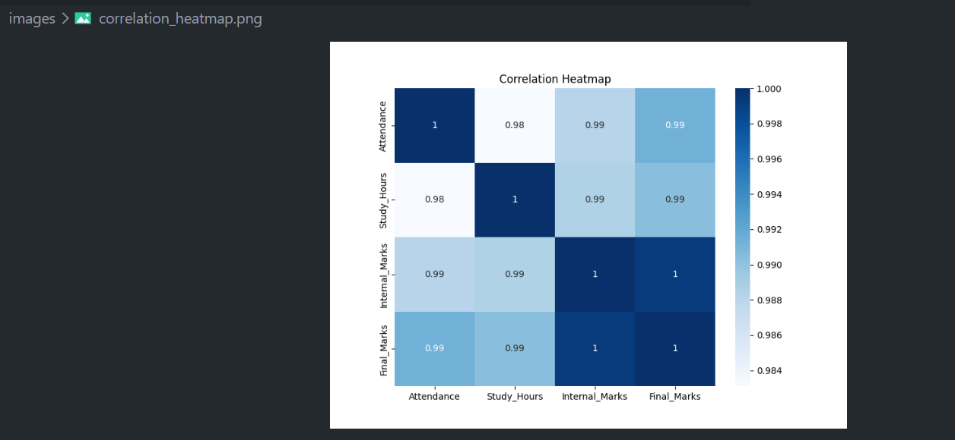
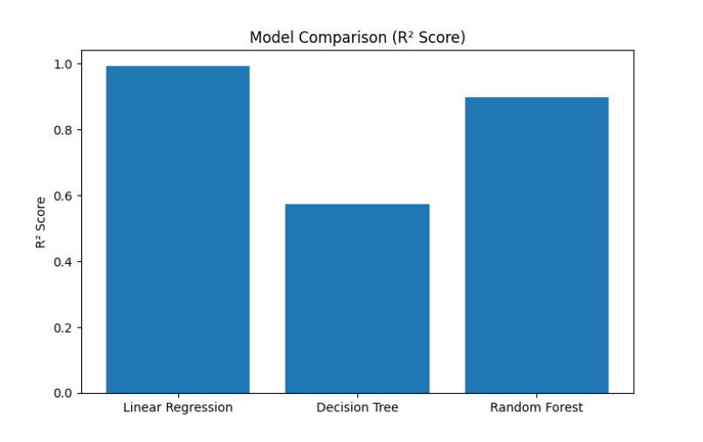
Exploratory Data Analysis(EDA)
Key Insights from EDA
• Correlation analysis was performed to understand relationships between features.
• Attendance, Study Hours, and Internal Marks positively influence Final Marks.
• Strong correlations indicate that these features are useful for prediction.
• The analysis helped in selecting relevant features for machine learning models.

Slide 7
Machine Learning Models
AL/ML
Models Used
• Linear Regression
• Decision Tree Regressor
• Random Forest Regressor
Model Evaluation Metrics
• Mean Absolute Error (MAE)
• R² Score
Best Model
• Linear Regression
• MAE = 0.25
• R² Score = 0.99

Slide 8
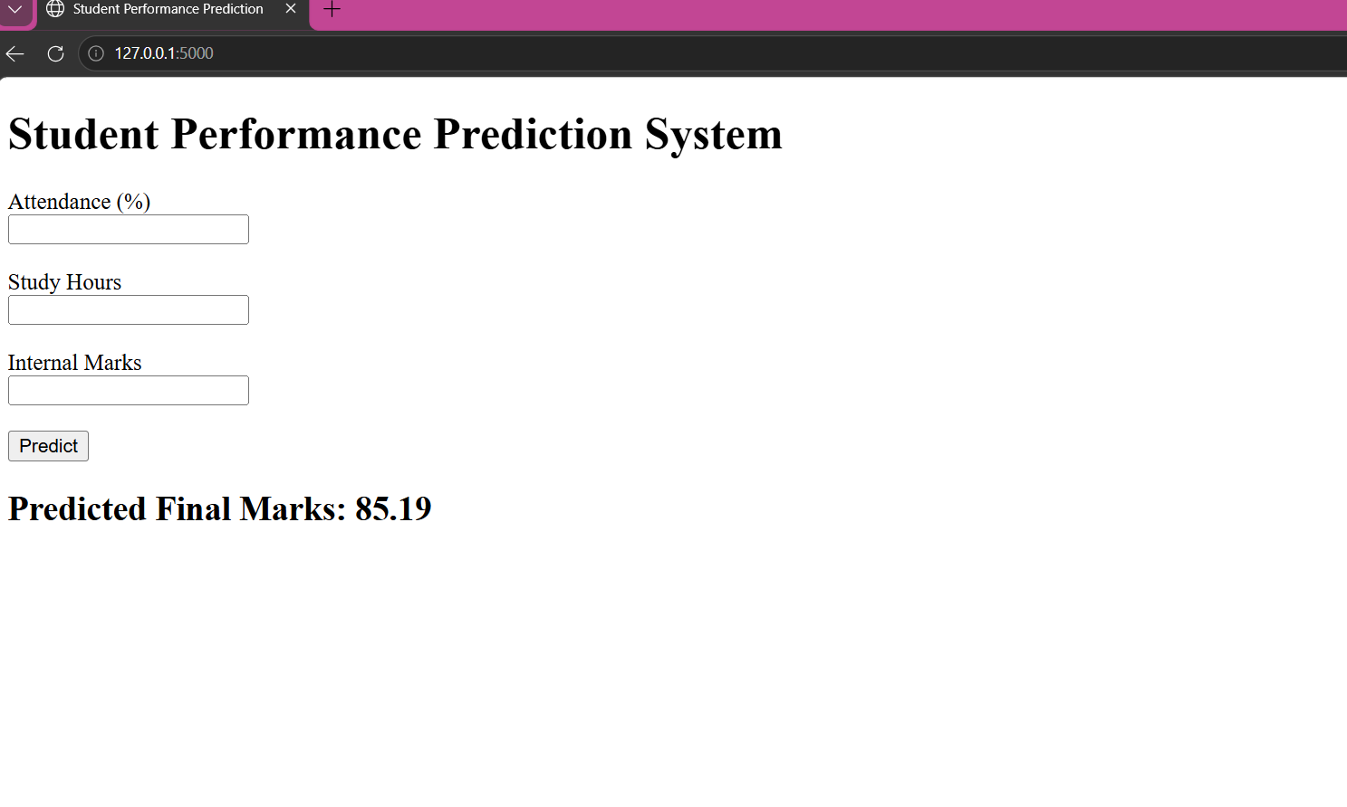
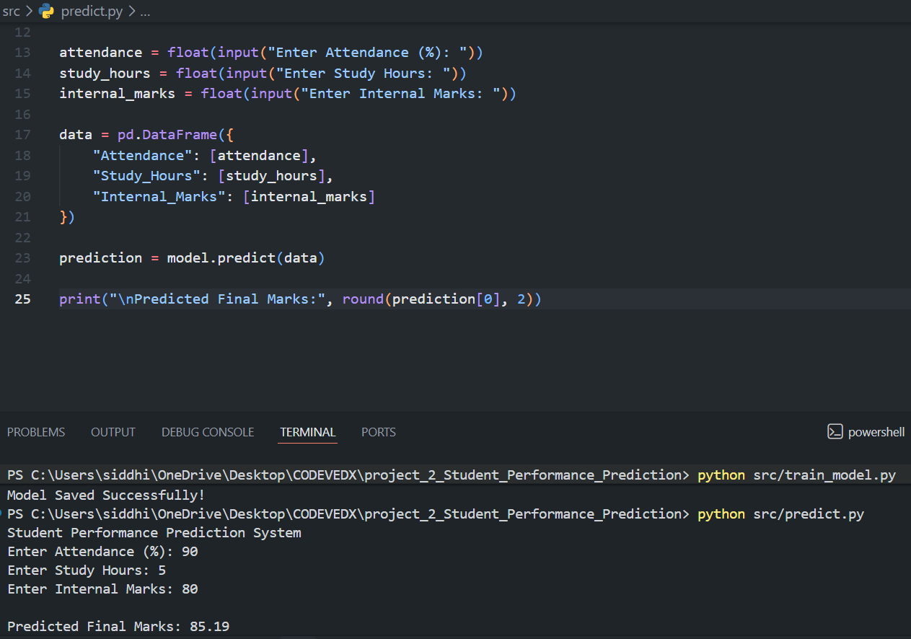
Flask Web Application
Features of the Web Application
• User-friendly interface for entering student details.
• Accepts Attendance, Study Hours, and Internal Marks.
• Uses the trained machine learning model for prediction.
• Displays predicted final marks instantly.
• Built using Flask and HTML.

Slide 9
Results & Conclusion
Model Performance
• Mean Absolute Error (MAE): 0.25
• R² Score: 0.99
• Linear Regression achieved the best performance.
Conclusion
• Successfully predicted student final marks.
• Attendance, Study Hours, and Internal Marks were important factors.
• The machine learning model achieved high prediction accuracy.

Slide 10
Future Scope
Thank You!
Questions &
Discussion
Future Scope
• Use a larger real-world student dataset.
• Add more features such as assignments, extracurricular activities, and attendance history.
• Improve prediction accuracy using advanced machine learning algorithms.
• Integrate a database for storing student records.
• Deploy the application on the cloud for public access.
Siddhi Mohite
AI/ML Internship Project

