Slide 1

Inventory Management System
for Small Businesses
A web-based platform to digitize stock, suppliers, and sales — with real-time low-stock alerts.
Siddhi Shinde
Modern College of Arts, Science and Commerce, Ganeshkhind, Pune

Slide 2




Problem Statement
Why small retailers need a digital system
Small retail shops and warehouses still track stock in notebooks or basic spreadsheets — a manual approach that quietly costs them money every day.
The Core Issue
Poor Inventory Visibility
Zero real-time link between what's on the shelf and what the business owner sees.
Managers can't see accurate, real-time stock levels.
Stockouts & Overstocking
Fast-sellers run out while slow movers tie up cash.
Used in retail stores, warehouses, pharmacies & restaurants — the same problem ERPs like SAP and Zoho Inventory solve at enterprise scale.
Revenue Loss
Delayed reordering means missed customer demand.
Human Errors
Manual entry causes mistakes in sales logs and records.
Inventory Management System | Siddhi Shinde
2

Slide 3



Project Objective
Build a secure, web-based inventory system for small retailers to digitize stock, track products, manage suppliers, record sales automatically, and receive alerts when items are running low.
Digitize Records
Automate Sales
Proactive Alerts
Replace notebooks & spreadsheets with one source of truth.
Every sale instantly updates stock — no manual recount.
Managers are notified before a stockout happens, not after.
Inventory Management System | Siddhi Shinde
3

Slide 4







Features Implemented
Core functionality delivered end-to-end
Role-Based Auth (JWT)
Product CRUD
Supplier Management
Admin has full control; Staff can only view/update stock.
Add, edit, delete products with category, price & threshold.
Full supplier directory linked to products.
Auto Stock Deduction
Low-Stock Alerts
Visual Dashboard
Every recorded sale reduces stock instantly.
Dashboard badge + automated email via SMTP.
Bar & line charts for top products and sales trends.
PDF / CSV Reports
Search & Filters
Invoice Generation
One-click inventory valuation reports.
Find products instantly by name or category.
Auto-generated PDF invoice for every sale.
Inventory Management System | Siddhi Shinde
4

Slide 5





Technologies Used
The stack behind the system
Backend
Database
Frontend
Python, Flask (REST API architecture)
PostgreSQL on Supabase, SQLAlchemy ORM
HTML5, Bootstrap, Chart.js
Auth & Security
Reports & Email
Deployment
PyJWT, bcrypt password hashing
ReportLab (PDF/CSV), Flask-Mail (SMTP)
Render (Web Service), GitHub version control
Inventory Management System | Siddhi Shinde
5

Slide 6


Project Workflow
From login to alert — how data flows through the system
1
2
3
4
Login
Dashboard
Operations
Transaction & Alert
User logs in; role (Admin/Staff) is encoded in a secure HTTP-only JWT cookie.
SQLAlchemy aggregates data; metrics render live via Chart.js.
Admin adds products, sets thresholds, manages supplier directory.
Sale reduces stock; if below threshold, an SMTP email fires automatically.
Inventory Management System | Siddhi Shinde
6

Slide 7
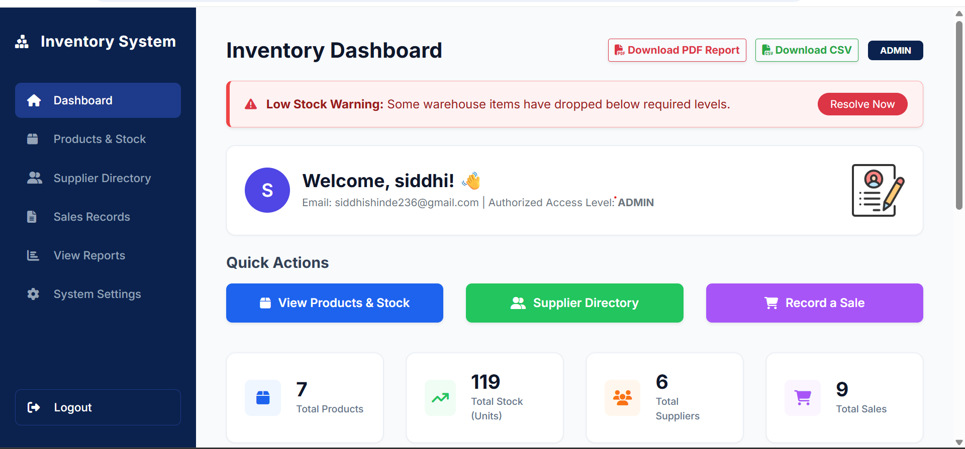
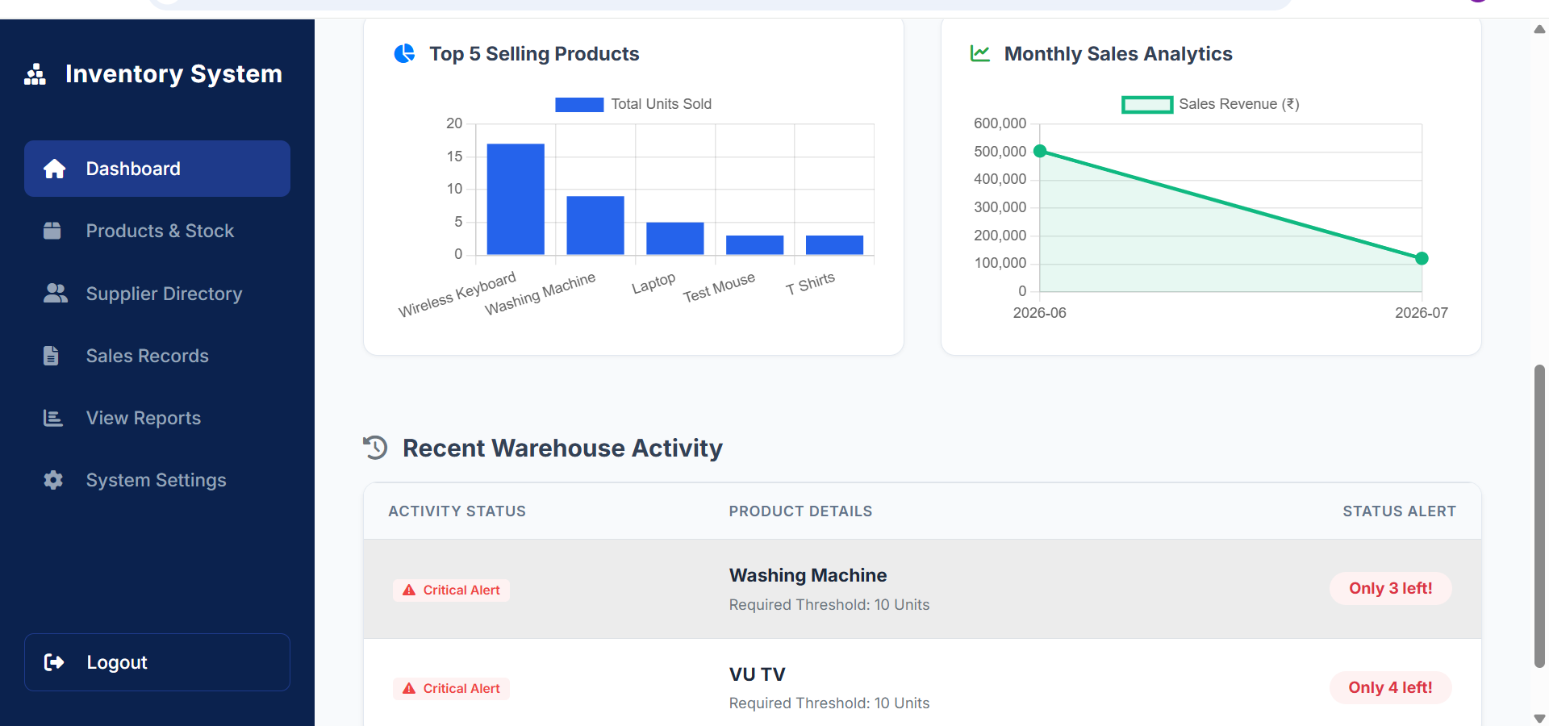
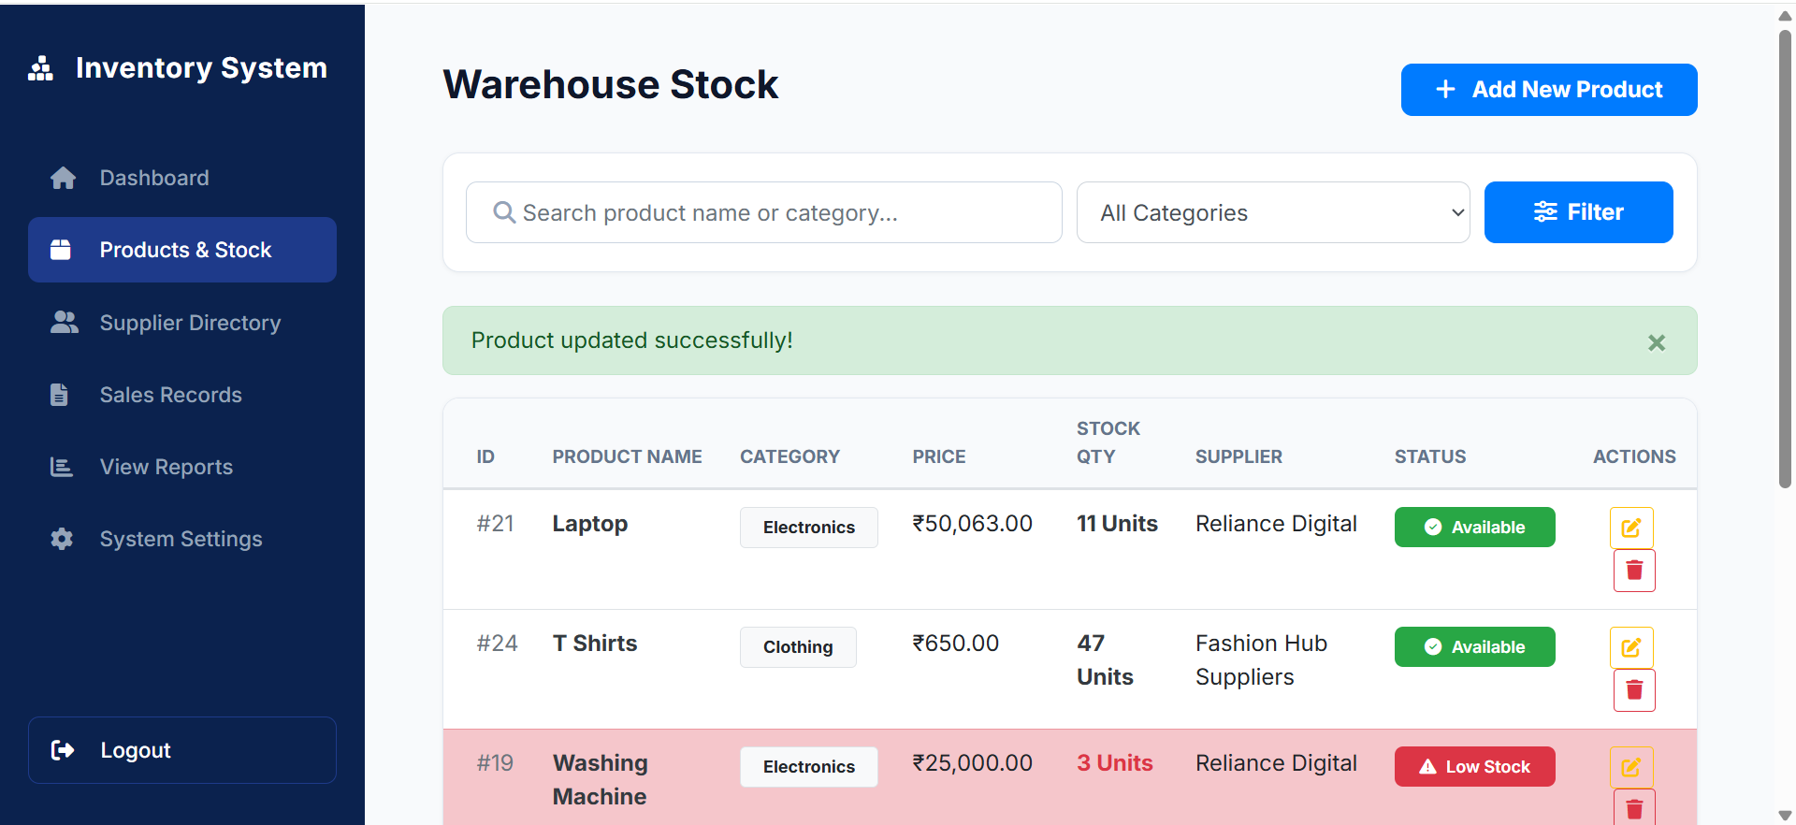
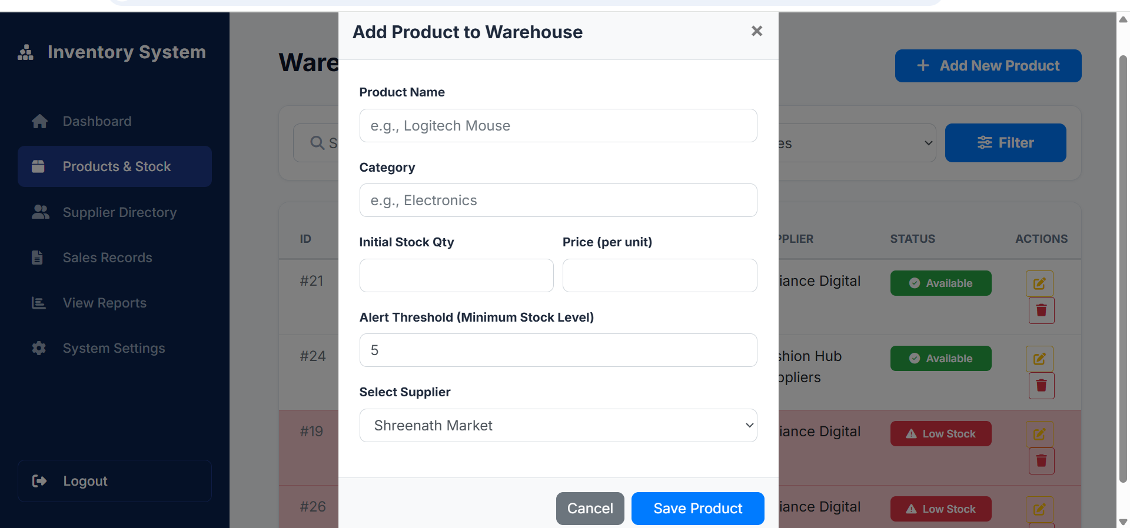
Screenshots — Dashboard & Stock
Dashboard Overview
Sales Trend & Top Products Charts
7
Warehouse Stock Listing
Add Product

Slide 8
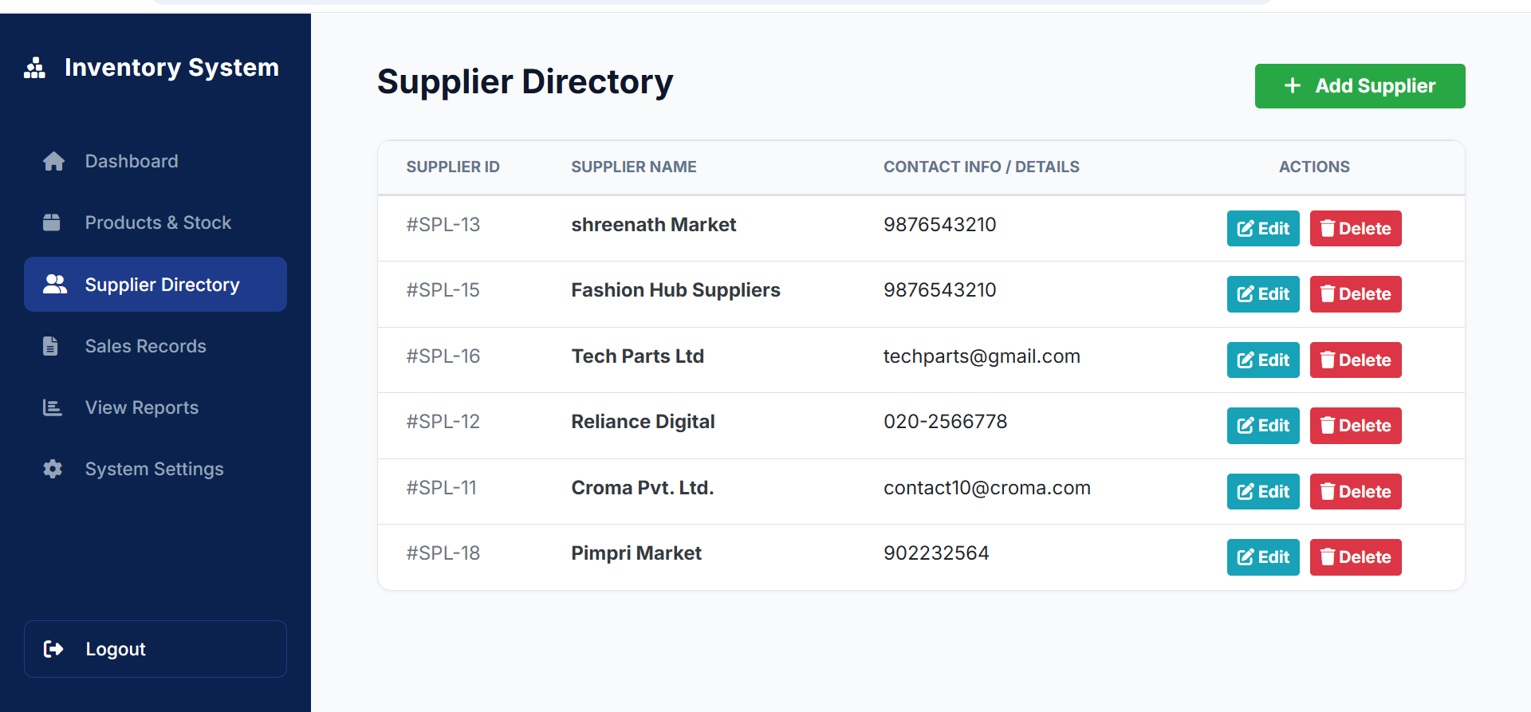
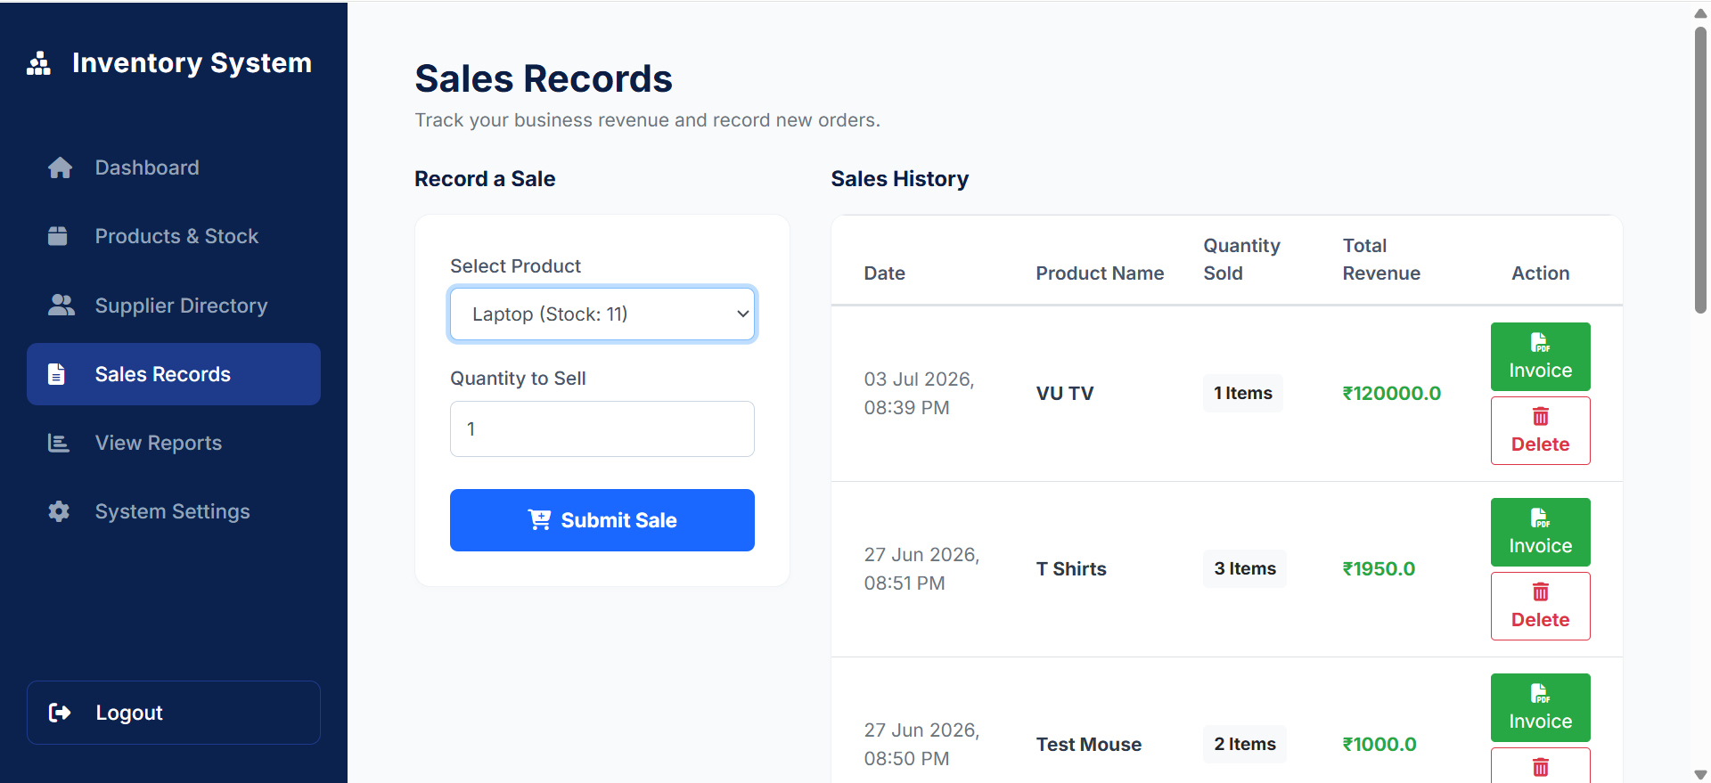
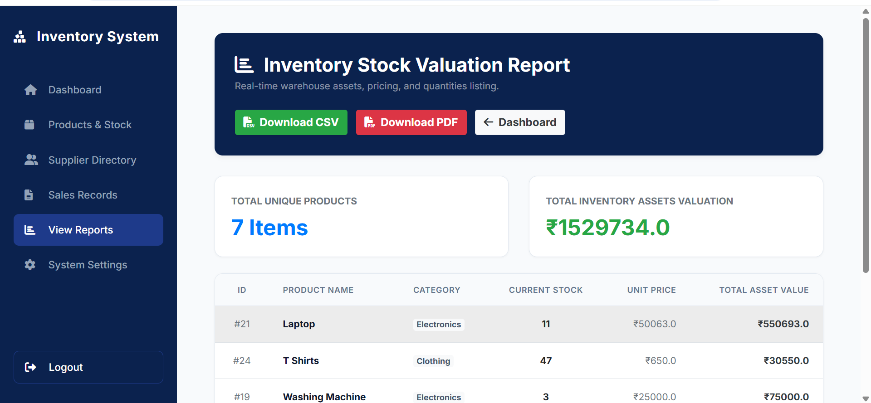
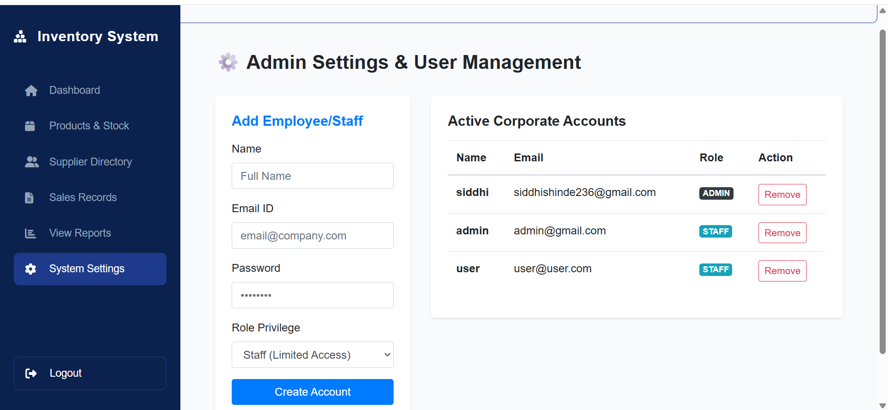
Screenshots — Suppliers, Sales & Reports
Supplier Directory
Sales Records
8
Inventory Valuation Report
Admin Settings / User Management

Slide 9

Challenges Faced
Security Incident
A local .env file containing the live Supabase connection string and Gmail SMTP app password was accidentally committed and pushed to the public GitHub repository.
Resolution
Configured .gitignore to permanently block variable files from being tracked.
Purged compromised history using an orphan branch pipeline (git checkout --orphan + forced push).
Regenerated all Supabase and Google credentials, achieving production-grade hardening.
Inventory Management System | Siddhi Shinde
9

Slide 10

Learning Outcomes
Skills gained through building this project
Full-Stack Data Flow
Transactional Workflows
Production Habits
Hands-on experience connecting Flask to a remote PostgreSQL engine via SQLAlchemy ORM.
Mastered atomic DB transactions, background email tasks, and dynamic PDF/CSV generation.
Git security practices, environment variable hygiene, and Role-Based Access Control.
Inventory Management System | Siddhi Shinde
10

Slide 11



Future Enhancements
What's next on the roadmap
Barcode Scanner Integration
Demand Forecasting (ML)
Multi-Location Support
Scan items via mobile camera to speed up stock entry.
Predict sales spikes and auto-suggest reorder quantities.
Manage stock across multiple warehouses or branches.
Mobile-Responsive PWA
Automated Billing
Native app-like experience for on-the-go managers.
Razorpay integration for direct customer invoicing & payment.
Inventory Management System | Siddhi Shinde
11

Slide 12

Thank You
Inventory Management System for Small Businesses
GitHub Repository
github.com/Siddhi-Shinde-dev/Inventory-Management-System
Siddhi Shinde
Modern College of Arts, Science and Commerce, Ganeshkhind, Pune

