Slide 1

Seasonal Agriculture Performance Analysis
Student Name: Siddhi Ramkrishna Manjarekar
College: Savitribai Phule Pune University
STU ID: STU654e5442c94401699632194
Internship ID: INTERNSHIP_17830691666a4779eecfe8a
Program: VOIS AICTE Data Analytics Internship (Batch 1 / 2026-2027)

Slide 2

PROBLEM STATEMENT
• Seasonal Climatic Fluctuations: Agricultural yields across India experience drastic variations driven by seasonal shifts in monsoon precipitation, ambient temperature, humidity, and soil moisture levels across Kharif, Rabi, and Zaid seasons.
• Resource & Economic Imbalances: Irrigation water requirements, disease vulnerability, and input costs (fertilizer, pesticides) fluctuate heavily, often turning off-season farming into a loss-making enterprise.
• Complexity of Raw Data: Large multi-dimensional agricultural datasets obscure crucial trends, making it difficult for farmers and planners to align crop selection with seasonal realities.
• The Core Challenge: Investigate 4,000 multi-state farm records to discover empirical performance differences, quantify environmental drivers of yield, evaluate irrigation efficiency, and deliver actionable planning insights.

Slide 3
PROJECT DESCRIPTION
• Empirical Multi-Seasonal Dataset: Comprehensive analysis of 4,000 farm records across India spanning 8 vital crops (Wheat, Maize, Pulses, Rice, Cotton, Chilli, Groundnut, Sugarcane) across Kharif (monsoon), Rabi (winter), and Zaid (summer) seasons.
• Multi-Dimensional Feature Profiling: Examines 28 granular metrics spanning climate (rainfall, temperature, humidity, sunlight), soil conditions (pH, moisture), resource inputs (NPK fertilizers, pesticides, irrigation water), and economics (costs, revenues, profits).
• Cross-Seasonal Comparative Analytics: Benchmarks yield productivity, water efficiency (tonnes/1000m³), and farm profitability across seasons to identify peak performance windows and acute vulnerabilities.
• Disease & Climate Risk Modeling: Correlates disease/pest incidence against seasonal humidity and temperatures to pinpoint critical preventive intervention schedules.
• Evidence-Based Decision Support: Formulates high-impact, actionable strategies for farmers, regional planners, and policymakers to maximize agricultural output and eliminate dry-season losses.

Slide 4

END USERS & STAKEHOLDERS
✓ Farmers & Farm Managers - Optimize crop selection
✓ Agricultural Economists - Understand profitability patterns
✓ Policy Makers - Support evidence-based agricultural policy
✓ Agricultural Planners - Develop seasonal strategies
✓ Research Institutions - Identify research opportunities
✓ Climate Scientists - Study seasonal patterns

Slide 5

TECHNOLOGY STACK
Languages: Python 3.x
Libraries: Pandas, NumPy, Matplotlib, Seaborn
Tools: Jupyter Notebook, GitHub
Analysis: Descriptive Statistics, Correlation Analysis, Comparative Analysis, Data Visualization
Data Format: CSV

Slide 6
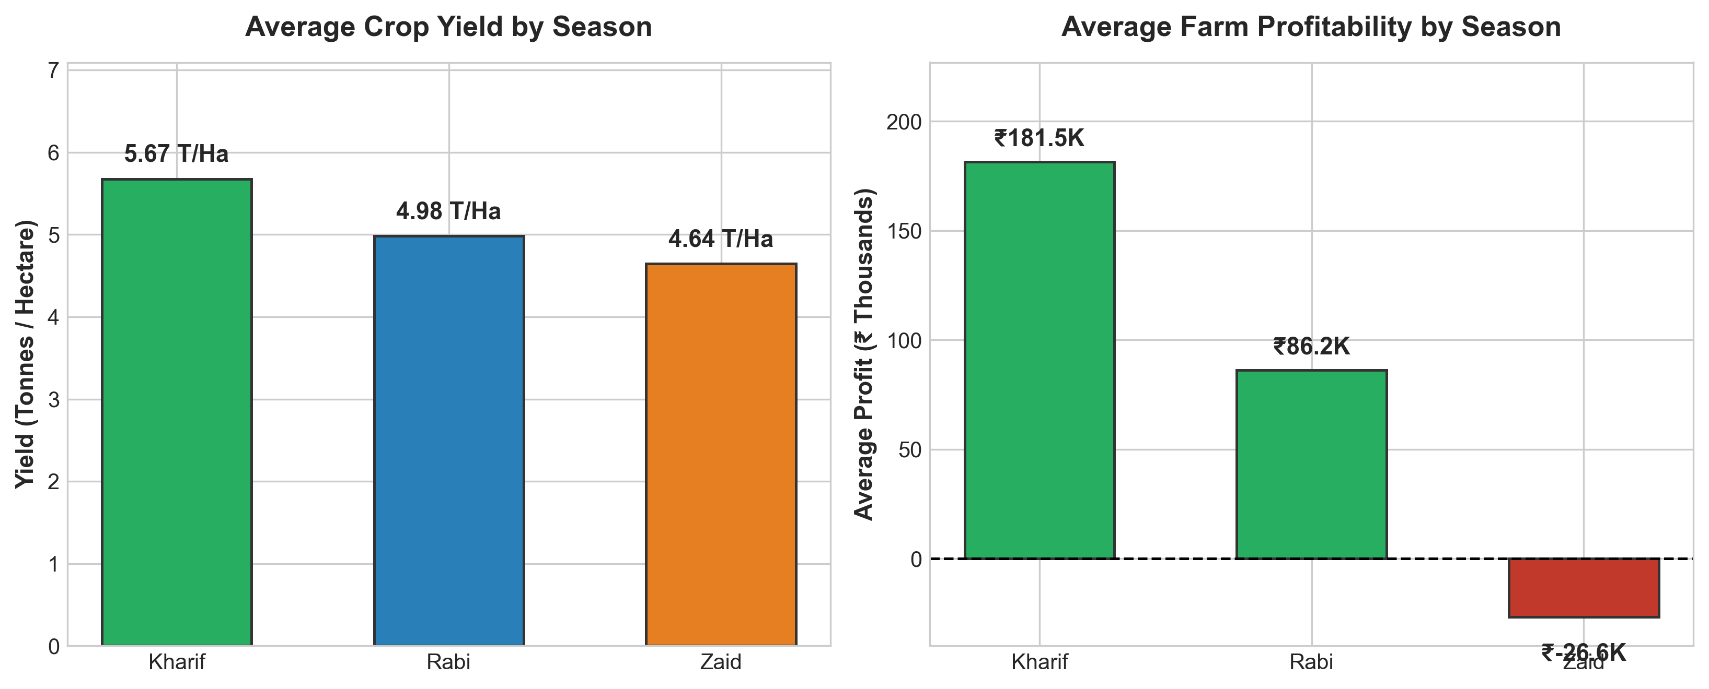
FINDING 1: Seasonal Performance Variation
KEY METRICS & INSIGHTS:
Average Yield Performance:
• Kharif: 5.67 T/Ha (Highest) • Rabi: 4.98 T/Ha • Zaid: 4.64 T/Ha (-18.2% drop)
Net Profitability (INR):
• Kharif: +₹181.5K (Highly Profitable) • Rabi: +₹86.2K (Moderate) • Zaid: -₹26.6K (Net Loss)
Critical Insights:
• Kharif yields 210% higher profit than Zaid. • Clear seasonal hierarchy: Kharif > Rabi >> Zaid. • Zaid season requires targeted intervention to prevent systematic farm losses.

Slide 7
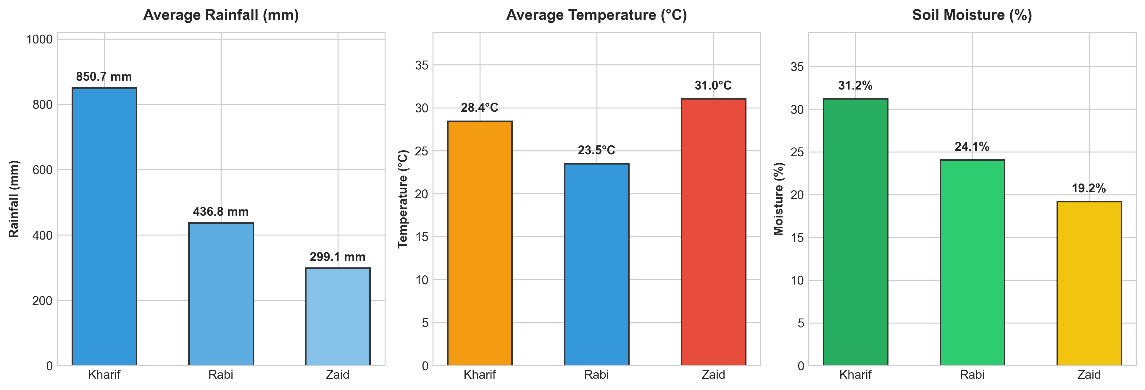
FINDING 2: Environmental Factors
ENVIRONMENTAL PARAMETERS:
Precipitation Patterns:
• Kharif: 850.7 mm (Monsoon abundance) • Rabi: 436.8 mm (Moderate) • Zaid: 299.1 mm (Severe water deficit)
Thermal Dynamics:
• Kharif: 28.4°C (Warm & humid) • Rabi: 23.5°C (Cool winter) • Zaid: 31.0°C (High thermal stress)
Soil Moisture Depletion:
• Kharif: 31.2% (Optimal) • Rabi: 24.1% (Sufficient) • Zaid: 19.2% (Depleted - requires irrigation)
Key Correlation:
• Compound stress in Zaid (low rain + high heat + dry soil) directly suppresses yields.

Slide 8
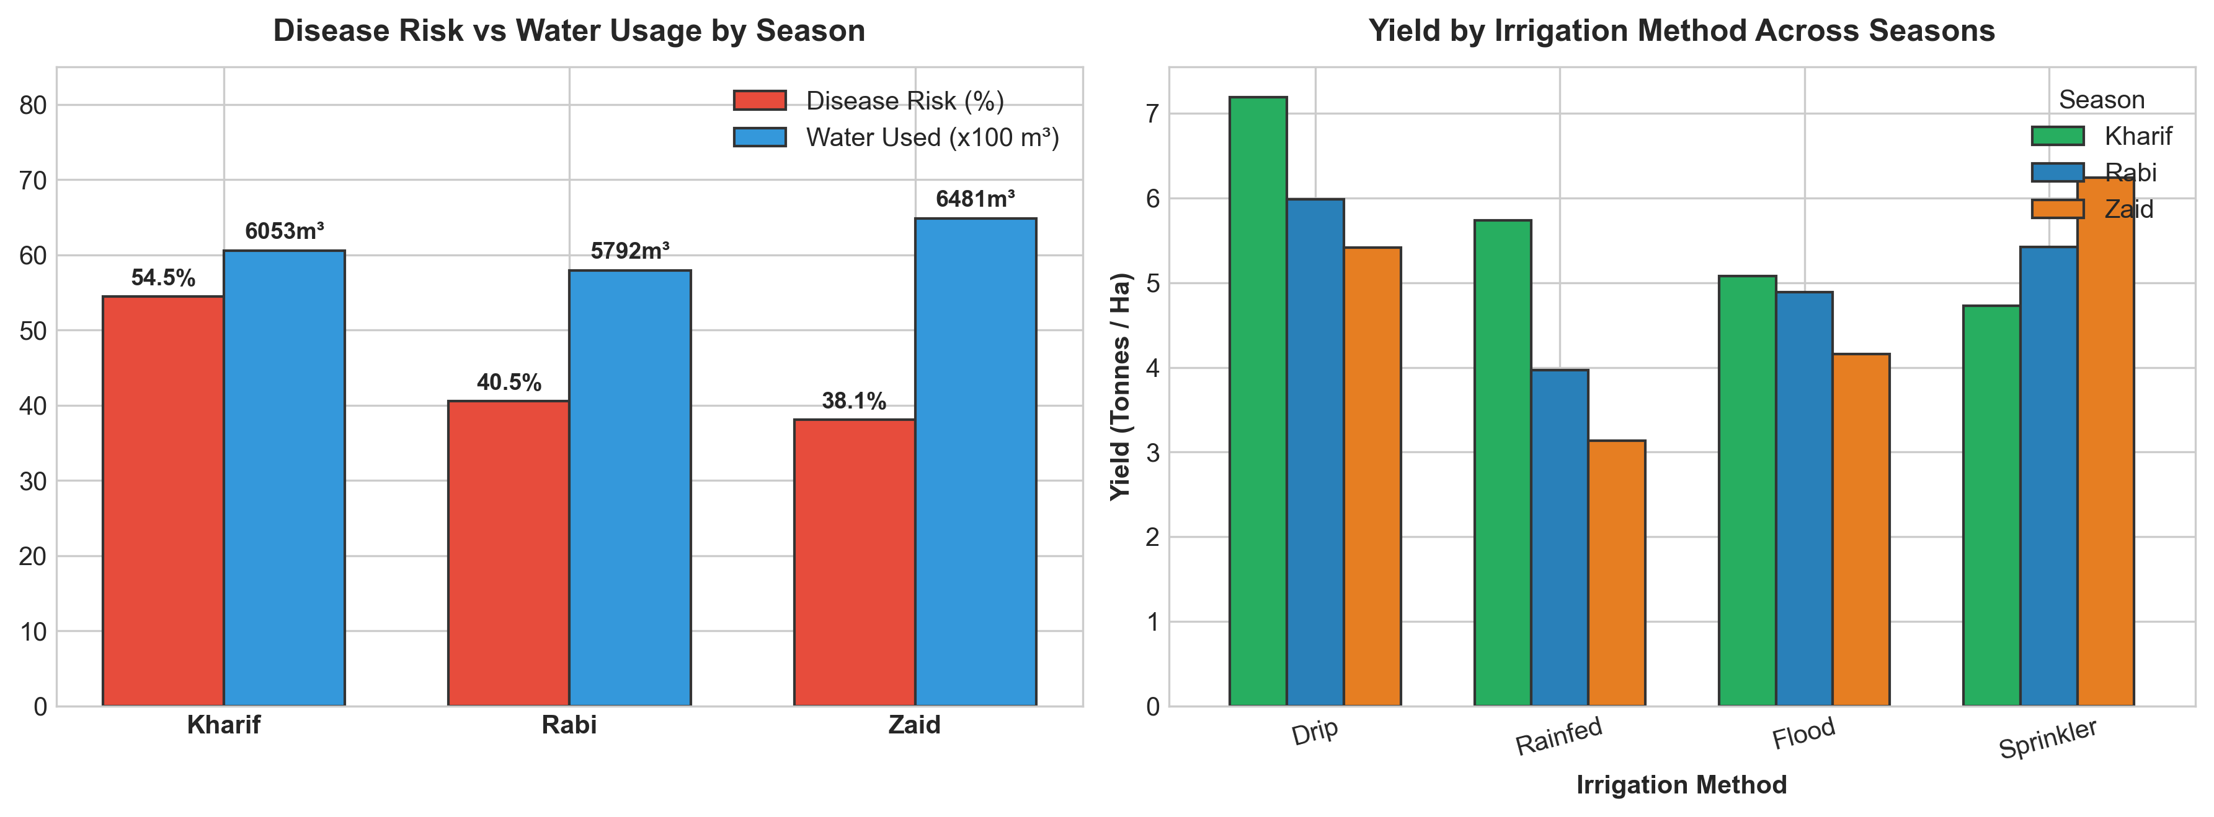
FINDING 3: Resource Usage & Disease
RESOURCE EFFICIENCY & RISKS:
Pest & Disease Risk (%):
• Kharif: 54.5% (High humidity & pest surge) • Rabi: 40.5% (Moderate) • Zaid: 38.1% (Lowest risk)
Water Resource Demands:
• Kharif: 6,053 m³ (Aided by rainfall) • Rabi: 5,792 m³ • Zaid: 6,481 m³ (Highest volume used)
Irrigation Performance:
• Drip Irrigation delivers 5.5-7.2 T/Ha yield across all seasons (Superior). • Flood/Rainfed yields drop to 3.2-4.1 T/Ha.
Strategic Action:
• Mandate Drip Irrigation during Zaid to preserve water & boost yields by >35%.

Slide 9
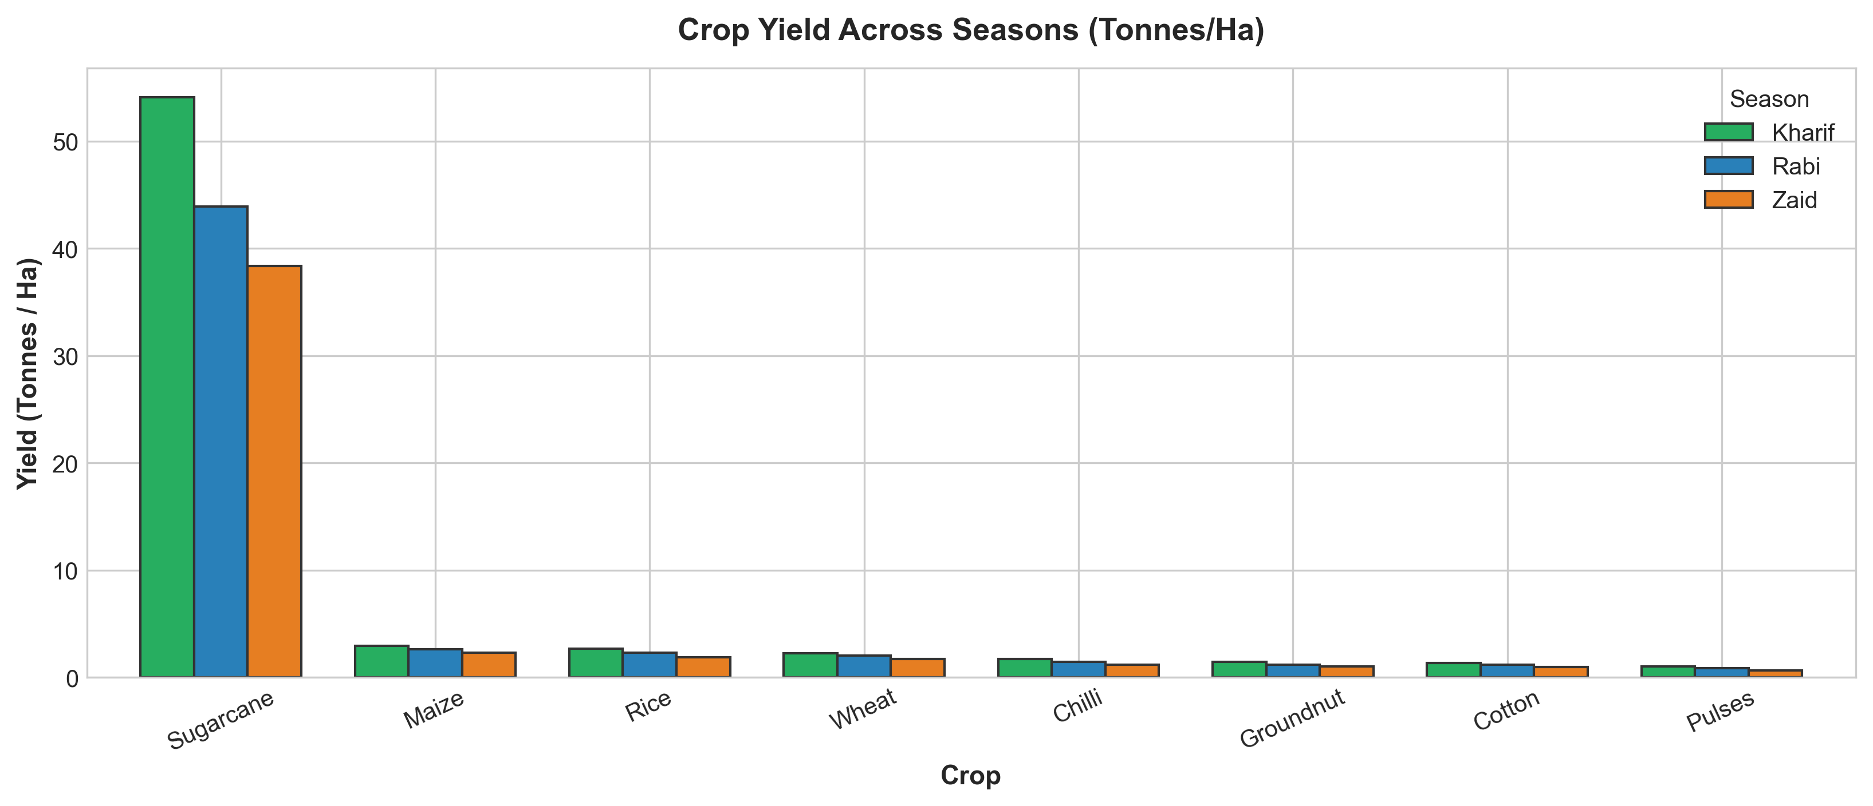
FINDING 4: Crop Performance
CROP PRODUCTIVITY BENCHMARKS:
Top Producing Crop:
• Sugarcane dominates all seasons: 54.1 T/Ha (Kharif), 43.9 (Rabi), 38.4 (Zaid).
Cereal & Grain Crops:
• Maize: 2.96 T/Ha (Kharif) → 2.32 (Zaid) • Rice: 2.70 T/Ha (Kharif) → 1.89 (Zaid) • Wheat: 2.26 T/Ha (Kharif) → 1.74 (Zaid)
Low Yielding / Sensitive Crops:
• Pulses remain low-yield: 1.04 T/Ha (Kharif) to 0.66 T/Ha (Zaid).
Core Conclusion:
• Uniform 14% to 18% yield decline across ALL crops from Kharif to Zaid confirms season as the dominant determinant.

Slide 10
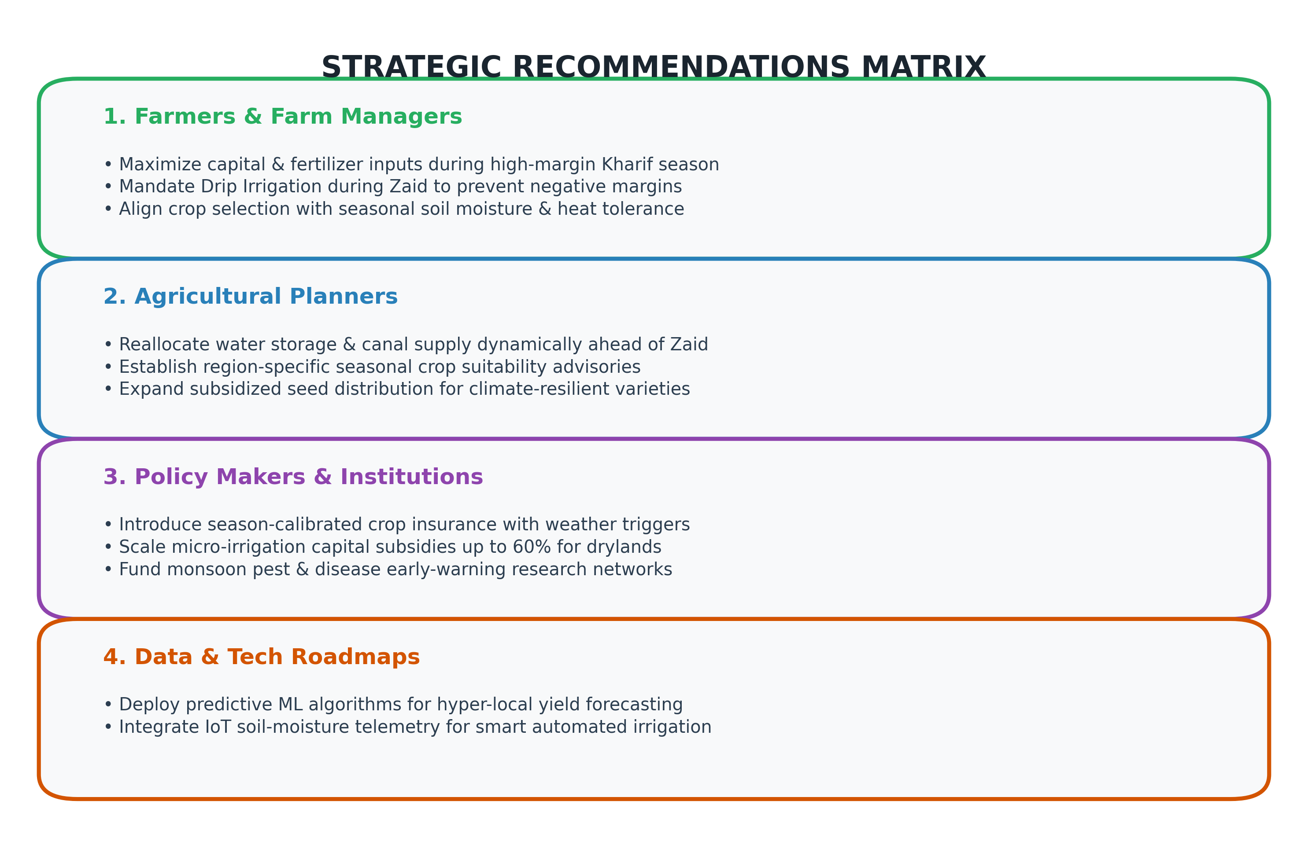
CONCLUSIONS & RECOMMENDATIONS
EXECUTIVE SUMMARY:
Core Empirical Findings:
1. Season dictates agricultural success, showing 18-210% variance in yield & profits. 2. Kharif is the primary profit generator; Zaid faces systematic structural losses without drip irrigation. 3. Disease vulnerability surges during monsoon (+43% over Zaid).
Strategic Action Plan:
• Farmers: Prioritize inputs in Kharif; shift to Drip Irrigation in Zaid. • Planners: Mobilize water allocations dynamically before summer. • Policy: Subsidize precision micro-irrigation; create season-indexed crop insurance.

Slide 11
FUTURE ENHANCEMENTS
01
04
• Interactive Web Intelligence Dashboard: Deploy an interactive Streamlit/Power BI dashboard enabling farmers and agricultural officers to simulate seasonal scenarios and test irrigation impacts.
• Precision Advisory Platform: Deliver automated localized advisories to farmers via SMS/WhatsApp with weather warnings and optimal crop planting calendars.
• Predictive Machine Learning Modeling: Develop supervised regression models (Random Forest, XGBoost) to forecast farm-level crop yields and market revenues based on early-season climate indicators.
02
• IoT Telemetry & Smart Irrigation: Integrate real-time IoT soil-moisture and ambient temperature sensors to trigger automated drip irrigation, cutting summer water consumption by up to 35%.
03
• Satellite Remote Sensing (NDVI): Incorporate multi-spectral satellite imagery to assess crop health, vegetative indices, and drought stress across large agricultural districts.

Slide 12
SOURCE CODE & DOCUMENTATION
PROJECT REPOSITORY & DELIVERABLES
• GitHub Repository: https://github.com/Siddhi-m-20/seasonal-agriculture-analysis
• Jupyter Notebook: Seasonal_Agriculture_Analysis.ipynb (Fully executed with all charts & tables)
• Dataset: seasonal_agriculture_performance_dataset.csv (Clean 4,000 farm records)
• Visualizations: visualizations/ (300 DPI high-res charts and 9-plot master dashboard)
• Documentation: README.md & PROJECT_SUMMARY_AND_FINDINGS.md (In-depth analysis reports)
• Execution: git clone https://github.com/Siddhi-m-20/seasonal-agriculture-analysis.git pip install -r requirements.txt jupyter notebook Seasonal_Agriculture_Analysis.ipynb

Slide 13

VOIS AICTE CERTIFICATION
COURSE COMPLETION DETAILS
Course Completed:
Data Visualization
Certificate ID:
VFLMS26_165191
Issued Date:
August 27, 2026
Awarded To:
Siddhi Manjarekar
College:
Sir Parashurambhau College, Pune
AICTE STU ID:
STU654e5442c94401699632194
Organizations:
Vodafone Idea Foundation • VOIS • Edunet Foundation
Requirement Status:
Verified Official Milestone for Major Project Submission

Slide 14
THANK YOU

