Slide 1

House Price Prediction: A Data-Driven Approach
SAVITRIBAI PHULE PUNE UNIVERSITY
Department of Scientific Computing
Project Guide:
Ichchhayakant Sharma Sir
Bhushan Zade Roll No: MS2421
Vaishnav Mankar Roll No: MS2409

Slide 2
Project Introduction
Problem Statement
Predicting house prices accurately is a common challenge in the real estate market. House prices depend on various factors like size, location, and amenities, making them often unpredictable.
Our Solution
With the help of data analysis and machine learning, we aim to create a predictive model that provides better price estimations, assisting buyers, sellers, and investors in making informed decisions.

Slide 3
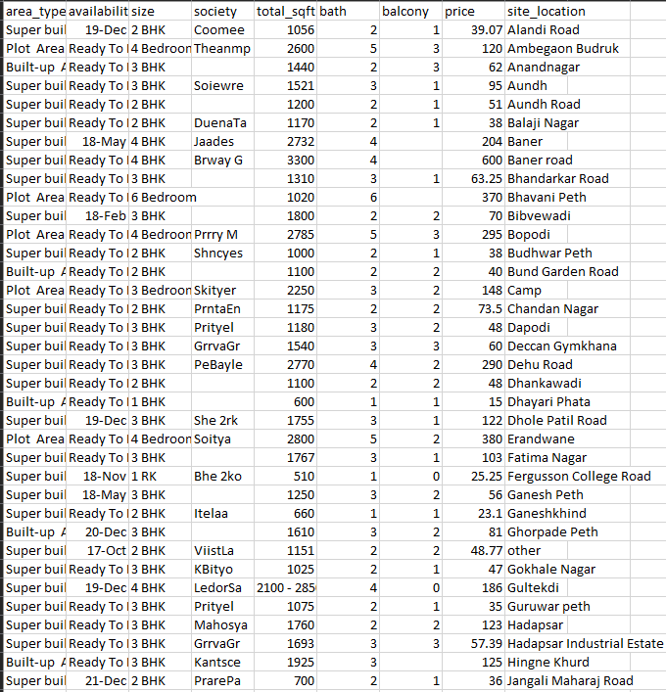
Dataset Overview
Data Source
We are using a dataset sourced from [source, e.g., Kaggle or government real estate data].
Key Features
The dataset contains [X rows] and [Y columns], representing thousands of properties. Key features include price, size, location, number of bedrooms and bathrooms, and other features like property type, year built, and amenities.

Slide 4

Data Cleaning and Preprocessing
1
Missing Values
We addressed missing values in features like Price and Size by replacing them with the median for numerical data or the most frequent value for categorical data.
2
Outliers
Outliers were identified using boxplots and treated by capping them within a reasonable range.
3
Duplicate Entries
Duplicate entries were removed to maintain data integrity.

Slide 5
Exploratory Data Analysis (EDA)
House Price Distribution
A histogram revealed that most properties fall within a mid- price range, with a few high-end properties as outliers.
Correlation Between Features
A heatmap showed a strong positive correlation between Size and Price, indicating that larger houses tend to cost more.
Other features like Location also showed significant impact on prices.

Slide 6
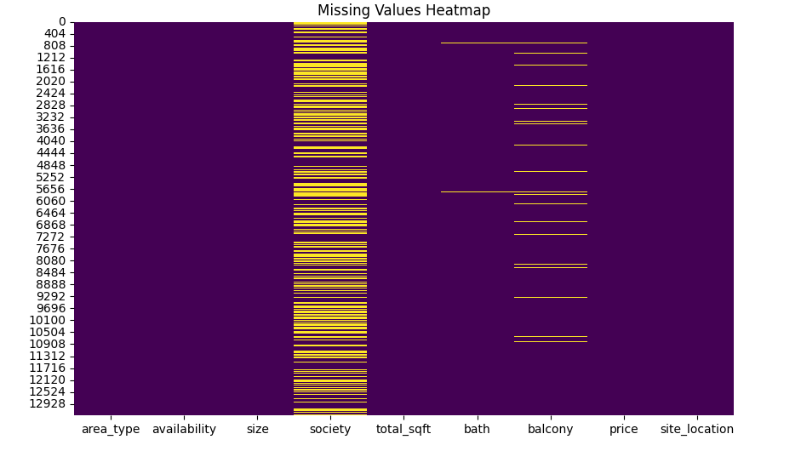
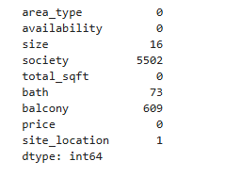
Challenges Faced
1
Missing Data
Missing values in critical features required careful imputation to avoid bias.

Slide 7
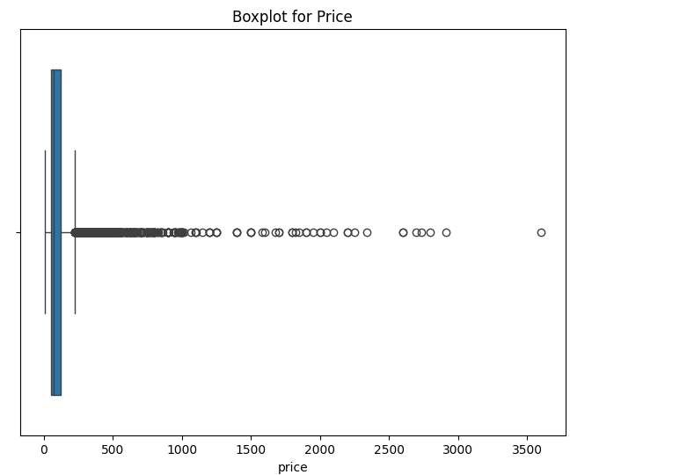
Challenges Faced
Outliers
Price outliers posed a significant challenge, as they could distort the results if not handled properly.
2

Slide 8
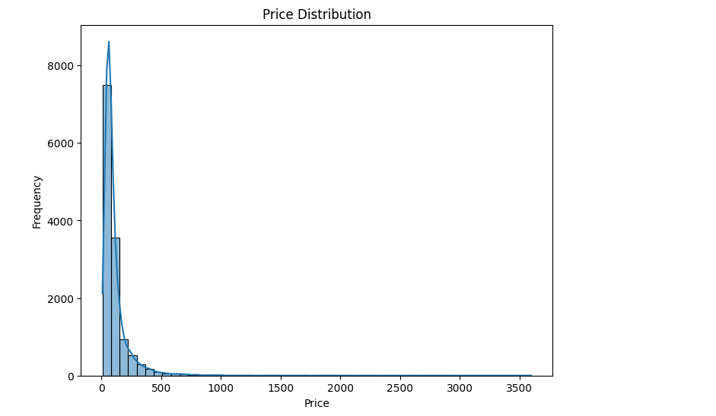
Challenges Faced
3
Imbalanced Data
Certain categories, like luxury homes, were
underrepresented in the dataset, which
may affect predictions.

Slide 9
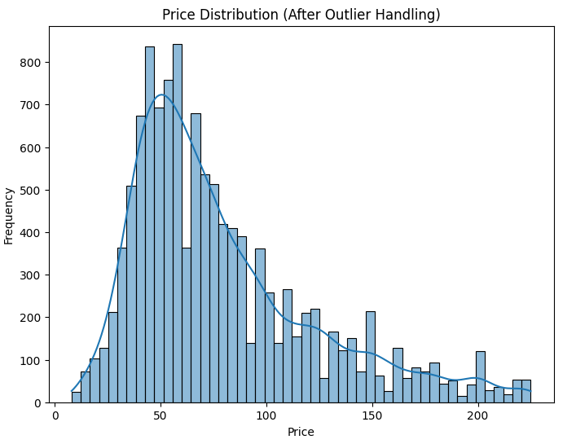
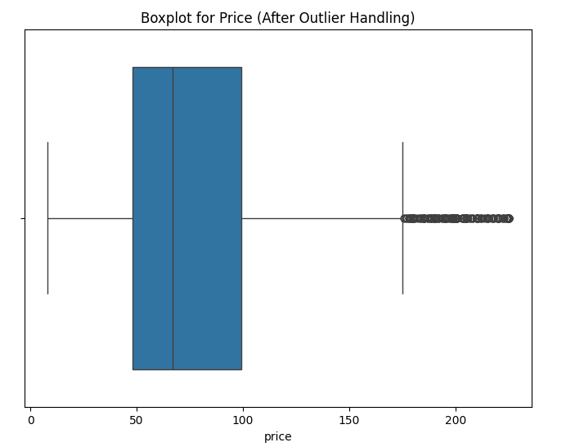
After

Slide 10
Key Insights from EDA
Location Matters
Urban properties are significantly more expensive than rural ones, likely due to higher demand and better infrastructure.
Size and Price Relationship
Larger homes generally have higher prices, but the relationship isn’t linear.
Strong Predictors
Features like Location, Size, and Number of Bedrooms show a strong correlation with price, making them important for our model.

Slide 11

Future Scope
1
Feature Engineering
Creating derived features like price per square foot or clustering locations into urban, suburban, and rural areas.
2
Model Building
We plan to use regression-based models, starting with Linear Regression, and later explore advanced techniques like Decision Trees or Random Forests.
3
Model Evaluation
Evaluating the models using metrics such as RMSE (Root Mean Squared Error) and R² to ensure accuracy and reliability.

Slide 12


