Slide 1


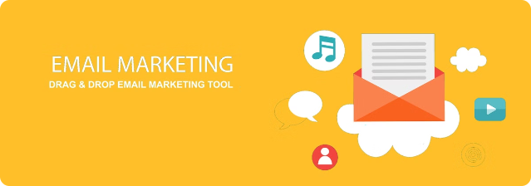

5 Trends of Email Marketing in India
Email marketing remains a powerful tool for businesses in India, with evolving trends shaping its effectiveness. From personalization to automation, the landscape is dynamic and offers opportunities for targeted, engaging campaigns.
by Saniya Maniyar
SM

Slide 2
Personalization Matters
Customized Content
Segmentation Strategies
Hyper-Personalization
Customers expect personalized messages that cater to their interests and preferences, leading to higher engagement and conversions.
Effective email segmentation allows businesses to deliver tailored content to specific audience groups, improving relevance.
The use of AI and machine learning enables hyper-personalized emails, creating a more personalized and memorable experience.

Slide 3

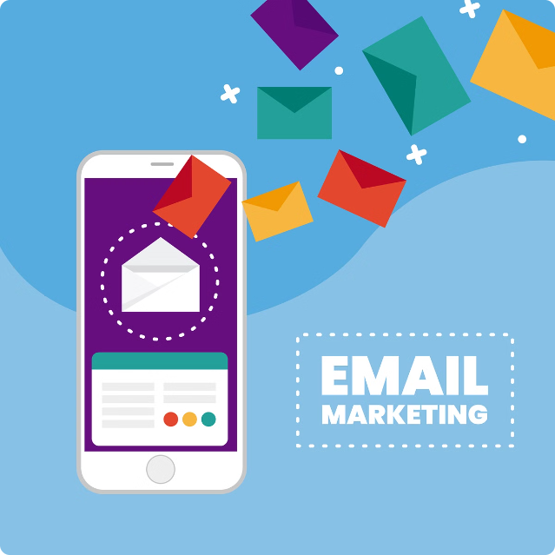
Rise of Mobile Optimization
1
Responsive Design
Ensuring email templates are mobile-friendly and easy to navigate on smaller screens.
2
Bite-Sized Content
Creating concise, scannable content that caters to the on-the-go nature of mobile users.
3
Optimized Calls-to-Action
Designing mobile-optimized CTAs that encourage quick and seamless conversions.

Slide 4


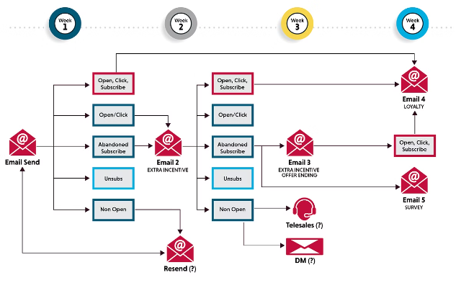


Automation and Workflows
Triggered Emails
Sending automated emails based on user actions, such as abandoned carts or product browsing.
Nurture Campaigns
Engaging leads through a series of automated emails that guide them through the sales funnel.
Omni-Channel Integration
Integrating email with other channels, like social media and e-commerce, for a seamless customer experience.

Slide 5





Leveraging Data Insights
Data-Driven Optimization
Using email performance data to continuously improve and refine campaigns.
Advanced Segmentation
Leveraging customer data to create more targeted and effective email segments.
Predictive Personalization
Utilizing AI and machine learning to predict customer preferences and deliver hyper-personalized content.

Slide 6


Sustainable Growth
Consent-Based Outreach
Focusing on building a permission-based email list to ensure compliance and deliverability.
Value-Driven Content
Creating content that provides genuine value to subscribers, fostering long-term engagement and loyalty.
Ethical Practices
Adopting ethical email marketing practices, such as transparency and unsubscribe options, to build trust.

