Slide 1

Customer Churn Prediction & ROI-Backend Playbook
Team: Aastha Gupta | Riya Singh | Siddhi NyatiGuide: Mr. Ankush Soni
“Predict. Protect. Profit.”

Slide 2

Problem Statement
Customer churn is a critical challenge that directly affects recurring revenue and business stability.
Acquiring a new customer costs 5–10× more than retaining an existing one.
Reducing churn by 5% can increase profits by 25–55%.
Traditional analytics fail to capture complex churn patterns and lack interpretability.
Project Goal:
Develop a machine learning–driven churn prediction system that identifies at-risk customers early and enables data-backed decision-making.

Slide 3

Project Objectives
Predict Churn
Identify Key Drivers (SHAP)
Develop Streamlit App
Develop and evaluate ML models to accurately identify customers at risk of churn.
Deploy an interactive Streamlit application with predictions, SHAP insights, and ROI analytics.
Use SHAP explainability to uncover the most influential factors behind churn.

Slide 4
Dataset Overview
~Link
7,043 rows (customers)
21 features describing customer behavior and account details
Target variable: Churn (Yes/No)
Feature Categories
Customer Demographics
Services Used
Account & Billing Information
Gender, Senior Citizen, Partner, Dependents
Phone service, Multiple lines, Internet type (DSL, Fiber), Online security, Backup, Device protection, Tech support, Streaming TV/Movies
Tenure (months), Contract type, Paperless billing, Payment method, Monthly & Total charges
Why This Dataset Is Useful
Well-structured and widely used in churn research
Provides rich behavioral + demographic attributes
Enables accurate churn modeling and explainability

Slide 5
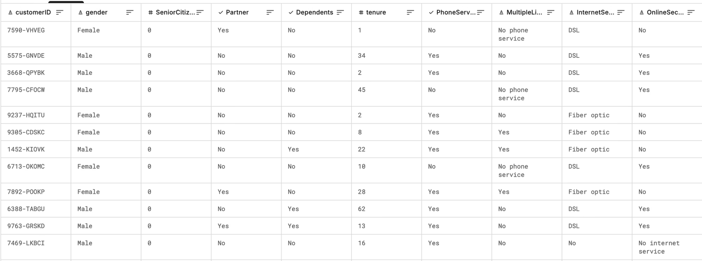

Slide 6
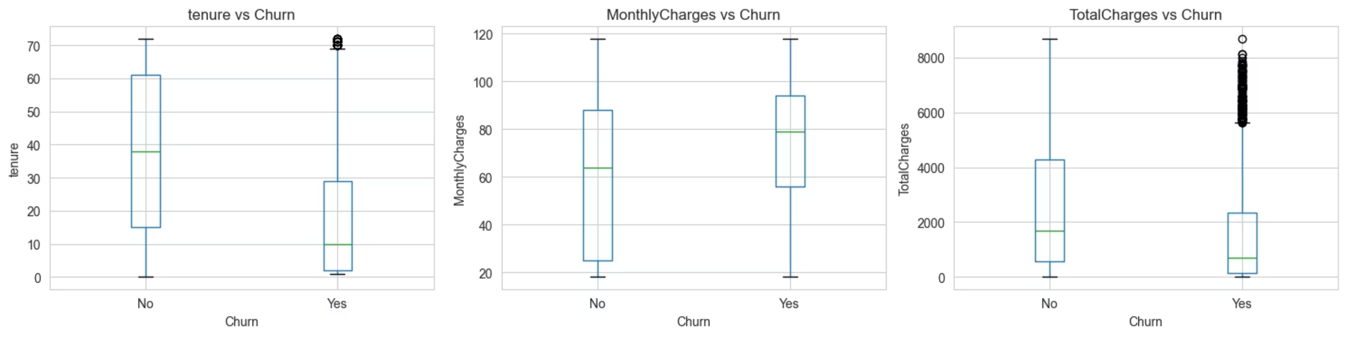
EDA Insights
Tenure vs Churn
Monthly Charges vs Churn
Total Charges vs Churn
Customers who churn typically have very short tenure, mostly within the first 0–12 months.
Churned customers generally experience higher monthly charges.
Churned customers have lower total charges, meaning their overall lifetime value is low.
Indicates price sensitivity—customers paying more are more likely to leave.
This confirms they often leave early, before contributing much revenue.
Longer-tenure customers show higher loyalty and significantly lower churn.
Highlights the need for pricing optimization or bundles for high-cost segments.
Improving customer onboarding and engagement early could significantly reduce churn.
Early-stage retention is crucial to reducing overall churn.

Slide 7
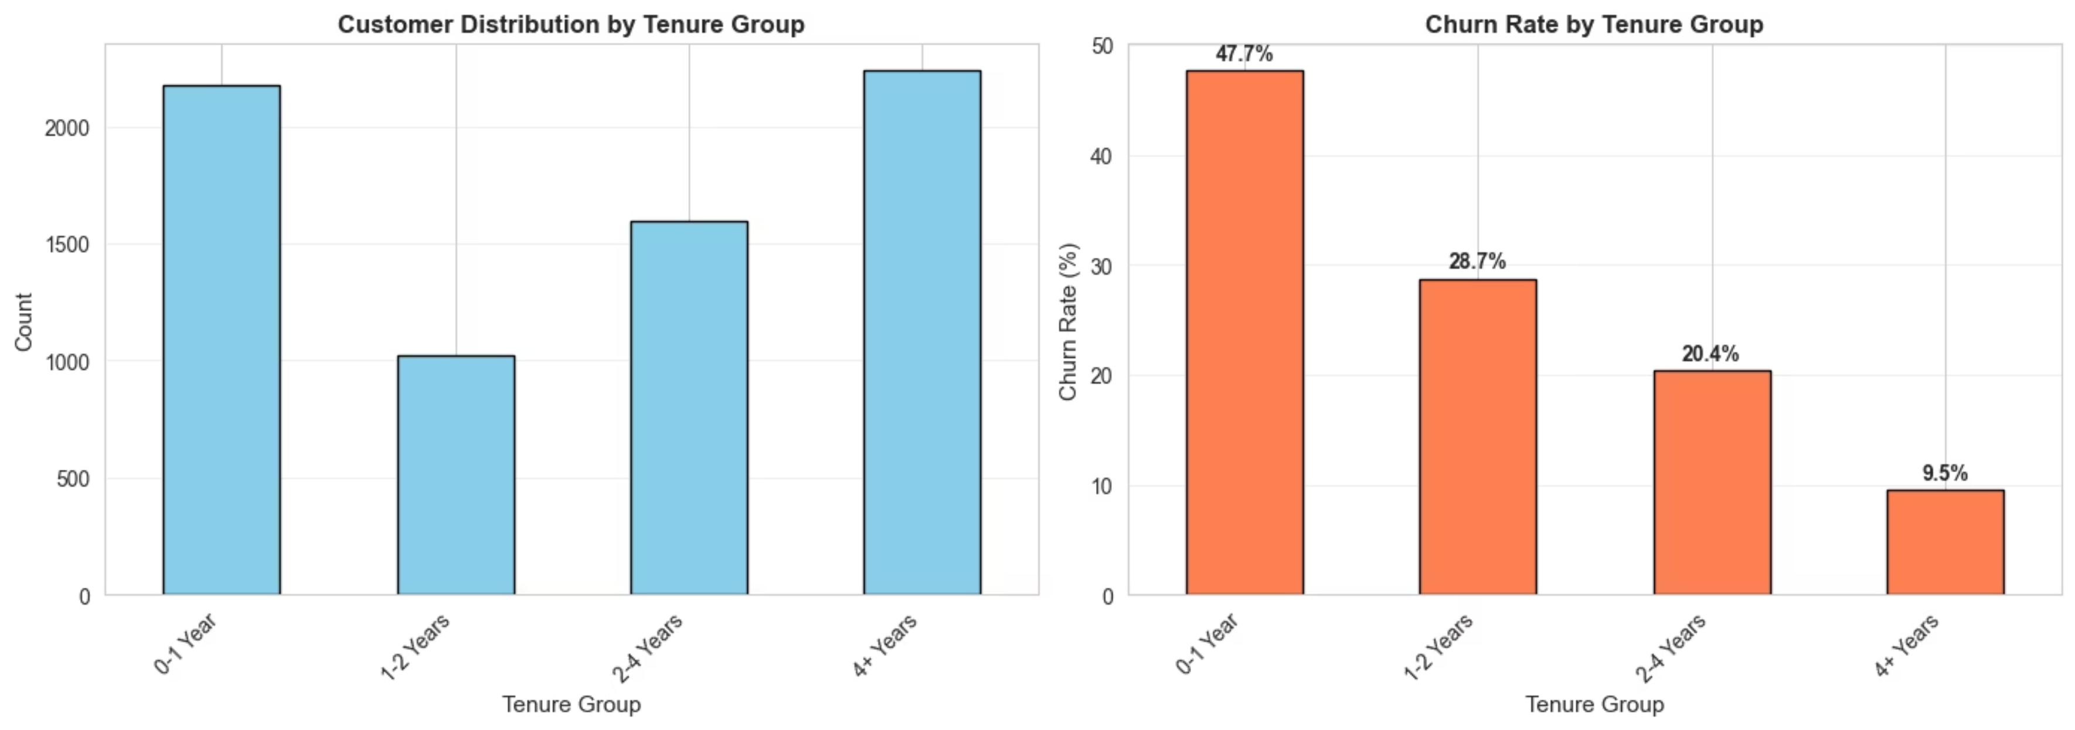
Tenure Group Analysis
Customer Distribution by Tenure
Churn Rate by Tenure
Key Takeaway
Customer loyalty strengthens with tenure. New customers (0–1 year) are the most vulnerable, showing 47.7% churn, while long-term customers (4+ years) have the lowest churn at 9.5%.
Improving onboarding and early engagement can significantly reduce churn among new joiners.

Slide 8
Class Imbalance with SMOTE-ENN
BEFORE SMOTE-ENN
AFTER SMOTE-ENN
Before Resampling (Original Training Data):
After Applying SMOTE-ENN:
Class 0 — No Churn: 4,139 (73.46%)
Class 0 — No Churn: 2,228 (44.43%)
Class 1 — Churn: 1,495 (26.54%)
Class 1 — Churn: 2,787 (55.57%)
Imbalance Ratio: 2.77 : 1
New Ratio: 0.80 : 1
The model was biased toward the majority class, leading to false negatives by missing potential churners.
SMOTE generated new churn samples, and ENN removed noisy majority points, producing a balanced and cleaner dataset.
SMOTE-ENN transformed the dataset from heavily imbalanced to nearly balanced, allowing the model to learn churn patterns more effectively.

Slide 9
Model Performance Comparison
Model Name
Accuracy
Precision
Recall
F1- Score
ROC - AUC
Logistic Regression
0.698
0.463
0.864
0.716
0.835
Decision Tree
0.713
0.475
0.775
0.729
0.753
Random Forest
0.731
0.496
0.799
0.746
0.832
Gradient Boosting
0.732
0.497
0.789
0.747
0.834
XGBoost
0.737
0.503
0.775
0.750
0.828
XGBoost consistently achieved the highest Accuracy, Recall, and F1-Score, making it the top performer for churn prediction.

Slide 10
Final Model Selection: XGBoost
Highest Accuracy
Superior F1-Score
Achieved the best overall accuracy among all models tested.
With an F1-score of 0.750, it demonstrates excellent balance between precision and recall.
Balanced Performance
Handles Imbalance Well
Maintains strong recall and precision, crucial for identifying churners effectively.
Robust performance even with imbalanced datasets, a common challenge in churn prediction.

Slide 11
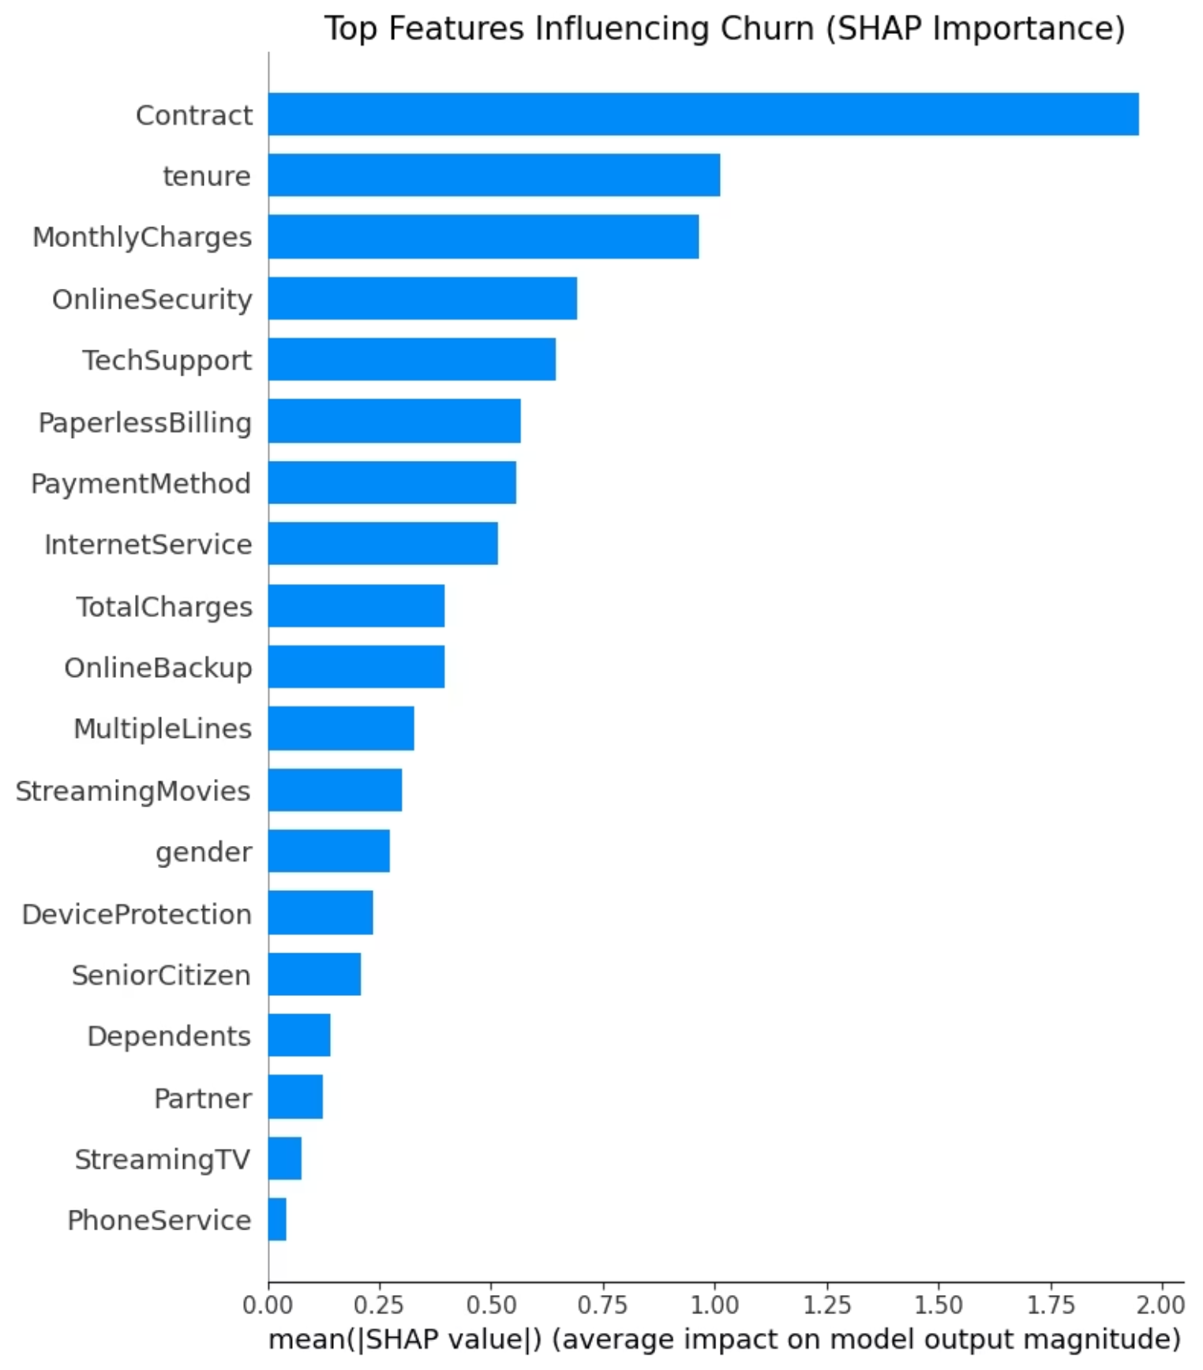
Top Features Influencing Churn (SHAP Importance)
Top drivers (highest impact)
Contract — strongest influence on churn (short-term contracts → higher churn).
Tenure — shorter tenure increases churn risk.
MonthlyCharges — higher monthly costs push churn probability up.
Other notable features
OnlineSecurity, TechSupport, PaperlessBilling, PaymentMethod, InternetService — meaningful influences; some protective (service bundles), some risk (paperless & payment types). TotalCharges lower importance than MonthlyCharges, indicating recent billing matters more than lifetime spend for churn signal.
Business implication / actionables
Prioritize retention for month-to-month contract customers and new joiners.
Introduce early engagement + cost-sensitive offers for high monthly-charge customers.
Promote bundles (security/support/streaming) to reduce churn probability.
The bar chart displays the average absolute SHAP value per feature — a measure of each feature’s average impact on the model’s churn prediction. Longer bars = larger contribution to model output (higher importance).

Slide 12
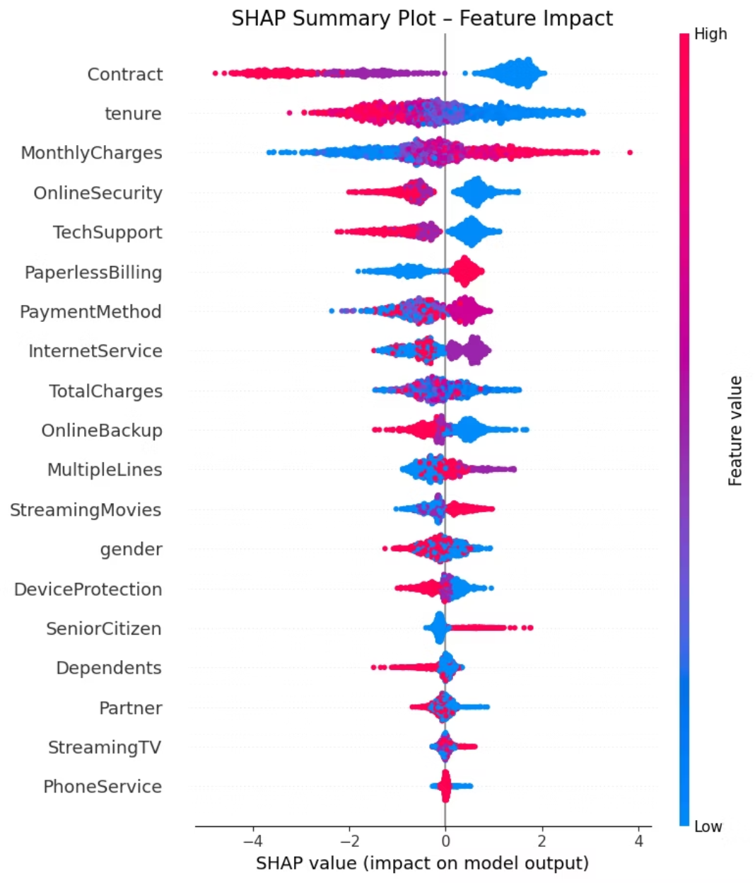
SHAP Summary Plot — Feature Impact
The SHAP summary plot shows how each feature influences churn predictions, combining both feature importance and direction of impact.
Key Insights From the Plot
Contract Type: Month-to-month contracts (high values) push churn higher; long-term contracts reduce churn.
Tenure: Low tenure strongly increases churn risk; long tenure reduces it.
Monthly Charges: Higher monthly fees push predictions toward churn.
Support & Security Services: OnlineSecurity, TechSupport, DeviceProtection reduce churn when enabled.
Bundles & Streaming Services: Customers with streaming add-ons show lower churn impact.
Each dot = one customer
Color = feature value (Red = high, Blue = low)
SHAP value > 0 increases churn probability
SHAP value < 0 reduces churn probability

Slide 13
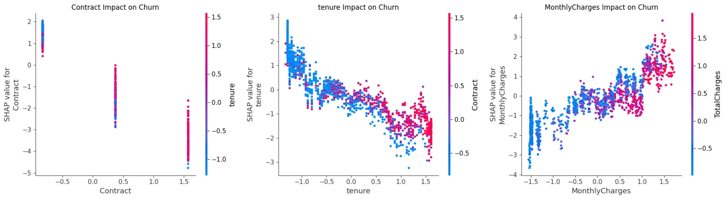
SHAP Dependence Plots — Top 3 Churn Drivers
The dependence plots reveal how specific feature values influence churn probability and how these effects interact with other variables.
Contract Type — Strongest Predictor of Churn
Month-to-month contracts show high SHAP values → sharply increased churn risk.
One-year and two-year contracts shift SHAP values downward → reduced churn.
Tenure — Longer Tenure Reduces Churn
New customers (low tenure) show strong positive SHAP values → high churn risk.
As tenure increases, SHAP values move negative → churn likelihood decreases.
Monthly Charges — High Bills Increase Churn
Low charges correspond to negative SHAP values → lower churn probability.
High monthly charges push predictions toward churn → indicates price sensitivity.
Key Insight
High cost + low commitment + short tenure form the strongest churn-risk patterns. These insights guide targeted retention: contract upgrades, early engagement, and pricing interventions.

Slide 14
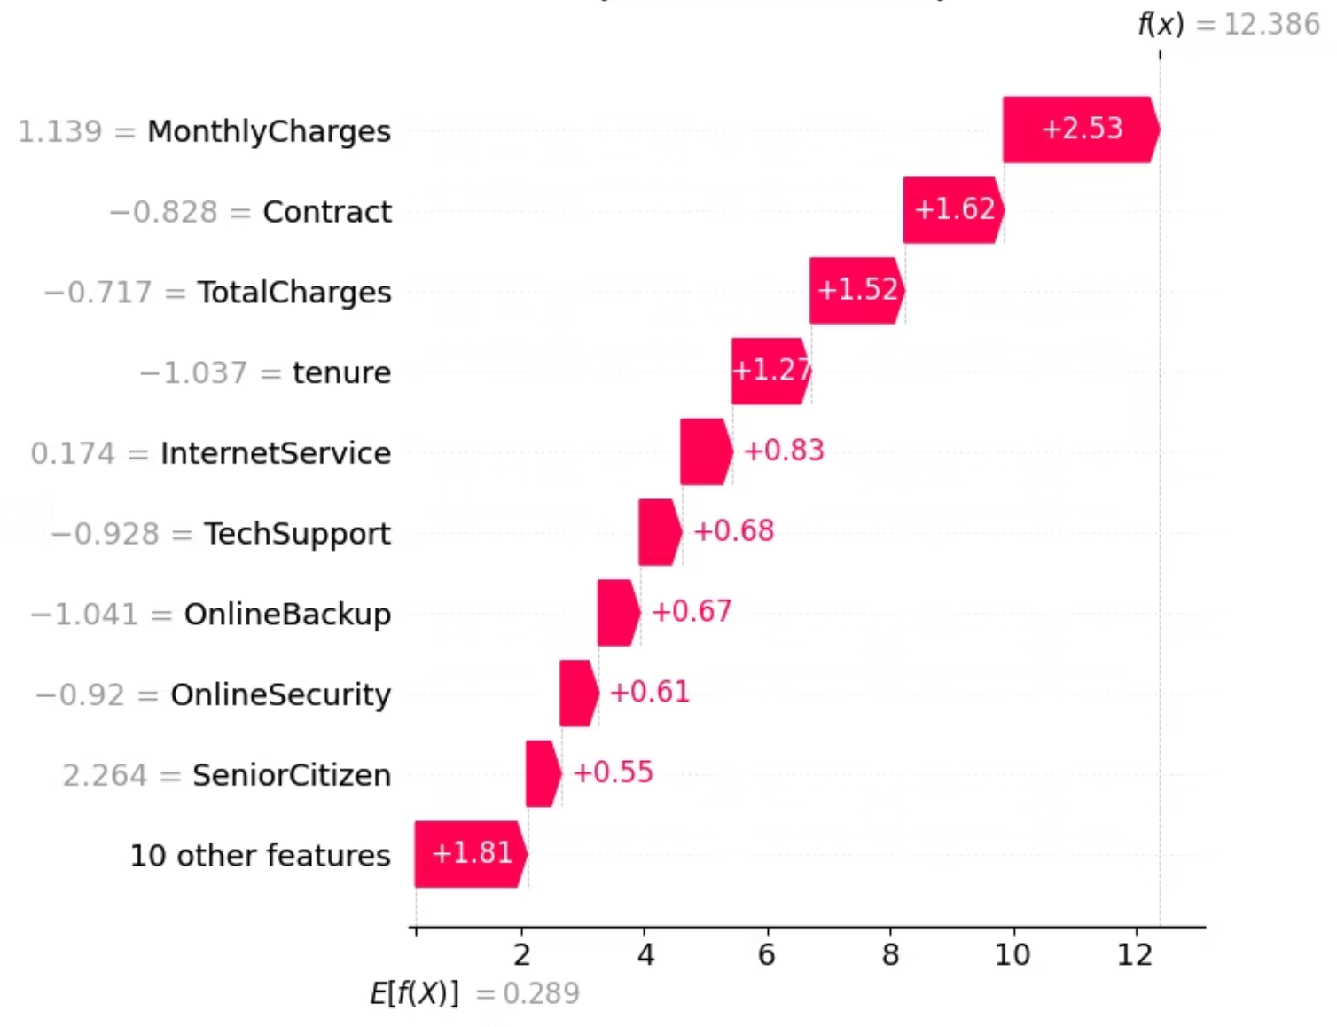
Why Customer #34 Is Likely to Churn
The model predicts Customer #34 will churn due to several high-risk factors.
Top Risk Drivers
Month-to-month contract – Low commitment increases churn probability.
Low tenure – New customers churn more frequently.
No security/backup services – Missing OnlineSecurity, TechSupport, OnlineBackup reduces loyalty.
High monthly charges – Price sensitivity drives churn.
New + high charges + low commitment + no service bundles = high churn risk.
Risky payment method – Electronic check users churn more often.

Slide 15
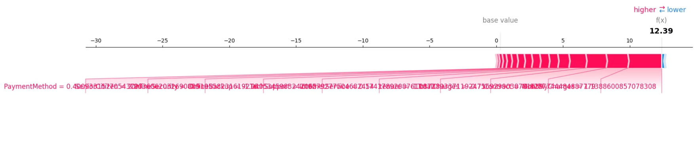
SHAP Force Plot — How Features Push This Churn Prediction
Strong Positive Push (toward churn)
This plot shows the direction and strength of influence:
Pink/red → push prediction higher (toward churn)
PaymentMethod – electronic check, high churn risk
Blue → push prediction lower (toward no churn)
Length of bar → magnitude of impact
Month-to-month contract
For Customer #34, the prediction is strongly pushed upward, resulting in a high churn probability.
High MonthlyCharges
Low tenure
Missing security/support services (No Tech Support / No Online Security)
Final Interpretation
Most forces (red) push strongly toward churn, confirming this customer as high risk. This validates the waterfall and dependence plots for Customer #34.
These features collectively push the prediction far above the base value.
Minor Negative Push (retention)
Small stabilizing effects from internet service and minor features

Slide 16
Thank You
Predict. Protect. Profit.
ChurnGuru — Customer Churn Prediction & ROI-Backend Retention Playbook
Team: Aastha Gupta | Riya Singh | Siddhi Nyati

