Slide 1

Designing Data Architecture for Business Intelligence BI Dashboards using AdventureWorksDW2017
Name: Siddhi Prabhu
NUID:001342165

Slide 2
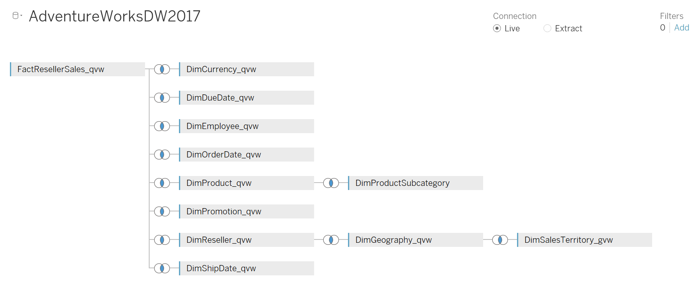
Data Sources

Slide 3
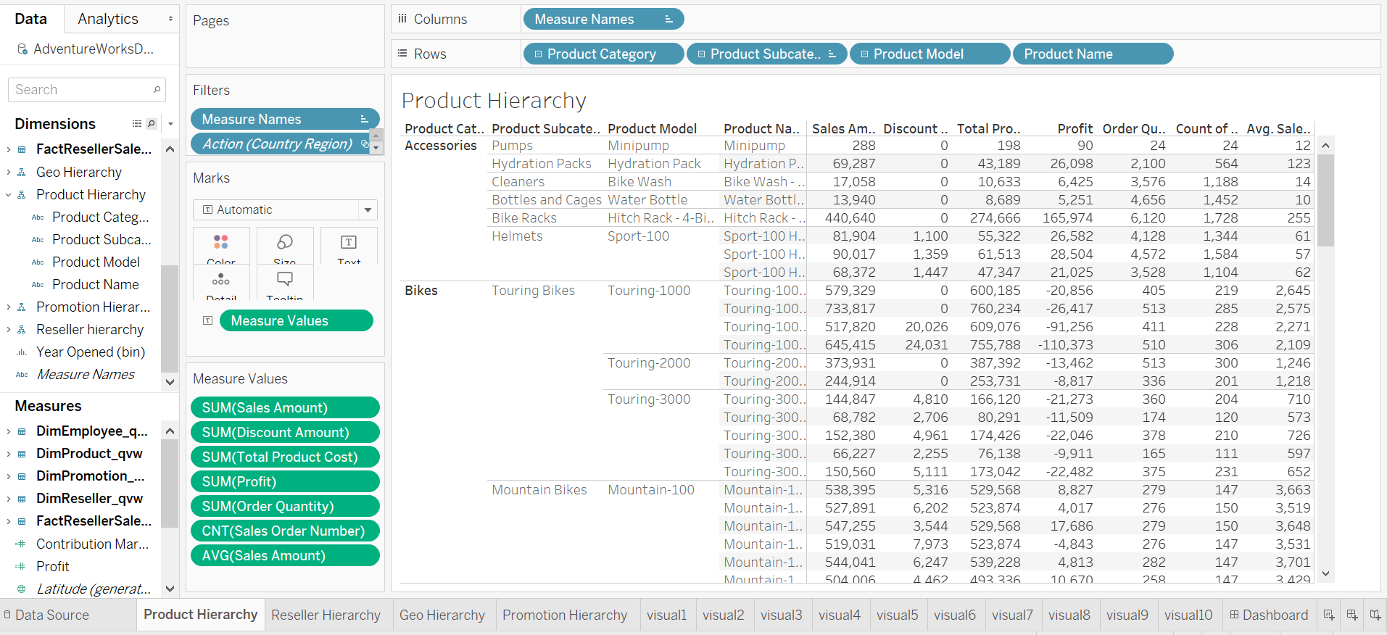
Reseller Tabular Reports-Product Hierarchy

Slide 4
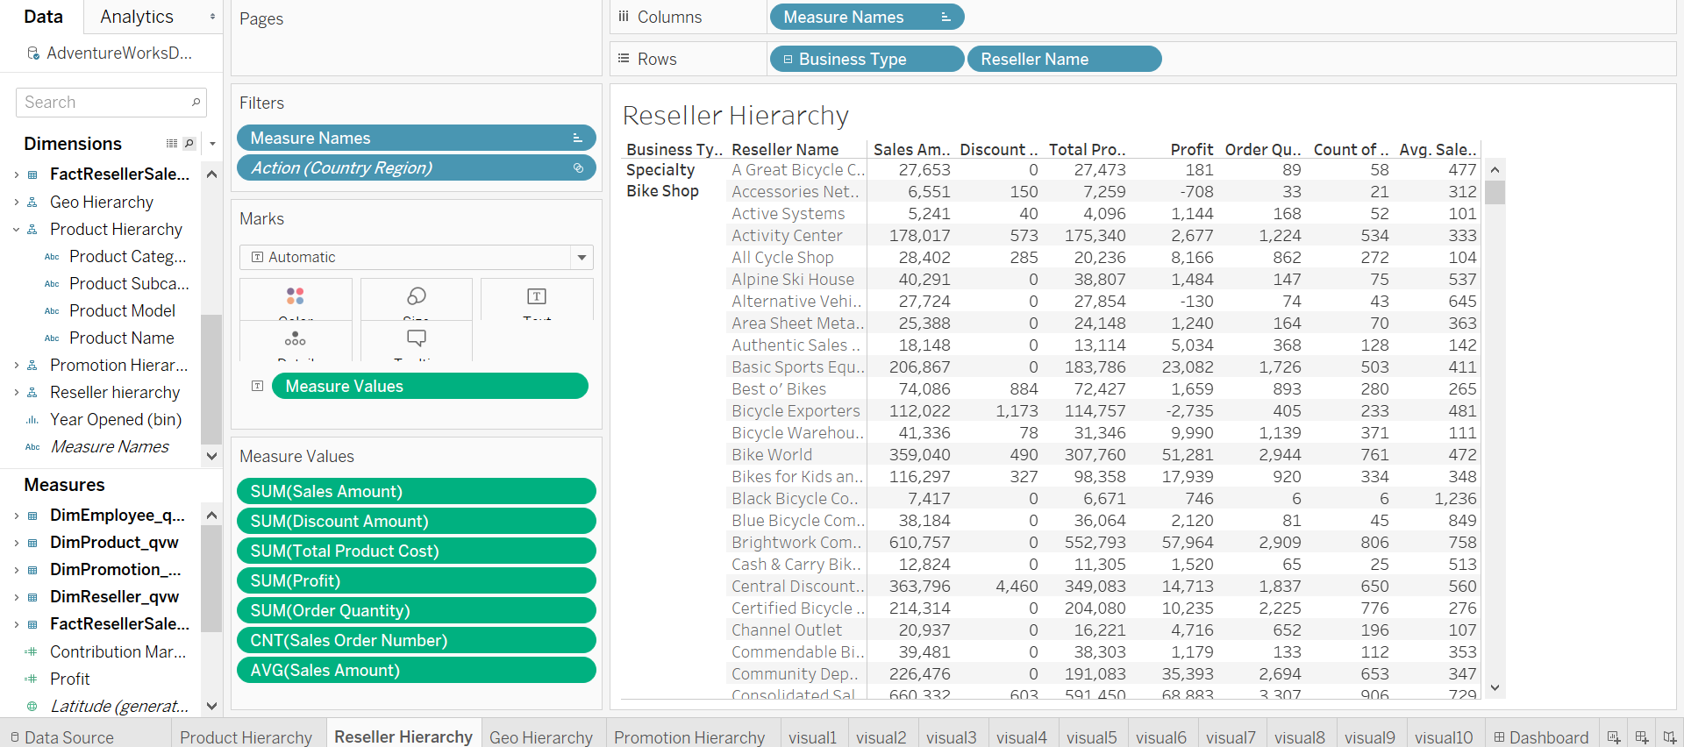
Reseller Tabular Reports-Reseller Hierarchy

Slide 5
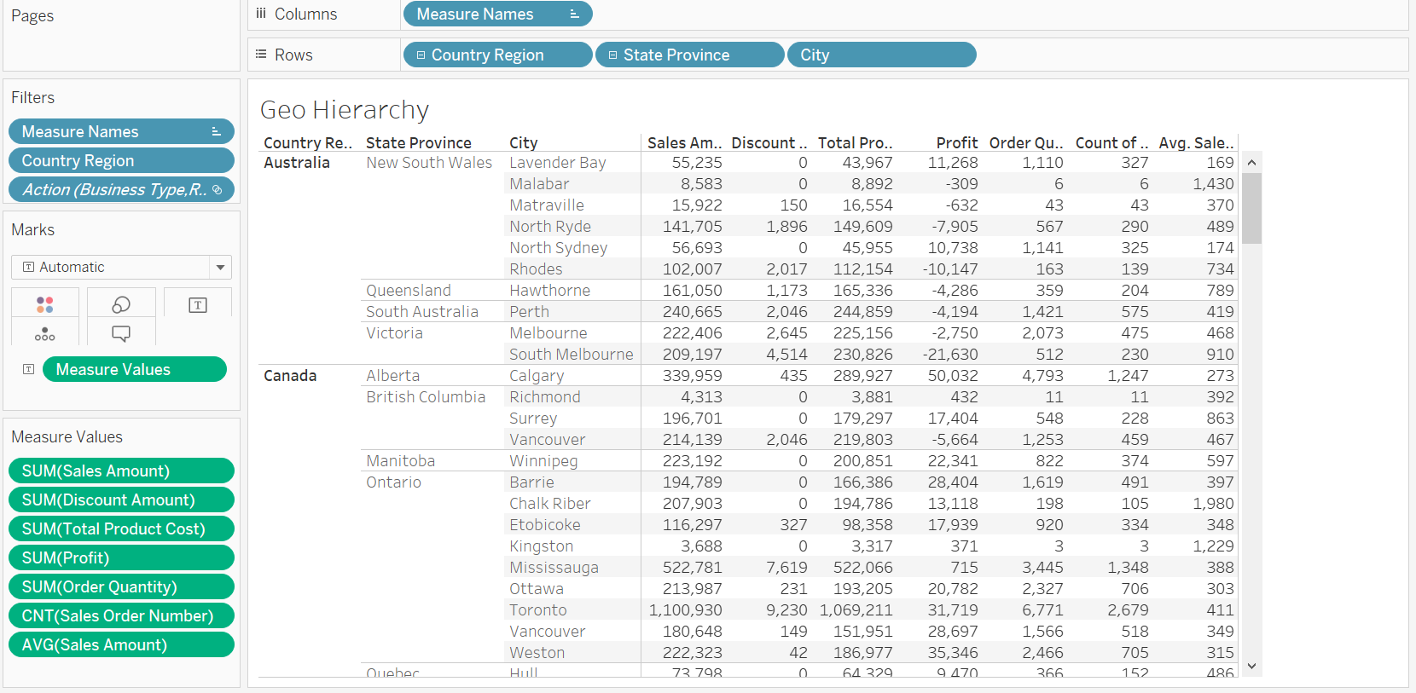
Reseller Tabular Reports-Geo Hierarchy

Slide 6
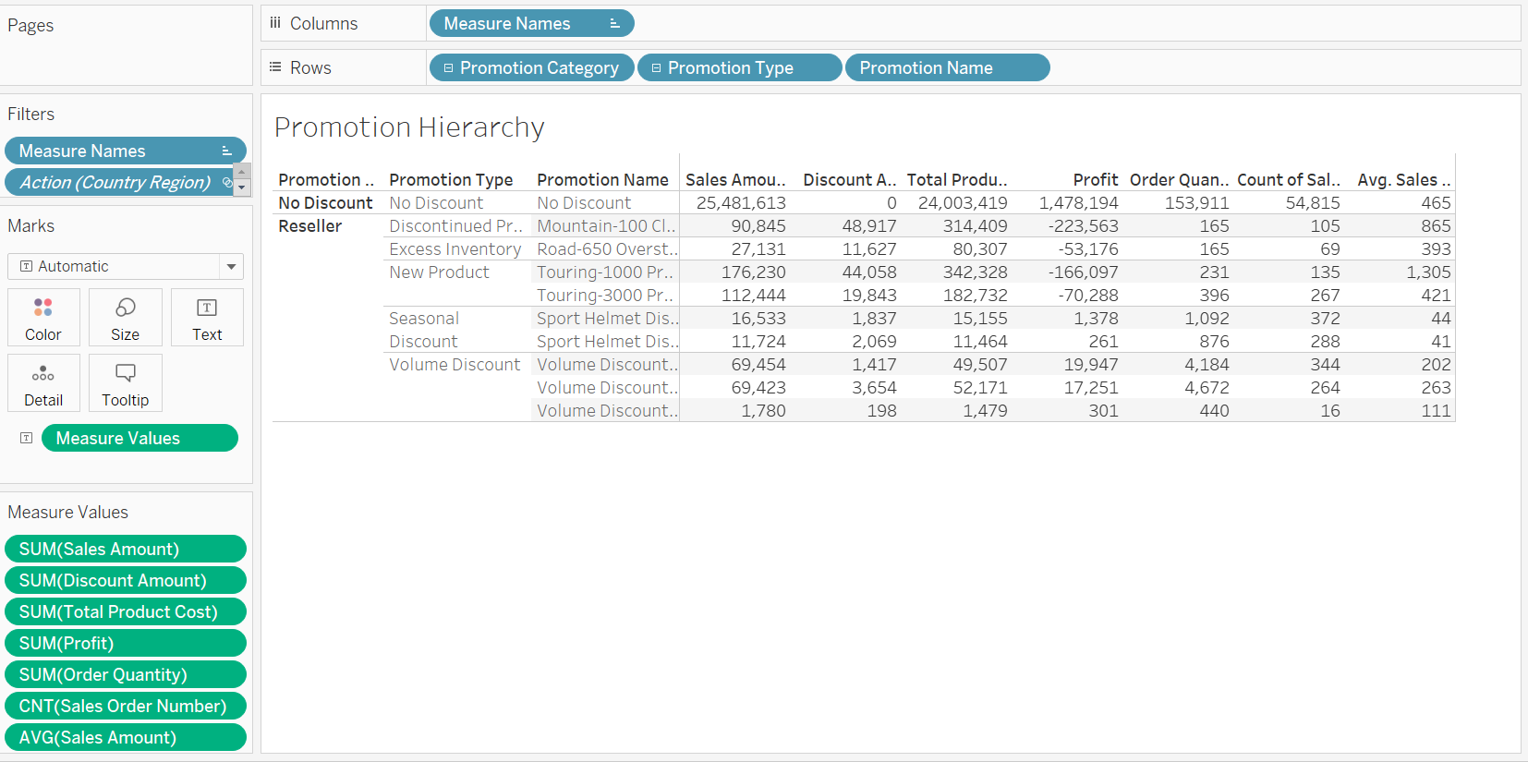
Reseller Tabular Reports-Promotion Hierarchy

Slide 7
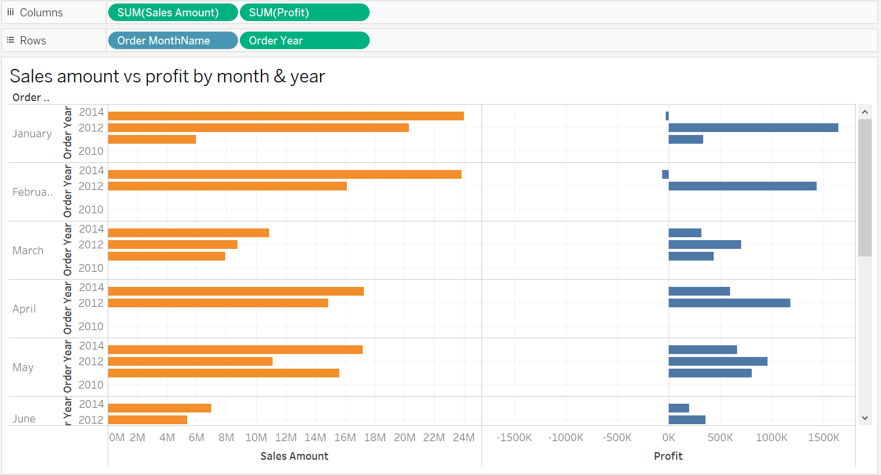
Reseller Visualization 1

Slide 8
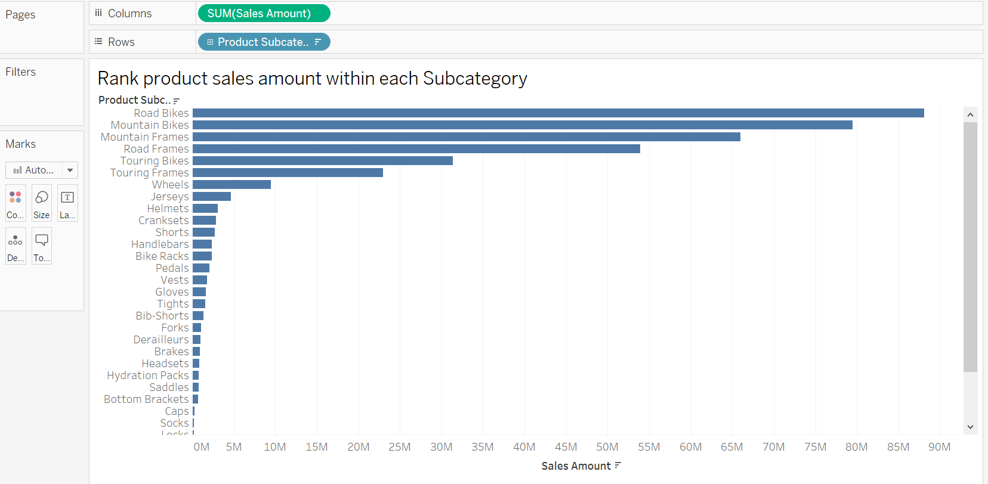
Reseller Visualization 2

Slide 9
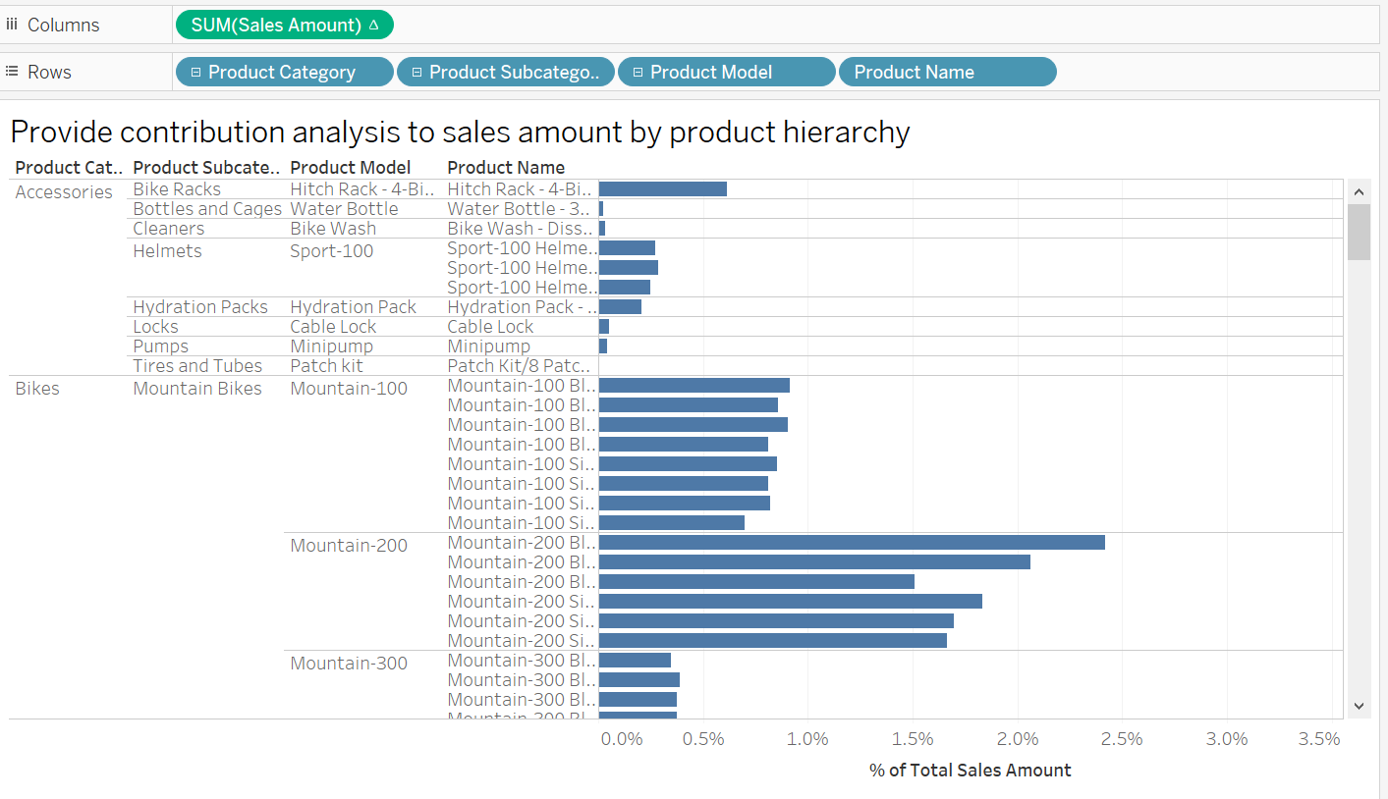
Reseller Visualization 3

Slide 10
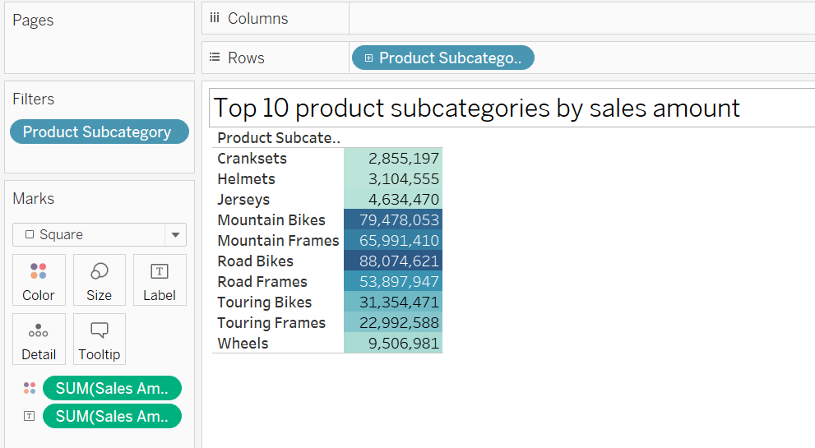
Reseller Visualization 4

Slide 11
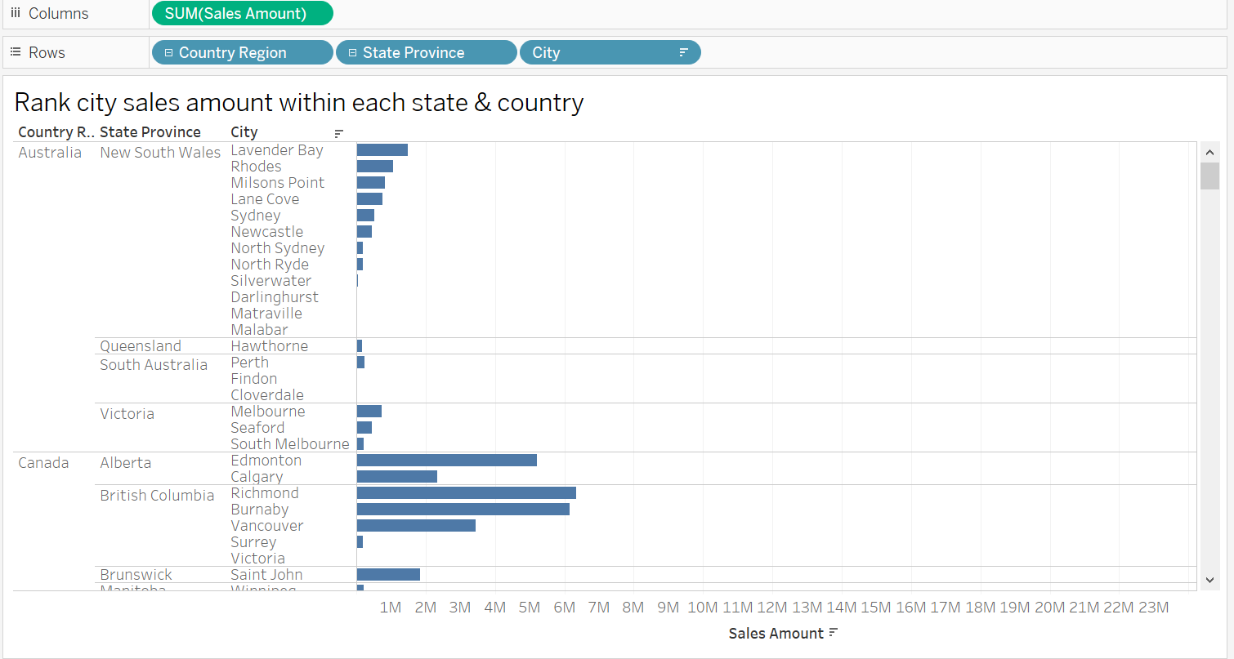
Reseller Visualization 5

Slide 12
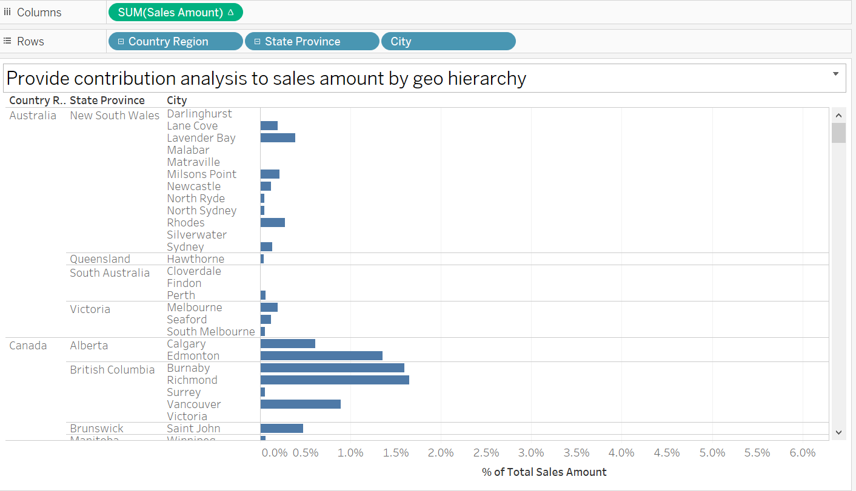
Reseller Visualization 6

Slide 13
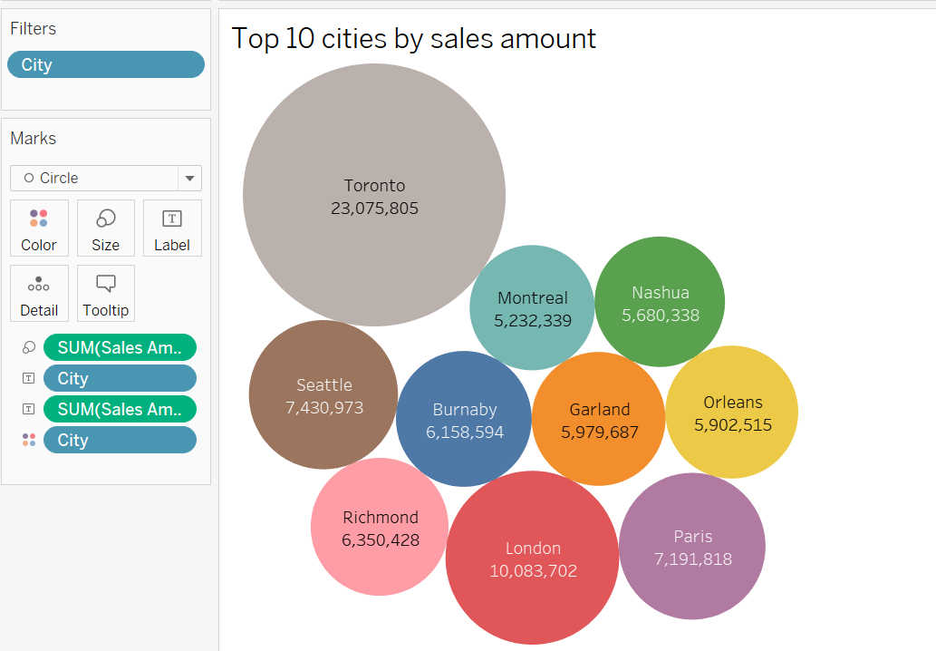
Reseller Visualization 7

Slide 14
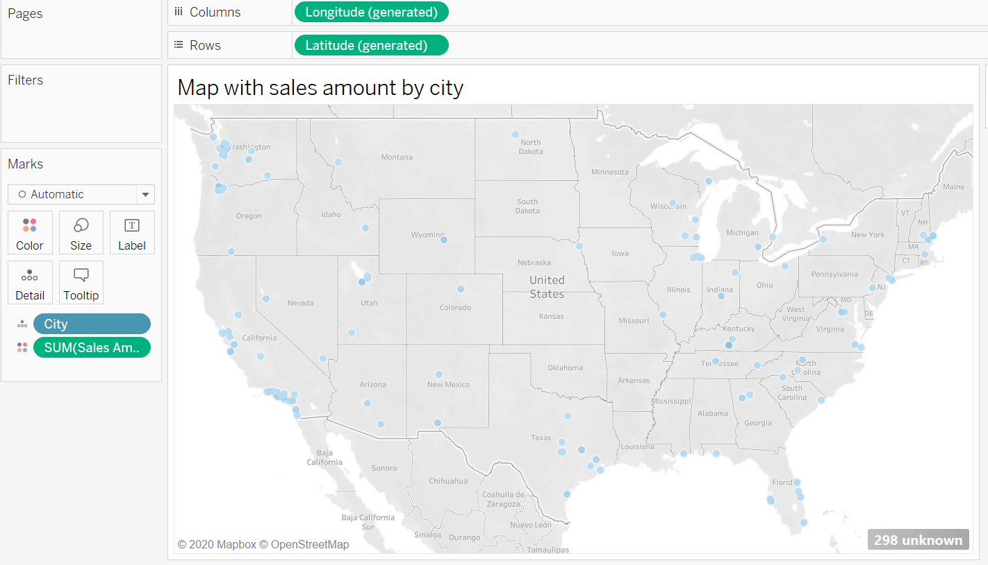
Reseller Visualization 8

Slide 15
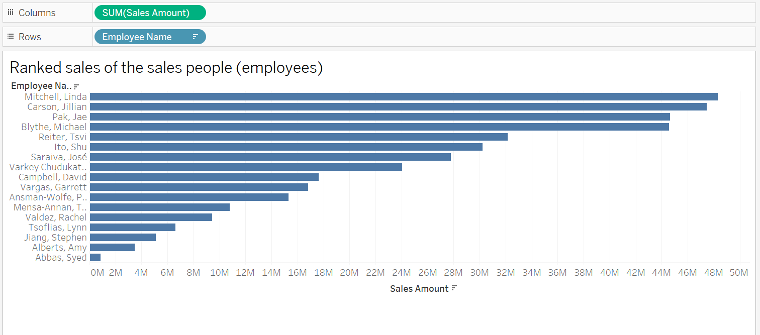
Reseller Visualization 9

Slide 16
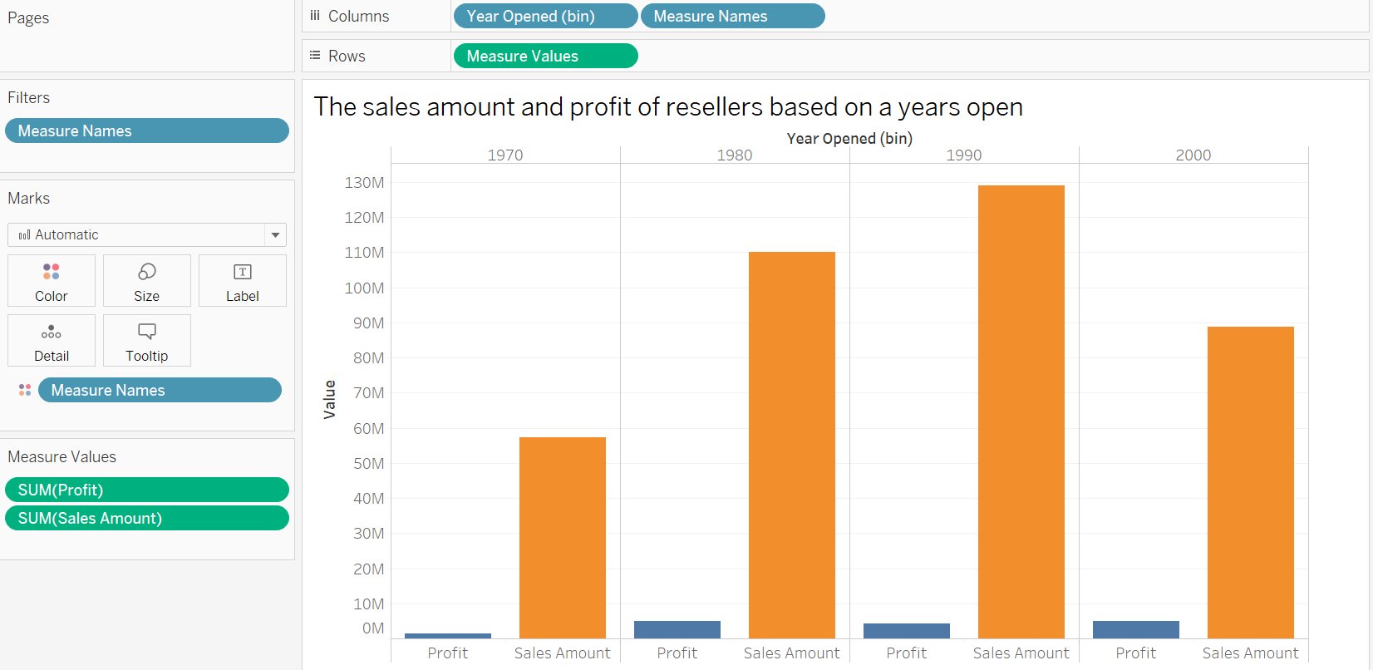
Reseller Visualization 10

Slide 17
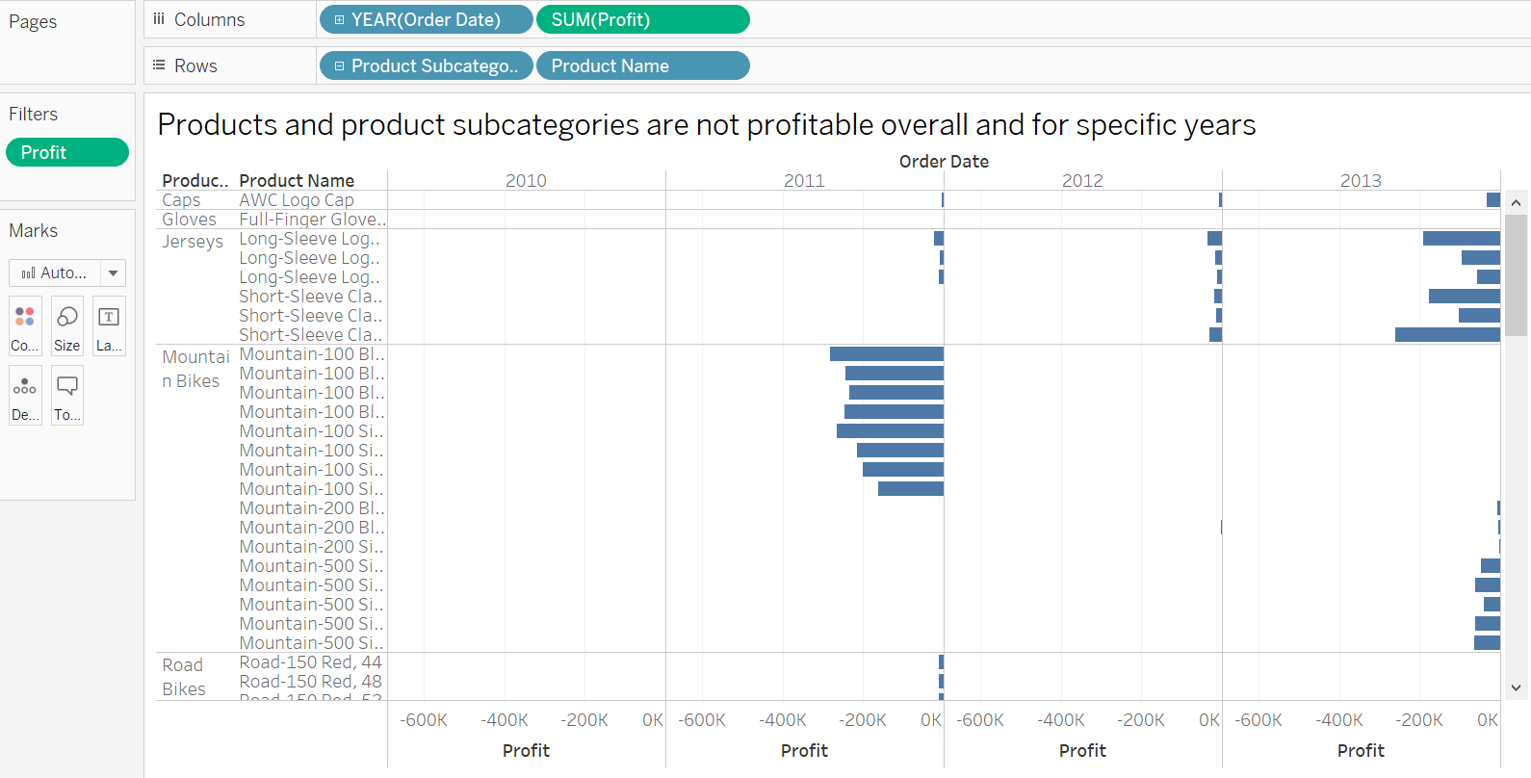
Resellers 1

Slide 18
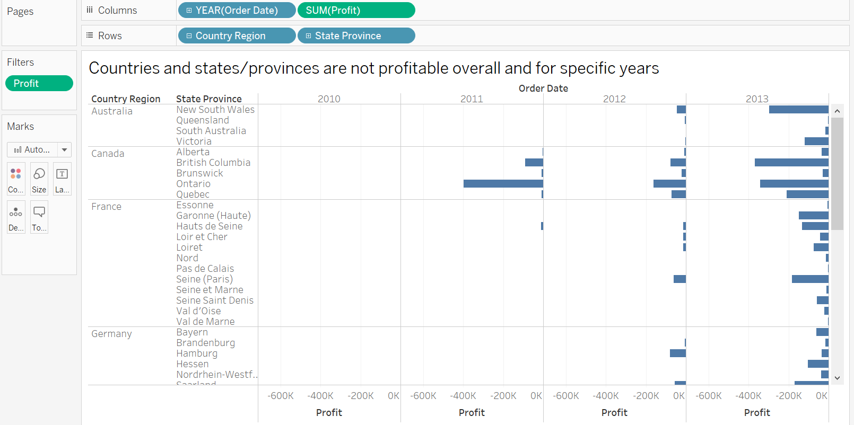
Reseller 2

Slide 19
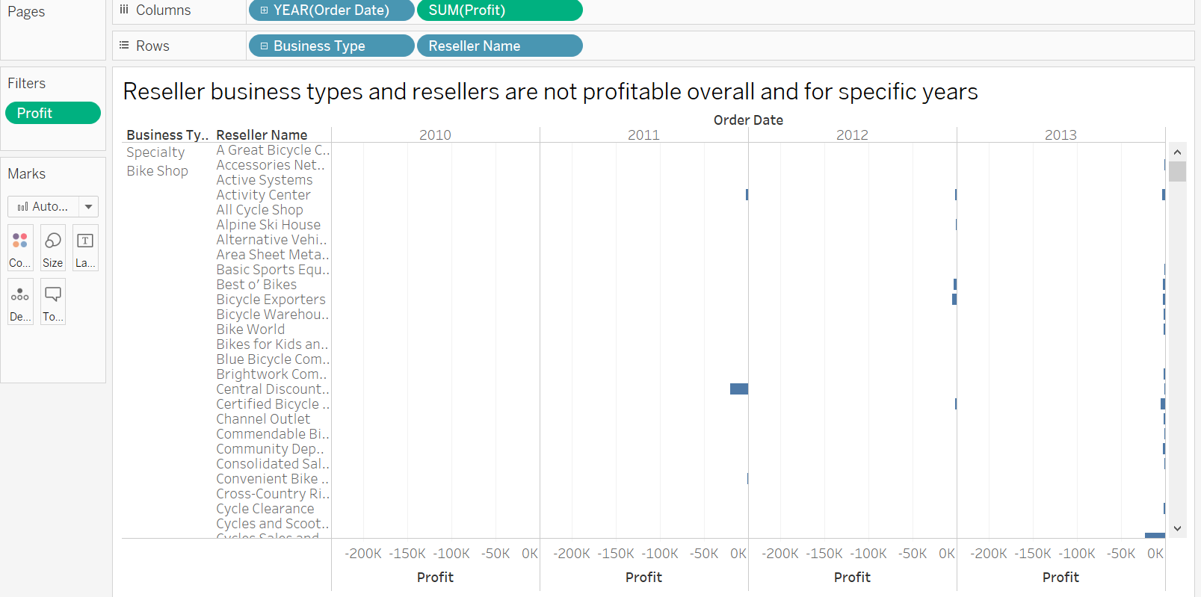
Reseller 3

Slide 20
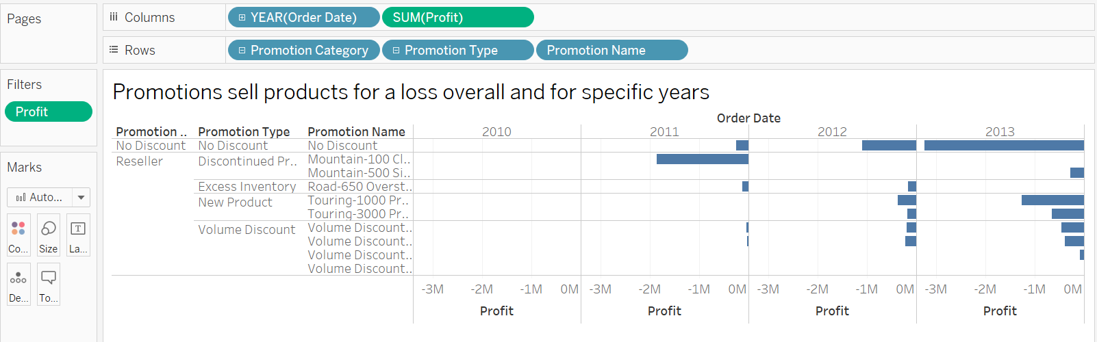
Reseller 4

Slide 21
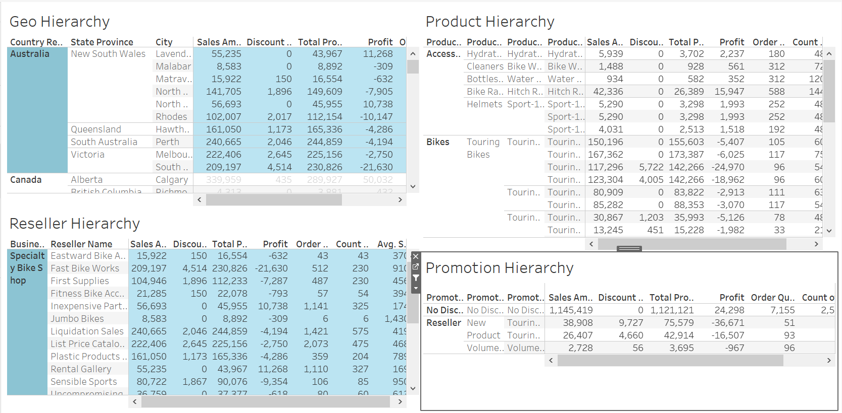
Dashboard

Slide 22
Thank You

