Slide 1
PROOFCHAIN | Project Review
Snehal Supekar
AI-Powered Digital Evidence Management and Analysis System
Divya Salunke
Project Goal • Time & Budget • Requirements • Risk • 25% Implementation
Siddhi Thorat
Guide Name:
Mrs. P. P. Shevatekar
FINAL YEAR PROJECT
ProofChain • Project Review
1

Slide 2
1. Project Goal
What ProofChain is designed to achieve
Build a secure, traceable and AI-assisted platform for collecting, preserving, analyzing and reporting digital evidence.
1
2
3
4
5
Secure Evidence
Integrity
Chain of Custody
AI Investigation
Decision Support
Authorized upload, storage and access using role-based controls.
Generate and verify SHA-256 hashes to detect evidence modification.
Maintain a timestamped record of every important evidence action.
Detect suspicious patterns, anomalies and relationships across evidence.
Provide explainable risk scores, findings, timelines and reports.
ProofChain • Project Review
2

Slide 3
2. Time, Cost & Budget Analysis
Initial Plan :
Estimated Project Cost
W1
Planning & design
Software & tools
₹0
W2
Authentication + RBAC
Dataset
₹0
Cloud/hosting
₹0*
W3
Case management
Total
₹0
W4
Evidence upload + SHA-256
W5
Chain of custody
Budget Strategy
W6–7
AI analysis
Use open-source software and local execution.
Use NIST-style simulated evidence / self-created test data.
Avoid paid AI APIs in the MVP.
Deploy locally for academic demonstration.
Optional hosting can be added later if required.
W8
Dashboard + correlation
W9
PDF reports
W10
Testing + documentation
ProofChain • Project Review
3

Slide 4
3. Software & Hardware Requirements
All core components can run on a student development machine
Software Requirements
Recommended Hardware
Frontend
React.js, Tailwind CSS
Processor
Intel Core i5 / Ryzen 5 or better
Backend
Python, FastAPI , NodeJS
RAM
8 GB minimum • 16 GB recommended
Storage
256 GB SSD minimum
Database
MongoDB
GPU
Not mandatory for MVP
AI / ML
scikit-learn, XGBoost, OpenCV
Network
Internet for package setup / updates
OCR / NLP
Tesseract or EasyOCR, spaCy / NLTK
Why This Is Feasible at ₹0
Security
JWT, bcrypt/passlib, SHA-256
React, FastAPI, MongoDB Community and Python libraries are open-source.
OCR, hashing, computer vision and classical ML can run locally.
No paid API is required for the core AI Investigator workflow.
A local machine is sufficient for the academic prototype.
Reports
ReportLab
Tools
VS Code, Git/GitHub, Postman
OS
Windows
ProofChain • Project Review
4

Slide 5
4. Risk Identification & Prioritization
Prioritize risks by impact on evidence integrity, security and project delivery
Risk
Impact
Likelihood
Priority
Mitigation
Unauthorized evidence access
High
Medium
HIGH
JWT + RBAC + protected routes
Evidence modification / loss
High
Medium
HIGH
SHA-256 + backups + immutable audit logs
AI false positives
High
Medium
HIGH
Explainable rules + confidence + human review
Large/unsupported files
Medium
Medium
MED
File validation + size/type limits
AI model limitations
Medium
Medium
MED
Use benchmark/test datasets and clear scope
Schedule overrun
Medium
Medium
MED
Deliver MVP first; advanced features later
Hardware resource limits
Medium
Low
LOW
Prefer lightweight models and local processing
Priority logic: HIGH = immediate control • MED = monitor and mitigate • LOW = monitor
ProofChain • Project Review
5

Slide 6
5. System Workflow
From authorized evidence submission to AI-assisted findings and reporting
1
2
3
4
5
6
7
8
Login & RBAC
Create Case
Upload Evidence
SHA-256 Hash
Chain of Custody
AI Analysis
Human Review
PDF Report
Security Layer
AI Investigator
Output
JWT authentication
Role-based access control
Secure file validation
Audit logging
OCR / text extraction
Pattern & anomaly detection
Risk scoring
Evidence correlation
Findings dashboard
Investigation timeline
Integrity status
PDF investigation report
ProofChain • Project Review
6

Slide 7
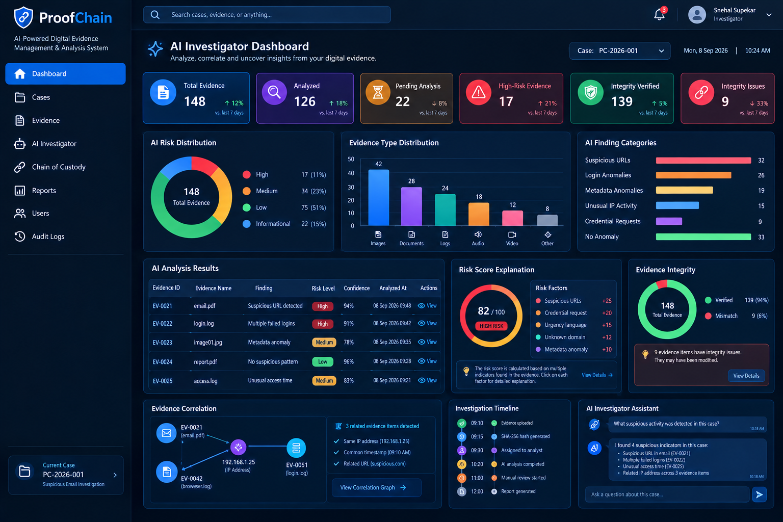
6. 25% Implementation Status
Current prototype demonstrates the foundation of the ProofChain workflow
Implemented at ~25%
Project UI / dashboard
DONE
Authentication + RBAC
NEXT
Case creation flow
NEXT
Evidence upload structure
NEXT
SHA-256 hashing concept
NEXT
AI analysis pipeline
NEXT
Correlation + reports
NEXT
25% prototype foundation complete
ProofChain • Project Review
7

Slide 8
7. Planned AI Investigator Visualization
The next stage turns evidence into explainable, investigator-facing insights
148
126
17
139
Total evidence
Analyzed
High-risk
Integrity verified
AI Risk Distribution
AI Finding Categories
Explainable Risk Score
High 17
Suspicious URLs
32
Suspicious URL
+25
Medium 34
Login anomalies
26
82/100
Credential request
+20
17 HIGH
Low 75
Metadata anomalies
19
Urgency language
+15
Informational 22
15
Unknown domain
+12
Unusual IP activity
Metadata anomaly
+10
Credential requests
9
AI assists the investigator; human review remains final.
ProofChain • Project Review
8

