Slide 1
Common errors in C Programming
&
How to fix them
GROUP MEMBERS:
VRUKSHITA VINOD (1262250376)
SIDDHI JHA (1262253755)
PALAK SONI (1262252891)
PRACHITI SURYAWANSHI (1262252177)
TANISH FIRODIYA (1262253209)

Slide 2


Introduction
1
Types of Errors
Logical Errors
Syntax Errors
Runtime Errors
Semantic Errors
2
Agenda
Topics to be Covered
3
How to avoid errors
4
Real life Errors
5
Conclusion

Slide 3

PROBLEM STATEMENT
C programs may contain syntax, logical, run time, and semantic errors that affect correctness and reliability.
This study aims to :
“ Identify the errors and apply appropriate techniques to detect and fix them effectively ”

Slide 4

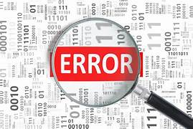
INTRODUCTION
WHAT IS A C PROGRAM ?
It is a set of instructions written in C to perform a task.
It starts from the main() function and is compiled before execution.
WHAT ARE ERRORS ?
.
It is a mistake in a program that causes it to produce wrong results or stop working.
Errors can occur during compilation or while the program is running.

Slide 5
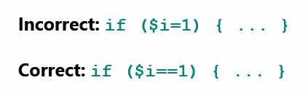
LOGICAL ERRORS
A logical error occurs when a program:
Compiles successfully
Runs without crashing
But produces incorrect output
The compiler (e.g., GCC) does not detect logical errors.
TRICKIEST KIND !!!!!!!
the compiler can’t detect these, it’s up to the programmer to find them by manually testing and debugging

Slide 6
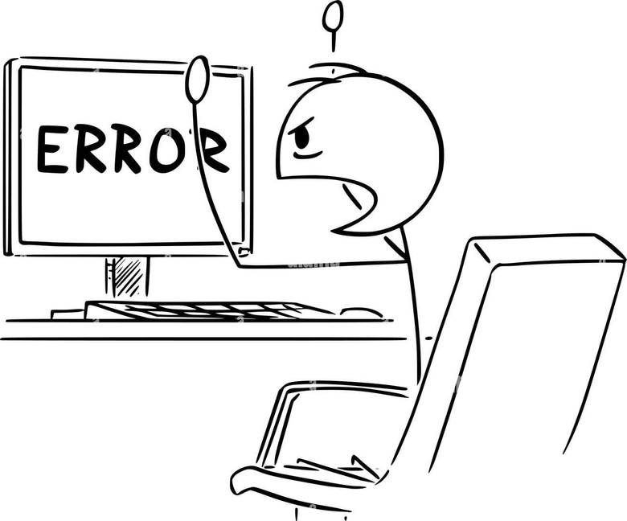
Common Logical Errors in C
1] Using = instead of ==
If (a = 10) // Wrong
✔ Instead Use:
if (a == 10) //Correct
2] Incorrect Formula Implementation
Wrong:
area = 2 * 3.14 * r * r; // Wrong formula
After fixing:
area = 3.14 * r * r; //Correct
3] Infinite Loop (Missing Update)
while(i < 5) {
printf("%d", i);
}
✔ After fixing, add:
i++;

Slide 7

FIXING APPROACH
Use print statements or a debugger to track variable values during execution.
Break down your logic into smaller chunks to test individually.
Write unit tests to check if functions give expected outputs.
Perform code reviews or explain your code logic to someone else (“rubber duck debugging”).

Slide 8
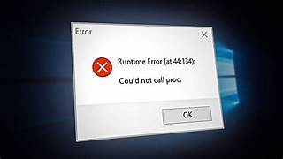
RUN TIME ERRORS
PROGRAM EXECUTION
PROBLEMS!!
It is an error in a program that occurs while the program is running after being successfully compiled.
They are not detected during compilation
The program compiles successfully but crashes or behaves unexpectedly
CAUSES
Division by zero
Accessing invalid memory
Infinite loops
Stack overflow
File not found
Invalid user input

Slide 9
Common Run Time Errors in C
1. Division by Zero
Trying to divide a number by 0.
Example: a = 10 / 0;
2. Null Pointer Dereferencing
Using a pointer that is not initialized or is NULL.
3. Array Index Out of Bounds
Accessing an array element outside its size.
Example: arr[10] when size is 5.
5. Stack Overflow
Too many recursive function
calls.
4. Infinite Loop
Loop condition never becomes false

Slide 10
FIXING APPROACH
C offers basic tools to detect and respond to runtime errors:
errno: A global variable that stores the error code when a library function fails.
perror(): Prints a descriptive error message based on the current value of errno.
strerror(errno): Returns a string describing the error.

Slide 11
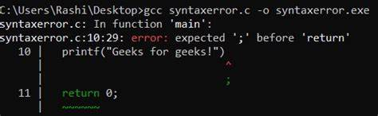
SYNTAX ERROR
Syntax errors occur when the rules and grammar of the C language are violated (e.g., missing semicolons, incorrect brackets).
They are detected at compile time by compilers like GCC.
The program cannot run until all syntax errors are corrected.
VIOLATION OF
C LANGUAGE RULES!!!

Slide 12

Common Syntax Errors in C
1]Missing semicolon
printf("Hello World") //Wrong
printf("Hello World"); //Correct
3]Incorrect Use of Quotes
printf('Hello'); //Wrong
printf("Hello"); //Correct
2]Missing Closing Bracket
int main() {
printf("Hello"); //Wrong
int main() {
printf("Hello");
} //Correct

Slide 13
FIXING APPROACH
Always check the compiler error messages. They usually point to the line and type of error.
Use an IDE or code editor that highlights syntax errors in real-time.
Read the code carefully to ensure all language rules are followed.

Slide 14

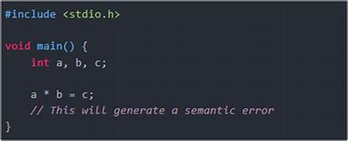
SEMANTIC ERRORS
HARD TO FIND!!
it occurs when the statements written in the program are not meaningful in the
compiler.
difficult to detect as their syntax is correct but the meaning is wrong.

Slide 15
Common Semantic Errors in C
1] Wrong Statement:
#include <stdio.h>
void main()
{
int a, b, c;
a + b = c;
// Error; Ivalue required as left operand of assignment
return 0;
}

Slide 16
2] Use of non- initialized variable:
#include <stdio.h>
int main()
{
int i;
i++;
// Error; the variable 'i' is not
initialized.
return 0;
}
3] Type Incompability:
#include <stdio.h>
void main()
{
int i = " Hello";
// Error; cannot convert 'char' to 'int'.
return 0;
}

Slide 17
FIXING APPROACH
Understanding the intended program logic.
Check variable declarations and initializations.
Verify expressions and operators are correct.
Review control structures (if, for, while).
Ensure function calls and return values are correct.
Test with different inputs to catch logical mistakes.

Slide 18
CONCLUSION
Errors are a natural part of C programming. Understanding syntax, runtime, logical and semantic errors helps in writing reliable code. Compilers detect compile-time issues, while debugging and testing help fix other errors. Good coding practices and proper error handling improve program efficiency and debugging skills.

Slide 19
Thank you!

