Slide 1
CMSE 928 — Applied Machine Learning
A Hybrid NLP Model for Fake News
Detection on the WELFake Dataset
Combining TF-IDF, GloVe/BiLSTM, and Linguistic Features
Siddhish Nirgude
MS Data Science | Michigan State University | April 2026
Instructor: Prof. Jie Hou | TA: Gabriel Thomas Maliakal
1

Slide 2
Problem Statement & Dataset
THE PROBLEM
WELFAKE DATASET
The rapid spread of misinformation online poses a serious challenge to public discourse. Manual fact-checking cannot keep pace with the volume of articles published daily across digital platforms.
Source | Kaggle (Verma et al., 2021)
Total articles | 72,134
After dedup | 62,660
Fake articles | 55.25%
Real articles | 44.75%
Split | 70% / 15% / 15%
Test set size | 9,399 articles
Merged from | Kaggle, McIntire, Reuters, BuzzFeed
OUR APPROACH
This project builds a hybrid NLP classification system that combines TF-IDF statistical features, GloVe semantic embeddings with BiLSTM, and handcrafted linguistic writing-style features into a single unified classifier.
RESEARCH QUESTION
Does combining TF-IDF vocabulary features, GloVe semantic embeddings, and linguistic writing-style features into a single hybrid model produce statistically significantly better fake news detection than any individual feature alone?
Dataset: kaggle.com/datasets/saurabhshahane/fake-news-classification
Verma et al. (2021). WELFake. IEEE Trans. Computational Social Systems, 8(4), 881–893.
2

Slide 3
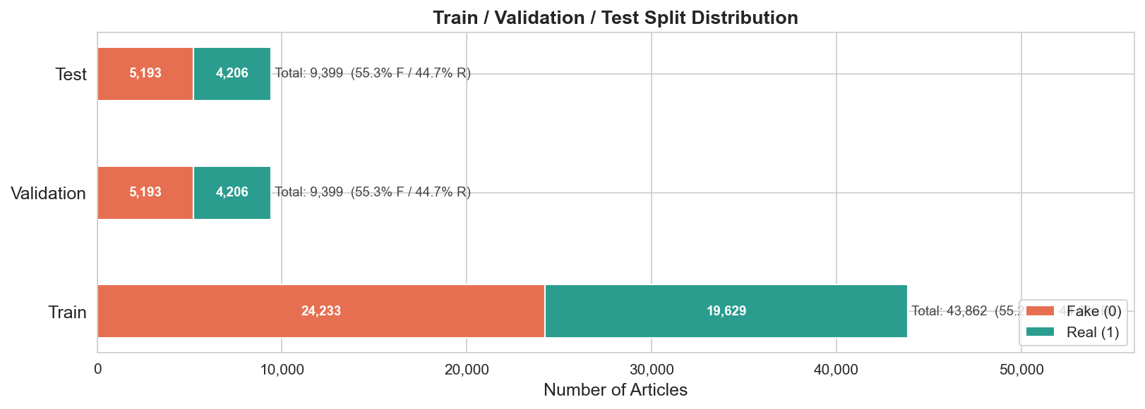
Data Pipeline & Preprocessing
PIPELINE STEPS
SPLIT DISTRIBUTION
1. Load Raw Data
72,134 articles — title, text, label columns
2. Handle Nulls
558 null titles, 39 null texts — combined into single content column
3. Deduplicate
9,474 duplicate texts removed — prevents data leakage between splits
4. Clean Text
URLs removed, punctuation stripped, lowercased
5. Stratified Split
Class ratio preserved — 55.25% Fake / 44.75% Real in each split
Class balance preserved across Train / Val / Test splits
72,134 raw → 62,660 after deduplication
Train: 43,862 | Val: 9,399 | Test: 9,399
3

Slide 4
ML Pipeline Overview
RAW TEXT 72,134 articles
PRE-PROCESS Dedup · Clean · Split 62,660 articles
PATH A — Classical ML
3-BRANCH
HYBRID
TF-IDF
+GloVe
/BiLSTM
+Linguistic
→Fusion
→Sigmoid
ABLATION No TF-IDF · No BiLSTM · No Linguistic
SIGNIFICANCE McNemar Test All p < 0.0001
TF-IDF
Vectorizer
50k features
Classical ML
LR · SVM
RF · XGBoost
Best: LinearSVC
97.20% F1
PATH B — Deep Learning
Tokenizer
+ Sequences
GloVe 100d
BiLSTM(256)
Sequential
Encoding
BiLSTM Baseline
97.83% F1
PATH C — Linguistic
10 Linguistic
Features
Flesch · Fog
Standard
Scaler
Normalized
Hybrid Only
(No standalone
model)
4

Slide 5
Feature Engineering — Three Parallel Tracks
TF-IDF Statistical Features
GloVe Semantic Embeddings
Linguistic Writing Style
Parameters
max_features = 50,000
ngram_range = (1, 2)
min_df = 5, max_df = 0.90
sublinear_tf = True
What it captures
Vocabulary and term frequency
patterns across articles.
Unigrams and bigrams.
Limitation
Word order not preserved.
Cannot capture semantic
similarity between words.
Configuration
Stanford GloVe 6B 100d
Vocabulary: 30,000 words
Coverage: 93.64%
What it captures
Pretrained on Wikipedia
and Gigaword corpus.
Semantic relationships
preserved in vector space.
Advantage
trump and president are
close in vector space
before training begins.
10 Handcrafted Features
Flesch Reading Ease
Gunning Fog Index
Word Count
Avg Sentence Length
Sentiment Polarity
Sentiment Subjectivity
Lexical Diversity
Negation Count
Key Insight
Captures HOW an article
is written, not WHAT.
Orthogonal to content
features above.
5

Slide 6
Classical ML Baselines
TF-IDF FEATURE ENGINEERING
TEST SET RESULTS
Hyperparameter tuning conducted by systematically
varying max_features, ngram_range, min_df and
max_df. Current values selected based on best
validation F1.
50k features · unigrams + bigrams
min_df = 5 · max_df = 0.90
sublinear_tf = True
Model | F1 Macro | ROC-AUC
Random Forest | 0.9429 | 0.9879
XGBoost | 0.9627 | 0.9938
Logistic Regression | 0.9703 | 0.9964
LinearSVC ★ | 0.9720 | 0.9967
MODELS AND TUNING
GridSearchCV with 5-fold cross validation applied
to find optimal regularization strength for each
model. RF and XGBoost used as default parameter
baselines.
Logistic Regression — GridSearchCV (C=10.0)
LinearSVC — GridSearchCV (C=1.0)
Random Forest — default params
XGBoost — default params
Best Classical Model: LinearSVC 97.20% F1
Benchmark all neural models must beat →
4 models trained · GridSearchCV 5-fold CV · TF-IDF 50k features
LinearSVC 97.20% · XGBoost 96.27% · LR 97.03% · RF 94.29%
6

Slide 7
BiLSTM Neural Baseline
ARCHITECTURE
WHY BILSTM?
Embedding (30,000 → 128d) 30k vocab · each word → 128-dim vector
TF-IDF destroys word order — treats every
article as an unordered set of terms.
BiLSTM reads sequences forward and backward
simultaneously, capturing long-range
dependencies and negation context.
Example:
TF-IDF: “not good” = “good not”
BiLSTM: “not good” ≠ “good not”
BiLSTM (256 units, bidirectional) Reads forward + backward · output: 512 dims
MaxPool over sequence Most activated feature across 300 positions
TEST SET RESULTS
Metric | Score
Accuracy | 0.9785
F1 Macro | 0.9783
ROC-AUC | 0.9980
vs LinearSVC | +0.0063
Dense(128, relu) + Dropout(0.2) Compress 512→128 · prevents overfitting
Dense(1, sigmoid) → Fake / Real Output > 0.5 = Real · < 0.5 = Fake
Total params: 4,663,425 · lr=0.001 · lstm=256 · dropout=0.2
7

Slide 8
3-Branch Hybrid Model
ARCHITECTURE
HYPERPARAMETER TUNING
TF-IDF
50k feats
→Dense(256)
→Dense(128)
GloVe 100d
→BiLSTM(256)
→Dense(128)
Linguistic
10 features
→Dense(32)
Four experiments on validation set:
Exp A — Learning rate best: 0.001
Exp B — LSTM units best: 256
Exp C — Dropout best: 0.5
Exp D — GloVe freeze best: fine-tune
Each experiment: 3 epochs with early
stopping patience=2 to efficiently
rank configurations on val F1.
Concatenate
128 + 128 + 32 = 288 dims
Dense(128, relu)
+ Dropout(0.5)
TRAINING BEHAVIOR
Epoch 1: train_loss=0.0994 val_acc=0.9848
Epoch 2: train_loss=0.0113 val_acc=0.9865 ← best
Epoch 3: train_loss=0.0051 val_acc=0.9855
Epoch 4: train_loss=0.0028 val_acc=0.9836
Early stopping at epoch 4.
Best weights from epoch 2 restored.
Rapid overfitting due to TF-IDF branch
having 12.8M parameters (50k × 256).
Dense(1, sigmoid)
Fake / Real
Total params: 16,669,473 · lr=0.001 · dropout=0.5 · GloVe fine-tuned
Full Hybrid: 98.43% F1 · ROC-AUC: 0.9991
+0.60% over BiLSTM · +1.23% over LinearSVC
8

Slide 9
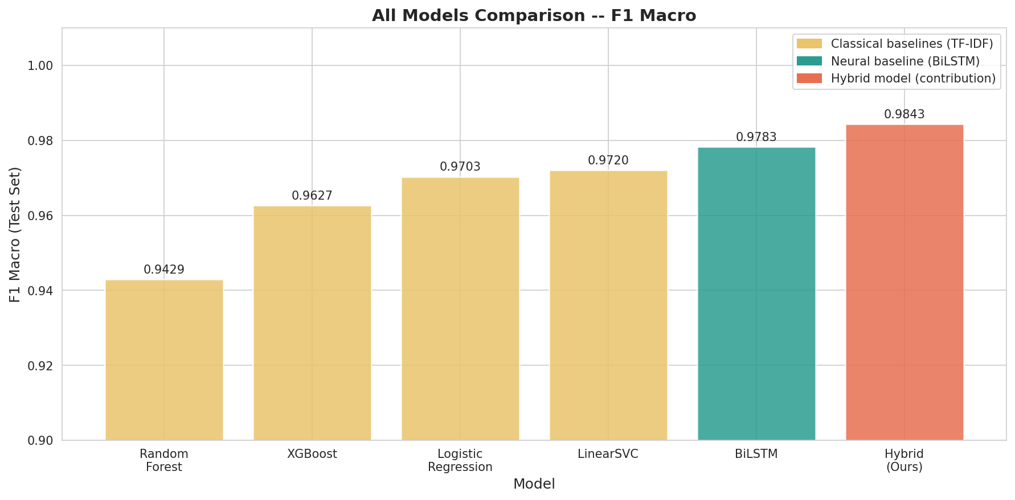
Model Comparison — All Results
Best Tree Model
Random Forest
94.29% F1
Best Classical
LinearSVC
97.20% F1
Neural Baseline
BiLSTM
97.83% F1
Our Contribution
Full Hybrid
98.43% F1
Beats Padalko et al. (2024) Att-BiLSTM 97.66% · All improvements statistically significant — McNemar p < 0.0001
9

Slide 10
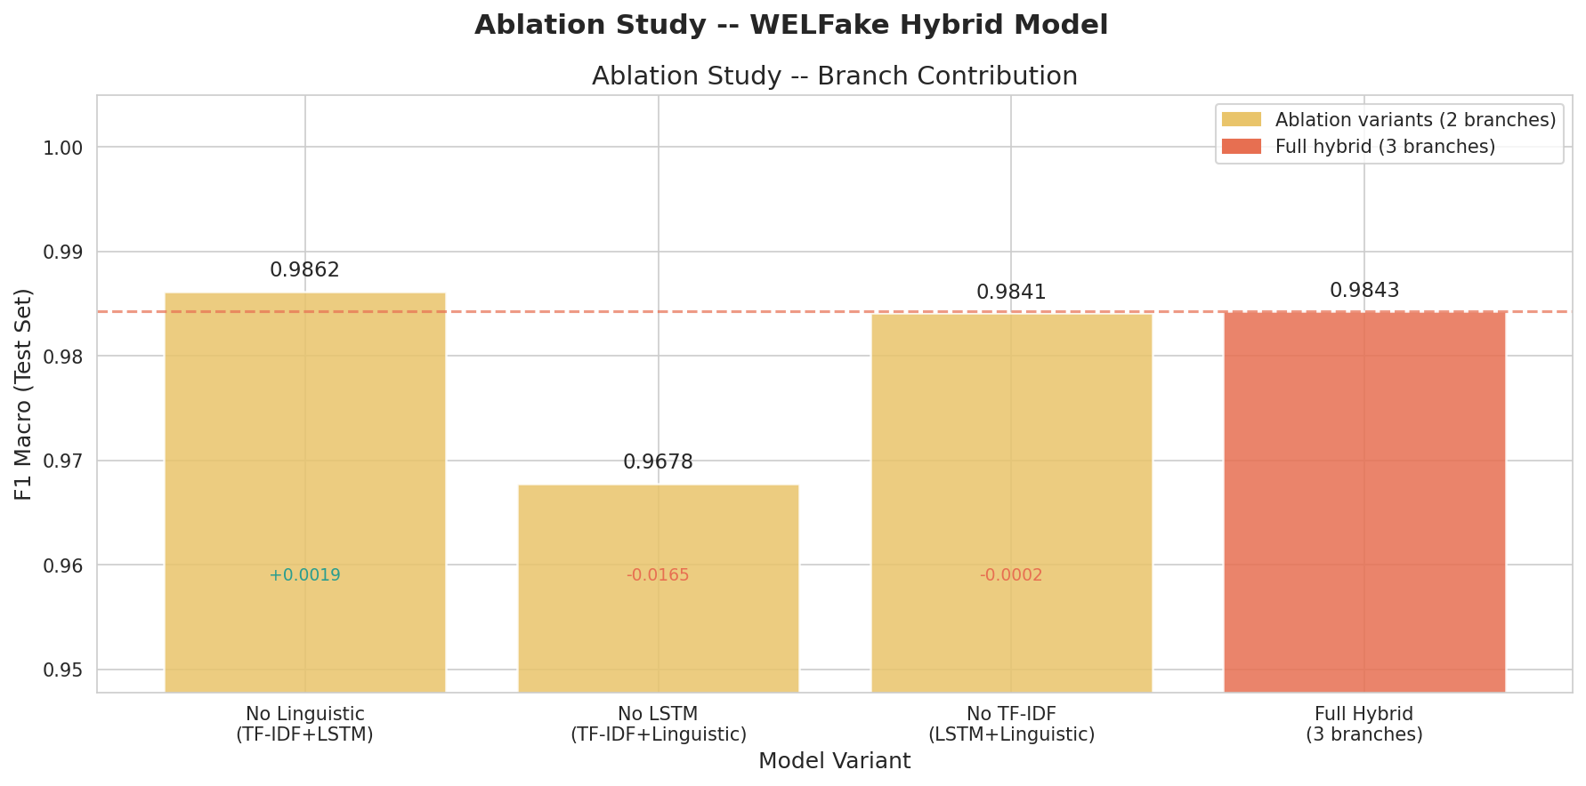
Ablation Study — Branch Contribution
Ablation study removes one branch at a time to quantify each component’s
individual contribution to performance. Three 2-branch variants trained with same optimal hyperparameters.
Most Critical Branch
GloVe / BiLSTM
Removing it: -1.65% F1
Least Critical Branch
Linguistic Features
Removing it: +0.19% F1
Best Overall Model
No-Linguistic Hybrid
TF-IDF + GloVe/BiLSTM
98.62% F1
Punctuation density and uppercase ratio showed near-zero variance across all articles after text normalization — contributing noise rather than signal to the fusion layer, slightly hurting performance.
10

Slide 11
Statistical Significance Testing
WHAT IS MCNEMAR’S TEST?
TEST RESULTS — 4 MODEL PAIRS
McNemar’s test checks whether performance
differences between two models are
statistically significant or due to
random chance.
Used here because both models are evaluated
on the SAME test set — predictions are paired.
p < 0.05 = improvement is real, not luck.
Pair | chi2 | p-value | Result
LinearSVC vs BiLSTM | 1350.44 | 0.0000 | ✓ Sig
BiLSTM vs Full Hybrid | 1878.97 | 0.0000 | ✓ Sig
LinearSVC vs No-Ling | 1736.94 | 0.0000 | ✓ Sig
Full Hybrid vs No-Ling | 3032.00 | 0.0000 | ✓ Sig
BiLSTM vs LinearSVC
BiLSTM correctly classified
170 articles
that LinearSVC failed on.
LinearSVC only beat BiLSTM
on 111 articles.
No-Linguistic vs LinearSVC
No-Linguistic correctly classified
180 articles
that LinearSVC failed on.
LinearSVC only beat hybrid
on 47 articles.
Full Hybrid vs No-Linguistic
chi2 = 3032.00
Removing linguistic features
is statistically beneficial.
The +0.19% gain is proven
real — not random.
All 4 comparisons significant at alpha = 0.05 · The +0.19% improvement from removing linguistic features is proven real — not random.
11

Slide 12
Future Work
1
Feature Engineering
2
Architecture
3
Models
Extract linguistic features
from raw uncleaned text to preserve
punctuation and uppercase
signals — the two features
that failed due to text
normalization in the current
preprocessing pipeline.
Replace MaxPool with an
attention mechanism over
BiLSTM to improve
interpretability and capture
more nuanced sequential
patterns across article
positions.
Explore transformer-based
models (BERT, RoBERTa) as
the sequence branch
replacing GloVe/BiLSTM
to leverage contextual
word representations
pretrained on much larger
corpora.
Current best: No-Linguistic Hybrid — 98.62% F1 · Beats Padalko et al. (2024) Att-BiLSTM 97.66% · McNemar p < 0.0001
12

