Slide 1
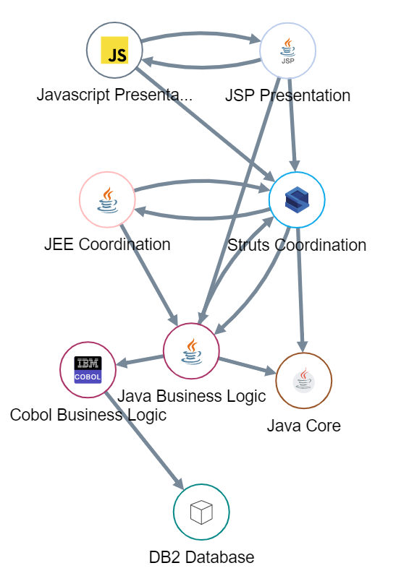







System-level vs. Line-level Code Analysis
Fundamental difference between CAST and SonarQube
CAST Application Intelligence Platform
SonarQube
Presentation Layer
Web, Mobile Apps
CAST System-level analysis models the flow across components and technology layers to analyze code the way an expert or an architect would.
Analogy : structure of the building
Sonar Line-level analysis examines each line or component individually to look for most common syntactical issues.
Analogy : quality of the bricks
Frameworks
System-level
Holistic, end to end analysis across the tech stack, including database and mobile apps
Unit-level
Without context of other components, no inter-dependencies
Business Logic
System-level flaws represent:
Only 8% of all defects
But 48% of the repair / rework efforts
And cause 90% of downtime / production issues
Data Layer Database
Scope of the analysis
“As organizations are under increasing pressure to accelerate software delivery, software code quality is no longer a "nice to have" but a necessity, hence the need for a system-level, architectural analysis of source code and applications' inner structure to deliver high-quality business applications.”

