Slide 1
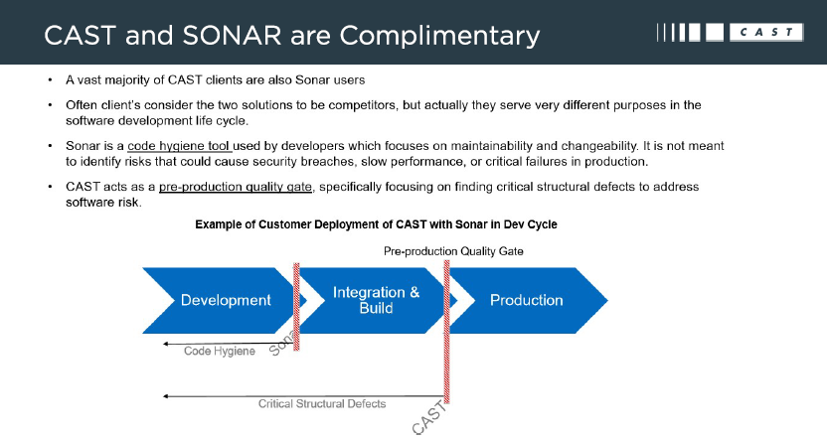
CAST Vs Sonar

Slide 2
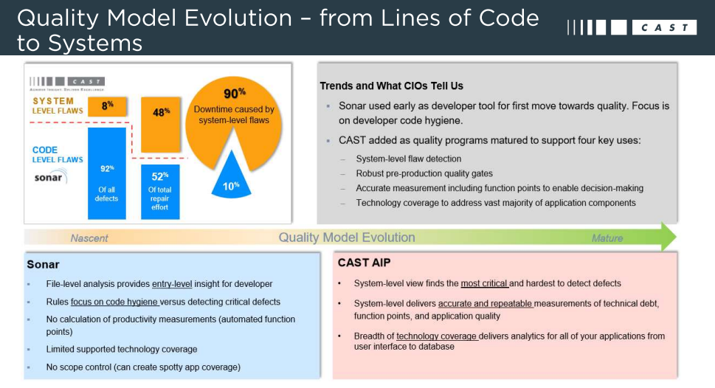
CAST Vs Sonar

Slide 3
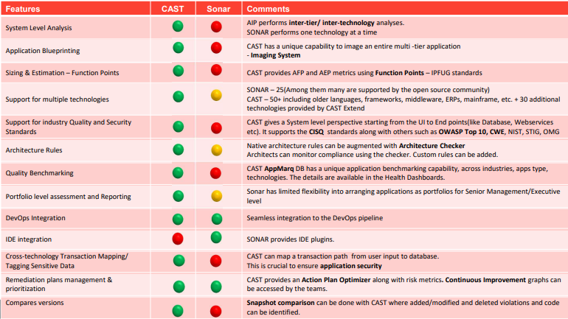
CAST Vs Sonar

