Slide 1
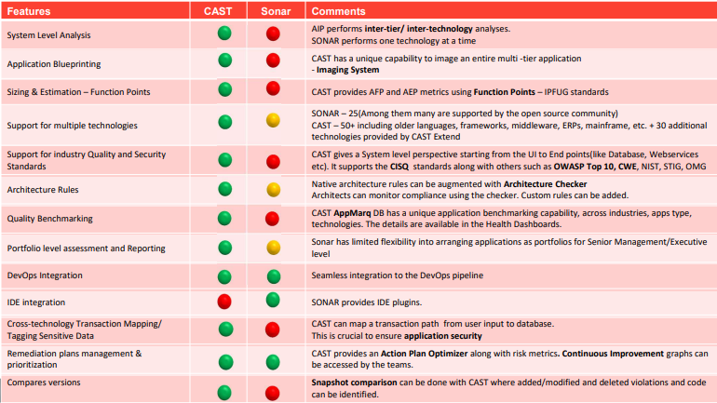
CAST Vs Sonar

