Slide 1

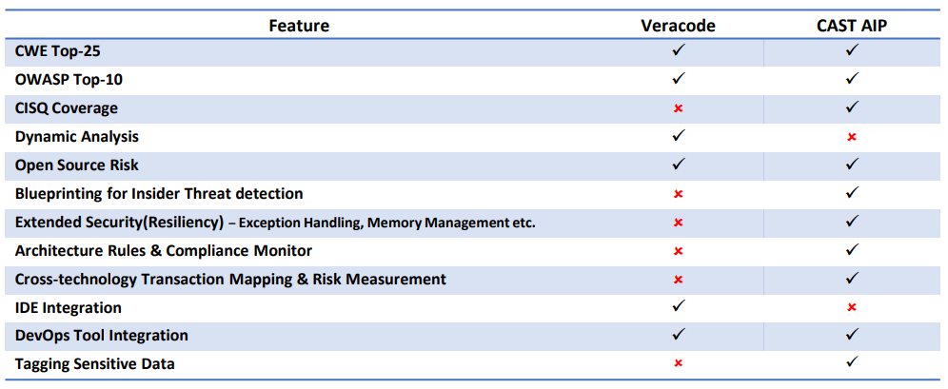
CAST Vs Veracode - General
 | Application Security Toolkit
 | SAST – Static Application Security Testing | DAST – Dynamic Application Security Testing | Software Composition Analysis
CAST
Veracode
CAST does not offer Dynamic Analysis as its focus is on Shift-Left to intercept the flaws before they reach production
Detailed Comparison

Slide 2
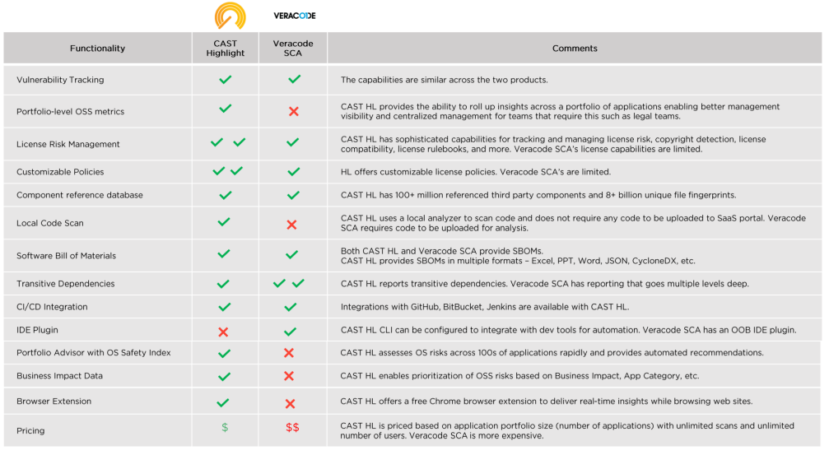
CAST Highlight Vs Veracode – Software Composition Analysis

