Slide 1
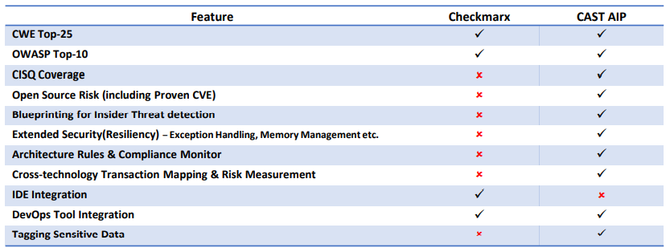
CAST vs Checkmarx
Features
Checkmarx
CAST AIP
Technology Coverage | Limited to 20+ technologies – mostly modern languages | Covers 50+ technologies, frameworks and databases
System Level Analysis | High level of false positives per analyst reports | Reduced false positives - Unique system level contextual analysis understands the structure of the application and uses that intelligence to weed out the irrelevant findings
Extended Security (Resiliency) | No extended security features | Extended security to the broader notion of resilience – ability to prevent outages, data corruption etc.
Insider Threats | Focusses only on walls and doors (CWE, OWASP) to secure the applications | Addresses insider threats

