Slide 1
PBL Project-31 Group 3

Slide 2
Project Aim
The title of this project is House Price Prediction Challenge and the aim of the project is to predict the house prices in India using regression algorithms.

Slide 3
Linear Regression
Linear Regression is a machine learning algorithm based on on supervised learning. It performs a regression task. Regression models a target prediction value based on independent variables. It is mostly used for finding out the relationship between variables and forecasting. Different regression models differ based on – the kind of relationship between dependent and independent variables, they are considering and the number of independent variables being used.

Slide 4
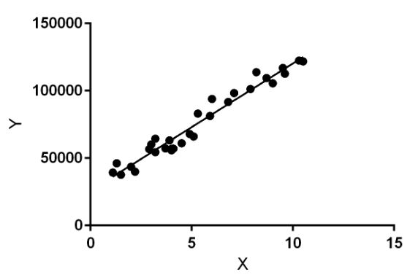

Slide 5
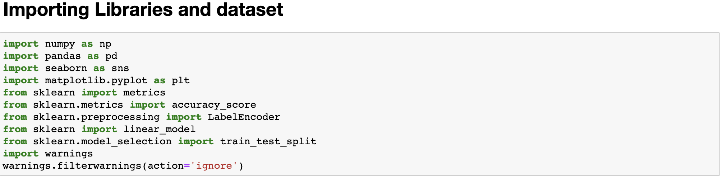
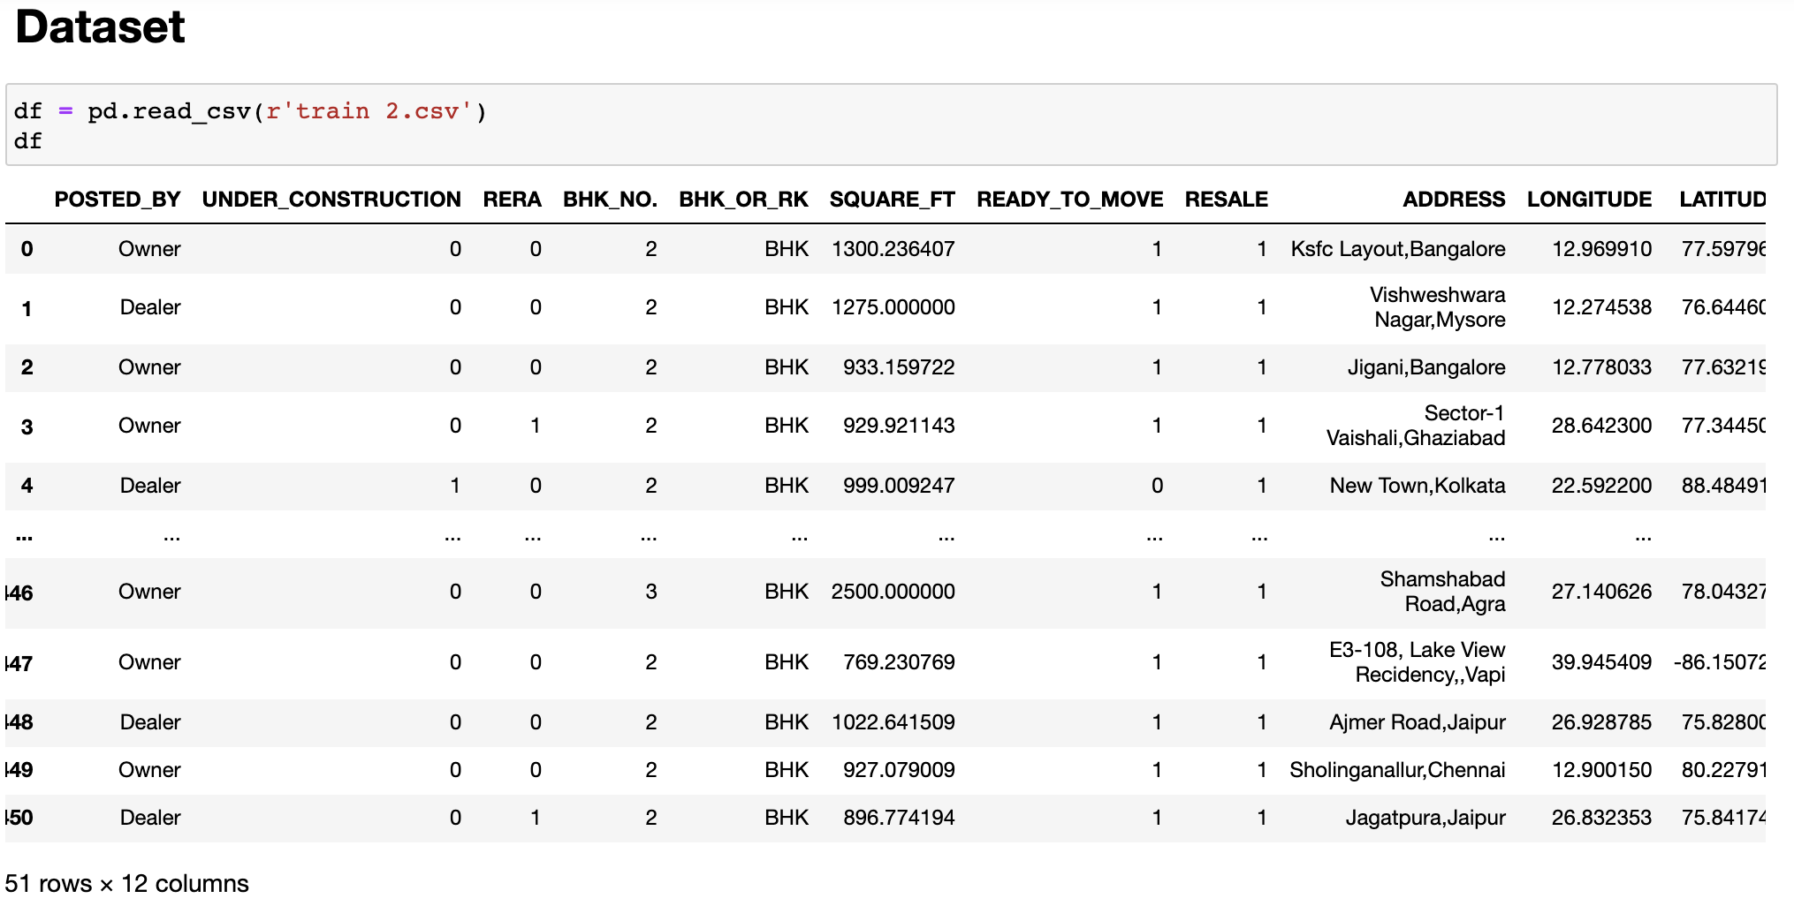
Importing Libraries and Dataset

Slide 6
Preprocessing
Data preprocessing is a crucial step that helps to enhance the quality of data to extract meaningful insights from the data. Data preprocessing refers to the technique of preparing (cleaning and organizing) the raw data to make it suitable for a building and training models. In simple words, data preprocessing is a data mining technique that transforms raw data into an understandable and readable format.
df.head()
df.info()
df.describe()
df.isnull().sum()

Slide 7
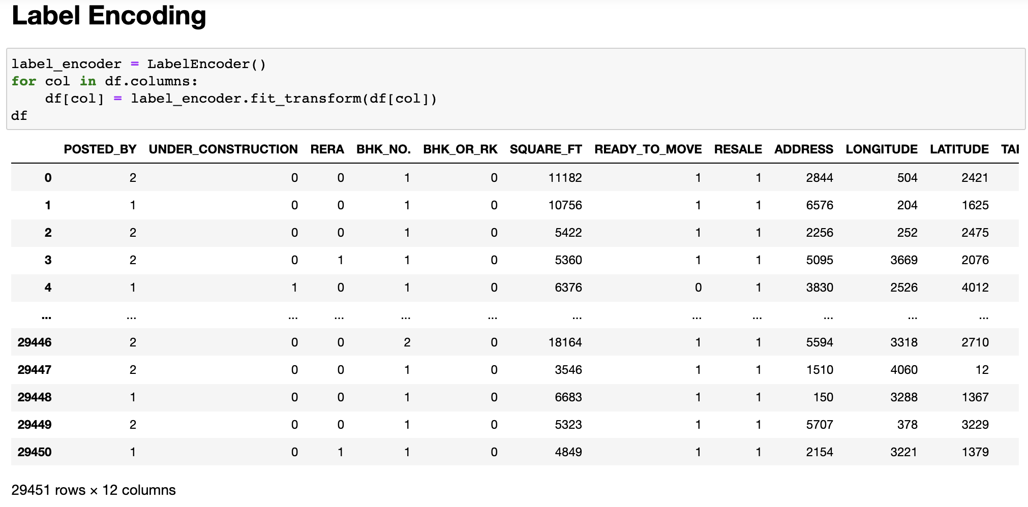
Label Encoding
Label Encoding refers to converting the labels into a numeric form so as to convert them into the machine-readable form. Machine learning algorithms can then decide in a better way how those labels must be operated. It is an important pre-processing step for the structured dataset in supervised learning.

Slide 8
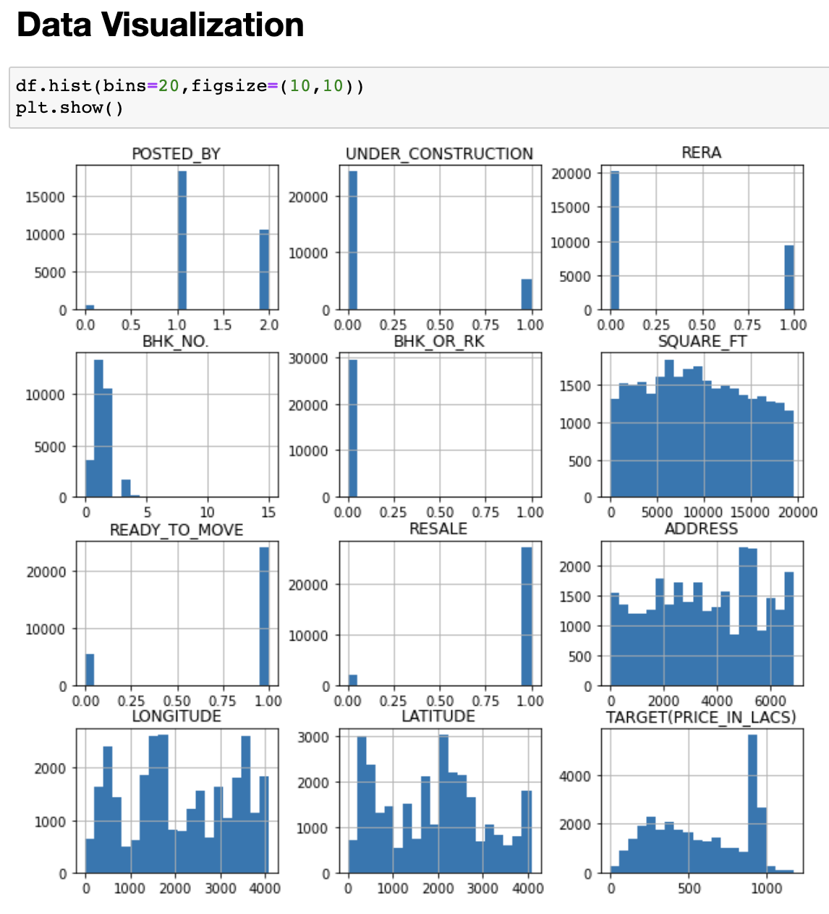
Data Visualization

Slide 9
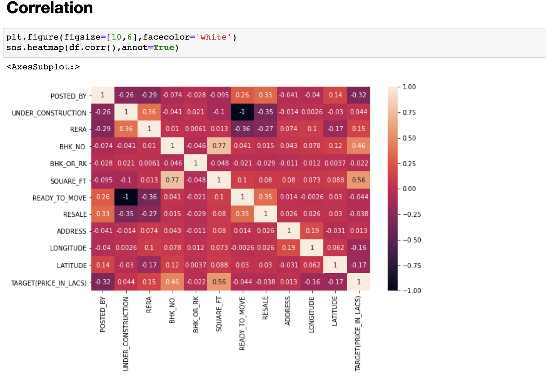
Correlation

Slide 10
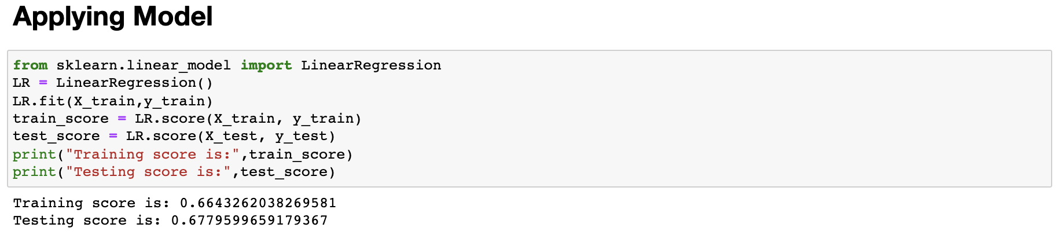
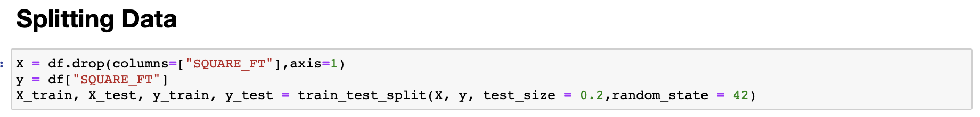
Splitting the dataset and obtaining training and testing scores

Slide 11
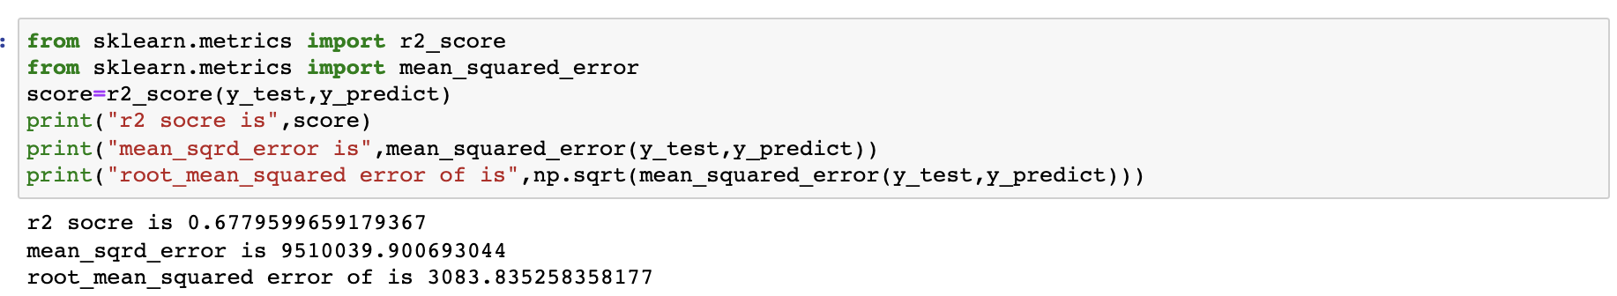
Predicting r2score,mean_sqrd_error and root_mean_squared error

Slide 12

Thank you

