Slide 1
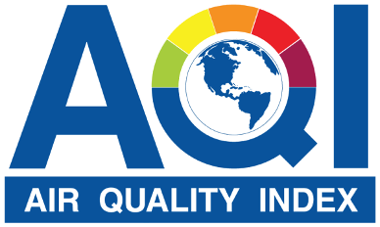
DELHI
ANALYSIS
Siddharth Chaudhary
2k21/ec/219

Slide 2
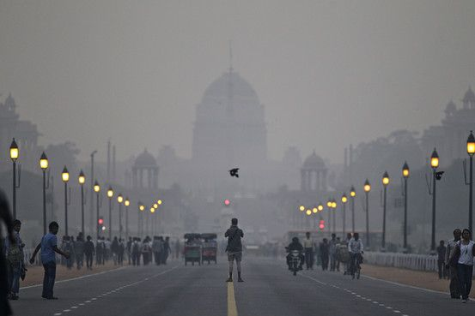
outline
introduction
Why this topic?
Key Performance indicator (kpi)
analysis
suggestions

Slide 3
introduction
Welcome to our presentation on the analysis and visualization of Delhi's Air Quality Index (AQI). Air quality has become a critical concern for urban environments, especially in densely populated cities like Delhi. This presentation aims to explore the trends, patterns, and implications of AQI data in Delhi, providing insights through comprehensive data analysis and visualizations.

Slide 4
Why this topic?
Delhi is one of the most polluted cities in the world, and understanding the AQI trends helps identify the main pollution sources and their effects on the environment. This analysis provides actionable insights for policymakers, environmentalists, and the public to develop effective strategies for reducing pollution and improving air quality. By focusing on the AQI, we aim to raise awareness, inform policy decisions, and contribute to the ongoing efforts to create a healthier and more sustainable urban environment.

Slide 5

Steps involved
Gather air quality data from various sources, such as government monitoring stations, sensors, or satellite imagery.
Calculate the aqi using standardized formulas and guidelines provided by environmental agencies.
Create visualizations, such as line charts or heatmaps, to represent the AQI over time or across geographical regions.
Compare the AQI metrics with the recommended air quality metrics.

Slide 6

Key Performance indicator (kpi)
Time Series Analysis of Air Pollutants in Delhi
AQI of Delhi in January month
AQI Category Distribution Over Time
Pollutant Concentrations in Delhi
Correlation Between Pollutants
Hourly Average AQI Trends in Delhi (Jan 2023)
Average AQI by Day of the Week

Slide 7

analysis

Slide 8
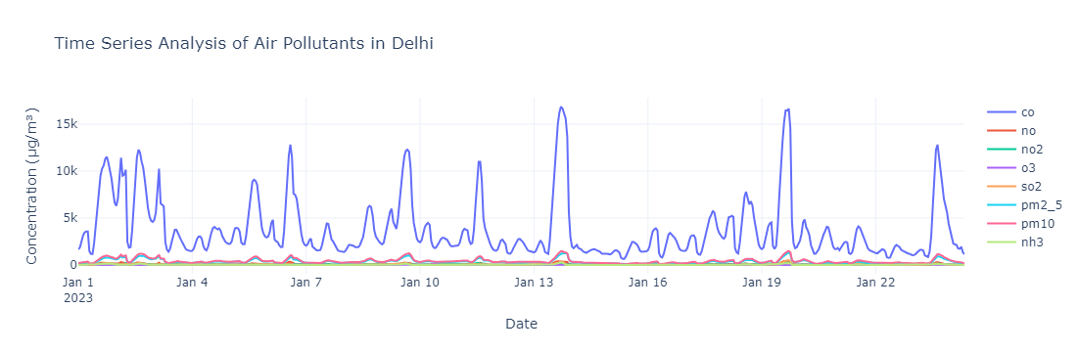
CO levels (shown in blue) are significantly higher than the other pollutants, with several spikes reaching concentrations above 10,000 µg/m³.
Periodic spikes in CO concentration occur throughout the month, indicating potential episodes of higher pollution.

Slide 9
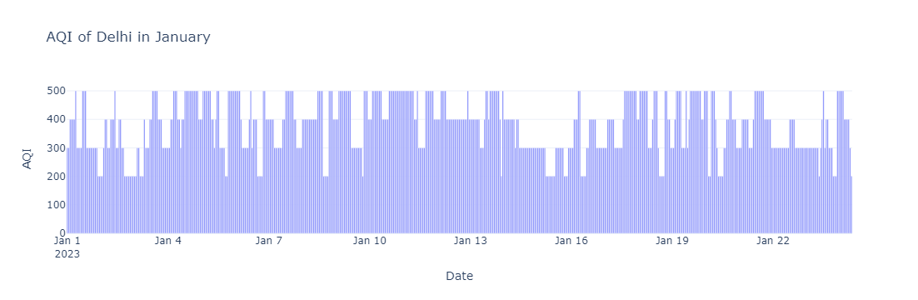
The AQI fluctuates significantly within the month, with values ranging from below 100 to close to 500.
The data indicates that air quality in Delhi remains predominantly in the unhealthy range for most of January.

Slide 10
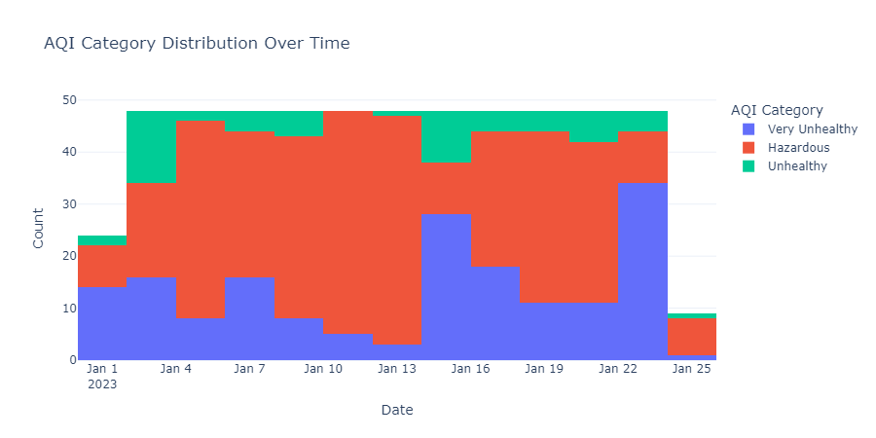
The majority of the days fall into the "Hazardous" category, indicating severe levels of air pollution.
The "Very Unhealthy" category is also prominent, particularly in the middle of the month.
The data suggests that air quality in Delhi frequently reaches levels that pose significant health risks.

Slide 11
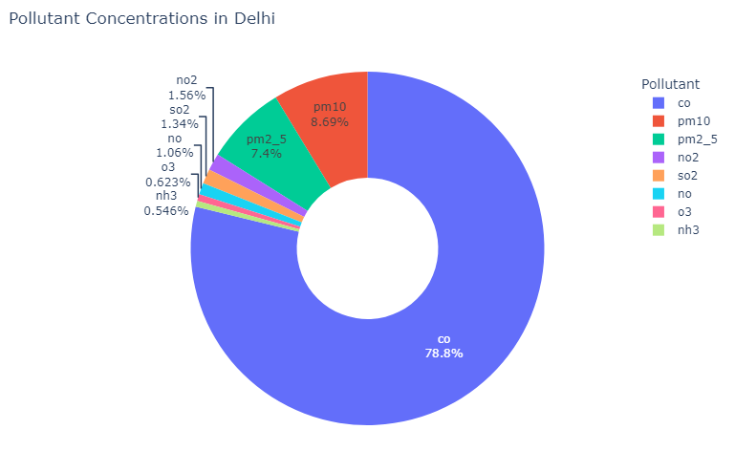
The majority of the pollution is due to CO, followed by PM10 and PM2.5, which are common indicators of air quality and can have significant health impacts. Other pollutants like NO2, SO2, NO, O3, and NH3 are present in much smaller concentrations.

Slide 12
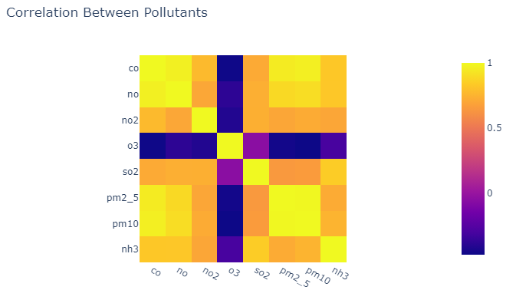
The correlation matrix shows the relationship between different air pollutants. Positive correlations among CO, NO, NO2, SO2, PM2.5, PM10, and NH3 suggest common sources or similar pollution patterns. In contrast, O3 has an inverse relationship with these pollutants, likely due to its dual role as a pollutant and a natural atmospheric oxidant.

Slide 13
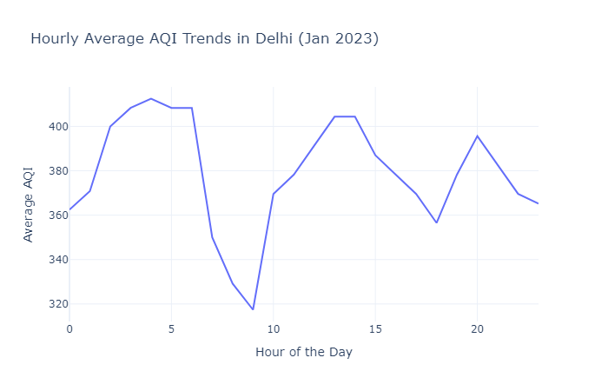
This pattern suggests a variation in air quality throughout the day, with higher pollution levels during late night and early morning hours, a decrease during early morning, and fluctuations throughout the day.

Slide 14
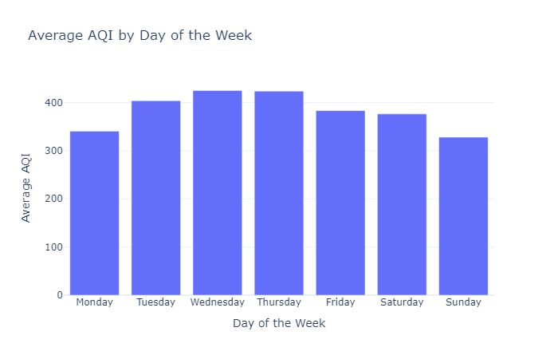
Most weekdays in Delhi have a high AQI, averaging between 320 and 400.
The pattern suggests that air pollution in Delhi is severe all weekdays,.

Slide 15
Summary
Air Quality Index (AQI) analysis is crucial for understanding and managing environmental quality, particularly in highly polluted areas like Delhi. Key contributors to Delhi's poor AQI include vehicular emissions, which release pollutants such as nitrogen oxides and particulate matter; industrial emissions from factories; dust from construction activities; agricultural burning in surrounding regions; and waste burning practices. Each of these factors adds significantly to the overall air pollution, impacting public health and environmental quality. Monitoring and analyzing AQI helps in assessing these contributions and formulating effective strategies for improvement.

Slide 16

Thank you

