Slide 1
PIZZA SALES ANALYSIS
Contents:
Database Source
Key Performance Indicator(KPI)
Power BI Visualisation
Information Extracted
Tips

Slide 2
Database Source:
Click Here
Key Performance Indicator(KPI) consider are:
1. Total Revenue 2. Avg Order Value
3. Total Pizza Sold 4. Total Order
5. Avg Pizza Per Order 6. Sales by Weekdays
7. Sales by Months 8. %tage of sale by pizza_category
9. %tage of sale by pizza_size 10. Total pizza sold by pizza_category
11. Top 5 pizza by Total_Revenue 12. Bottom 5 pizza by Total_Revenue
13. Top 5 by Total_Quantity 14. Bottom 5 pizza by Total_Quantity

Slide 3
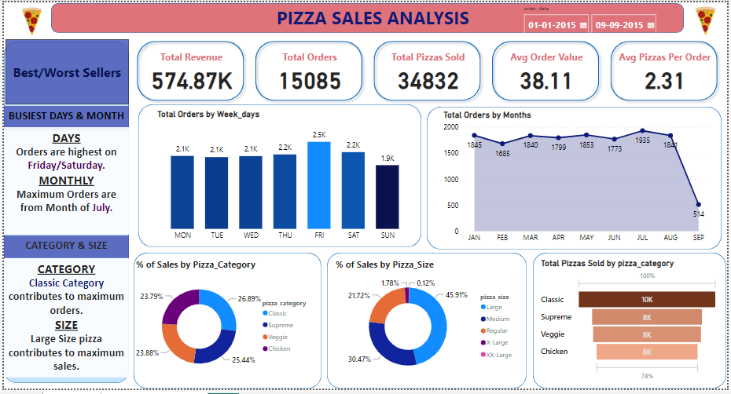
Power BI Visualisation

Slide 4
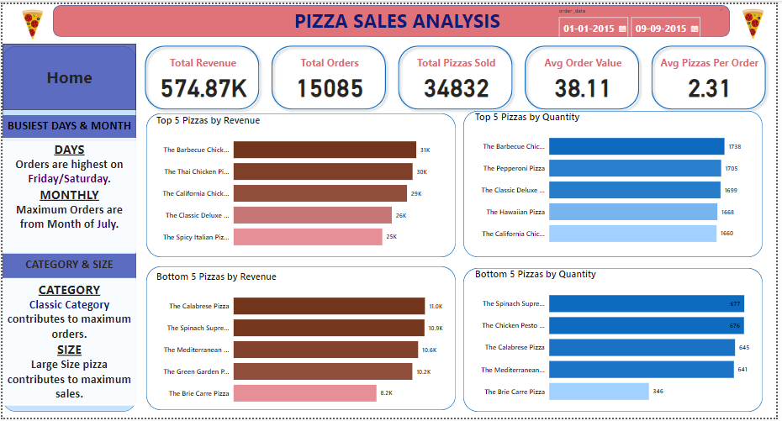

Slide 5
Information Extracted
BUSIEST DAYS:
Orders are highest on Friday/Saturday
BUSIEST MONTH:
Maximum Orders are from Month of July
CATEGORY & SIZE:
Classic Category contributes to maximum orders
Supreme Category contributes to minimum orders
SIZE:
Large Size pizza contributes to maximum sales
XX-Large pizza contributes to minimum sales

Slide 6
Tips
FEEDBACK AND COMPLAINT ANALYSIS: Complaints to identify common issues.
EXPANSION OPPORTUNITIES: Identify areas with high demand.
PROMOTIONAL STRATEGY: On peak sales days/months plan promotional campaigns.
Consider offering discounts or specials during slower periods to boost sales.

