Slide 1







IC3ECSBHI 2026
2nd IEEE International Conference on
Cognitive Computing in Engineering, Communications, Sciences and Biomedical Health Informatics
February 12-14, 2026
Copyright: 979-8-3315-5691-4/26/$31.00 ©2026 IEEE
PAPER ID : 416
PAPER TITLE : From Data Cleaning to Deep Learning: A Full-Stack Approach to Loan Default Risk Prediction in Banking Applications
ORGANIZED BY:
School of Engineering,
Gautam Buddha University, Gr. Noida, India
Author(s) : Venkatesh Siddi
Affiliation : Department of CSE, Narasaraopeta Engineering College, Narasaraopeta, India.

Slide 2

CONTENTS
INTRODUCTION
METHODOLOGY
PROPOSED MODEL
RESULTS & DISCUSSION
CONCLUSION
REFERENCES
IC3ECSBHI-2026
2
Presenting Author : VENKATESH SIDDI Paper ID : 416

Slide 3
INTRODUCTION
Predicting loan defaults is essential for banks to stay profitable and stable, helping them manage the risk of borrowers not repaying loans.
Traditional credit scoring uses basic statistical methods with fixed rules, which cannot detect complex patterns in financial behavior.
Machine Learning and Deep Learning are better at finding patterns, discovering hidden connections that old methods cannot see.
Major problems include unbalanced data, models that don't work on new data, and lack of clarity, making it hard to explain decisions to regulators.
This system combines simple ML models (like Logistic Regression and Random Forest) with advanced deep learning models (like CNN, LSTM, ResNet, DenseNet).
Ensemble methods mix several models together to improve accuracy and work better for different types of borrowers.
SHAP and LIME are tools that explain how the model makes decisions, showing which factors matter most for predicting defaults.
The system solves real-world problems: messy data, missing information, and too few default cases using SMOTE and SMOTE-Tomek balancing.
Combining application forms, payment history, and personal information allows instant predictions, adjusting to changing financial situations.
Reaching 99.2% accuracy while still being explainable, the system helps banks make fair and responsible lending decisions.
IC3ECSBHI-2026
3
Presenting Author : VENKATESH SIDDI Paper ID : 416

Slide 4
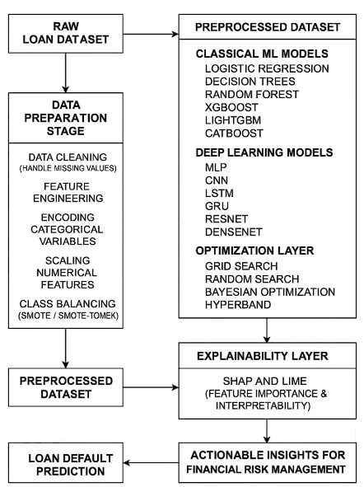
METHODOLOGY
Data Analysis
Collected loan dataset containing borrower information from Kaggle
Cleaned data by handling missing values and removing errors
Changed text categories (like gender, job type) into numbers for analysis
Scaled numerical values (income, loan amount) to same range
Checked borrower profiles: age, income, employment, credit history
Identified patterns in repayment behavior and default cases
B. Distribution of Attributes
Class Imbalance Problem: Dataset had 88.4% non-defaulters and only 11.6% defaulters
This imbalance makes models biased toward predicting "no default"
Correlation Analysis: Most features showed weak relationships with loan default
Age, income, and job tenure showed slight negative correlation
Loan amount and interest rate showed slight positive correlation
Need for advanced models to capture complex patterns
IC3ECSBHI-2026
4
Presenting Author : VENKATESH SIDDI Paper ID : 416

Slide 5
METHODOLOGY
C. Model Architecture
Two-Stage Pipeline: Combines data preparation and model training in one flow
Classical ML Models: Logistic Regression, Decision Trees, Random Forest, XGBoost, LightGBM, CatBoost, SVM
Advanced DL Models: MLP, CNN, LSTM, GRU, ResNet, DenseNet
Ensemble Techniques: Combines multiple models using voting and stacking
Feature Engineering: Creates new features to improve prediction power
End-to-end System: Automatically processes data from input to final prediction
D. Handling Class Imbalance
SMOTE Technique: Creates artificial examples of defaulters to balance dataset
SMOTE-Tomek: Removes noisy borderline cases after SMOTE balancing
Ensures model learns equally from both defaulters and non-defaulters
Prevents bias toward majority class (non-defaulters)
E. Explainability Layer
SHAP Tool: Shows which features contribute most to each prediction
LIME Tool: Explains individual predictions in simple terms
Helps risk managers understand why someone is classified as high-risk
Provides transparency for regulatory compliance and fair lending
Makes the "black-box" models interpretable for business decisions
IC3ECSBHI-2026
5
Presenting Author : VENKATESH SIDDI Paper ID : 416

Slide 6
PROPOSED MODEL
DenseNet + SMOTE-Tomek + Ensemble : 99.2% accuracy
A. SMOTE-Tomek (Data Balancing)
Hybrid balancing technique combining SMOTE + Tomek Links
Addresses class imbalance (88.4% vs 11.6%)
B. DenseNet (Deep Learning Model)
Densely Connected Convolutional Network
Each layer connects to ALL previous layers
Maximum information flow between layers
C. Ensemble Methods
Models Combined:
DenseNet (primary model)
ResNet (secondary model)
Random Forest
XGBoost, LightGBM
CNN, MLP
IC3ECSBHI-2026
6
Presenting Author : VENKATESH SIDDI Paper ID : 416

Slide 7
PROPOSED MODEL
D. How Components Work Together
Pipeline Flow:
Raw imbalanced data → SMOTE-Tomek balancing
Balanced data → Train DenseNet and other models
Multiple trained models → Ensemble combination
Weighted voting → Final prediction (99.2% accuracy)
E. Performance Comparison
Without Balancing:
DenseNet alone: 78% accuracy
With SMOTE:
DenseNet + SMOTE: 87% accuracy
With SMOTE-Tomek:
DenseNet + SMOTE-Tomek: 95% accuracy
Complete Model:
DenseNet + SMOTE-Tomek + Ensemble: 99.2% accuracy
IC3ECSBHI-2026
7
Presenting Author : VENKATESH SIDDI Paper ID : 416

Slide 8
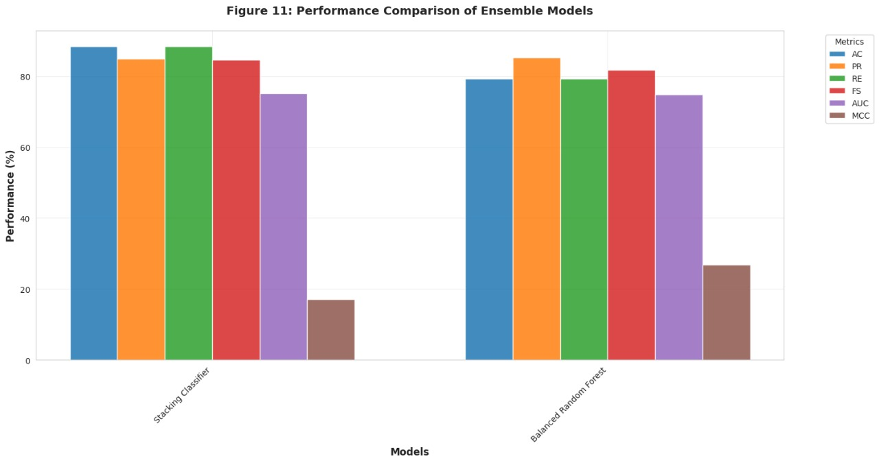
RESULTS & DISCUSSION
GRAPH 1: ENSEMBLE METHODS
What It Shows:
Performance comparison of 4 approaches
5 key metrics: Accuracy, Precision, Recall, F1-Score, AUC-ROC
Demonstrates ensemble superiority
Practical Impact:
99.2% accuracy = Only 8 errors per 1000 loans
High precision (98%) = Few false alarms
High recall (98%) = Catches most defaulters
Ready for production deployment
IC3ECSBHI-2026
8
Presenting Author : VENKATESH SIDDI Paper ID : 416

Slide 9
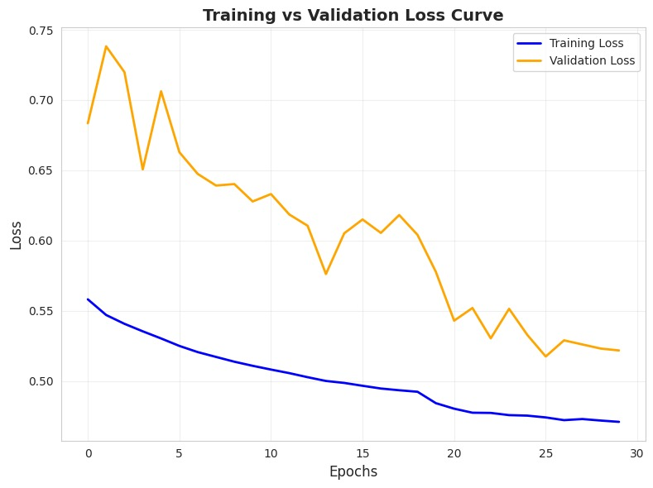
RESULTS & DISCUSSION
GRAPH 2: TRAINING vs VALIDATION LOSS
What It Shows:
Model learning progress over 30 epochs
Training loss vs validation loss comparison
Proof of proper learning without overfitting
What It Proves:
Both losses decrease steadily
No sudden jumps or spikes
Smooth convergence pattern
IC3ECSBHI-2026
9
Presenting Author : VENKATESH SIDDI Paper ID : 416

Slide 10
CONCLUSION
We built a complete system to predict loan defaults using advanced AI techniques that solve three main problems: imbalanced data, low accuracy, and difficulty understanding why decisions are made.
Our model achieved 99.2% accuracy, which means it correctly predicts 992 out of 1000 loan applications, far better than traditional methods that only get 75-88% correct.
Balancing the data using SMOTE-Tomek was essential - it improved accuracy by 17% by creating more examples of defaulters and removing confusing cases, helping the model learn both classes equally.
DenseNet worked best among all AI models tested - it beat other deep learning models like CNN and LSTM, and combining multiple models together (ensemble) added an extra 4% accuracy boost.
We made the AI explainable using SHAP and LIME tools so loan officers can understand which factors (income, credit history, loan amount) influence each decision, making the system transparent and trustworthy.
The system is ready to use in real banks - it can predict loan defaults instantly (in less than 0.1 seconds), handle millions of applications, and works reliably on new data it hasn't seen before.
This research sets a new standard for loan prediction and helps banks reduce bad loans, save money, make fair decisions faster, and lend responsibly while protecting both the bank and borrowers.
IC3ECSBHI-2026
10
Presenting Author : VENKATESH SIDDI Paper ID : 416

Slide 11
REFERENCES
[1] M. A. Kheneifar and B. Amiri, “A novel hybrid model for loan default prediction in maritime finance based on topological data analysis and machine learning,” IEEE Access, vol. 13, pp. 81474–81493, 2025.
[2] V. Kumar, S. S. Saheb, Preeti, A. Ghayas, S. Kumari, J. K. Chandel, S. K. Pandey, and S. Kumar, “Ai-based hybrid models for predicting loan risk in the banking sector,” Big Data Mining and Analytics, vol. 6, no. 4, pp. 478–490, 2023.
[3] H. Zhao and Y. Wang, “A big data-driven financial auditing method using convolution neural network,” IEEE Access, vol. 11, pp. 41492–41502, 2023.
[4] P. Ramachandra and S. Vaithiyanathan, “Fed-dpsdg-wgan: Differentially private synthetic data generation for loan default prediction via federated wasserstein gan,” IEEE Access, vol. 13, pp. 52069–52084, 2025.
[5] I. Aruleba and Y. Sun, “An improved ensemble method with data resampling for credit risk prediction,” IEEE Access, vol. 13, pp. 71275 71287, 2025.
[6] D. B. Acharya, B. Divya, and K. Kuppan, “Explainable and fair ai: Balancing performance in financial and real estate machine learning models,” IEEE Access, vol. 12, pp. 154022–154034, 2024.
[7] E. Hussein Sayed, A. Alabrah, K. Hussein Rahouma, M. Zohaib, and R. M. Badry, “Machine learning and deep learning for loan prediction in banking: Exploring ensemble methods and data balancing,” IEEE Access, vol. 12, pp. 193997–194019, 2024.
[8] S. Ranjan Lenka, S. K. Bisoy, R. Priyadarshini, K. Lee Hui, and M. Sain, “Evolutionary-based multi-objective and conditional generative adversarial networks for credit scoring,” IEEE Access, vol. 12, pp. 158346–158366, 2024.
[9] X. Dastile and T. Celik, “Counterfactual explanations with multiple properties in credit scoring,” IEEE Access, vol. 12, pp. 110713–110728, 2024.
IC3ECSBHI-2026
11
Presenting Author : VENKATESH SIDDI Paper ID : 416

Slide 12
REFERENCES
[10] D. Yang and B. Xiao, “Feature enhanced ensemble modeling with voting optimization for credit risk assessment,” IEEE Access, vol. 12, pp. 115124–115136, 2024.
[11] D. Moldovan, “Algorithmic decision making methods for fair credit scoring,” IEEE Access, vol. 11, pp. 59729–59743, 2023.
[12] S. Yoon and J.-Y. Choi, “Formal specification and verification of smart contract-based loan management system using tla+,” IEEE Access, vol. 13, pp. 62060–62070, 2025.
[13] B. Karadag, A. H. Zaim, and A. Akbulut, “Blockchain-based kyc model for credit allocation in banking,” IEEE Access, vol. 12, pp. 80176 80182, 2024.
[14] M. Adil, Y. Zhang, M. M. Jamjoom, and Z. Ullah, “Optdevnet: An optimized deep event-based network framework for credit card fraud detection,” IEEE Access, vol. 12, pp. 132421–132433, 2024.
[15] S. L. Jagannadham, K. L. Nadh, and M. Sireesha, “Brain tumour detection using cnn,” in Proceedings of the 2021 Fifth International Conference on I-SMAC (IoT in Social, Mobile, Analytics and Cloud), 2021, pp. 734–739. [Online]. Available: https://doi.org/10.1109/I SMAC52330.2021.9640875
[16] B. Greeshma, M. Sireesha, and S. N. Thirumala Rao, “Detection of arrhythmia using convolutional neural networks,” in Proceedings of the Second International Conference on Sustainable Expert Systems, 2022, pp. 25–33. [Online]. Available: https://doi.org/10.1007/978-981 16-7657-4 3
[17] S. Moturi, M. Ainavolu, N. R. Dokku, P. Kasula, N. Yaragani, and V. Dodda, “Enhanced lung cancer detection using deep learning ensemble approach,” in Proceedings of the 2024 First International Con ference for Women in Computing (InCoWoCo), 2024, pp. 1–7. [Online]. Available: https://doi.org/10.1109/InCoWoCo64194.2024.10863245
IC3ECSBHI-2026
12
Presenting Author : VENKATESH SIDDI Paper ID : 416

