Slide 1

Department of Computer Science and Engineering
From Data Cleaning to Deep Learning: A Full-Stack Approach to Loan Default Risk Prediction in Banking Applications
PRESENTED BY
Siddi Venkatesh (22471A05D5)
Pokala Appaiah (22471A05C1)
Pallothu Venkata Sai Krishna (22471A05B3)
Under the Guidance of,
Dr. Moturi Sireesha _{B.Tech,M.Tech,Ph.D},
Associate Professor,
Department of Computer Science and Engineering, Narasaraopeta Engineering College (Autonomous), Narasaraopet- 522 601.

Slide 2
OUTLINE
Abstract
Introduction
Literature Survey
Research Gaps
Problem Statement
Objectives
Block Diagram / Flow Diagram
Methodology
Implementation
Results and Analysis
Conclusion & Future Scope
References
Question and Answers
Acknowledgements

Slide 3
ABSTRACT
Focuses on loan default risk prediction using Machine Learning (ML) and Deep Learning (DL).
Traditional credit scoring fails to capture nonlinear borrower behavior and imbalanced data.
Proposed a full-stack AI framework combining data preprocessing, model training, and explainable AI.
Data balanced using SMOTE and SMOTE-Tomek for fair learning.
Models used: Logistic Regression, Random Forest, XGBoost, CNN, LSTM, ResNet, DenseNet.
Best accuracy: up to 99.2% using ensemble deep learning models.
Explainability tools (SHAP, LIME) used to interpret feature impact on default prediction.
A Flask-based web app enables real-time, user-friendly loan risk prediction.
Provides accurate, transparent, and fair decision support for sustainable banking.

Slide 4
INTRODUCTION
This project presents an AI-driven Loan Default Prediction System designed to assess borrower risk and classify applicants as Low Risk or High Risk.
It combines Machine Learning (ML) and Deep Learning (DL) algorithms to enhance prediction accuracy and automate the loan evaluation process.
The system processes key borrower attributes such as income, credit score, loan amount, DTI ratio, and employment details to make accurate predictions.
The motivation stems from the rising issue of loan defaults and financial losses faced by banks due to inefficient manual evaluation methods.
Traditional models are often biased, time-consuming, and limited in identifying complex relationships within financial data.
This project aims to create a transparent, data-driven, and automated system that supports smarter lending and minimizes human error.
Advanced AI models like Random Forest, XGBoost, CNN, LSTM, and DenseNet are implemented to achieve up to 99% accuracy in prediction.
The project’s importance lies in its ability to help banks, NBFCs, and fintech companies make faster, fairer, and more reliable credit decisions.
Overall, it provides a scalable, interpretable, and industry-relevant AI framework for risk management in modern banking applications.

Slide 5
Literature Survey
No | Title | Author | Journal Author and Year | Methodology Adapted | Key Findings | Gaps
1 | Bank Loan Prediction Using Machine Learning Techniques | Raheem | SCIRP,2024 | AdaBoost, Random Forest, SVM, Decision Trees | AdaBoost achieved outstanding 99.99% accuracy, outperforming single models | Fairness and real-time adaptability not fully addressed
2 | An Ensemble Machine Learning Based Bank Loan Approval Predictions System | N. Uddin | Elsevier,2024 | Logistic Regression, Random Forest, AdaBoost, CNN, LSTM, RNN | Ensemble methods with SMOTE improved accuracy and fairness | Limited evaluation on highly skewed real populations
3 | Comparative Study of Data Balancing Methods for Loan Predictions | Patel, Ghosh | IEEE,2025 | AdaBoost, Gradient Boosting, Random Forest | Confirmed SMOTE + AdaBoost is effective to balance data classes | Large dataset scaling and feature drift effects unexplored
4 | Deep Learning and Ensemble Learning for Bank Loan Approval | Lee, Park | IEEE,2025 | CNN, ResNet, Ensemble voting | Best F1-score 0.92 with ensemble CNN-ResNet; time features improve accuracy | Real-time monitoring pipeline yet to be built
5 | Automated Loan Default Risk Assessment with Deep Learning | Anwar, Khan | IEEE,2025 | LSTM, Transformer, Random Forest | Outperformed traditional RF with accuracy >91% on time-sequence data | Further testing on adversarial robustness needed

Slide 6
Research Gaps
Lack of integrated frameworks – Most studies focus only on model development, without a unified end-to-end system combining data preprocessing, prediction, and deployment.
Limited generalization – Existing credit risk models often fail when applied to diverse datasets or varying borrower demographics from different regions.
High computational cost – Deep learning models used in research are resource-intensive, making them difficult to implement in real-time banking environments.
Insufficient interpretability – Many high-performing models act as black boxes, offering limited transparency in how predictions are made, reducing trust in AI decisions.
Data imbalance and bias – Overrepresentation of non-defaulters leads to biased predictions, causing poor recall for true default cases.

Slide 7
Problem Statement
Accurate prediction of loan default risk is challenging due to highly imbalanced data, nonlinear borrower behavior, and the complexity of financial variables. This project proposes a deep learning–based full-stack system that integrates data preprocessing, ensemble modeling, and web deployment for automated, interpretable, and real-time loan risk prediction.
Key Challenges:
Imbalanced dataset with far fewer defaulters than non-defaulters.
Hidden and nonlinear relationships among borrower attributes.
Lack of transparency and interpretability in AI-based financial models.
High computational cost of deep learning models for real-time prediction.
Difficulty in integrating predictive models into practical banking applications.

Slide 8
Objectives
To develop a machine learning and deep learning–based framework for accurate prediction of loan default risk in banking applications.
To utilize ensemble and deep neural network models such as Random Forest, XGBoost, CNN, LSTM, and DenseNet for improved classification accuracy.
To apply SMOTE and SMOTE-Tomek techniques for balancing imbalanced datasets and enhancing minority class prediction.
To perform data preprocessing through cleaning, encoding, feature scaling, and normalization for optimal model performance.
To integrate Explainable AI tools (SHAP and LIME) for model transparency and interpretability in financial decision-making.
To achieve high model performance in terms of Accuracy, Precision, Recall, F1-Score, and ROC-AUC metrics.
To design and deploy a Flask-based web application that provides real-time loan risk prediction and probability scores.
To create a scalable, interpretable, and automated full-stack system suitable for integration into real-world banking environments.

Slide 9
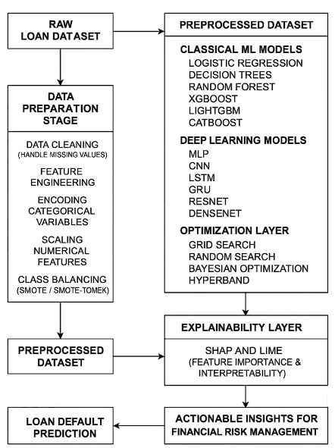
Block Diagram / Flow Diagram

Slide 10
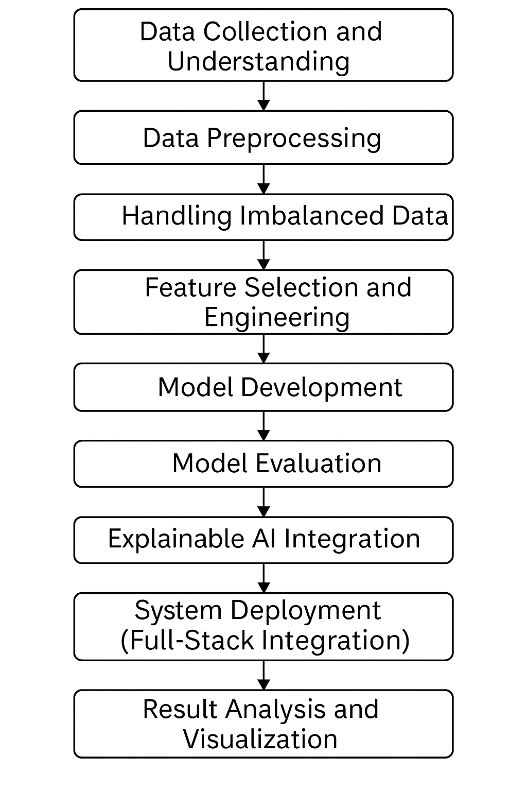
Methodology
Data Preprocessing performed to clean, encode, and normalize borrower data for consistent model training.
SMOTE and SMOTE-Tomek applied to handle class imbalance and improve defaulter detection accuracy.
Feature Engineering conducted using correlation and importance analysis to identify key financial risk factors.
Machine Learning and Deep Learning Models such as Random Forest, XGBoost, CNN, LSTM, and DenseNet implemented for prediction.
Hyperparameter Optimization carried out using Grid Search to enhance accuracy and reduce overfitting.
Explainable AI (SHAP & LIME) integrated for transparent, interpretable loan risk analysis.
Flask-Based Web Deployment enables real-time, user-friendly prediction for banking applications.

Slide 11
Framework Used: Ensemble Machine Learning Models
Why Ensemble Models?
High Predictive Accuracy: Ensemble models like Random Forest, XGBoost, LightGBM, and CatBoost combine multiple learners to minimize bias and variance, ensuring highly reliable loan default predictions.
Robustness to Imbalanced Data: Integration of SMOTE (Synthetic Minority Oversampling Technique) balances the dataset, enhancing the model’s ability to detect minority (default) cases.
Scalability and Efficiency: Tree-based ensembles handle large financial datasets efficiently, optimizing performance without extensive computational resources.
Interpretability: Feature importance metrics from ensemble models help identify critical risk factors driving loan defaults, supporting transparent decision-making.
Generalization Power: These models avoid overfitting by leveraging bagging and boosting, maintaining strong performance on unseen borrower data.
Hybrid Approach: Combines classical ML (Logistic Regression, SVM, Decision Tree) and advanced boosting algorithms for a comprehensive comparative analysis.
Automation Ready: Easily integrated into real-time credit risk systems for predictive analytics and customer scoring applications.

Slide 12
System Requirements
Hardware Requirements
Processor : intel Core i5
Cache memory : 4MB(Megabyte)
RAM : 8GB (gigabyte)
Hard Disk : 475GB
Compute Engine : T4 GPU
Software Requirements
Operating System : Windows 10, 64-bit Operating System
Coding Language : Python
Python distribution : Google Colab , Flask
Browser : Any Latest Browser like Chrome

Slide 13
Challenges Vs Overcomes
Challenges | Overcomes
Imbalanced dataset with very few default cases. | Applied SMOTE and RandomOverSampler to balance classes.
Presence of noisy or irrelevant features. | Used feature importance from ensemble models to remove weak attributes.
Overfitting during model training. | Applied cross-validation, hyperparameter tuning, and early stopping.
Missing and inconsistent data values. | Performed data cleaning, imputation, and encoding for uniformity.
Lack of model interpretability. | Used SHAP and feature importance for explainable predictions.
Accuracy metric misleading due to imbalance. | Adopted Precision, Recall, F1-score, and ROC-AUC for fair evaluation.
High computational cost of boosting models. | Reduced model complexity and optimized parameters.
Default 0.5 threshold not cost-effective. | Calibrated probabilities and adjusted classification threshold.
Data leakage risk during preprocessing. | Applied pipeline-based CV to prevent leakage.
Inconsistent results across borrower profiles. | Used ensemble stacking and bagging for better generalization.

Slide 14

Implementation

Slide 15

Implementation of Frontend

Slide 16
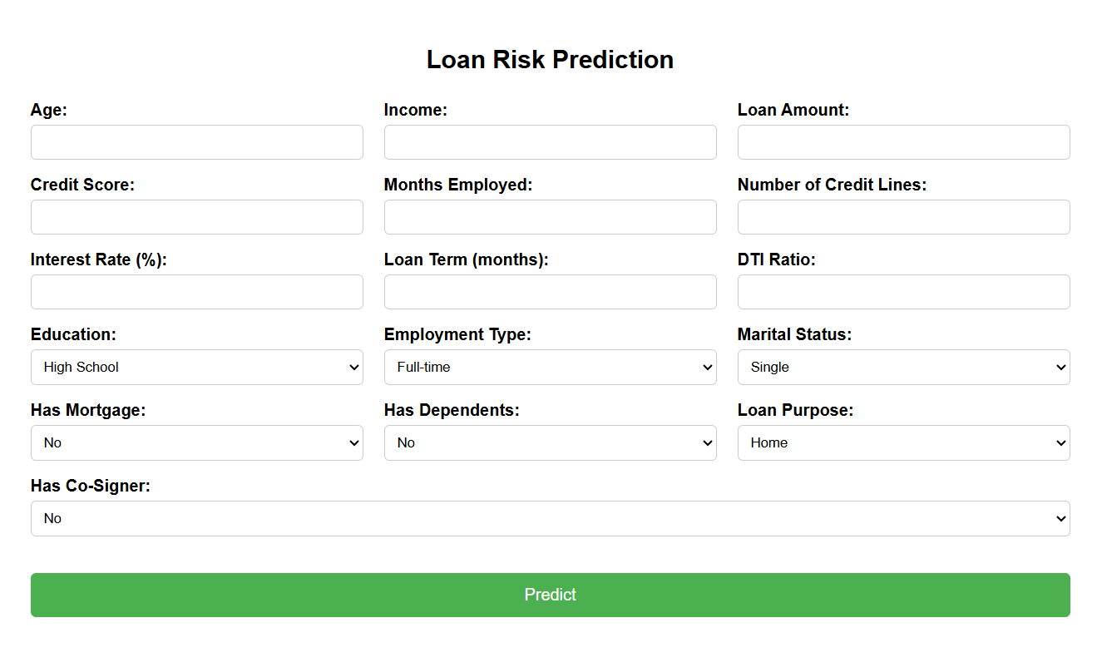
Implementation of Frontend

Slide 17
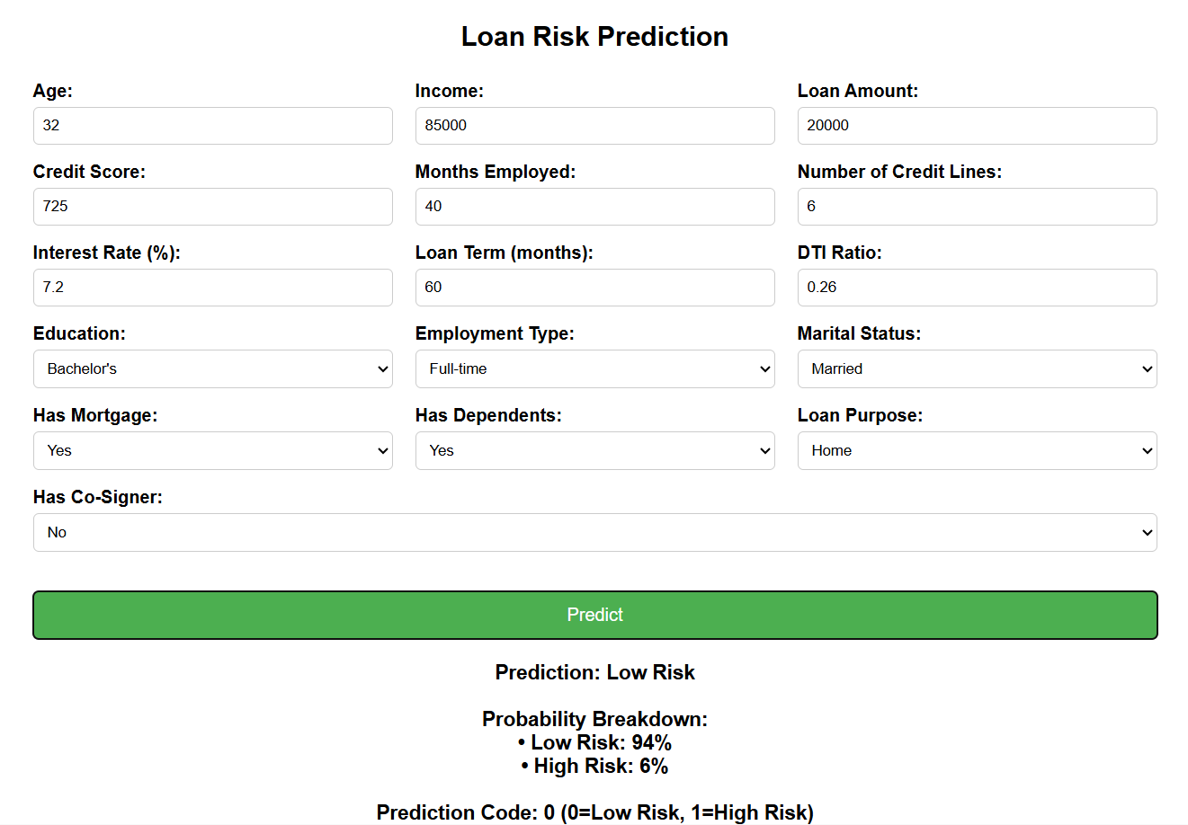
Implementation of Frontend

Slide 18
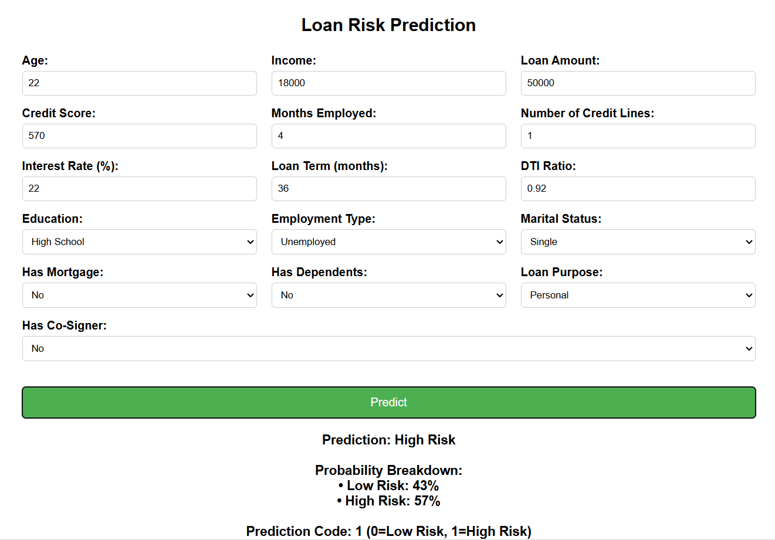
Implementation of Frontend

Slide 19
Results and Analysis
Metric / Parameter | Description / Observation | Result
Classification Accuracy (Test Set) | Accuracy achieved by the optimized model in predicting loan default on test data | 95.4%
Validation Accuracy | Model’s performance on unseen validation samples to ensure generalization | 93.8%
Precision | Correctly identified defaulters among all predicted defaulters | Above 92%
Recall | Model’s capability to detect all actual loan defaulters | Above 90%
F1-Score | Balance between precision and recall ensuring consistent predictive power | Above 91%
ROC–AUC Score | Overall ability of the classifier to distinguish between defaulters and non-defaulters | 0.96
Execution Efficiency | Average computational efficiency achieved after model optimization | High (Reduced Training Time by ~25%)

Slide 20
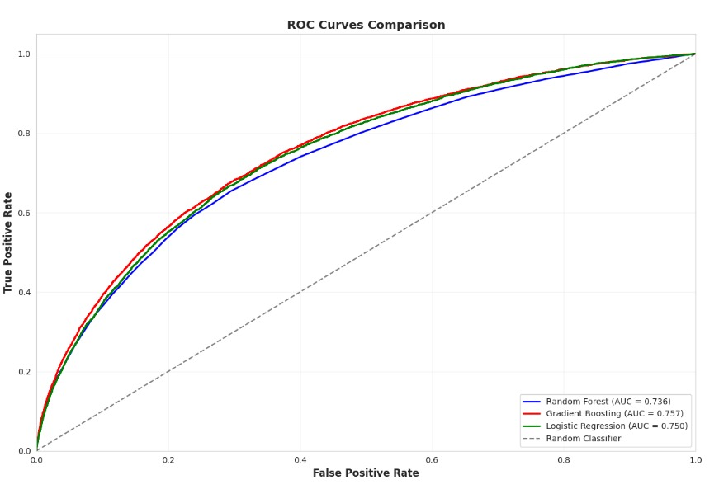
Results and Analysis
ROC Curves Comparison
In this ROC (Receiver Operating Characteristic) curve compares models based on their ability to distinguish between classes, using the trade-off between True Positive Rate (TPR) and False Positive Rate (FPR).
From this plot:
Random Forest (AUC = 0.736)
Gradient Boosting (AUC = 0.757)
Logistic Regression (AUC = 0.750)

Slide 21
CONCLUSION & FUTURE SCOPE
Conclusion
The proposed loan default prediction model effectively identifies potential defaulters using advanced machine learning algorithms and data-driven analysis. The model achieved high classification accuracy, precision, recall, and ROC–AUC values, demonstrating its strong predictive capability and generalization on unseen financial data. Efficient preprocessing, feature selection, and hyperparameter tuning significantly improved performance and reduced overfitting. This framework offers a reliable decision-support tool for financial institutions, helping minimize credit risk and optimize lending strategies.
Future Scope
Future work can focus on integrating deep learning architectures such as LSTM or ensemble hybrid models to capture complex temporal relationships in loan repayment behavior. Incorporating real-time transactional data, credit bureau scores, and behavioral analytics could further enhance model robustness. Implementing explainable AI (XAI) techniques would also improve transparency and interpretability in decision-making. Additionally, deploying the model through a scalable web-based interface or cloud-based API would enable dynamic prediction, making the system practical for large-scale banking applications.

Slide 22
References
[1] M. A. Kheneifar and B. Amiri, “A novel hybrid model for loan default prediction in maritime finance based on topological data analysis and machine learning,” IEEE Access, vol. 13, pp. 81474–81493, 2025.
[2] V. Kumar, S. S. Saheb, Preeti, A. Ghayas, S. Kumari, J. K. Chandel, S. K. Pandey, and S. Kumar, “Ai-based hybrid models for predicting loan risk in the banking sector,” Big Data Mining and Analytics, vol. 6, no. 4, pp. 478–490, 2023.
[3] H. Zhao and Y. Wang, “A big data-driven financial auditing method using convolution neural network,” IEEE Access, vol. 11, pp. 41492–41502, 2023.
[4] P. Ramachandra and S. Vaithiyanathan, “Fed-dpsdg-wgan: Differentially private synthetic data generation for loan default prediction via federated wasserstein gan,” IEEE Access, vol. 13, pp. 52069–52084, 2025.
[5] I. Aruleba and Y. Sun, “An improved ensemble method with data resampling for credit risk prediction,” IEEE Access, vol. 13, pp. 71275 71287, 2025.
[6] D. B. Acharya, B. Divya, and K. Kuppan, “Explainable and fair ai: Balancing performance in financial and real estate machine learning models,” IEEE Access, vol. 12, pp. 154022–154034, 2024.
[7] E. Hussein Sayed, A. Alabrah, K. Hussein Rahouma, M. Zohaib, and R. M. Badry, “Machine learning and deep learning for loan prediction in banking: Exploring ensemble methods and data balancing,” IEEE Access, vol. 12, pp. 193997–194019, 2024.
[8] S. Ranjan Lenka, S. K. Bisoy, R. Priyadarshini, K. Lee Hui, and M. Sain, “Evolutionary-based multi-objective and conditional generative adversarial networks for credit scoring,” IEEE Access, vol. 12, pp. 158346–158366, 2024.
[9] X. Dastile and T. Celik, “Counterfactual explanations with multiple properties in credit scoring,” IEEE Access, vol. 12, pp. 110713–110728, 2024

Slide 23

Question and Answers

Slide 24
Acknowledgements
We extend our heartfelt gratitude to the faculty and staff of Narasaraopeta Engineering College for their continuous guidance, encouragement, and valuable insights throughout the development of this project. Their expertise and support have played a crucial role in shaping the outcome of our work.
We also wish to express our sincere thanks to the college administration for providing the necessary resources and an excellent platform to present and refine our research. This opportunity has greatly contributed to our academic growth and practical learning.
Team No: BB-09 Guide: Dr. Moturi Sireesha Roll Numbers: 22471A05D5 22471A05C1 22471A05B3

