Slide 1
Digital Portfolio
STUDENT NAME: SIDDIQ BASHA.S
REGISTER NO:20324U09085
NMID:6FAE427CF802F27A3C94C68F740C3A42
DEPARTMENT: BCA
COLLEGE: Dr M.G.R CHOCKALINGAM ARTS COLLEGE
UNIVERSITY:THIRUVALLUVAR UNIVERSITY

Slide 2
PROJECT TITLE
DIGITAL PORTFOLIO WEBSITE USING FRONT END WEB DEVELOPMENT

Slide 3


AGENDA
Problem Statement
Project Overview
End Users
Tools and Technologies
Portfolio design and Layout
Features and Functionality
Results and Screenshots
Conclusion
Github Link
3/21/2024 Annual Review

Slide 4

PROBLEM STATEMENT
In Today’s digital age, having an online presence is essential for individuals, especially students, developers, and professionals seeking opportunities in academics or the job market. Traditional resumes and printed portfolios are no longer sufficient to showcase one’s skills, experience, and personality effectively. A digital portfolio provides a dynamic and interactive platform for individuals to present their work, achievements, and contact information in a professional manner.

Slide 5

PROJECT OVERVIEW
The Digital Portfolio Website project focuses on designing and developing a personal portfolio using front-end web development technologies such as HTML, CSS, and JavaScript. The website acts as a digital resume and professional identity platform, allowing users to present their background, skills, projects, resume, and contact information in a clean and interactive format.
This portfolio is especially useful for students, job seekers, freelancers, and professionals who want to enhance their visibility in the digital world. It provides a structured and visually appealing way to showcase work and achievements, making it easier for employers, clients, or collaborators to learn more about the individual.

Slide 6

WHO ARE THE END USERS?
The end users of a Digital Portfolio Website are the individuals or groups who will interact with and benefit from the website. These include:
Potential Employers / Recruiters
Academic Institutions / Professors
Clients / Freelancers’ Prospective Customers
Peers / Colleagues
The Portfolio Owner (You)

Slide 7

TOOLS AND TECHNIQUES
Category | Tool / Technology | Purpose
Markup Language | HTML5 | For structuring the content and layout of the website.
Styling Language | CSS3 / (Optionally: Tailwind, Bootstrap) | For styling the website (colors, fonts, layout, responsiveness).
Scripting Language | JavaScript | For adding interactivity and dynamic content.
Code Editor | Visual Studio Code (VS Code) | For writing and managing code efficiently.
Version Control | Git / GitHub | For tracking changes and deploying code online (e.g., GitHub Pages).
Browser Dev Tools | Chrome / Firefox Developer Tools | For debugging and testing the website layout and functionality.
Design Tools | Figma / Canva / Adobe XD (optional) | For creating UI mockups or design planning.
Icons & Fonts | Font Awesome, Google Fonts | For enhancing the visual appeal with custom icons and typography.
Deployment Platform | GitHub Pages / Netlify / Vercel | For publishing the website online for public access.

Slide 8
POTFOLIO DESIGN AND LAYOUT
1. Cover Page
Your name
Profession/title (e.g., Graphic Designer, Architect)
Contact info or logo (optional)
Clean, minimalistic design
2. Table of Contents (Optional for large portfolios)
List of projects
Page numbers (especially useful in print or PDF)
3. Introduction / About Me
Brief professional bio
Statement of purpose or design philosophy
Key achievements or goals
8

Slide 9
4. Projects / Work Samples
For each project:
Title
Brief description (concept, objectives, role, tools used)
Process work (research, sketches, wireframes, concepts)
Final outcome (high-quality visuals or documentation)
Reflection or results (optional, e.g., user feedback, sales increase, awards)
5. Skills & Tools
Design tools (e.g., Adobe Suite, Figma, Rhino)
Coding (if relevant)
Soft skills or languages (optional)
6. Contact Information / Call to Action
Email
Website or portfolio link
Social media (LinkedIn, Instagram if relevant)
QR code to online portfolio (optional)

Slide 10
FEATURES AND FUNCTIONALITY
🔍 KEY FEATURES of a Digital Portfolio
1. Home Page / Landing Page
Professional welcome message
Your name and title (e.g., “UI/UX Designer” or “Multimedia Artist”)
Featured work or intro video/banner
Simple navigation bar
2. About Me / Bio Section
Short professional summary
Headshot (optional)
Design philosophy or mission statement
3. Work/Projects Showcase
Organized by type, medium, or industry
Each project includes:
Title
Overview
Tools used
Your role
Process (sketches, wireframes, stages)
Final outcomes (images, videos, mockups)

Slide 11
6. Contact Page
Email form or direct link
Social media icons
Location (optional)
QR code for downloadable version or business card
⚙️ FUNCTIONALITY
✅ Interactive Navigation
Smooth scrolling, dropdown menus, hamburger menu (for mobile)
Anchor links (e.g., Jump to “Contact” or “Project 3”)
Sticky or fixed navbar for better UX
✅ Responsive Design
Adapts to desktop, tablet, and mobile screens
Use breakpoints and test across devices
✅ Media Integration
Images, audio, videos, sliders, animations
Embedded prototypes (Figma, Adobe XD, etc.)
✅ Search or Filter Projects
Tags or categories (e.g., “Web Design,” “Branding,” “Illustration”)
Search bar (optional, for large portfolios)

Slide 12

RESULTS AND SCREENSHOTS
🎯 Results
Increased Visibility and discoverability online.
More Job or Freelance Opportunities from recruiters or clients.
Clear Communication of Skills and creative process.
Improved Personal Branding and credibility.
Data-Driven Improvement using visitor analytics.
Self-Reflection and Growth by documenting your journey.
Always Ready for Opportunities with an up-to-date showcase.
3/21/2024 Annual Review
12

Slide 13
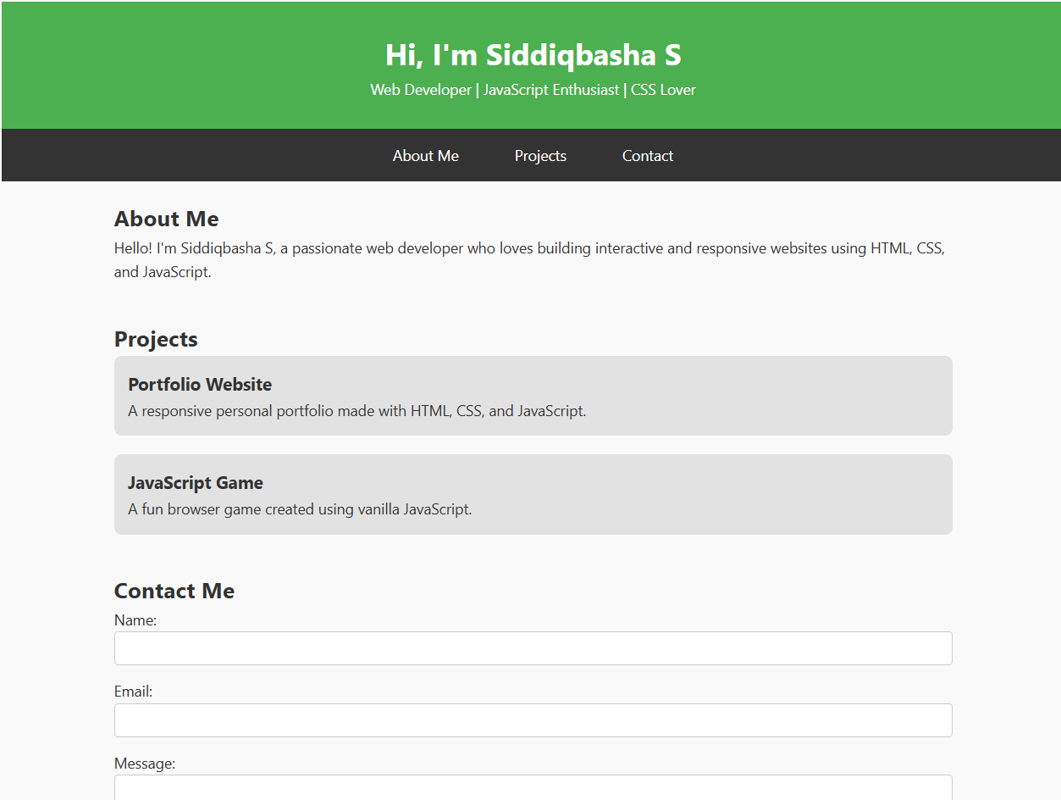
OUTPUT

Slide 14
CONCLUSION
A digital portfolio is an indispensable tool for today’s professionals, offering a dynamic and accessible way to showcase skills, creativity, and accomplishments. Beyond simply displaying work, it communicates your process, problem-solving abilities, and personal brand, making you more visible and attractive to potential employers, clients, and collaborators.
14

