Slide 1
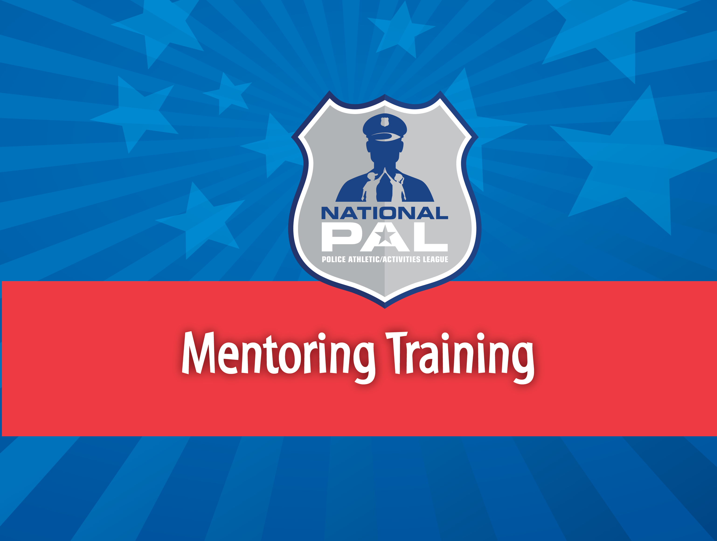
Notes:
Hello and Congratulations on being selected as a mentor with the National PAL Mentoring Program!Today you will be participating in the National PAL Mentoring program mentor training. To successfully complete this training and participate as a National PAL mentor you will be required to take a brief survey assessment to acknowledge your understanding of the training material. If you have any questions before completing the survey we will be providing you with the contact information of Mrs. Angie Caffee the Director of Grant Operations for National PAL

Slide 2
Coming Up Today
Program Overview
Benefits of Mentoring
Role of a Mentor
Boundaries
Confidentiality
Mandatory Reporting
Mentor Assessment/Survey
Notes:
The presentation will consist of the following:

Slide 3
Program Overview
The National PAL Mentoring Program connects youth and teens ages 8-17 with caring mentors to engage in structured hands-on educational and social development activities on a weekly basis available through PAL Chapters.
Key Program Elements
Time commitment – This is a one year program
All mentors must volunteer their time
Mentors and mentees will meet in small groups (7-to1 mentee-to-mentor ratio) at least two times per month, for a total of no less than 4 hours per month during each NPAL Mentoring module (sessions can be weekly for one hour a week)
Mentees and mentors will participate in NPAL enrichment activities, engaging youth in leadership activities, community service, and decision-making trainings
Notes:
The National PAL Mentoring Program connects youth and teens with caring mentors. Mentors will engage with mentees on a weekly or bi-weekly schedule, depending on your individual PAL Chapter’s meeting schedule. Very important program elements to keep in mind as a mentor includeThe minimum of one year commitment to your mentee. Some programs will continue through the summer months. Please confirm with your Program Coordinator what commitment may be necessary during the summerAll mentors must volunteer their time, meaning you will not and should not be paid for time spent serving as a mentorEach mentor will be paired with a maximum of 7 mentees and is required to log 4 hours of mentor-mentee sessions per monthDuring each meeting, mentors will participate in your Chapter’s selected curriculum of activitiesDuring the course of the grant period, you will help plan and implement a community service project alongside staff and mentees

Slide 4
Goals and Objectives
Decreasing juvenile delinquency
Increasing participation and creating a sense of owner in their community
Reducing risk factors that lead to gang involvement and drug use
Improving youth’s perception of law enforcement and decreasing involvement in the juvenile justice system
Notes:
The goals and objectives of this program are to engage with at-risk or high-risk youth through mentorship by: Decreasing juvenile delinquency by establishing positive relationships with adults outside of the mentee’ s family structureIncreasing participation and creating a sense of ownership in their community by allowing mentees to feel that they have a “vested interest” in their communities and they have the power to make a difference Reducing risk factors that lead to gang involvement and drug use by participating in the mentoring program and other PAL activities which can lead to behavioral changes Improving youth’s perception of law enforcement and decreasing involvement in the juvenile justice system through regular interaction with law enforcement and helping mentees understand how to communicate with police officers and other authority figures. It is our hope that the goals and objectives of this program align with you reasons for becoming a mentor with National PAL

Slide 5
Benefits of Mentoring
For Mentees
Greater feeling of belonging
Increased social skills
Decreased likelihood to partake in risky behaviors
Higher graduation & attendance rates
For Mentors
Gain Perspective
Improves leadership capacity and communication skills
Greater patience
Increased empathy
Notes:
The benefits of mentoring are not one-sided. Mentors and mentees alike are both beneficiaries of successfully mentor relationships. For mentees, mentor relationships show young people that there is someone who cares about them, assures them they are not alone in dealing with day-to-day challenges, and makes them feel like they matter. Research confirms that quality mentoring relationships have powerful positive effects on young people ranging from personal, academic, and professional situations. For mentors, mentoring relationships can provide a fascinating outlook to what is happening in the lives of younger people and is the best tool to remain current on issues as they are happening. This new perspective will allow mentors to renew their communication skills with a greater sense of empathy for today’s youth.

Slide 6
Role of a Mentor
Be there.
Be a trusted leader, not an all-knowing authority.
Be a positive role model.
Be ready to help out.
Always proceed with respect.
Listen.
Accept different points of view.
Empathize with the mentee’s struggles.
See solutions and opportunities as well as barriers.
Be flexible and open.
Notes:
Be there – your commitment and obligation to your mentee is crucial. As mentioned before you are committing to a year long relationship and one key to a successful mentee/mentor relationship is to be aware of your obligations and take them seriously. Be a trusted leader, not an all knowing authority. Your role is not to be a parent or disciplinarian. As a mentor, you should take a non judgmental stance and guide your mentee to make positive decisionsRemember that you have young people looking up and emulating your actions. Always maintain the role of a positive role model while acting as a mentor and in your everyday life. As a supporter mentors should be ready to help out as a listening ear and confidantAlways proceed with respect – mutual respect in any relationship is needed to build trust Keeping an open mind and remaining non judgmental will allow you as a mentor to gain understanding to the different points of views of your menteesThe struggles of your mentees may face can differ greatly from when you were their age. Getting to know their challenges will allow you to empathize with their strugglesRemain positive yet genuine. Sometimes the glass is half full as opposed to half empty. See solutions and opportunities as well as barriers.

Slide 7
A Mentor Does Not…..
Expect dramatic changes overnight.
Serve as a youth’s financial provider or ATM machine.
Pretend to know it all.
Provide the solutions to all issues facing youth today.
Interact with mentees outside the NPAL mentoring program

Slide 8
Mentors are Advocates
Mentors help mentees by:
Finding and connecting them with available resources at your PAL Chapter.
Seeking necessary help for them such as a tutor for academics.
Noticing any changes in attitude and seeking the help of professionals at the PAL if necessary.

Slide 9

Boundaries
Physical
Monetary
Social
Notes:
Boundaries play an important role in mentor/mentee relationships. It is best to set boundaries of your relationship from the very start. In mentoring, boundaries help youth, mentors and parents understand the expectations of the match. Young people need consistent boundaries and realistic expectations to feel safe physically and emotionally.As mentors you are expected to model appropriate boundaries with your mentee so that the mentee in return honors the boundaries with you and develop their own boundaries in other areas of their lives.

Slide 10
Boundaries - Physical
Youth sometimes have a strong need for positive physical contact.
Touch should always be mentee-initiated to ensure their safety.
All interactions should be continuously observable and interruptible.
“Safe touch” areas are:
Elbows
Shoulders
Hands
Notes:
To ensure both you as the mentor and the mentee are protected, limit contact to a handshake or back on the back. Whether in person or remotely, always have a third party aware of your interactions with youth, and no interactions should take place behind closed doors or in a one-on-one conversation online– this is what is meant by “observable and interruptible.” Someone should always be able to observe your interactions or be able to interrupt them at any time. Safe places to touch being that youth have a strong need for positive physical contact is the elbows, shoulder or hands. No where else. For best outcome, ensure that touch is initiated by youth. Remember that these rules are the same for teens acting as peer mentors as well as adult mentors. As a peer mentor, you should follow the same precautions as an adult mentor when setting boundaries.

Slide 11

Boundaries - Monetary
No gifts are permitted – monetary or otherwise
The National PAL Mentoring program is site-based. Use all the resources of your PAL
Notes:
All of us can benefit from having healthy boundaries in our relationships. Setting boundaries helps to establish and nurture trust within your relationship with the mentee. Remember a mentor’s role is not that of a provider. You are not a mentor as a means of finical support for your mentee. That is not your responsibility. The planned activities and outings are funded by your PAL and contact or outings outside of those planned by the your PAL are prohibited.

Slide 12

Boundaries - Social
Your Personal Information: Age, Telephone #, Address – no need to share.
E-mails, Facebook posts, Twitter, Instagram, are not permitted.
Do not take photos of mentees on your personal devices
Notes:
Keep all activities and contact to being at the PAL site together in-person. Discuss with your mentee what conversations and language are off limits and appropriate ways and times of day to communicate.There should be no interactions online or over the phone, and no pictures being taken of mentees on personal cell phones. This will help maintain their privacy and ensure that their image is only being used in ways that parents have consented to. Be mindful not to disclose to your mentee any information that may be considered inappropriate. If you have difficulty deciding if the information is appropriate, more than likely you should not be telling your mentee about it. So when in doubt, stay silent. If needed, change the subject of the conversation. Or simply tell the mentee that the topic should not be under discussion and the two of you have more important things to talk about.

Slide 13
Confidentiality
Information your mentee tells you must be kept in confidence. Sharing that information is a violation.
If you hear anything from your mentee about themselves or others:
Child Abuse
Physical Abuse
Sexual Abuse
General Child Safety
Report to the mandatory reporter hotline in your state– see information on next slide
Notes:
Change from last year**-- The person who directly hears about the abuse should be the one to report, not their supervisor or PAL Staff, if it was the mentor who heard directly from the child. It is okay to notify the staff, but ensure that the person who has been confided in is the one to report

Slide 14
Mandatory Reporting
What to Report
Substance use and abuse
Abuse, violence, and bullying
Mental health issues
Peer pressure
Death
Sexual relationships
For more information, contact the Child Welfare Information Gateway at: http://www.childwelfare.gov/ or 1-800-394-3366
Notes:
All 50 states have passed some form of mandatory child abuse and neglect reporting and it is critical for mentors to understand the reporting requirements as defined by your state. Be sure to work with the program coordinator at your PAL to inquire more about reporting requirements. Most state’s definitions of child abuse and neglect will cover what constitutes physical abuse, neglect, sexual abuse, sexual exploitation, emotional or mental injury, and abandonment.Mandatory reporting by mentors may or may not be required by your state, but even if you are not 100% sure if your mentee or someone they know is subject to any kind of abuse it is strongly recommended you report your findings.

Slide 15
Survey Instructions
To successfully complete this training and participate as a National PAL mentor you will be required to take a brief survey to acknowledge your understanding of the mentor training material.
Mentor Training Survey/Assessment
Notes:
Congratulations! You’re almost done. To successfully complete this training and participate as a National PAL mentor you will be required to take a brief survey to acknowledge your understanding of the mentor training material. Please note that each mentor must complete their own individual survey. Click the link to the survey to complete your training. If you have any questions please contact Ms. Angie Caffee with the National PAL.

Slide 16
Contact Information
Angie Caffee
Director of Grant Operations
National Association of Police Athletic/Activities League, Inc. (704) 492- 0358
acaffee@nationalpal.org
Mentor Training Survey/Assessment

